Slide 1
A Modeling Language for Large, Complex, Time-Varying Systems
18-21 January 2026
David Brookshire Conner

Slide 2
Research context: Digital business transformation (DBT)
Introduce something new (usually technology, i.e., digital) that changes an organization
→ Voluntary or involuntary introduction
Voluntary:
Adopting artificial intelligence tools driving change in workflow and employee skill sets
Involuntary:
Advanced persistent threat (APT) driving change in software practices and security posture

Slide 3
How to Do a DBT
Digital | → | Digitization | → | Digital Transformation
Technology | → | Data-Driven | → | Interconnections
It’s hard to do
Pay consultants lots of money and still fail
Consider three approaches:
Introduce one thing and push it
Follow a framework
Analyze the structure and design a new target structure

Slide 4
Research Questions
How do you describe a large, complex system that is changing over time?
  System: arrangement of components Interacting in some way. Broad sense of component: people, technology, information, process, policy, more…
  Describe: Identify the components and their interactions
  Large: Several orders of magnitude
  Complex: At several levels, in many senses
  Change: Any of this can change
  Over time: At any time
What characteristics of a large, complex system facilitate or obstruct change over time?

Slide 5
Contextual Fields
Information systems: Technologic artifact situated in a system of people, processes, knowledge, more
→ But also social publics, communities of practice, more
Computer science: The nature and limits of the technologic artifact
→ But also the nature and limit of the processes and the knowledge
Organizational psychology and management: The people in the system
→ But also the nature and limit of the system for humans
Epistemology and ontology: The nature and limits of the knowledge
→ But this also defines how the system is described

Slide 6
The Modeling Language

Slide 7
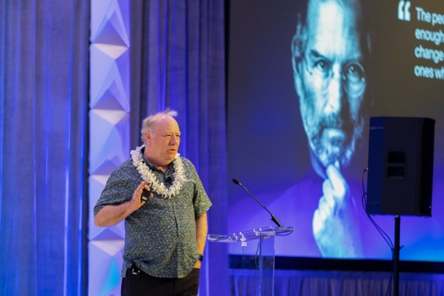
A Modeling Language for Large, Complex, Time-Varying Systems
LCTVS?
Fortune-500 scale
10k people
Meganode ICT networks
Gigadollar budgets
Undergoing a digital transformation
The language?
Actors representing anything
Anything can change
Anything can be active
Anything can cooperate with anything else
Image description (14px)
Uses?
A description
Not a mandate
A tool for analysis
It works!
Other papers…
Education, Finance
Cybersecurity, AI

Slide 8
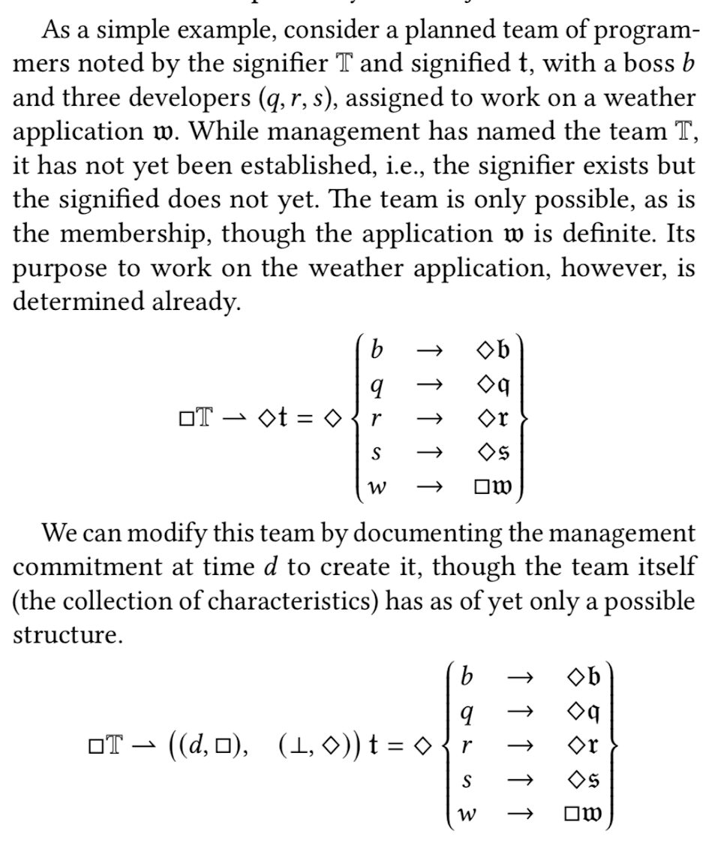
The model: Actors
An actor is a set of attributes
Distinguish between signifier and signified
Distinguish between possible and definite
Everything can change over time

Slide 9
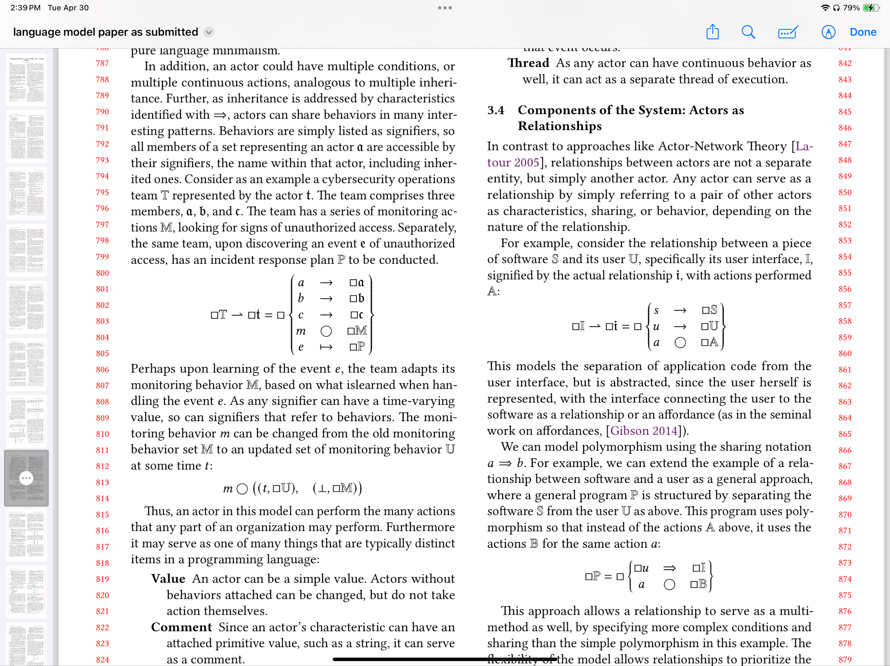
The model: Behaviors
Attributes can describe continuous behaviors
Attributes can describe event-driven behaviors
Either can change over time

Slide 10
The model: Sharing
An attribute can act as a shared set of attributes
Compare per-object sharing e.g., in the Self programming language
Compare multi-methods as well
Changeable over time
Multiple shared sets of attributes

Slide 11
Examples
HCII 24
PTC 25
SIGCHI 25
PTC 26

Slide 12
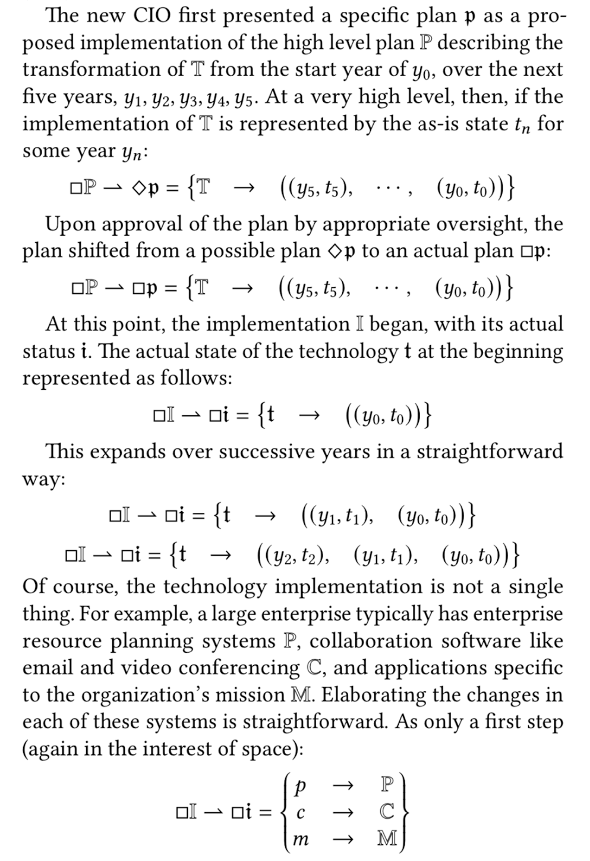
Case Studies: Hawaiʻi State DOE
Describing a five-year plan to improve technology
Plan was approved and became an implementation
Break each of the characteristics down into more and more detail
ERP, ICT, Educational apps, etc
Security: Published in HCII 2024
Devices during COVID: Published in
PTC 2025

Slide 13
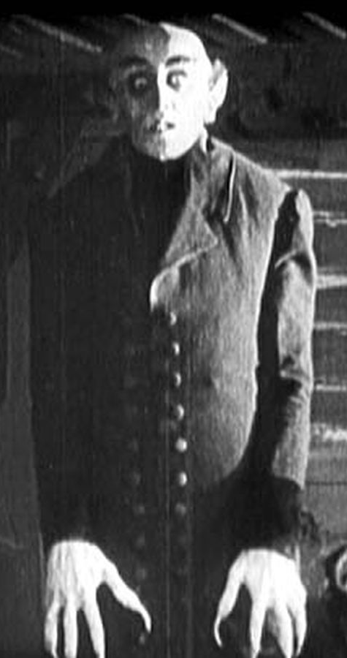
Uncanny Discourse
Applying some of these concepts to the question of artificial intelligence in human-computer interaction
Freud’s Uncanny, Foucault’s Discourse, and Mori’s Uncanny Valley
New insights into how transformations involving AI should be planned
New research questions, view on prior work
Published at ACM SIGCHI 2025 Yokohama
The Cult of the Big Slop here at PTC 26

Slide 14
Future Work

Slide 15
Completing the Dissertation
Collaborate with technology leaders
Validity concerns: Ones I know, or “snowball” approach
Model the organizations and planned changes
Share conclusions and insights
Demonstrating the utility the framework/modeling language

Slide 16
Candidate Collaborators
UH System ITS
Hawaiʻi State ETS
C&C of Honolulu
Hawaiʻi State DOE
First Hawaiian
American Savings Bank
Transform Hawaiʻi Government
Others through connections (“snowball” approach)
Personal connections so still autoethnographic approach
Design science, as opposed to action research
Share insights with the collaborators

Slide 17
Making the Modeling Language More Usable
By people besides me
Describing existing theories in the modeling language
Formal programming language
Modeling tool
Collection of design patterns for digital transformation
Applications to other descriptions of complex systems

Slide 18
Mahalo nui no kēia haʻawina!
He mau nīnau?

