Slide 1



AI Governance: From Abstract Ethics to Physical Reality
18-21 January 2026
Braham Singh
What Texas, data districts, and power infrastructure teach us about governing AI

Slide 2



The Governance Gap
What We Talk About vs. What Actually Governs AI
AI governance focuses on:
But typically ignores the physical layer
Models
Power
Ethics
Water
Safety
Land
Workforce impact
Community consent
"The most powerful AI regulators today don't write policy papers. They issue interconnection approvals."
Braham Singh | Infrakey DC Parks | AI Infrastructure & Governance | PTC’26

Slide 3
The AI Paradox
Virtual Use. Physical Cost
AI feels weightless:
But every interaction consumes:
A click
Electricity
A query
Cooling
An inference
Water
Global benefits, local consequences
Braham Singh | Infrakey DC Parks | AI Infrastructure & Governance | PTC’26

Slide 4
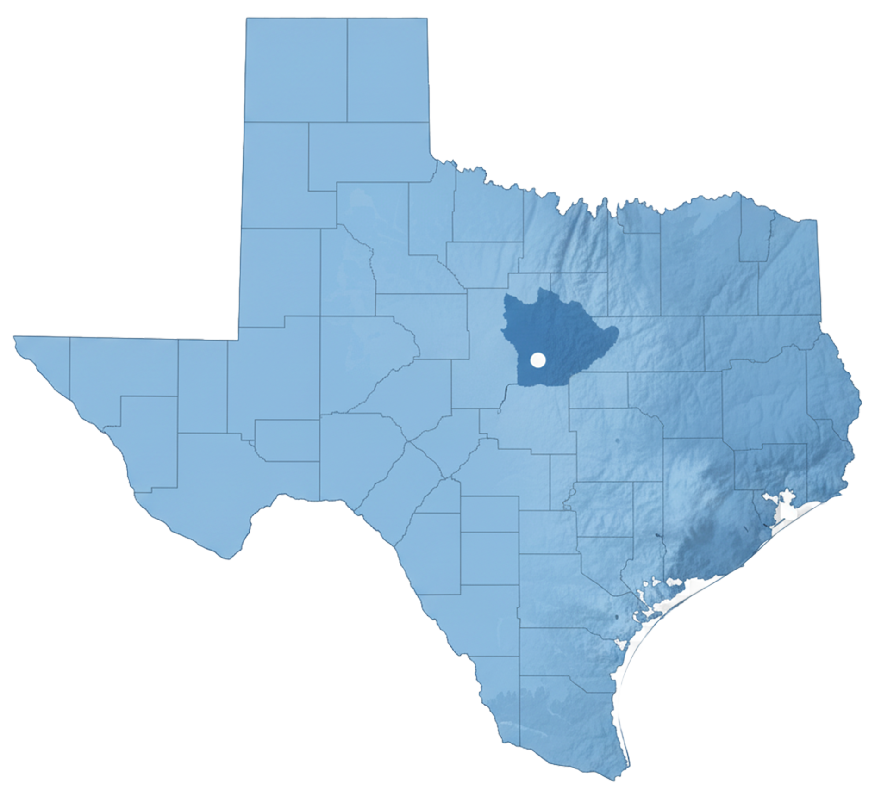
Where AI Governance Becomes Real
Central Texas as a Living Governance System
ERCOT
Utilities
Cities & counties
They collectively decide:
Who gets power
How fast AI scales
At what social cost
"Interconnection queues are AI policy."
Braham Singh | Infrakey DC Parks | AI Infrastructure & Governance | PTC’26

Slide 5
Infrastructure Is Governance
Reliability Is Not Neutral
Tier III distributed redundancy is brilliant engineering
But it embeds moral decisions:
Who pays?
Who bears environmental risk?
Who lives next to these brilliantly redundant systems?
Key takeaway: Reliability is a governance choice, not just a technical one.
Braham Singh | Infrakey DC Parks | AI Infrastructure & Governance | PTC’26

Slide 6

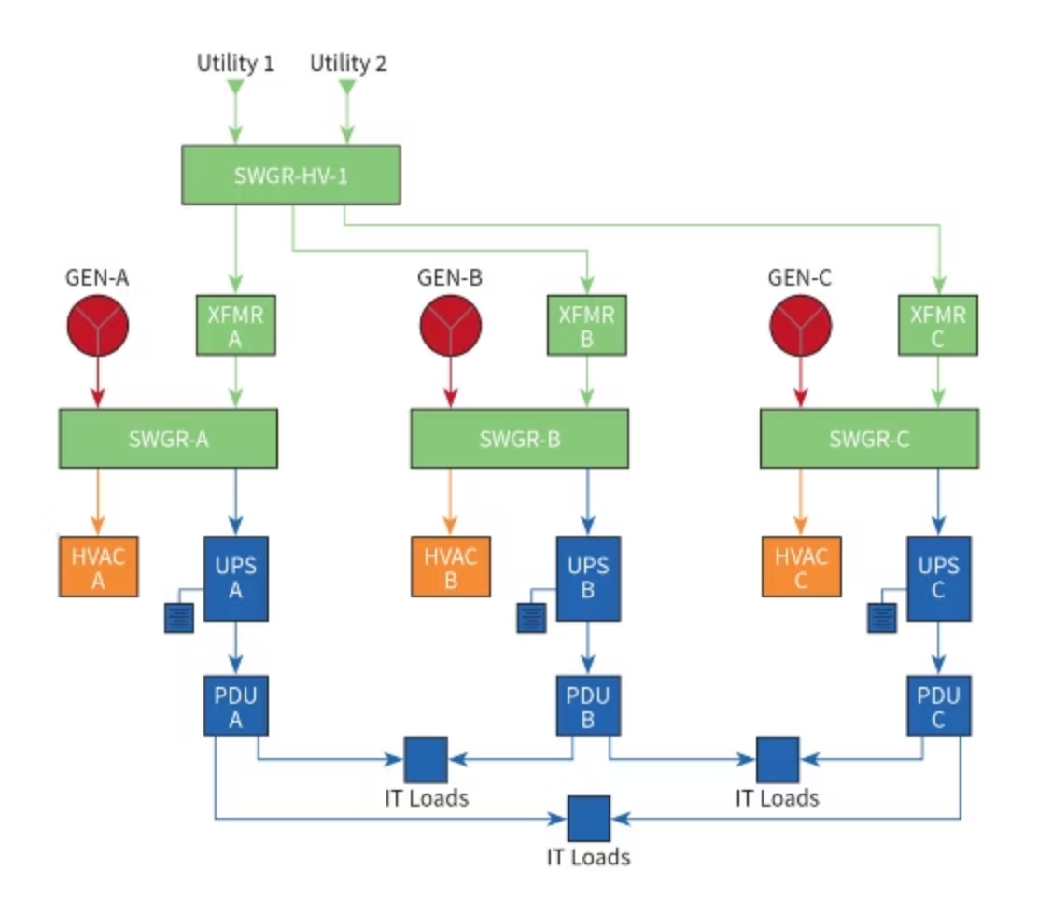


The Hidden Failure
Why Diesel Gensets are a Governance Problem
Traditional Tier III:
Treats each data center as sovereign
Replicates diesel sets at every site
Result:
Emissions multiplied
Community impact unmanaged
No system-level accountability
Braham Singh | Infrakey DC Parks | AI Infrastructure & Governance | PTC’26

Slide 7


Rethinking Redundancy
Asset-Level to District-Level
Question:
Answer:
Can Tier III reliability be governed on a district scale?
Yes—through district infrastructure:
District BESS and Distributed Energy Resources
District provided redundancy with SLAs
Shift: Asset sovereignty → District responsibility
Braham Singh | Infrakey DC Parks | AI Infrastructure & Governance | PTC’26

Slide 8
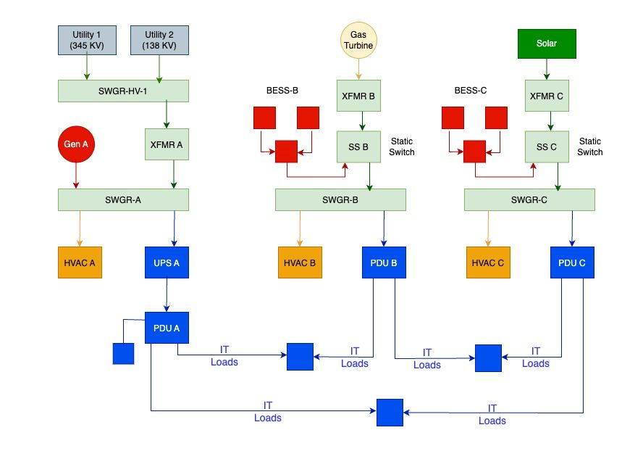
The Lacy Lakeview Data District
District redundancy saves Capex and reduces emission
Microgrids for Data CentersV3.5DNA

Slide 9
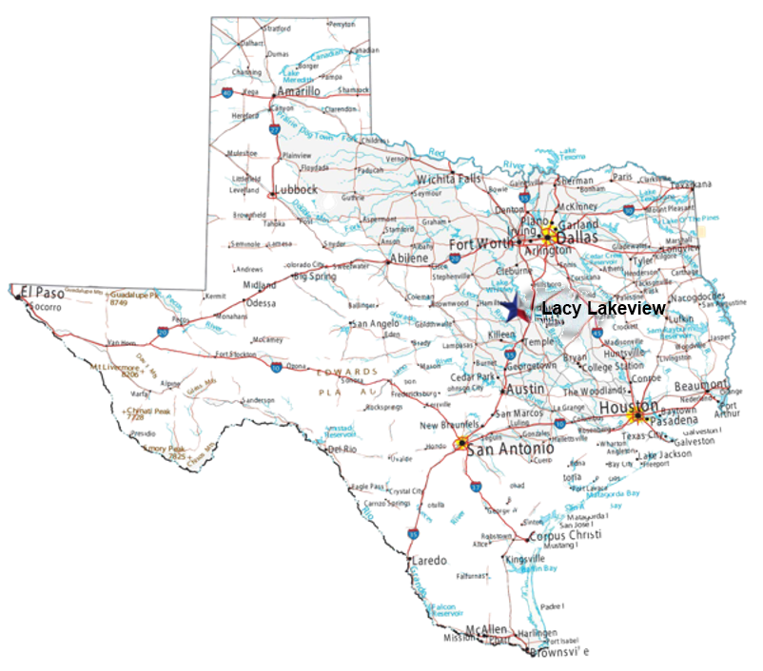
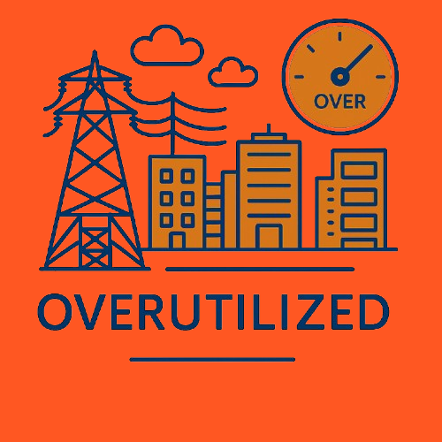

Lacy Lakeview as a Governance Case Study
Public–private data district with city and county participation
  Power, Water, Land, and Growth governed upfront
  Governance by design

Slide 10
Community Consent Is the Real Bottleneck
Scaling Fails Without Local Buy-in
Communities experience:
Global AI benefits mean little locally
Data districts create:
Water stress
Transparency
Environmental exposure
Negotiation
Social license to operate
Braham Singh | Infrakey DC Parks | AI Infrastructure & Governance | PTC’26

Slide 11
A New Definition of AI Governance
Not Ethics Alone. Not Code Alone.
AI governance must consider:
Physical constraints
Infrastructure design
Community participation
Utility coordination
"AI is governed where it is powered."
Braham Singh | Infrakey DC Parks | AI Infrastructure & Governance | PTC’26

Slide 12
Every Click Has a Physical Address
"Governance doesn't begin in Brussels or Washington. It begins where the power lines land."
Braham Singh | Infrakey DC Parks | AI Infrastructure & Governance | PTC’26

