Slide 1
AI in Education and Its Social Consequences: Digital Divides, Institutional Readiness, and Implementation
Nir Kshetri
The Charles A. Hayes Distinguished Professor
Bryan School of Business and Economics, University of North Carolina—Greensboro

Slide 2

Generative and Agentic Artificial Intelligence in Higher Education
Frameworks for Teaching, Governance, and Equity
Nir Kshetri

Slide 3
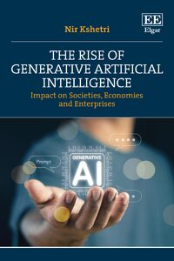

Slide 4
What is the Digital Divide?
Disparities in access to and use of ICTs, especially the Internet (Castells, 2002)
Traditionally viewed as users vs. non-users
Early concept = first-level digital divide (Newhagen & Bucy, 2004)

Slide 5
First-Level Digital Divide
Focus: Material Access
Devices, software, and peripherals needed for Internet use
Driven by social inequalities and unequal resource distribution (van Dijk, 2005)
Emerging divides due to technology evolution and varied device access

Slide 6
Second-Level Digital Divide
Focus: Skills & Usage
Distinction between access and ability to use effectively
Even with Internet access, disparities exist in:
  Technical proficiency
  Information literacy
  Content creation/engagement (Hargittai, 2001; 2002)

Slide 7
Table 6.1: Dimensions of the second-level digital divide in generative AI use in the academic settings
Category | Key Challenges | Implications
Gender-Based Disparities in AI Usage | Female students report significantly lower confidence and usage rates than male peers. A 45% gender skill gap exists in higher education. | Without targeted support, AI adoption may reinforce gender inequality, excluding female students from full participation in AI-enhanced learning.
Language Limitations in AI Tools | GAI models are overwhelmingly trained on dominant languages like English. Local and indigenous languages are underrepresented, limiting accessibility. | Students who speak underrepresented languages cannot meaningfully engage with GAI tools, reducing inclusivity and reinforcing linguistic and cultural marginalization.
Infrastructure and Educational Barriers in the Global South | Limited internet access, poor infrastructure, and scarce AI-related education reduce GAI adoption. Only half of African countries meet basic digital literacy benchmarks. | Lack of investment and institutional support perpetuate global educational inequalities and restrict the potential of AI to empower students in low-resource environments.
Under-Resourced Schools and AI Challenges | Smaller, public, and minority-serving institutions lack formal AI guidelines and support systems, disadvantaging underserved student populations. | These students miss out on skill-building and ethical training opportunities, widening the digital divide and deepening inequities in AI readiness and literacy.

Slide 8
Third-Level Digital Divide
Focus: Outcomes & Benefits
Unequal ability to translate digital engagement into tangible gains
Influenced by economic, social, cultural, and human capital (Van Dijk, 2006)
Examples of outcomes:
  Educational performance
  Employment opportunities
  Social inclusion

Slide 9
Table 6.2: Data and evidence on the third-level digital divide in Generative AI use
Source/Study | Key Data/Findings | Implication for Third-Level Digital Divide
Yu et al. (2024) | Analysis of 1.14 million writing samples from 16,791 undergraduates (2021–2024) showed greater LLM-related improvement for higher-socioeconomic status (SES) students. | Even with equal AI access, outcomes remain unequal due to systemic advantages linked to SES.
Ravšelj et al. (2025) | Survey of 23,218 students in 109 countries: Low-income students valued ChatGPT for basic support, high-income peers focused on advanced features. | Reflects differences in perceived value and benefit, not just access or usage.
Yan (2024); Lacsa (2024) | Premium tools (e.g., GPT-4, ChatGPT Plus, Copilot) offer better outcomes but are inaccessible to many. | Affordability barriers stratify users, reinforcing unequal outcomes.
Pearson (2024); Ledford (2024) | Pearson’s $10.99/month AI tools increase satisfaction and learning support. | Low-cost AI tools help, but even these tiers may be unaffordable for the most marginalized.
Alharbi (2023) | 64% of students in high-income regions vs. 45% in low-income regions recognized ChatGPT’s language understanding. | Economic context shapes engagement and perceived effectiveness, reinforcing benefit gaps.
D’Agostino (2023); Chetty et al. (2020) | Under-resourced institutions lack formal LLM guidelines. Students from top 1% income families are 77x more likely to attend elite colleges than bottom 20%. | Lack of institutional support compounds outcome disparities in generative AI adoption.
Mehra et al. (2004); Wei et al. (2011) | Benefits from tools like MathGPT depend on prior academic preparedness and motivation. | Students with stronger academic foundations are better positioned to capitalize on GAI tools.

Slide 10
From Access to Impact
Evolution of Digital Divide:
Access → first-level divide
Skills & Usage → second-level divide
Outcomes & Benefits → third-level divide
Key insight: Digital tools do not automatically reduce inequalities

Slide 11
Heterogenous response to GAI
Kshetri, N. (2024)."The academic industry’s response to generative artificial intelligence: An institutional analysis of large language models", Telecommunications Policy, June, 102760
Time period: T₁
π₂ > π₁
Time period: T₂
Industry response: Lack of widespread adoption
(Proportion accepting: π₁
Proportion resisting: 1- π₁₎
Industry response: increasing acceptance and incorporation in teaching/learning
(Proportion accepting: π₂
Proportion resisting: 1- π₂₎
Arrival of a disruptive technology
(e.g. GAI)
P₂
P₁
P₄
P₃
Disruptive characteristics of GAI, limited exposure and uncertainties (challenges in grasping the innovation's potential for value creation)
Academic institutions’ and educators’ evaluation of GAI’s value creation potential (technology, application, user, ecosystem, and bus. model).
Institutional change agents’ efforts
Actions to maintain control over and gain resources from other key actors

Slide 12
Figure 6.1: Four propositions on generative AI and the multi-level digital divide in education
Proposition 1: Generative AI reduces first-level digital divides by increasing access to educational tools.
Proposition 3: Paid versions of generative AI exacerbate the third-level digital divides.
Proposition 2: The use of free generative AI tools does not eliminate second-level digital divides.
Proposition 4: Without targeted interventions, generative AI will reinforce rather than reduce structural inequalities in education.

Slide 13
Digital Divide in the AI Context
Key questions for academic settings:
How do access, skills, and outcomes manifest in AI tool use?
How do institutional resources affect AI adoption and success?
What drives unequal learning outcomes, even with similar access?
How can institutions mitigate third-level divide in AI use?
How do disparities in AI literacy and prompting skills affect outcomes?

Slide 14
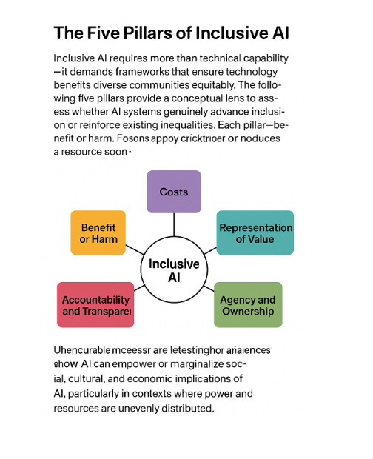

Slide 15
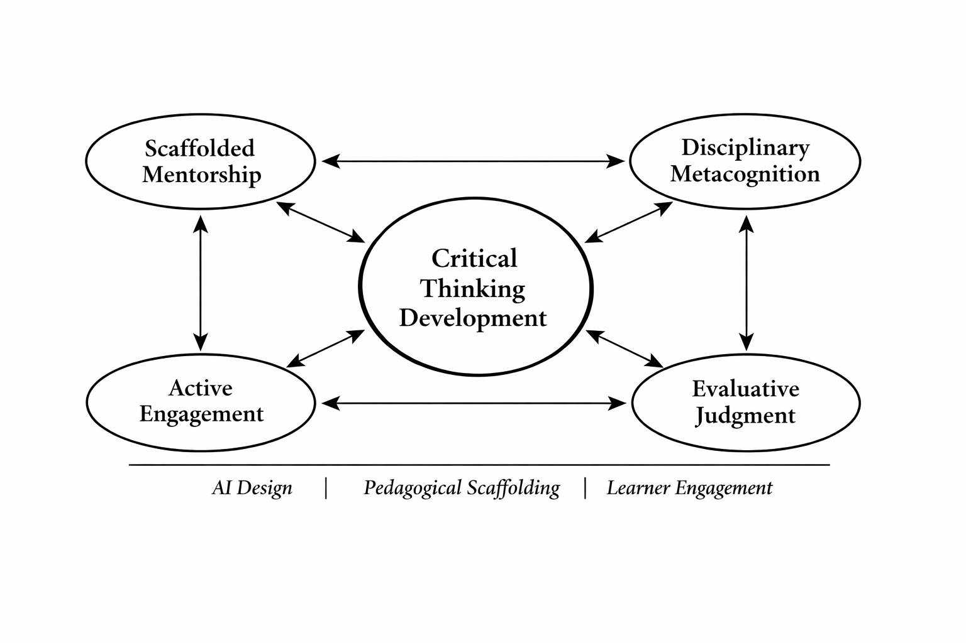
Conceptual Framework for Fostering Critical Thinking through Generative AI

Slide 16
Core Components of AI-Mediated Critical Thinking: Definitions, Applications, and Examples
Concept | Definition | GAI Context | Example
Scaffolded Mentorship | Temporary guidance provided to learners to support skill mastery, gradually removed as competence develops (Vygotsky, 1978) | Teachers or AI-mediated platforms guide students in using AI tools, gradually encouraging independent evaluation and reasoning | Estonia’s TI-Hüpe: teachers guide students in iterative AI projects; Purdue AI Lab: structured mentorship for ethical AI use; Colby Mule Chat: tutors guide comparison of LLM outputs
Disciplinary Metacognition | Awareness and regulation of one’s own thinking processes within a specific academic discipline (Allen et al., 1999) | Students reflect on their cognitive processes while interacting with AI outputs, adapting strategies to solve domain-specific problems | Estonia TI-Hüpe: reflective diaries to critique algorithmic biases; Voss’s computational linguistics course: ethical reflection with Python/NLP; Lipson’s Robotics Studio: documenting AI prompts and outcomes
Active Engagement | Purposeful interaction with content through questioning, iteration, and reflection (Scriven & Paul, 2004) | Learners interact dynamically with AI tools rather than passively consuming outputs, refining reasoning and problem-solving | Northeastern Claude AI: Socratic questioning challenges students; Bryce Wolcott’s Flexi lessons: students iterate on evidence and present findings
Evaluative Judgment | Ability to understand quality standards and make informed decisions about one’s own and others’ work (Sadler, 1989; Tai et al., 2018) | Learners critically assess AI-generated outputs and peer work, identifying reasoning gaps, biases, and evidence quality | Colby Mule Chat: students compare LLM outputs to evaluate consistency and bias; Lipson Robotics Studio: students assess AI design solutions; Wolcott’s science classes: students refine evidence and reasoning

Slide 17
AI in Education: Social Consequences and Inequality
AI reshapes—not removes—educational inequality.
Access gaps persist (devices, bandwidth, compute), but deeper divides arise in AI skills (prompting, evaluation, integration) and, most critically, in outcomes—who converts AI use into academic and career gains.
Outcomes depend on institutional context, not technology alone.
Students and researchers at well-resourced institutions are far more likely to translate AI use into publications, grades, grants, and advancement due to mentorship, infrastructure, and professional networks.
“Free” AI masks structural advantage.
Privileged users benefit from higher AI literacy, better guidance, and premium tools, producing a stratified learning environment where AI amplifies existing advantages.

Slide 18
AI in Education: Social Consequences and Inequality
AI does not inherently weaken or enhance critical thinking.
Its impact depends on pedagogical design: structured inquiry, iterative feedback, and metacognitive reflection strengthen critical thinking, while passive or convenience-driven use erodes intellectual autonomy.
Equitable impact requires intentional intervention.
Closing AI-driven divides demands coordinated investment in AI literacy, pedagogical standards, faculty training, and institutional readiness—not infrastructure alone.
Key takeaway:
AI’s educational impact is socially determined. Without equity-centered design and institutional capacity, AI will automate inequality rather than democratize opportunity.

