Slide 1
Anonymity in Cellular Core Networks
18-21 January 2026
Mehdi Sepasi
UCI

Slide 2

Your sensitive information is at risk!
Image generated using ChatGPT (OpenAI, 2026).

Slide 3
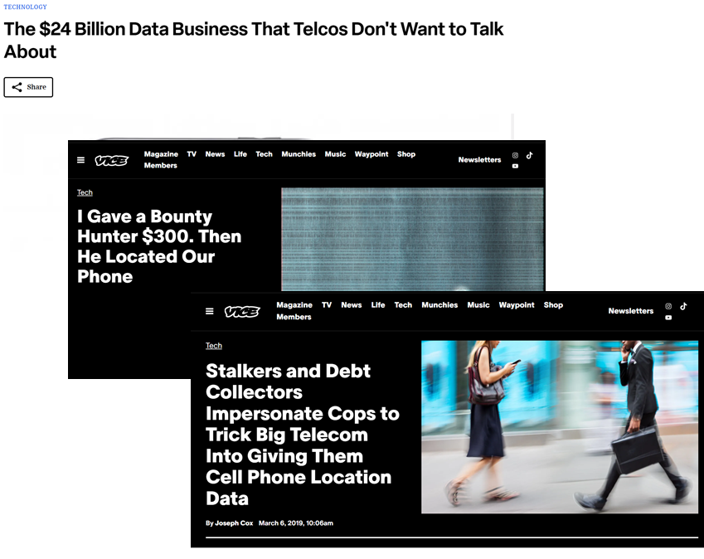
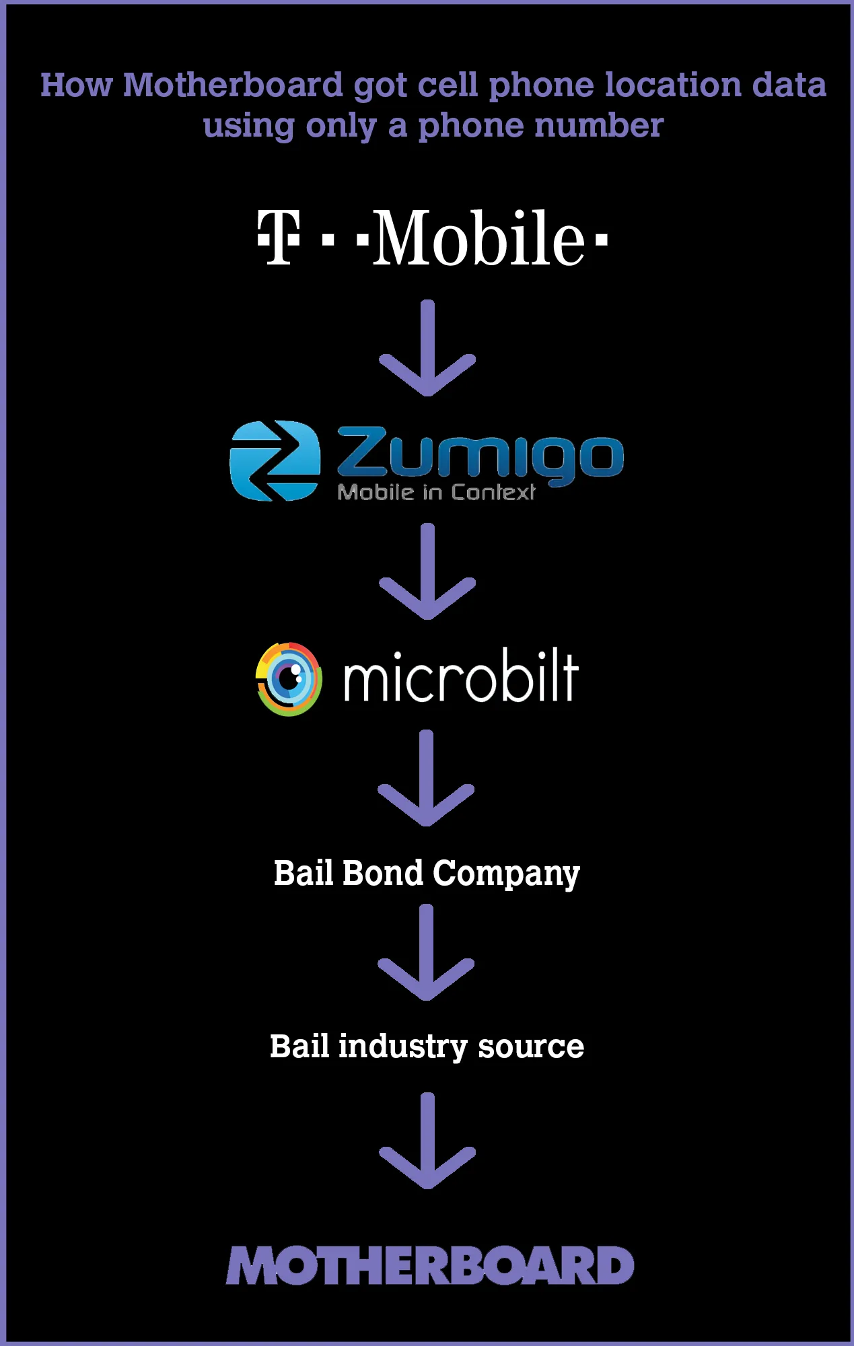
User Data Can Be Leaked to Third Parties Through Cellular Ecosystems
https://www.vice.com/en/article/i-gave-a-bounty-hunter-300-dollars-located-phone-microbilt-zumigo-tmobile/
https://adage.com/article/datadriven-marketing/24-billion-data-business-telcos-discuss/301058/

Slide 4
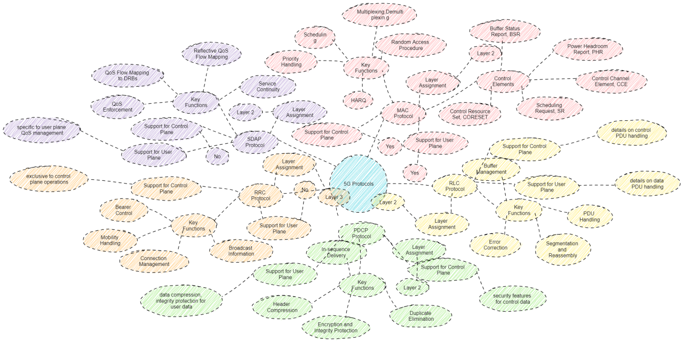
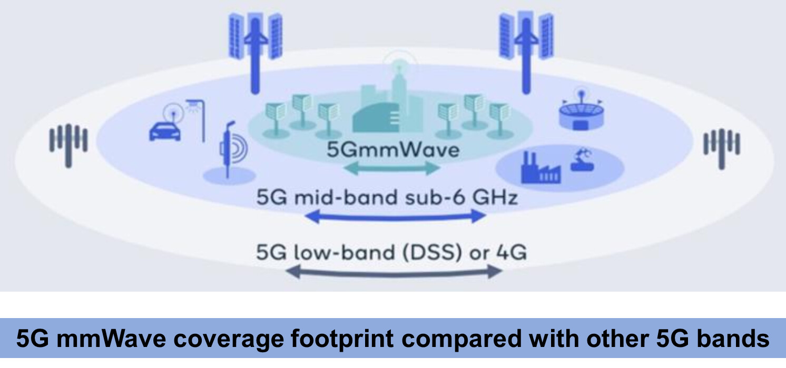
It is Getting worse!
More User Info + Finer Levels of Detail

Slide 5
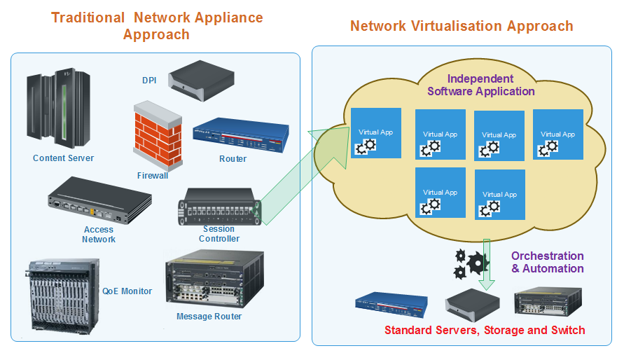
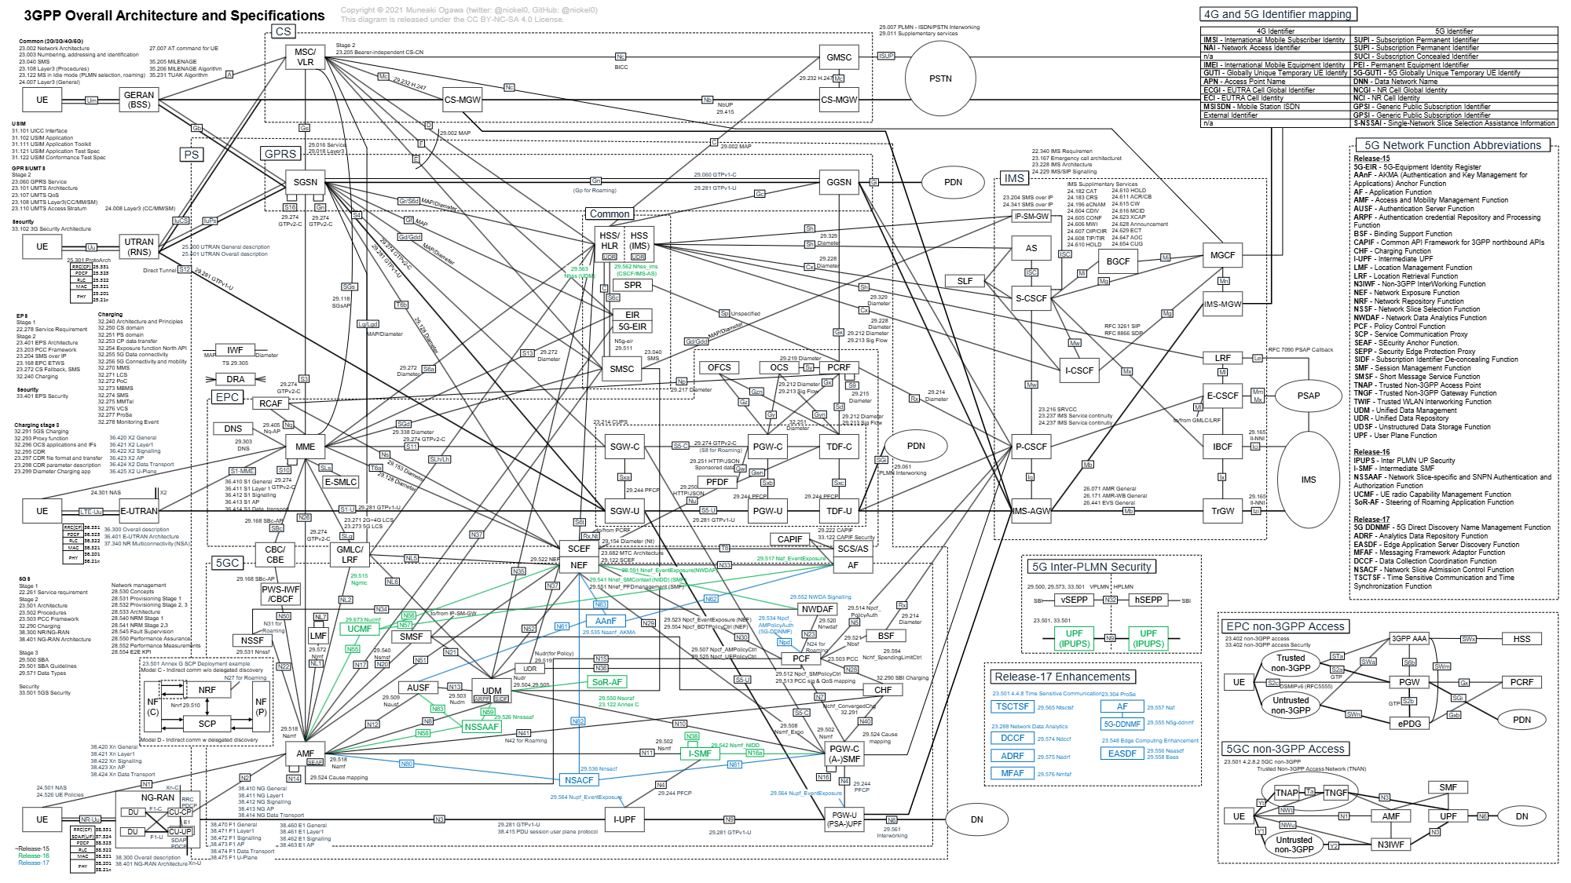
It is Getting worse!
Expanded exposure of user data to new actors

Slide 6
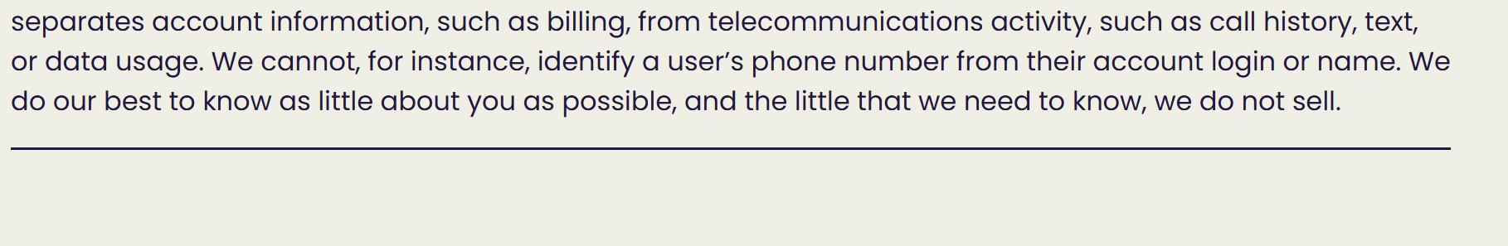
An increasing number of wireless carriers now market privacy.
Expanded exposure of user data to new actors

Slide 7
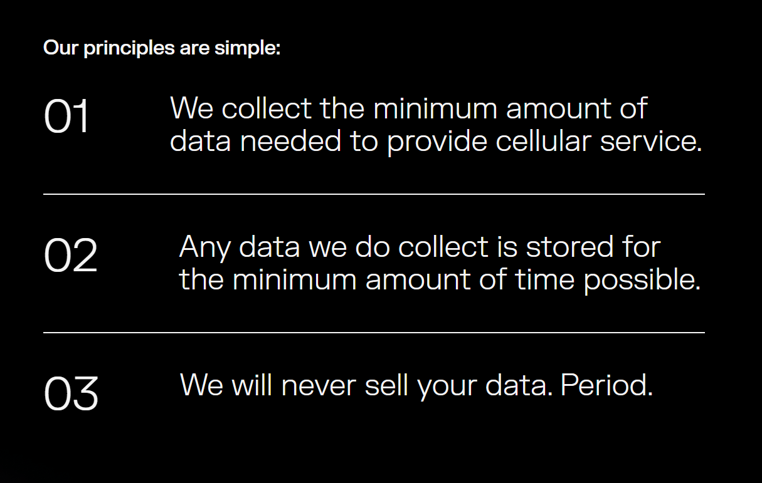
An increasing number of wireless carriers now market privacy.
Expanded exposure of user data to new actors

Slide 8
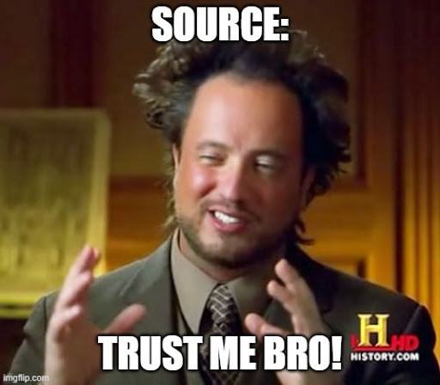
An increasing number of wireless carriers now market privacy.
Expanded exposure of user data to new actors

Slide 9
Background

Slide 10
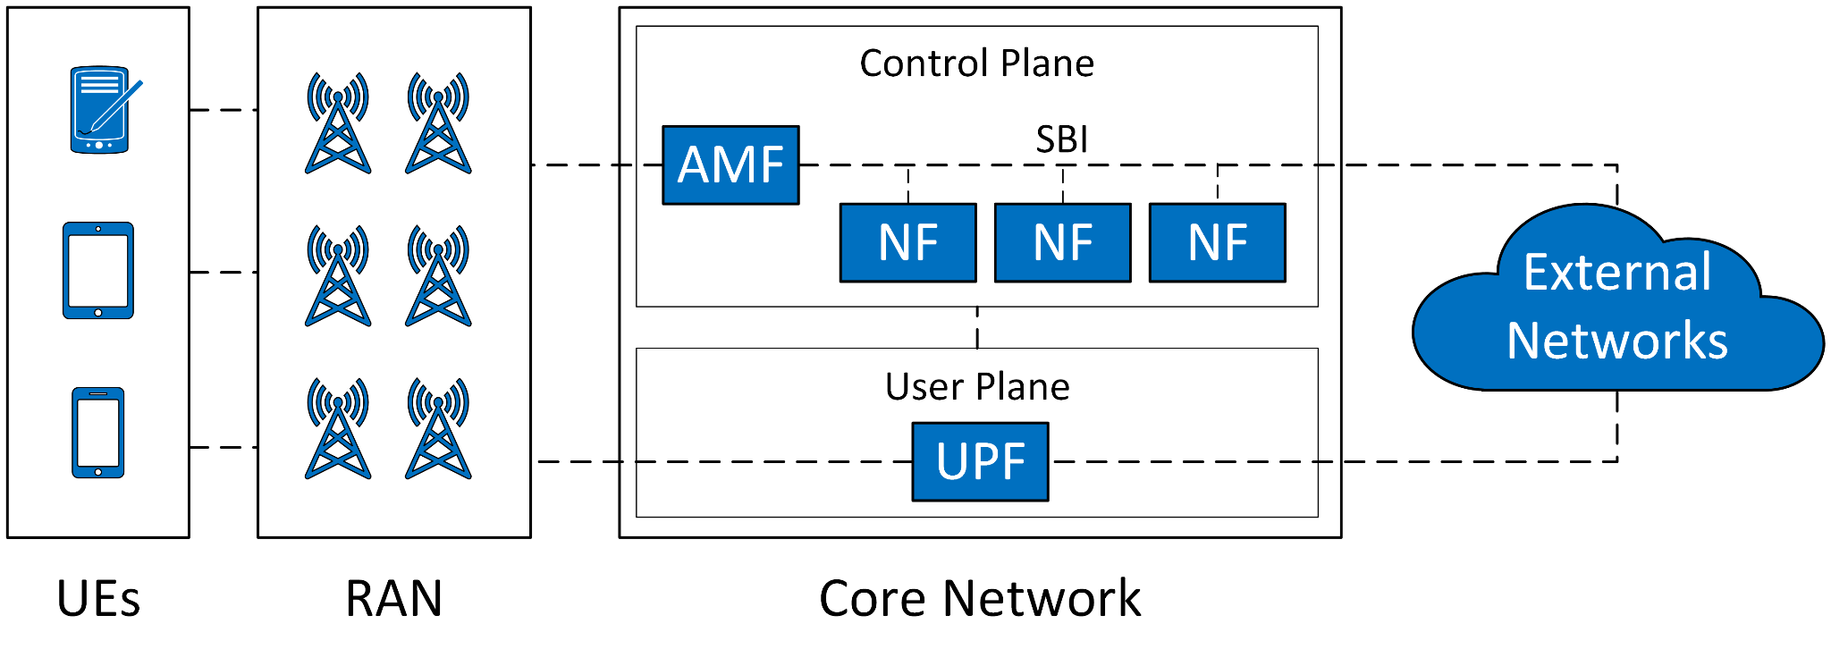
Cellular Network Architecture

Slide 11
Cellular Network Architecture

Slide 12
Cellular Network Architecture

Slide 13
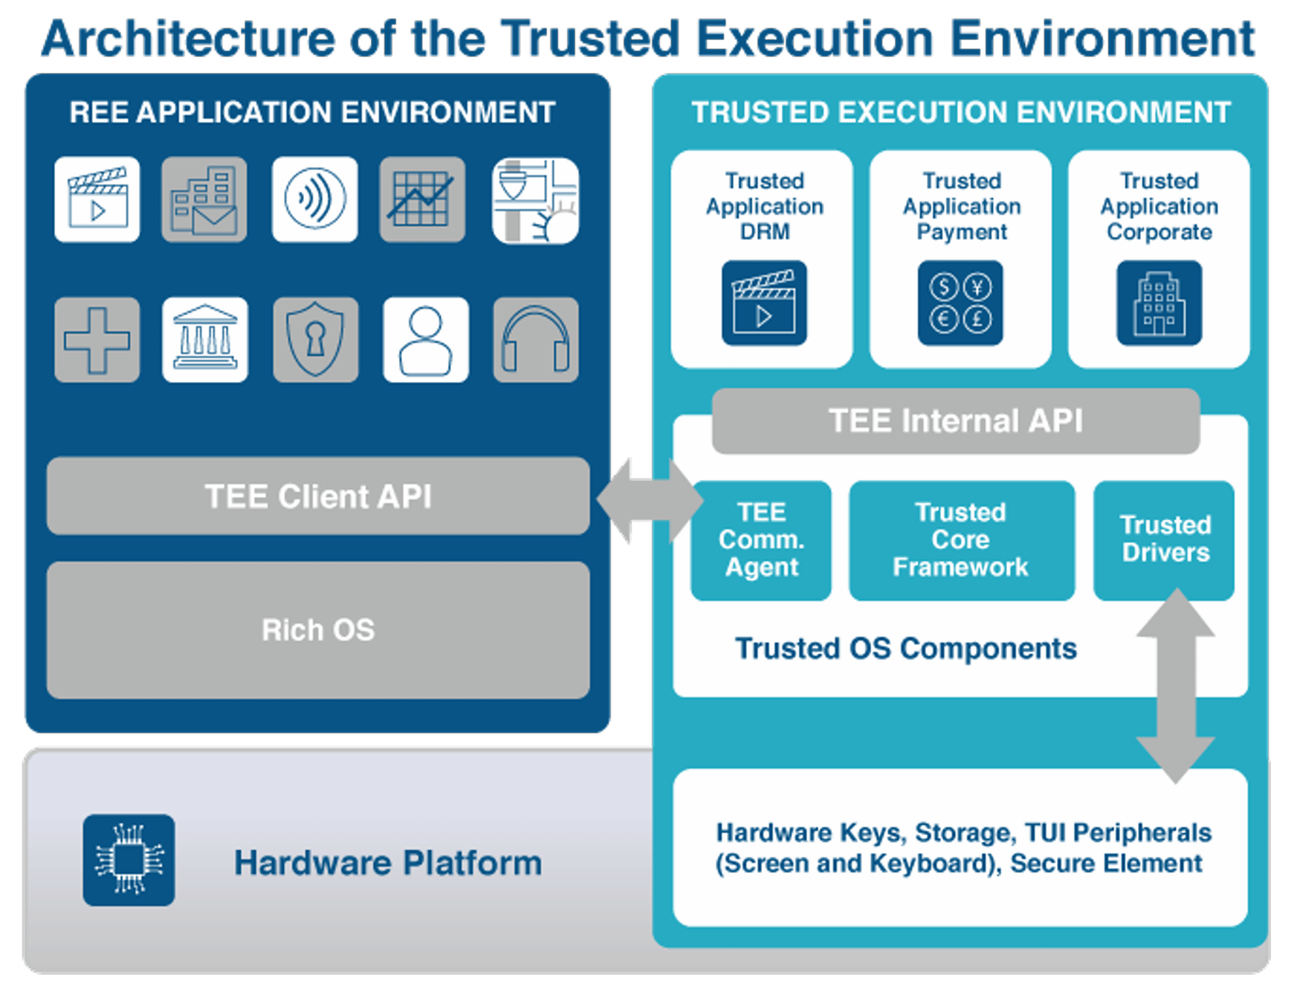
Trusted Execution Environment (TEE)
https://globalplatform.org/wp-content/uploads/2018/05/Introduction-to-Trusted-Execution-Environment-15May2018.pdf

Slide 14
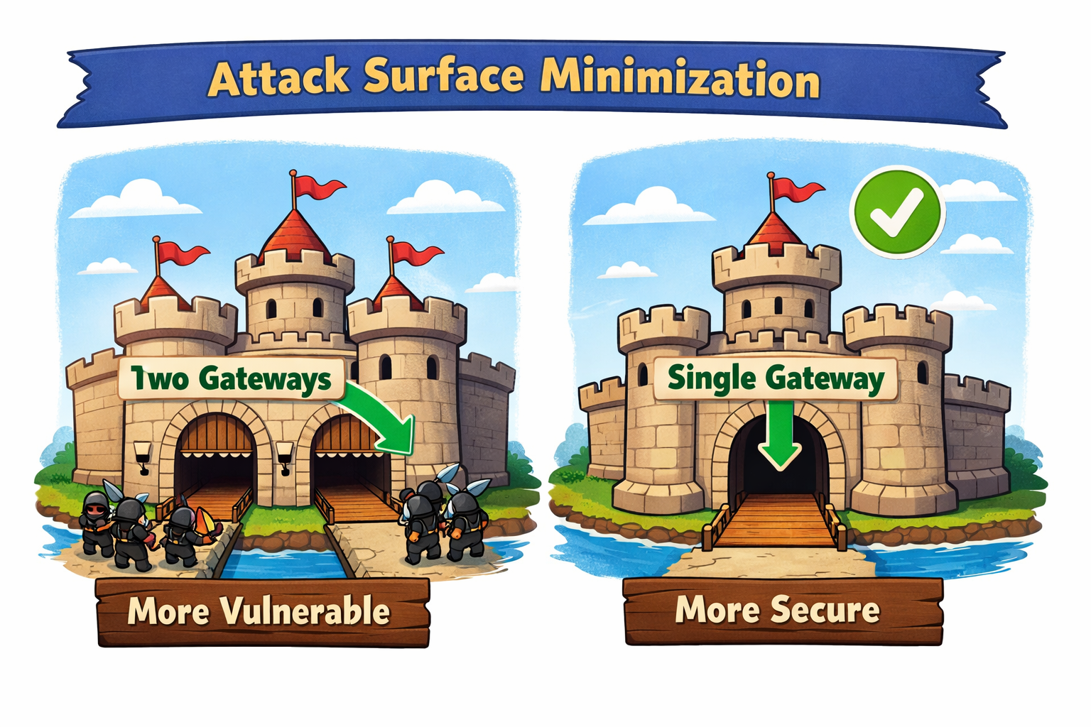
ASM

Slide 15
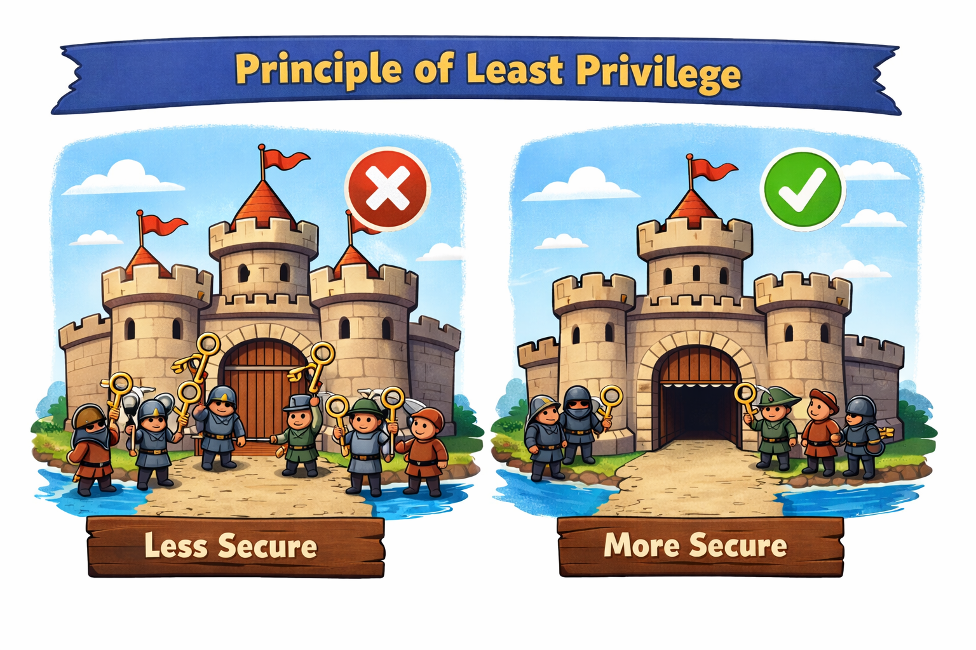
PoLP

Slide 16
Methodology

Slide 17
Threat Model
Cloud Providers
NF Vendors
Third-party vendor(s) in charge of developing various NFs
May embed malicious code within the NFs to capture data and send it for unauthorized use
Host the entire core network or a subset of its NFs.
Could be rogue employees
May monitor the runtime behavior of hosted NFs

Slide 18
Threat Model
Goal: Deanonymize cellular network users
Honest-but-curious: they follow the defined network protocols but are motivated to infer and uncover the identities of users within the network.

Slide 19
Threat Model
Goal: Deanonymize cellular network users
Honest-but-curious: they follow the defined network protocols but are motivated to infer and uncover the identities of users within the network.
Do not have direct access to the RAN information.

Slide 20
Threat Model
Goal: Deanonymize cellular network users
Honest-but-curious: they follow the defined network protocols but are motivated to infer and uncover the identities of users within the network.
Do not have direct access to the RAN information.
Non-targeted

Slide 21


Our Goal
Prevent the attackers to gather the user information to identify or track them.

Slide 22
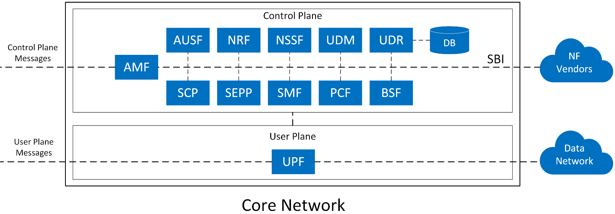
Naive Solutions are not practical.

Slide 23
Let’s identify and tackle it at its origin.

Slide 24
Challenges
What should we anonymize?
How should we anonymize data?
How can we support identity-based services?
What security guarantees can be provided?
What are the implications of these design choices?

Slide 25
Personally Identifiable Information
PII is any information that can be used to distinguish, trace an individual's identity, and any other information that is linked or linkable to an individual.
Direct PII:
Globally unique
Stable identifiers
Inherently tied to a user or device.
Indirect PII:
Do not identify users on their own
May become linkable through long-term observation or when combined with other information.

Slide 26
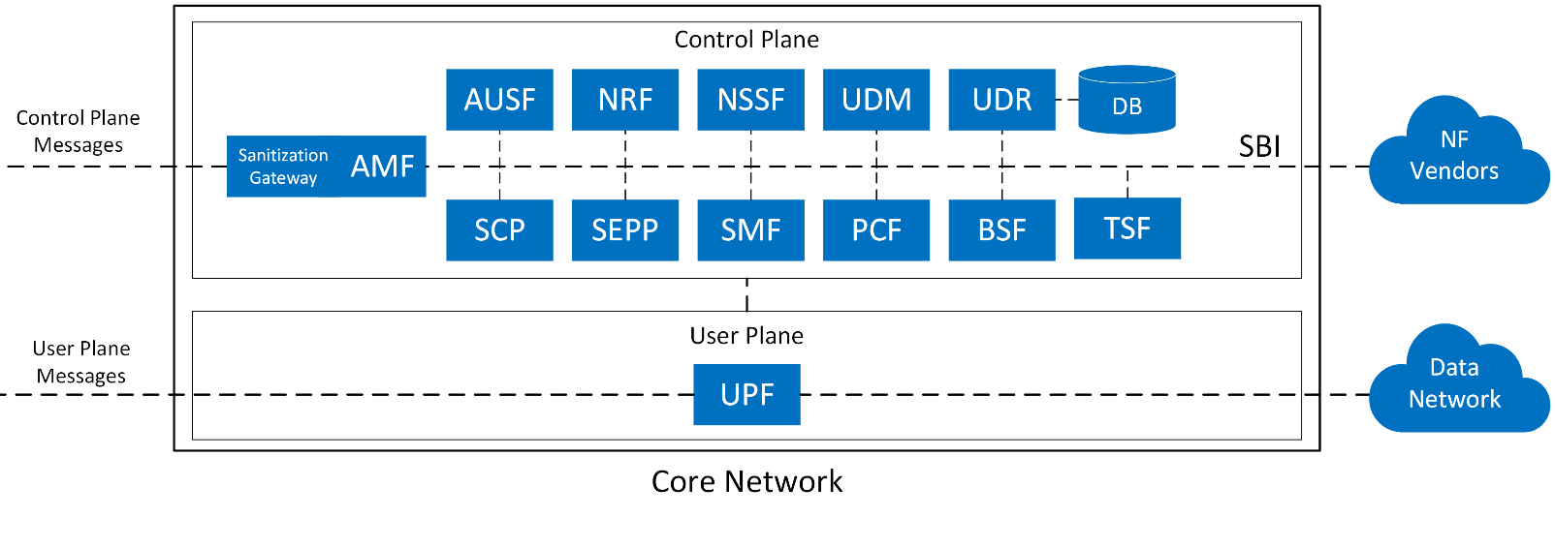
Design
Use direct PII fields within trusted components only and replace them with pseudonyms for use by untrusted NFs

Slide 27
Design
Use direct PII fields within trusted components only and replace them with pseudonyms for use by untrusted NFs
Rotate pseudonyms and temporary identifiers between epochs using re-registrations.

Slide 28
Design
Use direct PII fields within trusted components only and replace them with pseudonyms for use by untrusted NFs
Rotate pseudonyms and temporary identifiers between epochs using re-registrations.
Prevent cross-epoch linkability by coordinated tier-based re-registrations.

Slide 29
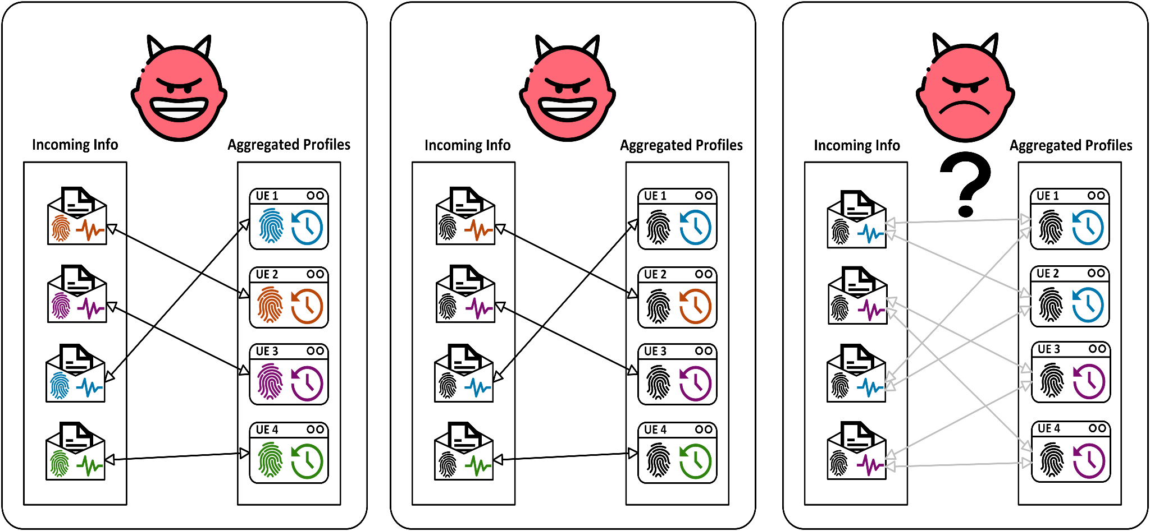
Linkability

Slide 30
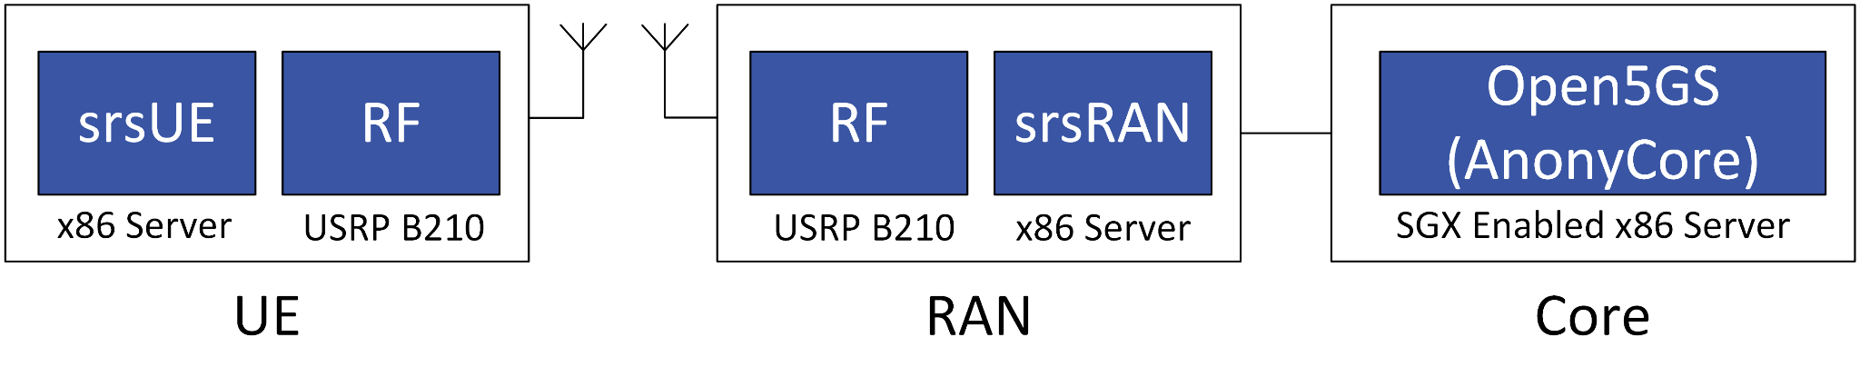
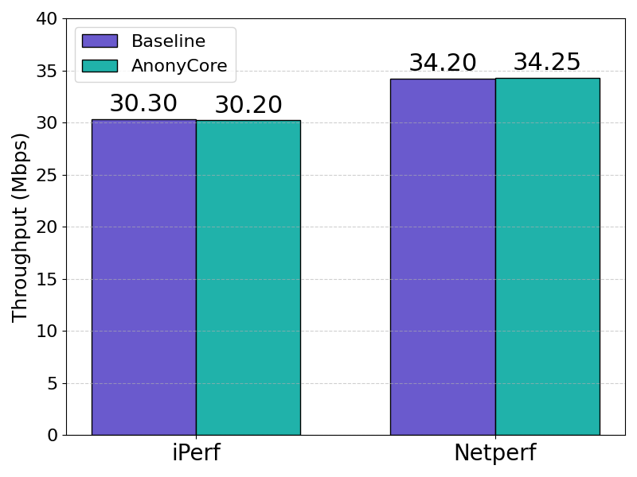
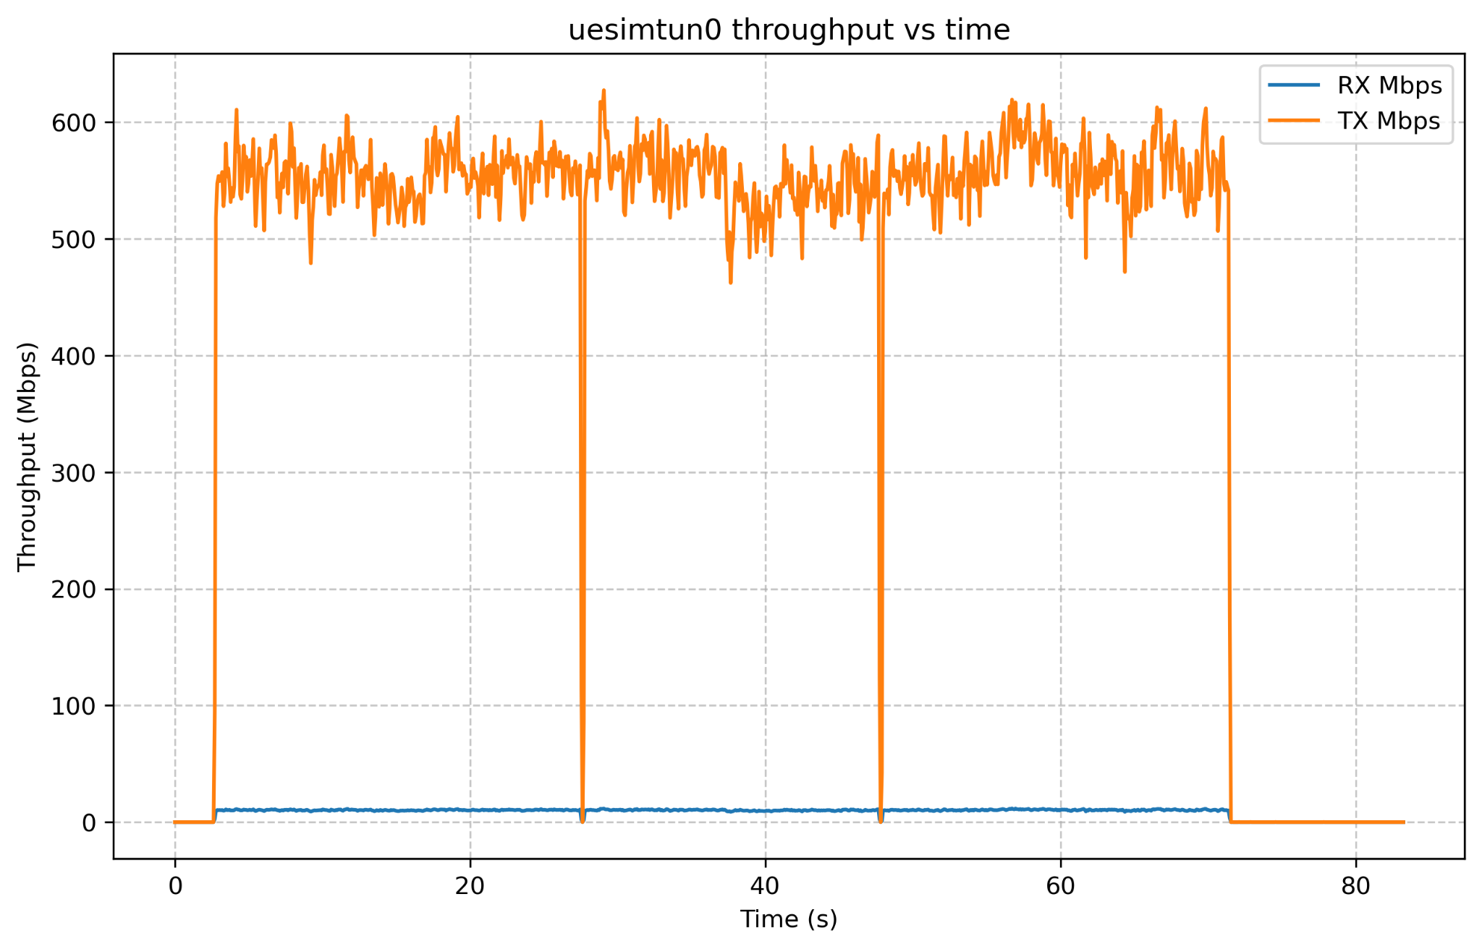
Results

Slide 31
Future Directions
Trusted Radio Access Network
Static IPs
Roaming Scenarios

Slide 32
Questions?

