Slide 1
APAC telcos bridge digital divide with fiber rollouts and new FTTH business models
18-21 January 2026
Julija Jurkevic,
Sr. Research Analyst
S&P Global Market Intelligence

Slide 2
Topics
FTTH broadband growth and service take-up rates in Asia-Pacific
Solutions to bridge the divide in fiber adoption
How the affordability of fiber services influences these solutions

Slide 3

Why do we focus on FTTH?
As digital transformation accelerates across economies, fiber-optic networks have become the backbone for high-speed, reliable internet, supporting everything from smart cities to cloud computing and 5G.
The Asia-Pacific region has seen a rapid expansion of fiber broadband infrastructure, with governments and operators striving to bridge the digital divide and offer affordable, flexible connectivity.

Slide 4
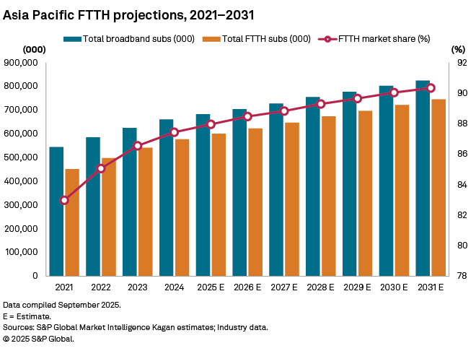
FTTH - dominant fixed broadband technology, on track to replace copper and cable region-wide
By 2031, fiber is projected to account for 90.3% of all fixed broadband households in the region, up from 83% in 2021.
This shift is the result of combined efforts by both government regulators and telcos to replace legacy copper and cable networks with high-capacity fiber infrastructure as well as efforts to increase high speed broadband affordability.

Slide 5
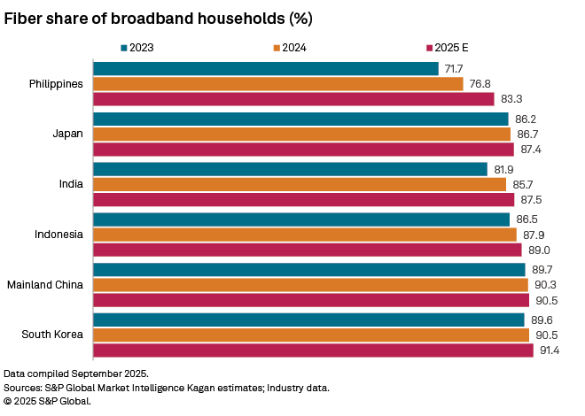
FTTH market share, selected APAC markets
Out of 18 markets we cover in detail in the APAC region, only Cambodia, New Zealand, Pakistan and Taiwan had fiber share of total subs below 70% at end-2025.
Cambodia and Taiwan have significant cable presence with about 30% of broadband homes subscribing to cable.

Slide 6
Singapore remains the leader in fiber broadband take-up, with near-universal coverage and adoption, high speeds, and a robust regulatory framework. It is the only market in the region where fiber is the sole fixed broadband technology.
Although most fixed broadband connections in countries like India, Indonesia and the Philippines are fiber, less than 40% of households have a fixed broadband subscription.
Indonesia and India, while making extensive efforts in fiber deployment, face challenges in converting coverage into subscriptions, particularly in rural and low-income segments.
Data compiled January 2026.
Sources: S&P Global Market Intelligence Kagan estimates; industry data.
© 2025 S&P Global.

Slide 7
FTTH service take-up rate remains uneven in the APAC region
How many homes passed by fiber become subscribers?
Despite fiber networks reaching over 50% of households in most markets in our analysis, fiber service take-up rates remain below 50% in nearly half of the markets.

Slide 8
How are low fiber service take-up and urban-rural digital divide addressed in Asia-Pacific?
Government initiatives and public-private partnerships
The rise of “pay-as-you-grow” network and service models
Prepaid FTTH plans

Slide 9
Government-backed initiatives to expand fiber networks to underserved areas
Hong Kong government implemented a subsidy scheme that extends fiber-based networks to 235 villages.
Taiwan’s Smart Country Plan (2021-2025) offers tax credits, preferential loans, and R&D support to telecom companies for fiber and 5G deployments with the goal to achieve 90% 2 Gbps coverage.
India’s BharatNet project aims to connect 250,000 villages with affordable fiber services. It receives significant government funding from the Digital Bharat Nidhi (formerly Universal Service Obligation Fund).
The Philippines National Fiber Backbone (NFB) project is funded through a loan from World Bank and by the Philippine government. Completion is expected by end of 2027.
Indonesia's Palapa Ring Project, a $1.3-$1.5 billion national fiber optic backbone completed in 2019, was primarily funded through a Public-Private Partnerships, Universal Service Obligation fund, and supplemented by state-backed loans. It connected all provincial capitals and most district/city capitals.

Slide 10
The rise of “pay-as-you-grow” and prepaid FTTH plans
The pay-as-you-grow (PAYG) infrastructure model is a scalable, demand-driven approach to network deployment and service delivery. ISPs invest in infrastructure incrementally, expanding capacity and coverage as subscriber demand materializes. This includes infrastructure sharing and leasing of wholesale network capacity.
  As an extension of this model, 5G fixed wireless (FWA) is used to provide high-speed broadband in remote areas.
    Examples include Australia’s NBN, New Zealand’s Rural Broadband Initiative, Indonesia’s government-backed “People’s Internet” program launched in Nov 2025.
PAYG fiber broadband services—where users pay for access in flexible increments rather than committing to long-term contracts—have gained traction, especially in emerging markets and among cost-sensitive consumers.
    “Buy Now, Pay Later” option offered by Maxis Malaysia, Singtel Singapore (mainly used for devices, including routers).
Prepaid fiber services help operators monetize underutilized infrastructure, reduce churn, and reach new customer segments. They are powerful tool for digital inclusion, especially in markets with high prepaid mobile usage and income volatility.
  Major telcos in the Philippines, Pakistan, and India offer prepaid fiber plans with varying speeds, data allowances and bundled value-added services, such as OTT video.

Slide 11
Asia-Pacific FTTH affordability by market (%), 2025
Based on 2025 per capita gross national income at purchasing power parity, S&P Global Market Intelligence Kagan calculated that fiber services are most affordable in advanced markets.
The Philippines has the least affordable fiber services with an affordability index of over 2%. This means that consumers spend over 2% of their household income on fiber broadband.
While fiber broadband is relatively affordable in India and Indonesia overall, income gaps between urban and rural areas remain large.
What percentage of household income is spent on fiber services?
Data compiled January 2026.
Sources: S&P Global Market Intelligence Kagan estimates; industry data.
© 2025 S&P Global.

Slide 12
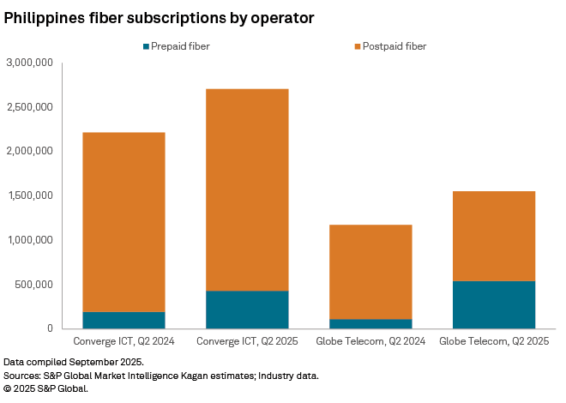
The Philippines, a prepaid fiber pioneer
Globe Telecom launched its prepaid fiber internet service, “GFiber Prepaid”, in June 2023.
Converge ICT's prepaid fiber service, “Surf2Sawa (S2S)”, was officially launched on March 16, 2023.
PLDT Home Fiber Prepaid was launched on June 1, 2025
More than 50% prepaid fiber subscription growth YoY for Globe and Converge

Slide 13
Thank you!
Julija Jurkevic
Email: Julija.Jurkevic@spglobal.com

