Slide 1
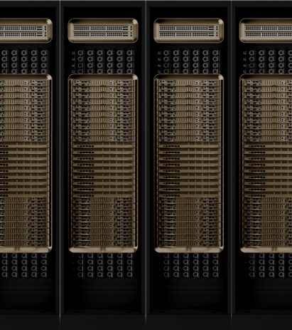
DESIGN SMARTER
DELIVER FASTER
Presented by Eric Lalaurie – Technical Director
20th January 2026

Slide 2

WHO AM I
Technical Director and ICT Lead at WSP (Australia)
Lead Telecoms Engineer for multiple Hyperscale size Facilities
Leads a team of 50+ Engineers and consultants
WHAT DO WE DO
Global scale, local delivery. 75k+ professionals across 50+ countries, combining global expertise with local market knowledge to deliver complex programs worldwide
End‑to‑end services across sectors. Integrated advisory, planning, design, program & project management, and asset services covering Transportation & Infrastructure, Earth & Environment, Property & Buildings, Energy/Power, Water, and Mining & Metals.

Slide 3
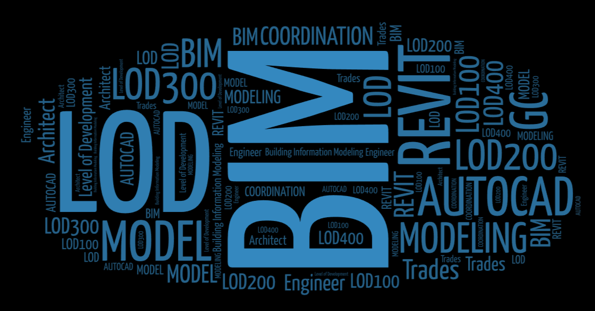
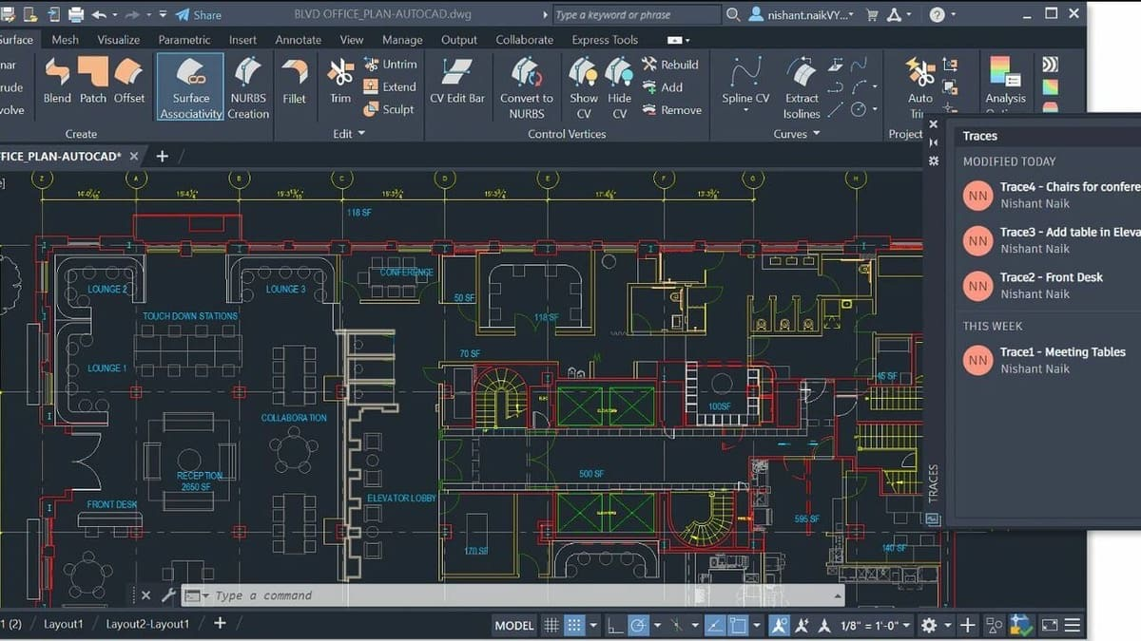
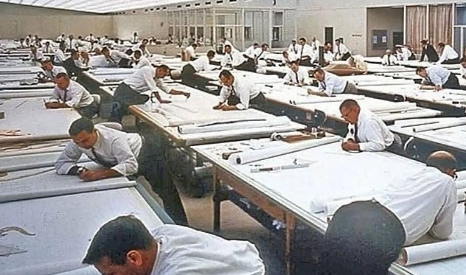
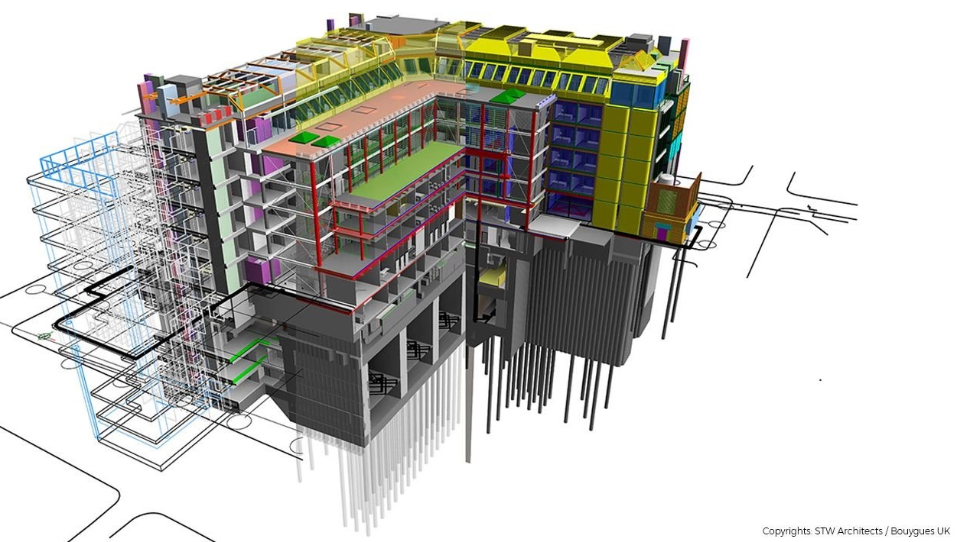
THE EVOLUTION OF DESIGN & DOCUMENTATION TOOLS

Slide 4

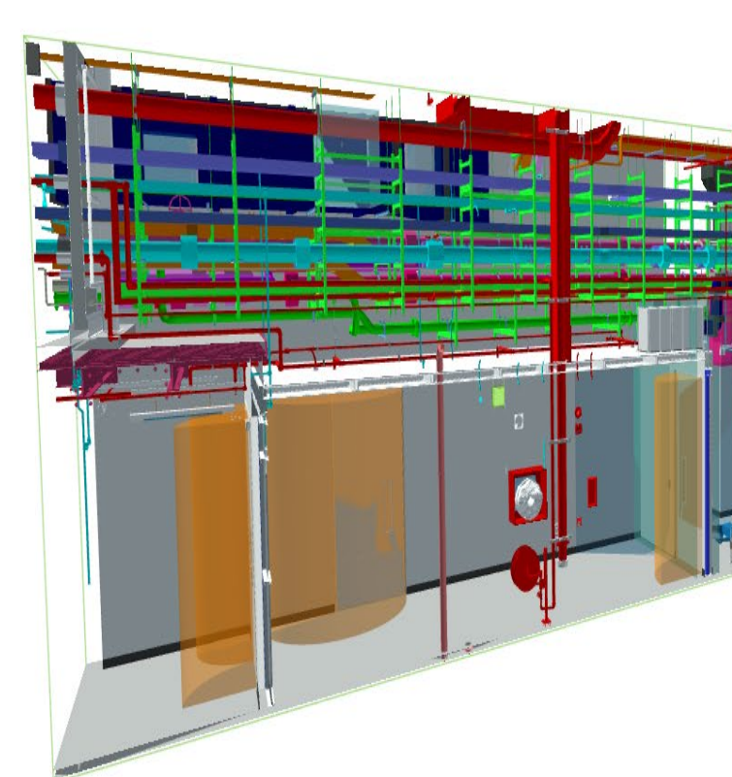
COMPLEXITY IS INCREASING
HOW CAN WE DESIGN AND MODEL MEP / PATHWAYS / NETWORK CABLING IN A MULTI STORY DATA CENTER CAMPUS?
LOD 300 IFC
LOD 400 Contractor model
“Clash free” model
Complex model using complex object families
“Perfect” output expected by clients
Pre-designed modules required to speed construction
Multi-Discipline
Complex building
Limited space for reticulation
Thousands to tens of thousands backbone cabling trunks
60,000 patch leads per Data Center
Highly complex Network Architecture
BUT TIMELINES ARE COMPRESSING
Notes:
Design for Manufacture and Assembly
Complexity of the liquid cooling facility
Racks deployed today are ~70kW
Designs for 100 to 150 kW
Future 600kW
LOD 300–detailed design: In this phase, the model includes geometric information, specific sizes, shapes and detailed object components. It’s used for producing construction documents and coordinating different disciplines.
LOD 350–construction documentation: The model includes detailed assemblies and fabrication or construction-level information. It’s used for generating construction documents and shop drawings.
LOD 400–fabrication and assembly: This level involves the creation of detailed models with specific assemblies and connections, suitable for fabrication and assembly purposes.

Slide 5
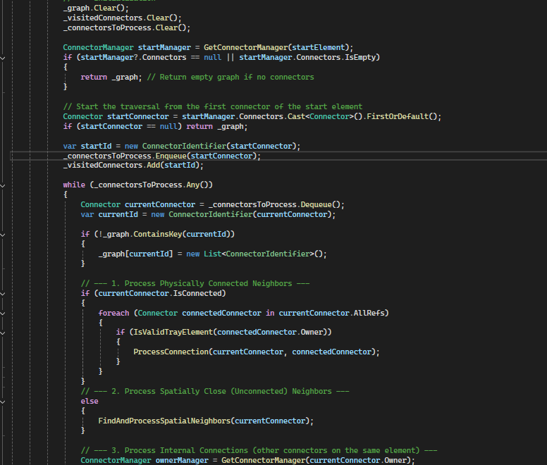
APIs and Object-oriented programming languages
Modern programming languages
Modular
Code reusability
Modern GUI for easier debugging
Generally runs faster than visual or traditional scripting
Easier to optimise
Easy version control

Slide 6
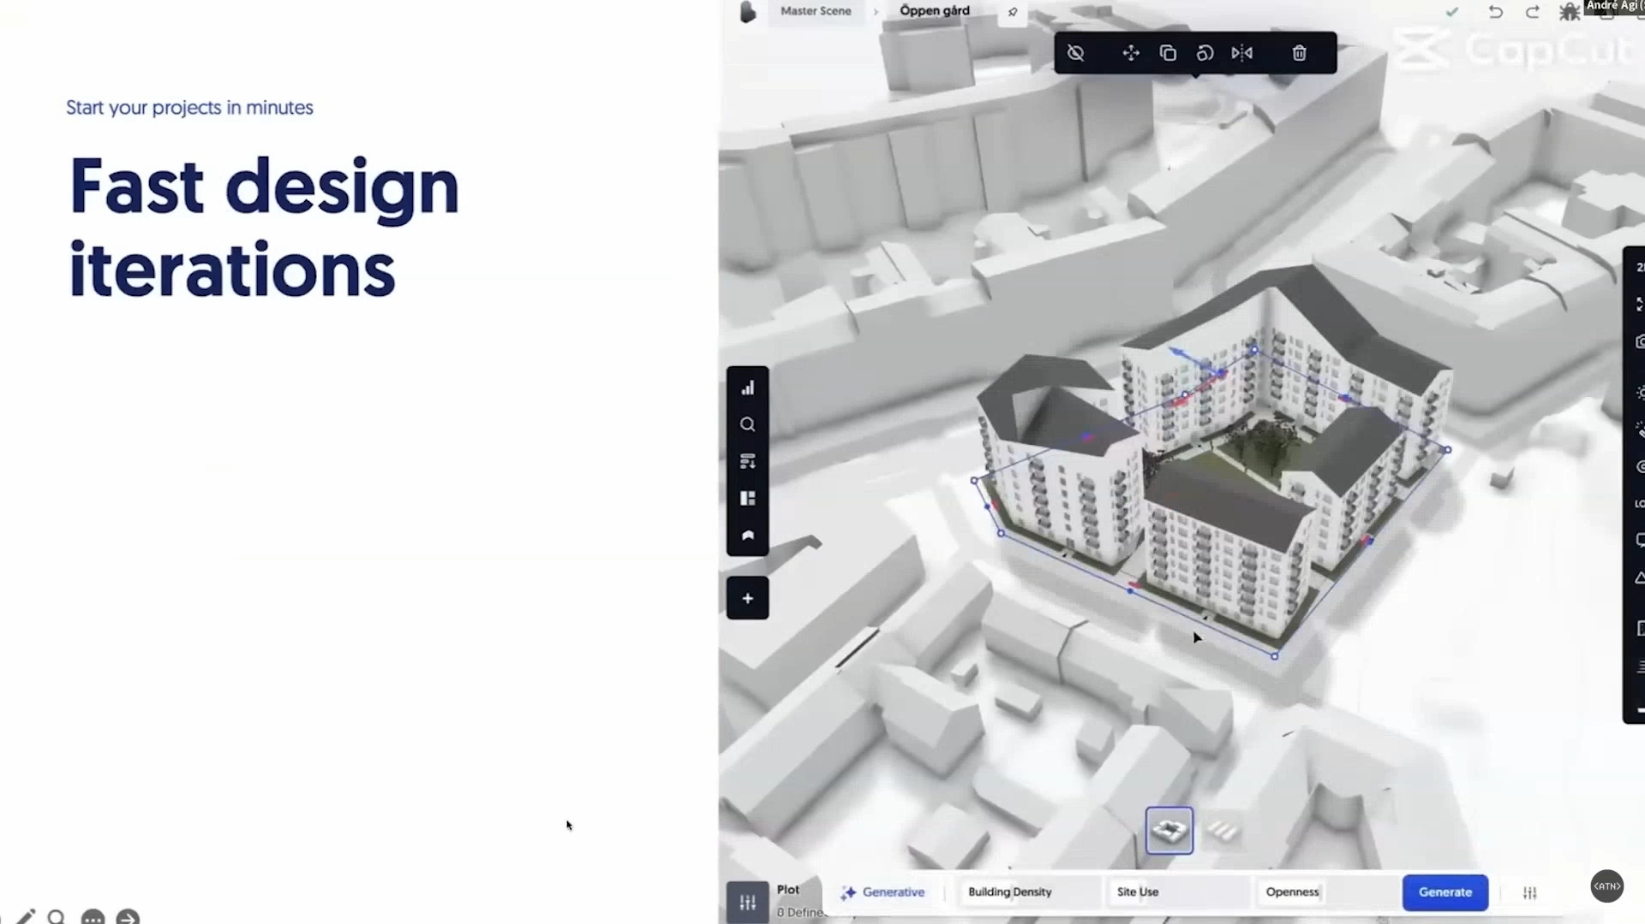
Generative AI
Design based on code compliance
Generative rapid prototyping
Example: SPACIO.AI
Notes:
SPACIO.AI

Slide 7

Thank you
wsp.com

