Slide 1
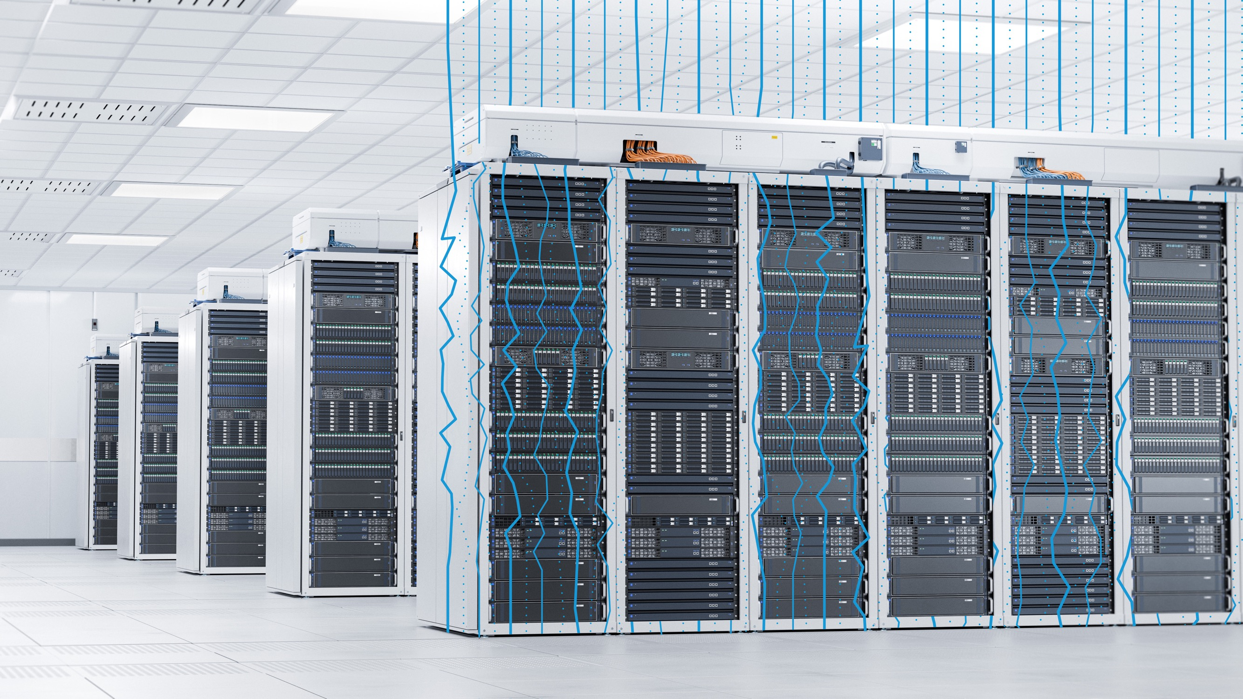

Grid-to-Chip Solutions to Power, Cool and Scale AI Data Centers
Graciano Beyhaut
VP and GM, Critical Power Business

Slide 2
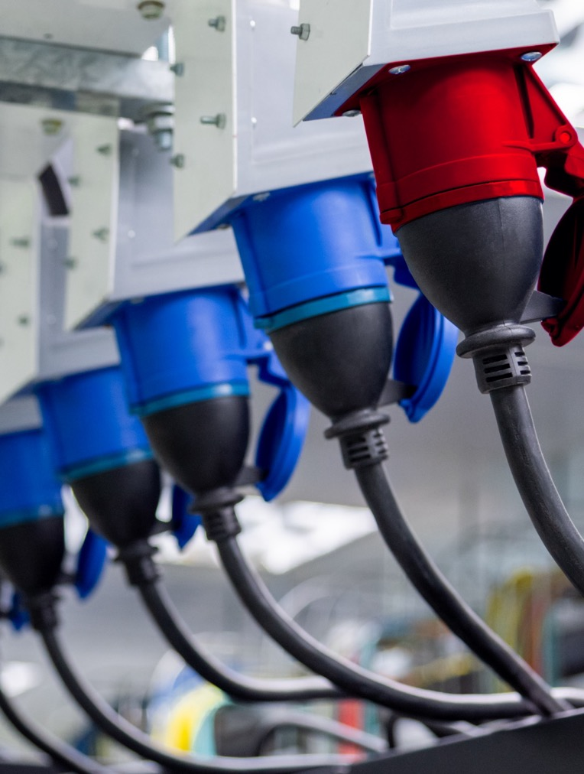
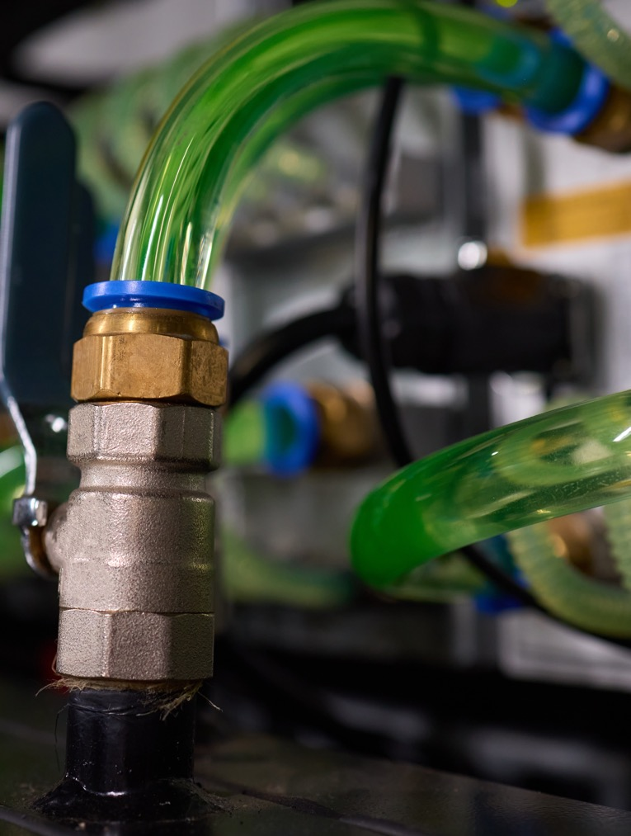
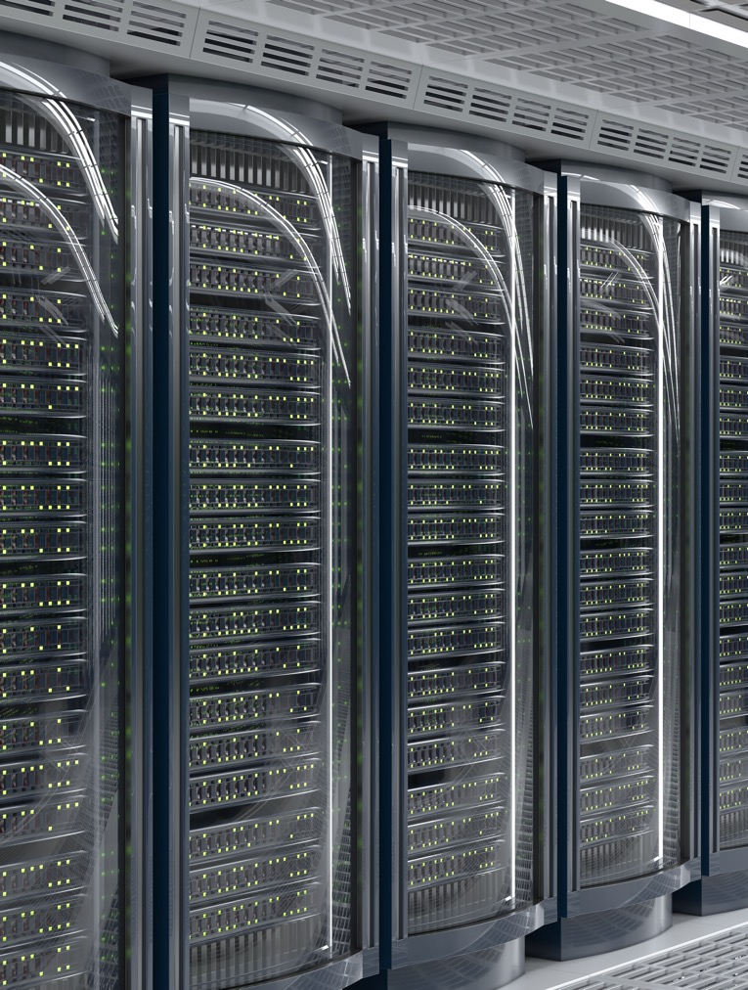
AI era data center growth challenges
Data center power heat and scale challenges demand innovation
NEW POWER REQUIREMENTS
Foundational gap in power infrastructure
GROWING HEAT DENSITY
Compute densities driving shift to liquid cooling
CONSTRAINED BY LACK OF SCALE
Thwarted innovation and access to essential technology

Slide 3

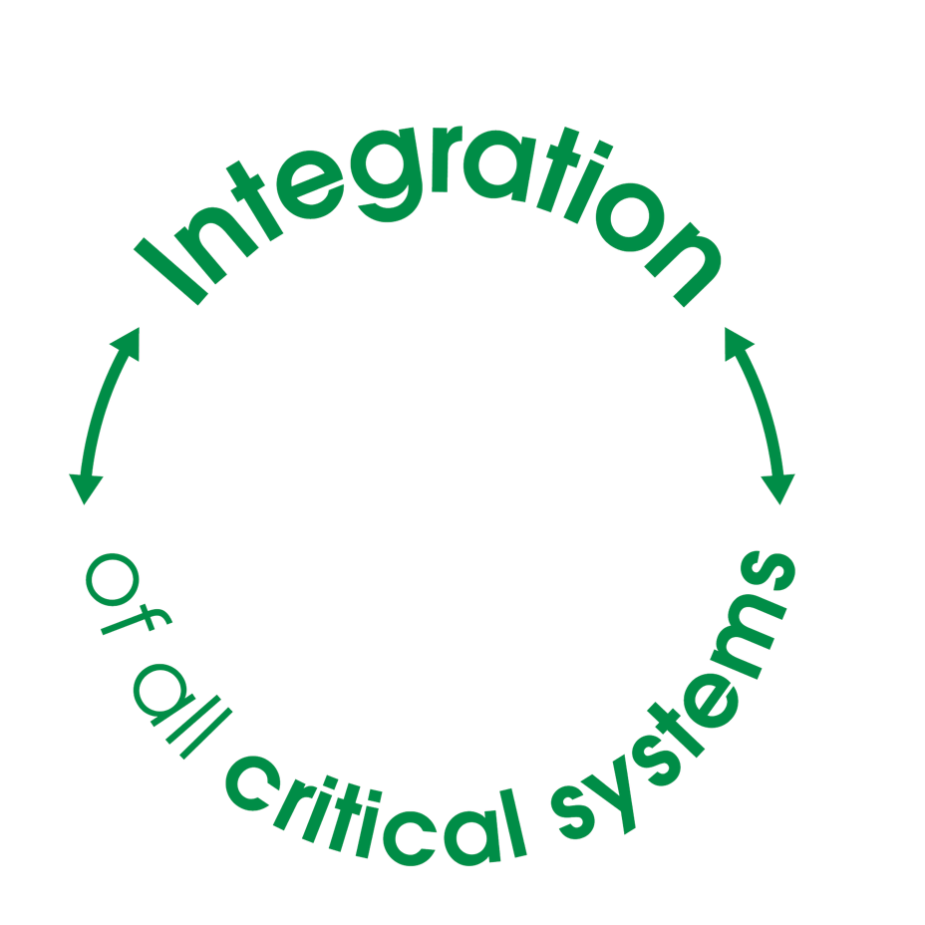




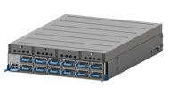
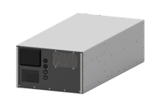

Next-gen infrastructure is driven by close collaboration
Power, cooling, and IT integration is essential in the AI era
Today
Tomorrow
Power Delivery
Walls and silos limit collaboration and growth
Power
Delivery
IT
Compute
Cooling Systems
Cooling Systems
IT Compute
Notes:
ROB
Let’s start with some of the metaphorical walls
Traditionally, power, cooling, and compute were all designed and built separately
In the AI era, that’s a recipe for failure
In the past power was almost taken for granted
A 3MW Utility service could handle 200 racks, but now, it might only handle 3 small AI clusters
In order to keep up with the exponential demands of AI hardware, power and cooling infrastructure must be designed alongside compute instead of treated as an afterthought

Slide 4
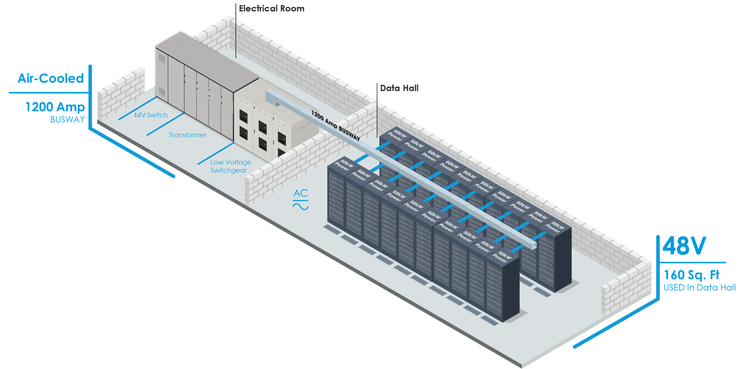

The data center is transforming
Data halls and electrical rooms are being fundamentally redesigned
Today
Tomorrow
Collaborative design & engineering
Modular, off-site fabrication
Space optimization to boost compute density
OUTCOME
More capacity delivered within the same or smaller footprint
Notes:
ROB
This is more than just checking each other’s work
It requires new approaches to design, increased pre-fabrication and modularity, and redesigning data center layouts to optimize for compute density
All of which will lead to more capacity, of higher-powered compute, delivered in smaller footprints

Slide 5
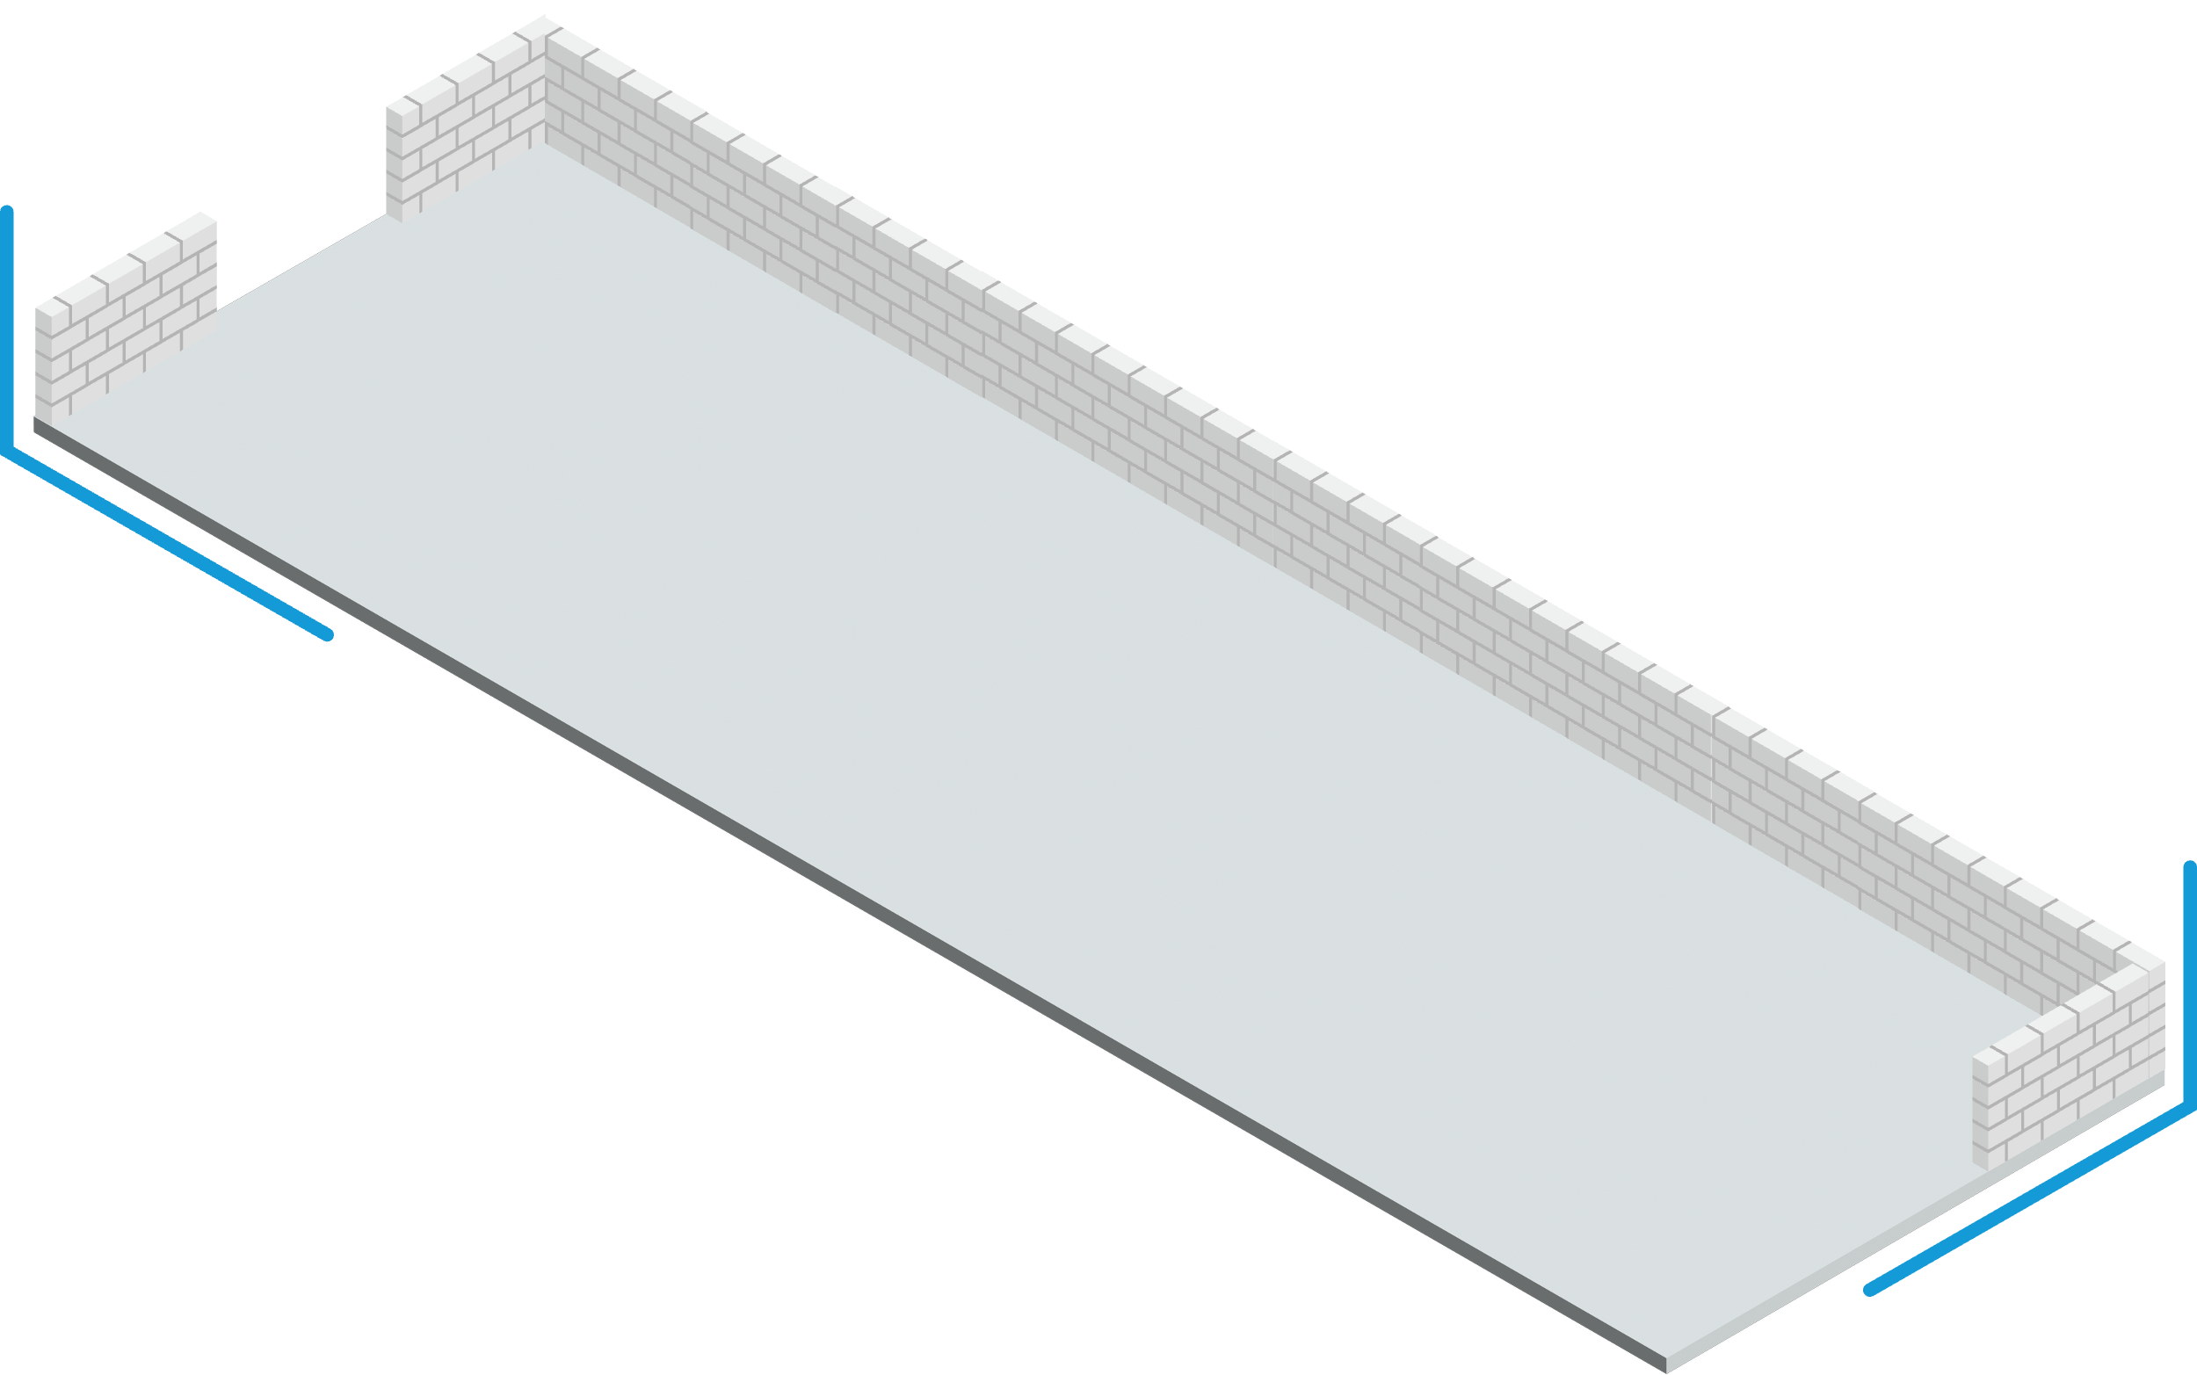
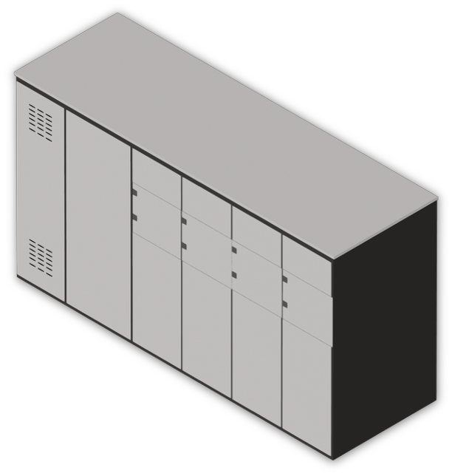
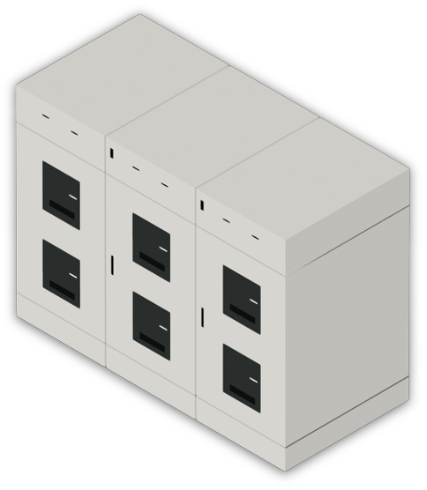
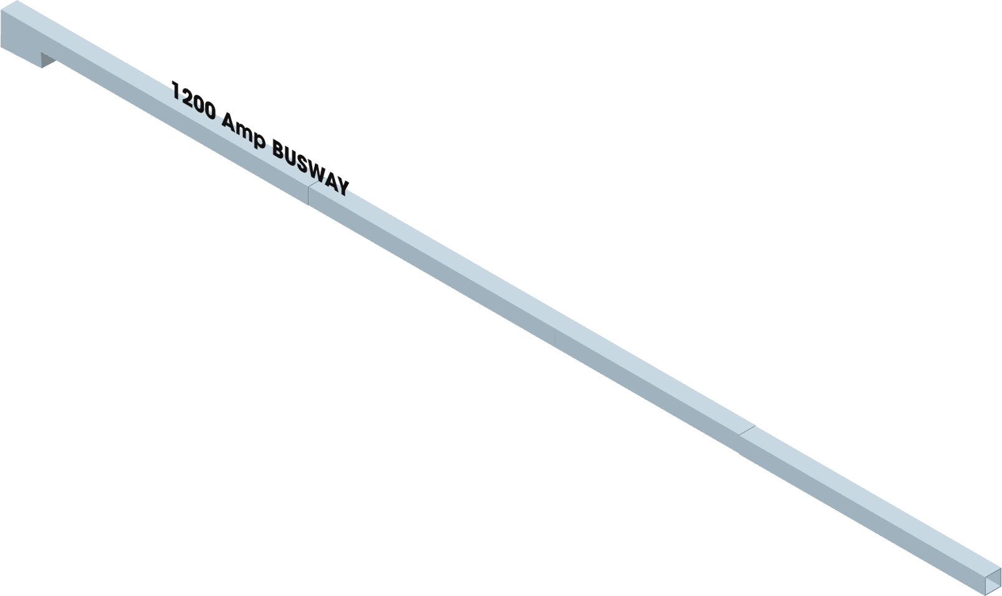
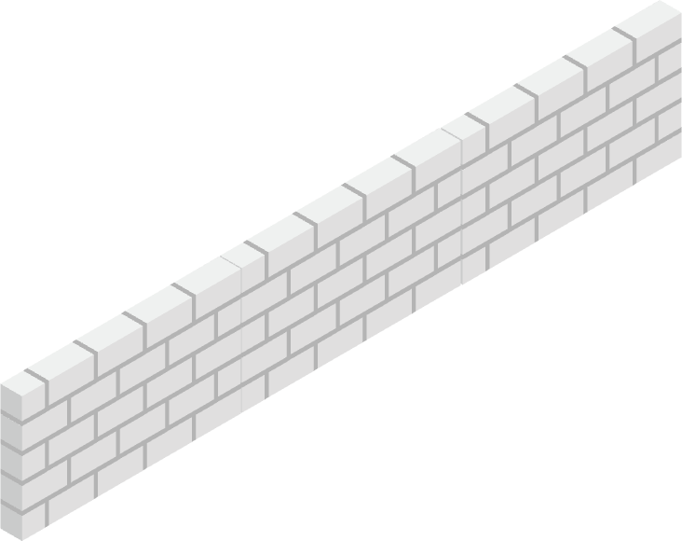
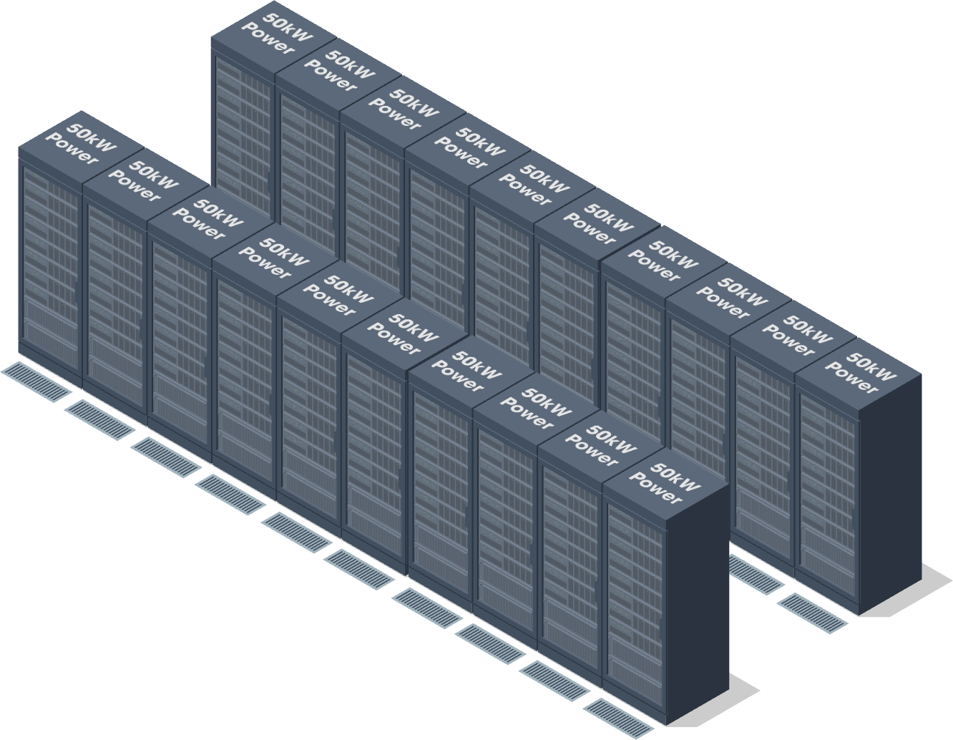


Current isolated IT power [ today ]
Electrical Room
Air-Cooled
Data Hall
1200 Amp
BUSWAY
MV Switch
Transformer
Low Voltage
Switchgear
AC
48V
160 Sq. Ft
USED In Data Hall
Notes:
CHRIS
That leads us to how those metaphorical walls tumblin’, tumblin’ are going to also mean physical walls come crumblin’ down
I hope everyone in the audience today is familiar with what a modern data center looks like, but if you aren’t then here’s a simplified illustration

Slide 6



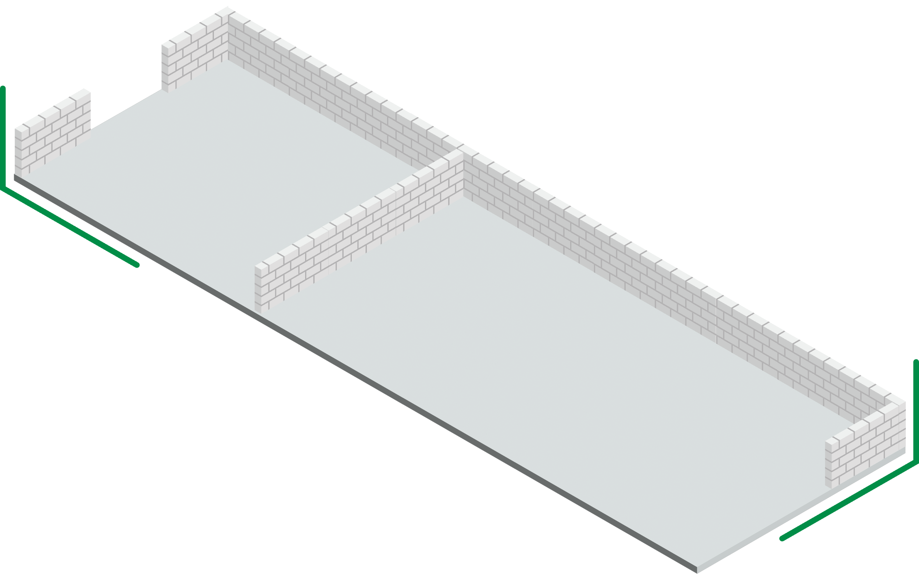
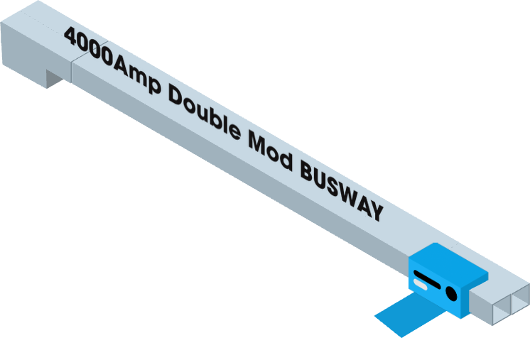
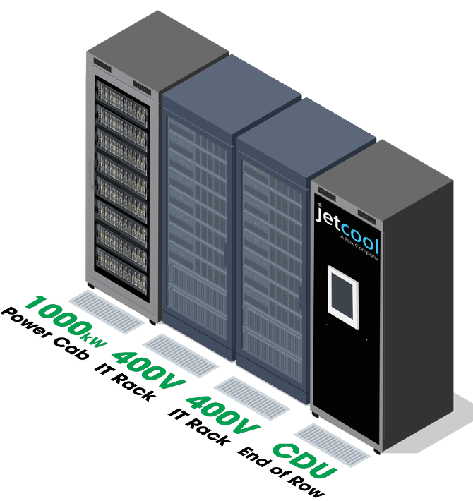

Future consolidated IT power [ 2027 ]
Electrical Room
20%
Improvement in efficiency
$240k
Annual energy savings per rack
80%
Reduction in IT floor space
Liquid Cooled
Data Hall
4000 Amp
DOUBLE MOD BUSWAY
MV Switch
Transformer
Low Voltage
Switchgear
AC
800VDC
UP
TO
32 Sq. Ft
USED in Data Hall
Notes:
CHRIS
In the near future, we’re looking at substantial consolidation within the data hall, mostly due to HVDC allowing for much denser compute
This is representative of bleeding edge implementations - realistically, most data centers will be a mix of AI and non-AI architectures
The walls are still there, but the groundwork has been laid for massive change

Slide 7



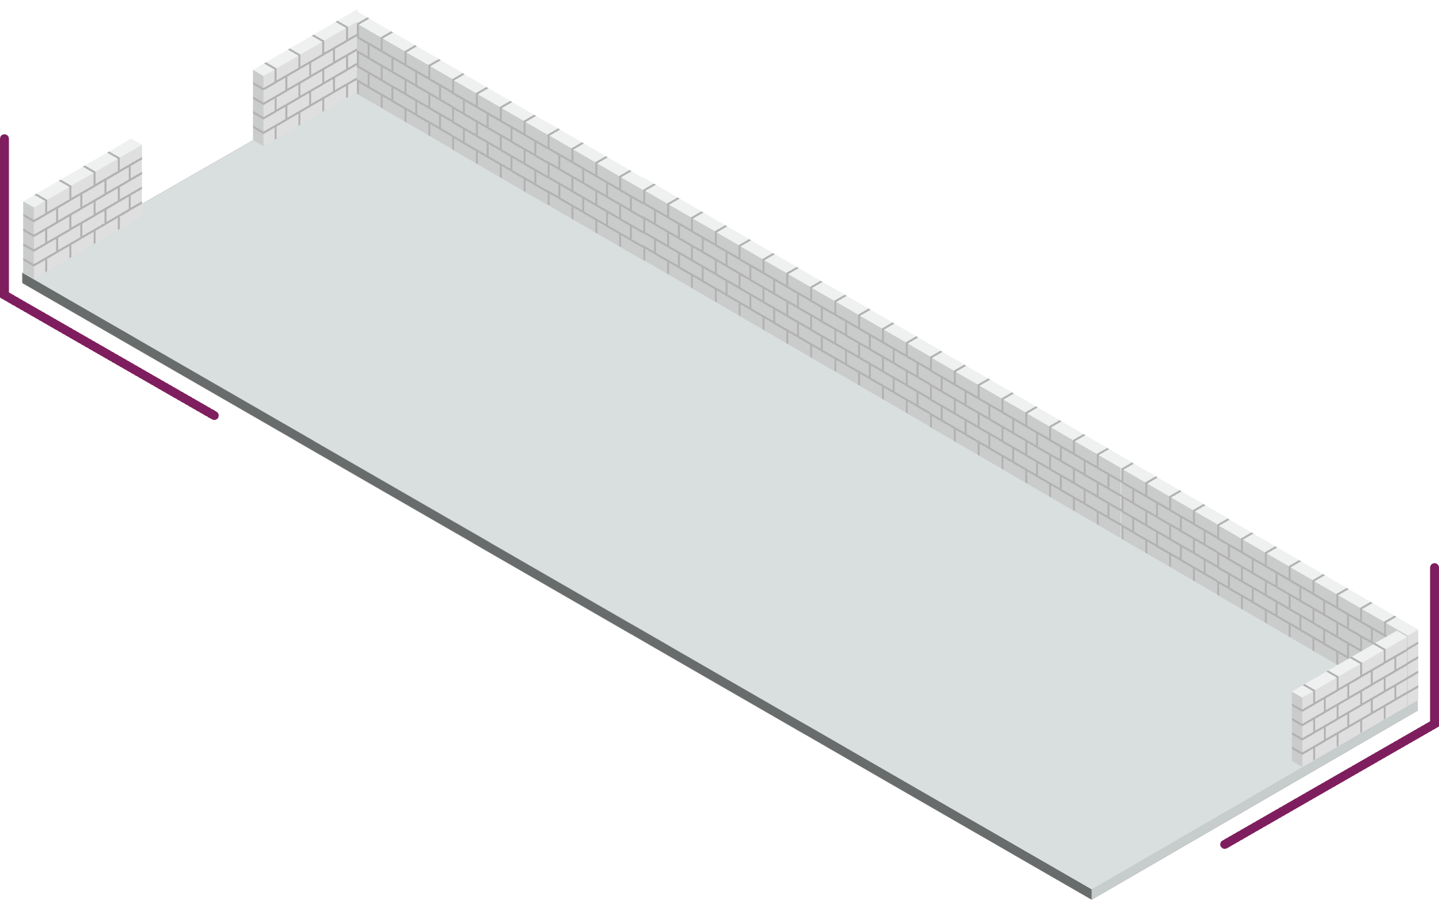
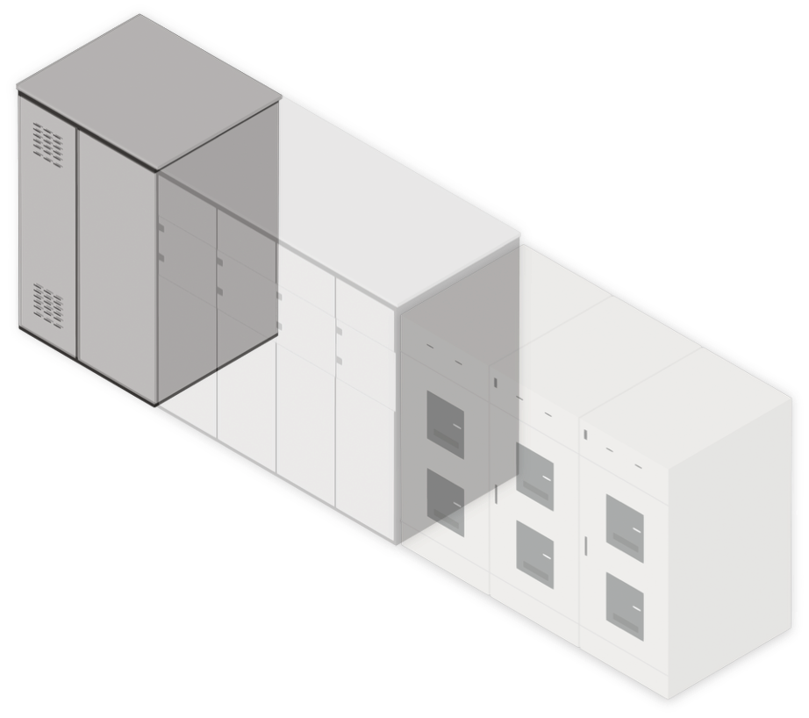
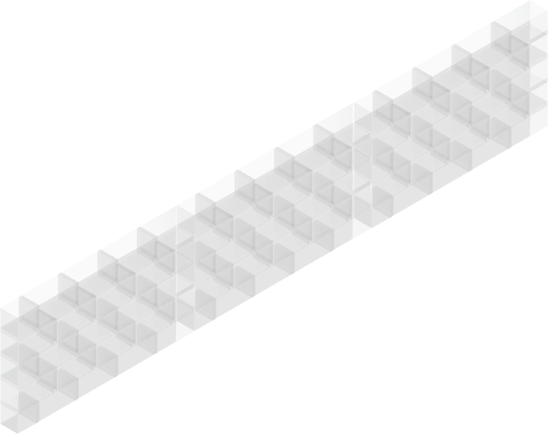


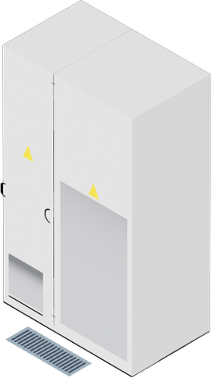
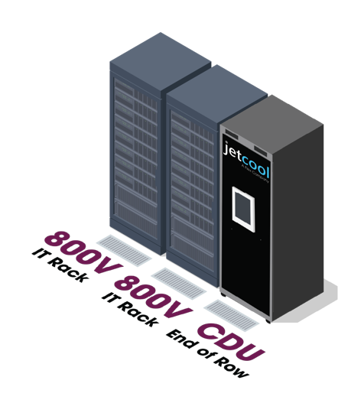

Next Gen [ 2030 ]
Electrical Room
27%+
Efficiency gain
$330k
Energy savings
per 1MW per year
90%
Space savings
– simplifies data center construction and reduces size of electrical room
Liquid Cooled
Data Hall
MV to data hall
AC
MV Switch
DC
Solid State Transformer
800VDC+
32 Sq. Ft
USED in Data Hall
Notes:
CHRIS
A little further out, those walls are crumblin’ down
With HVDC and AI compute maturing, data centers will be primed for completely new approaches to power and cooling infrastructure
This will blur the lines between white space and grey space, bringing power infrastructure into the data halls alongside compute and cooling

Slide 8

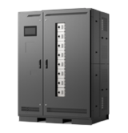
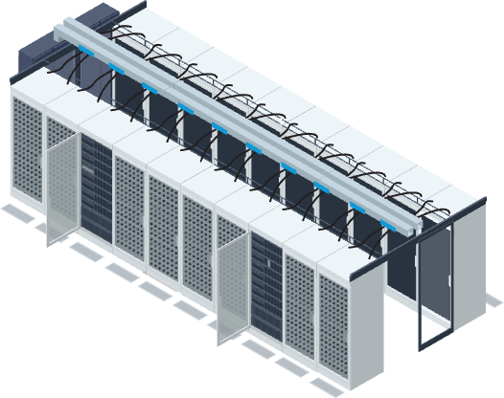
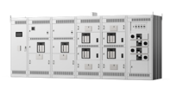
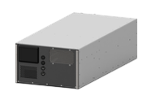

Convergence is happening in several spaces
The walls are coming down…
Power
Compute
Power
Cooling
Grey
Space
White
Space
BENEFITS
Reduce Complexity
Collaboration
Mitigate need for Skilled Labor
Standardization
Increased Efficiencies
Notes:
CHRIS
To quickly summarize, power and compute are converging, power and cooling are converging, and white space and grey space are converging
We are already proving this with our new AI Infrastructure platform – that cuts deployment time by 30% and is optimized for efficiency
These walls coming down don’t just speed up the design process, they bring benefits throughout the product lifecycle

Slide 9


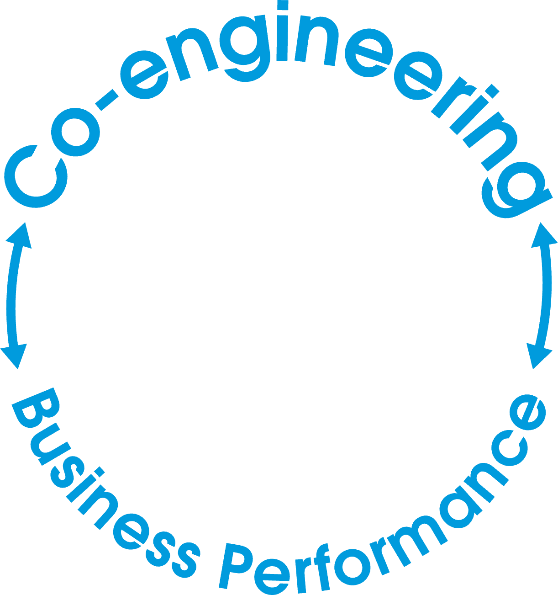



This convergence
is both an opportunity and an enabler
Industry challenges
Time-to-market and scale
Higher efficiency
Lower
operating costs
Power safety and efficiency
IT and thermal performance
Greater
resilience
Notes:
ROB
If you look at the major challenges the industry is facing today, none of them can be solved without a holistic and collaborative approach
Getting rid of those roadblocks and pinch points is amazing on its own, but it’s only half the story
This convergence will also lay the foundation for improvements in three areas all of us are chasing every single day: efficiency, cost, and resilience

Slide 10
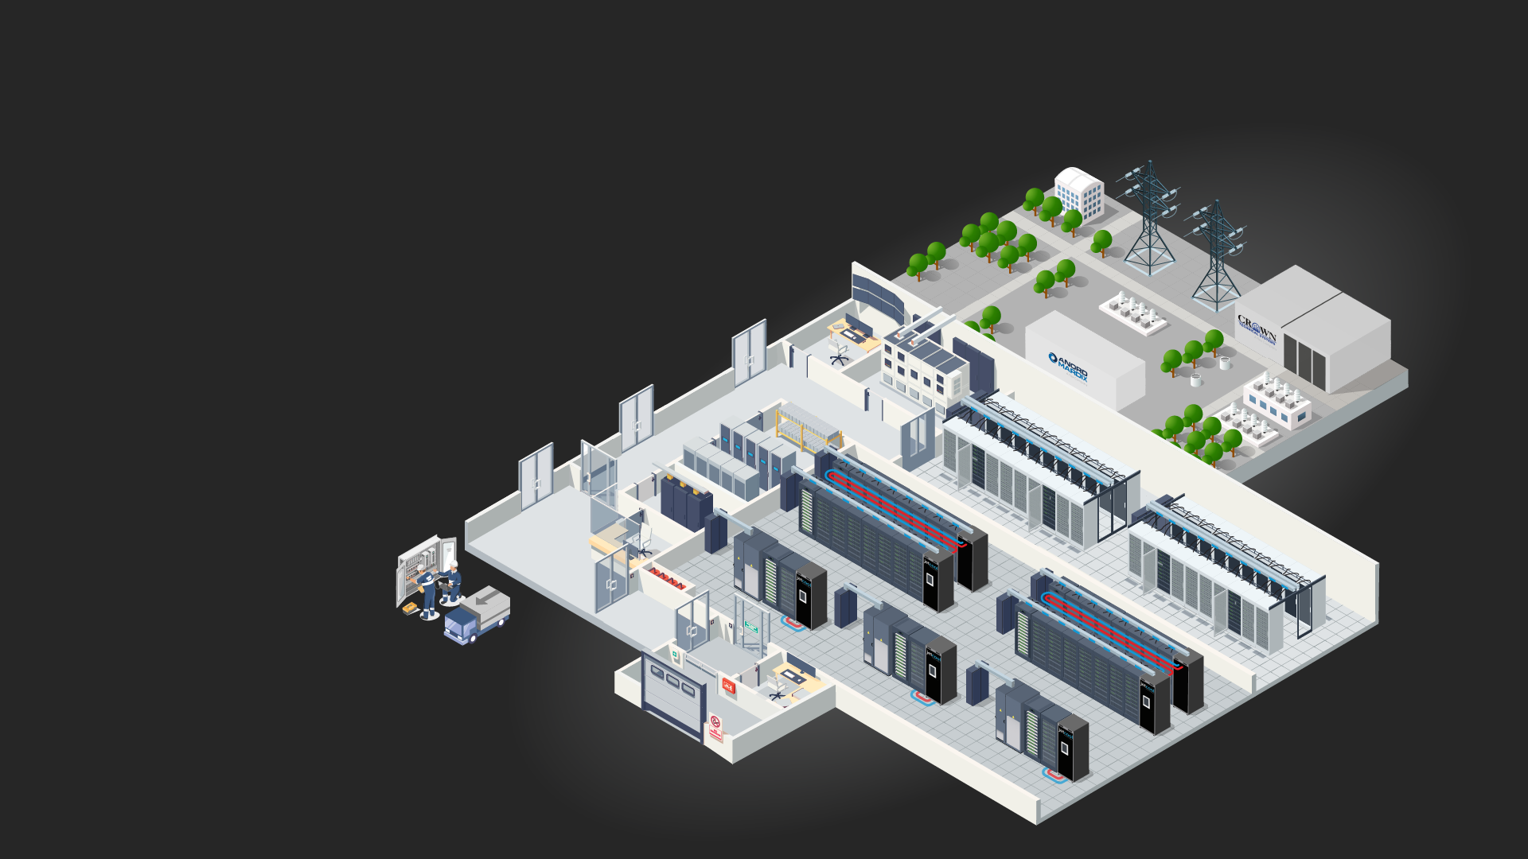
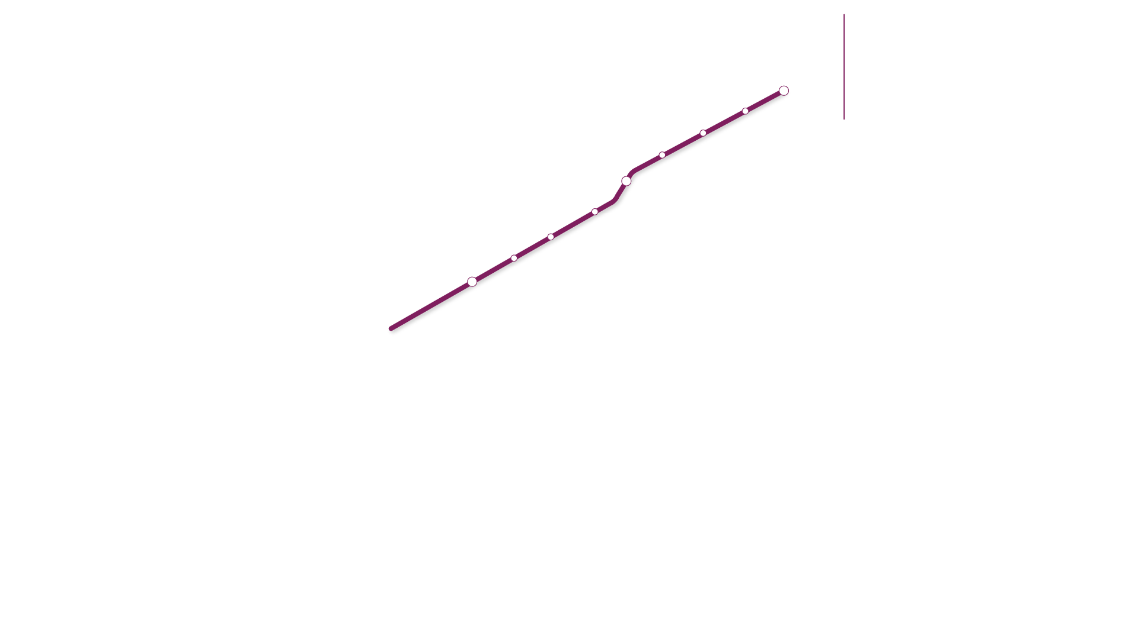
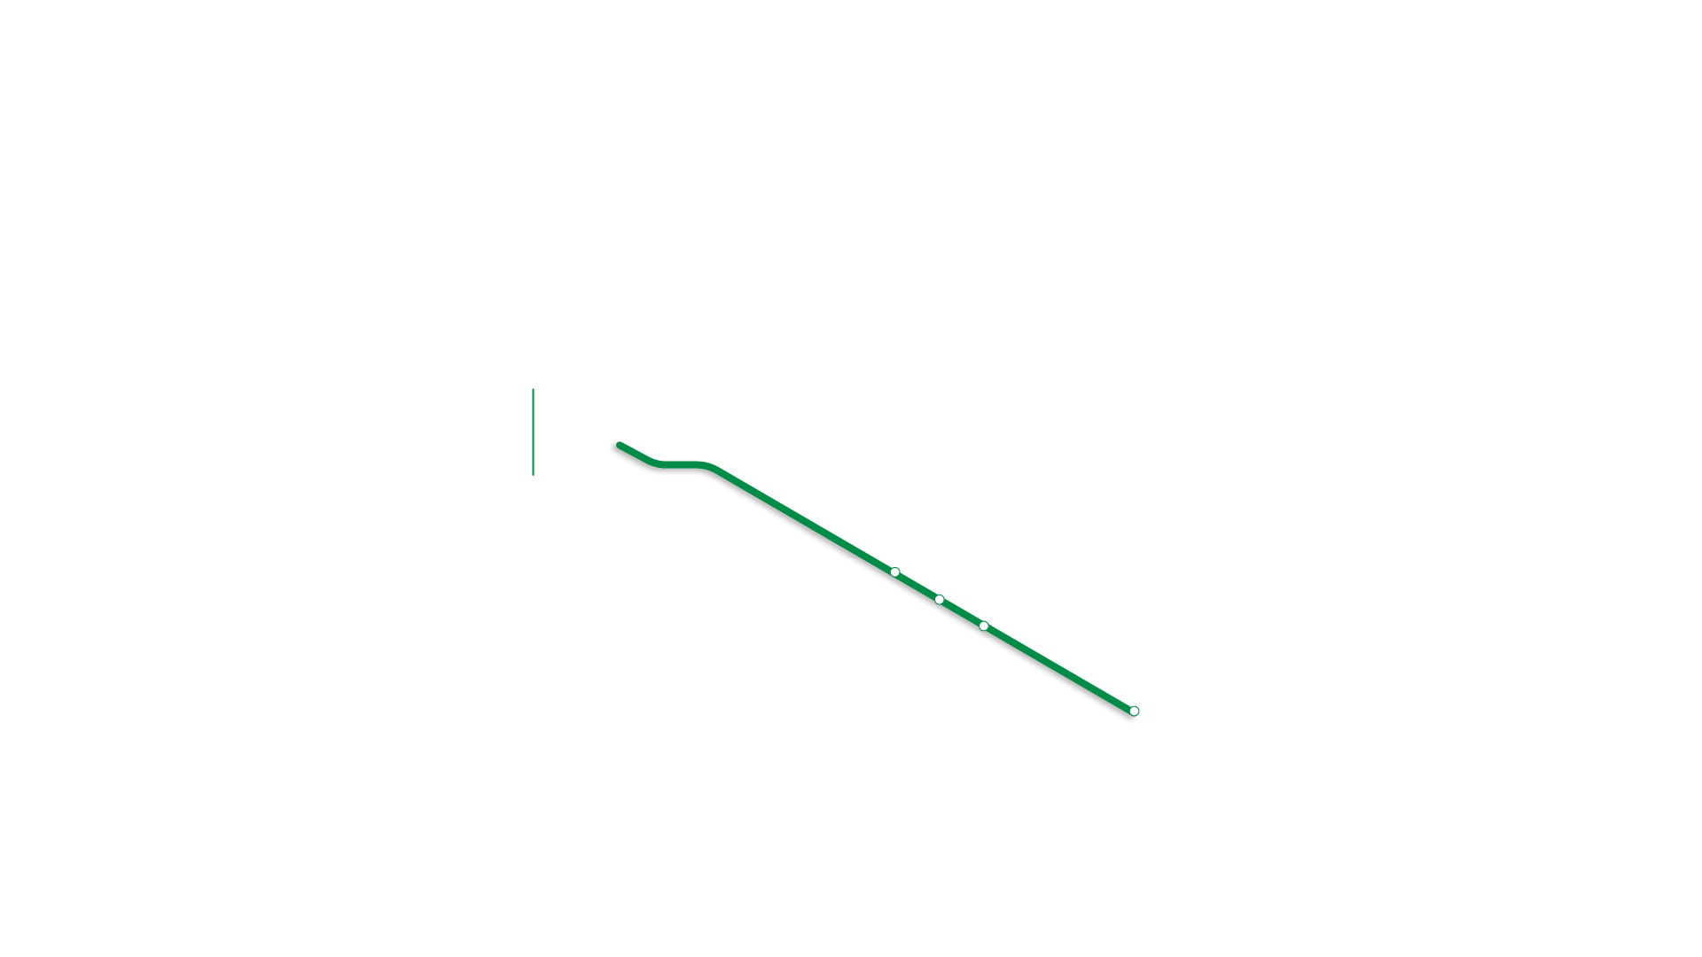
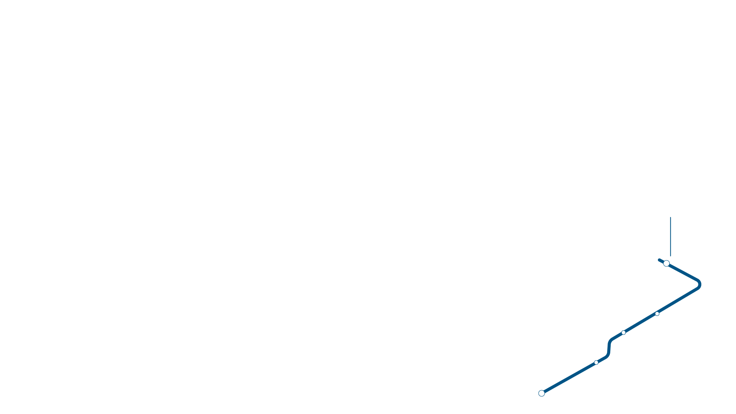


Harness Flex’s end-to-end portfolio of data center products and services

