Slide 1
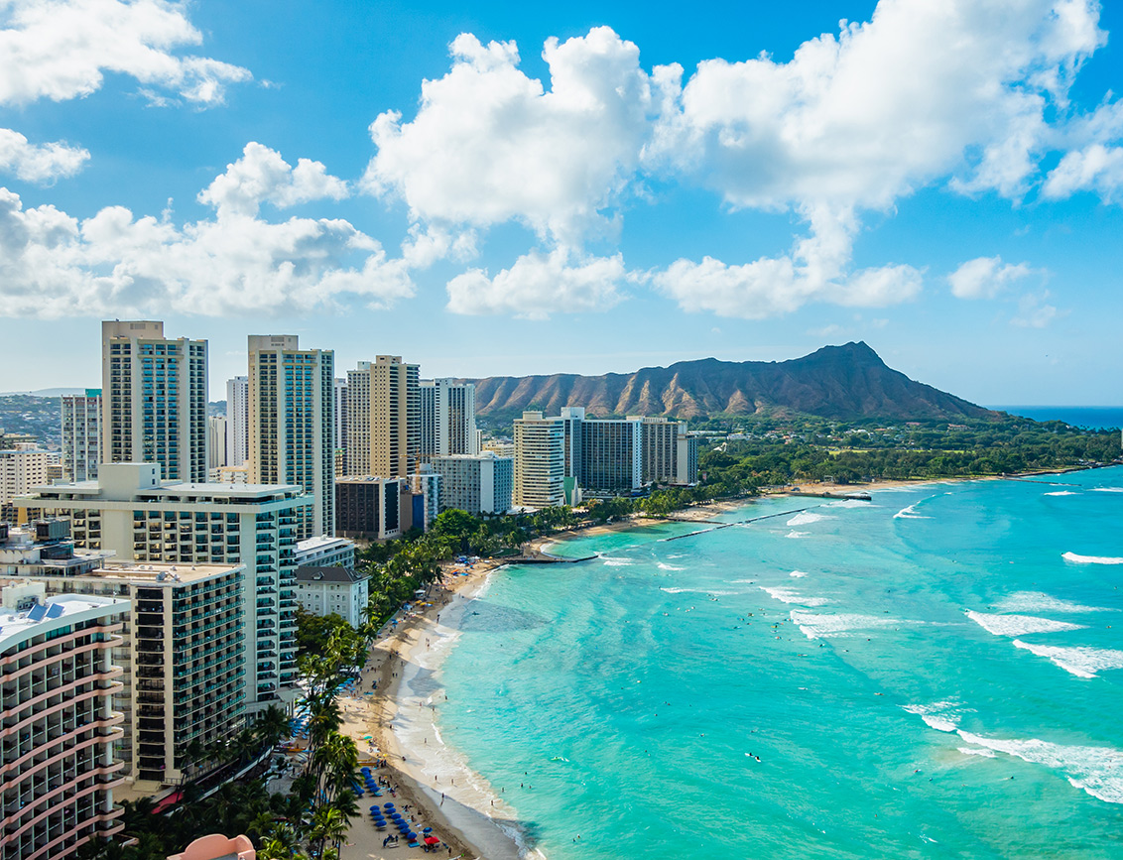


Latin America Data Centers: Market Capacity, Energy & Policy in the AI Era
January 19th, 2026

Slide 2
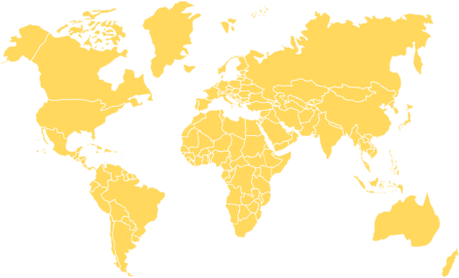







- Connecting the World
C-Connex is a company focused on strong relationships and partnerships. With a strong desire to keep innovating, we are investing heavily in our supply Chain and Operations to solve the problems and difficulties our customers and partners face in the field.
This footprint ensures redundancy, resilience, and rapid deployment capabilities for our customers
Over 25 years of experience in panel and cable manufacturing
Operations across the U.S, LATAM & Europe
Serving more than 70 customers worldwide
Proven expertise with leading Data Centers and Hyperscale's
Five global manufacturing facilities
Consistent double-digit annual growth
New offices in Ashburn (VA) & Santiago (CH)
512
Office
Ashburn
315
Factory
Japan
Office
Ciudad de Mexico
Office
Florida
Factory
Shenzhen
Factory
Taiwan
Office
Dallas + Austin
Factory
Guadalajara
Factory
Hai Phong - Vietnam
Brazil
Office
Chile
Office
São Paulo
Factory
Office

Slide 3

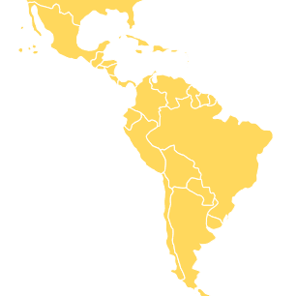
Why C-Connex chose Latin America
Hyperscale MW-Scala announcements
Multi-billion-dollar capital commitments
And governments actively competing
C-Connex launched operations in 2024 in São Paulo, Brazil — the epicenter of the LATAM market.
Key Notes
Several countries already demonstrate campus-scale development, while others remain in early ramp-up stages.
The key question today is not whether LATAM will grow - but where capacity will concentrate first.

Slide 4




Brazil: The regional anchor and its advantages
Energy at Scale: Clean & Abundant
REDATA: Brazil’s public policy for Data Center Incentive Framework
In late 2025, Brazil introduced REData — a special tax regime for data centers designed to unlock up to $500 billion in private investment over the next decade.
In practice
Reduces taxes on DC equipment and services
Import duty relief Where no local equivalent exists
Requires 2% reinvestment into Brazilian R&D
Requires 10% capacity reserved for domestic usage
Mandates clean energy & water efficiently
In summary: It improves Project economics exactly when MW deployment is accelerating
Hydropower accounts for 56%
Wind represents approximately 14%
Solar contributes Around 9%
Biomass das roughly 8%
Renewable sources represent 88% of total energy generation

Slide 5

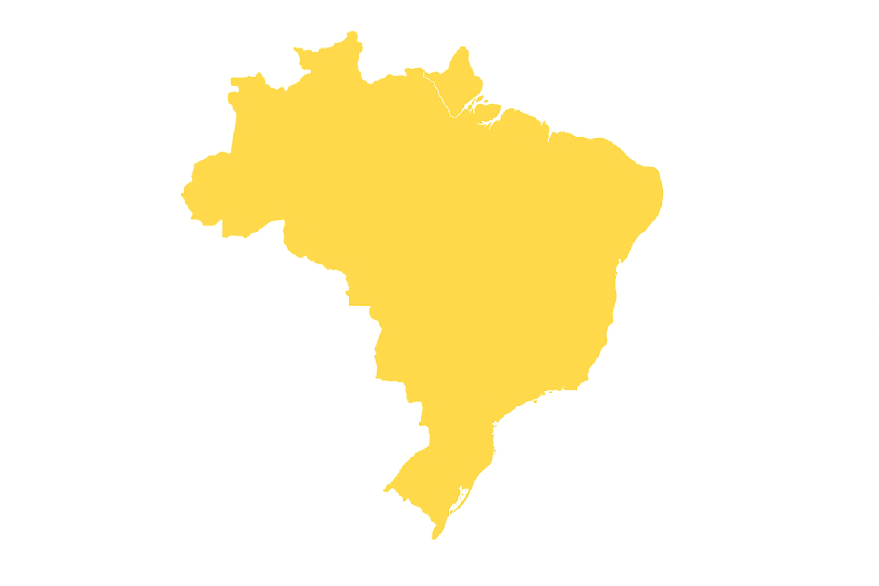

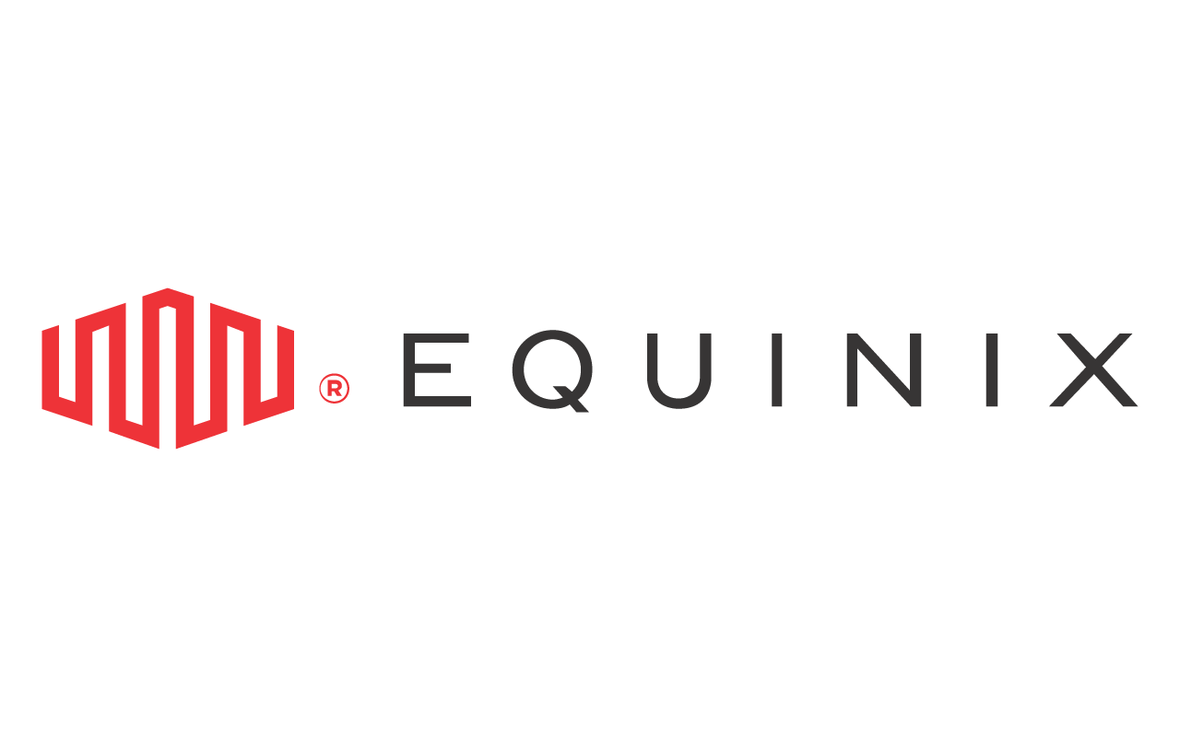




Brazil: Recent Key Players developments
450MW IT campus in São Paulo and a 3GW AI City project in Rio Grande do Sul
Biggest Latam player Is set to invest USD60M in São Paulo + USD 1.5B in Chile.
Expansion of eight existing facilities
C-Connex has its office & storage located at Barueri, metropolitan region of São Paulo city (in São Paulo state). From this location, we can store and deliver at cutting-edge solutions at record speed
Over $450 million in new investments
Office & Storage
São Paulo
AI City project in Rio with 1.5GW IT capacity
$40 billion investment planned in Ceará
200MW hyperscale capacity in São Paulo

Slide 6
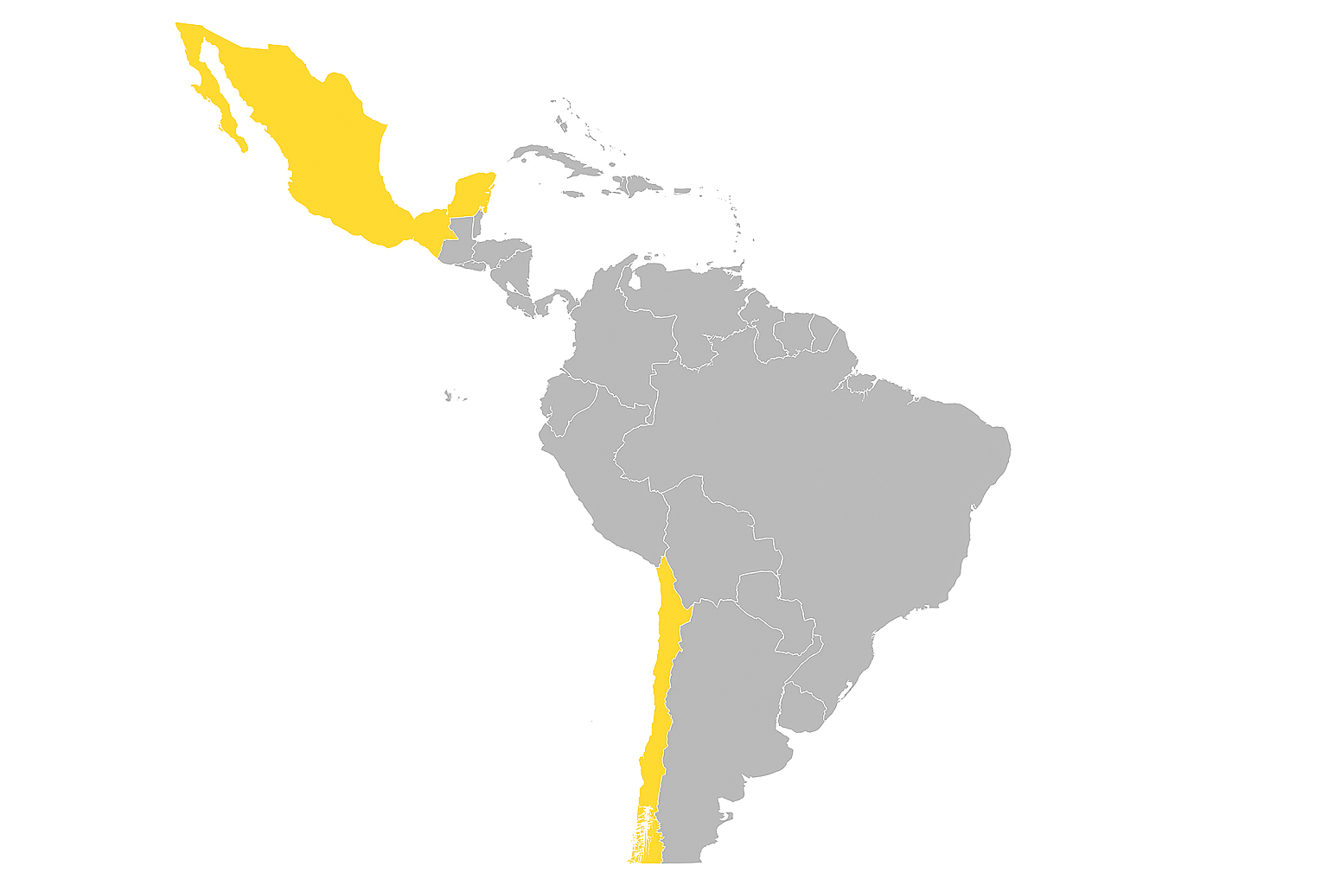


Mexico & Chile
C-Connex hold offices in both countries to meet local demands and stablish local partnerships
Mexico
It currently holds the largest single-country MW announcements in LATAM
CloudHQ: USD 4.8B for approx. 900MW in Querétaro
ODATA: Disclosed approx. 300MT IT capacity at its Querétaro campus – with about 200MW already energized
However, its constraint is grid readiness and transmission capacity
Chile
Chile offers strategic connectivity between LATAM and Asia & Australia
AWS committed USD 4 billion for a new region by 2026

Slide 7




Other countries
Argentina
Reported ~500 MW / US$25B concept — very high upside, higher variance
Colombia
Reported ~500 MW / US$25B concept — very high upside, higher variance
Each of these countries plays a specific strategic role in C-Connex portifolio
Peru
Projected ~50+ MW market growth by 2029 — early expansion phase
Uruguay
Google announced US$850M, signaling hyperscale credibility
Panama: Interconnection & cable geometry

Slide 8
C-Connex strategy for LATAM
Our Future & Key Takeaways
C-Connex knows Latin America Is Building the AI Substrate
Hundreds of MW being announced
Billions of dollars in capital deployed
Alignment between energy, policy and infrastructure
The global data center map is being redrawn —
and Latin America is now a first-order chapter.
C-Connex is doubling investment each year and is prepared to meet our customer’s demand, aligned with with country’s potential.
Brazil for energy and policy depth; Mexico for scale; Chile and Colombia for execution certainty; Uruguay and Panama for resilience; Argentina for upside potential.

Slide 9
Thank you for your attention
January 18th, 2026

