Slide 1
From Subsea to Satellite 2026
Introduction to Submarine Cables and Satellite Communications
Tony Mosley

Slide 2
Let’s Begin in the Ocean
Submarine Cables

Slide 3
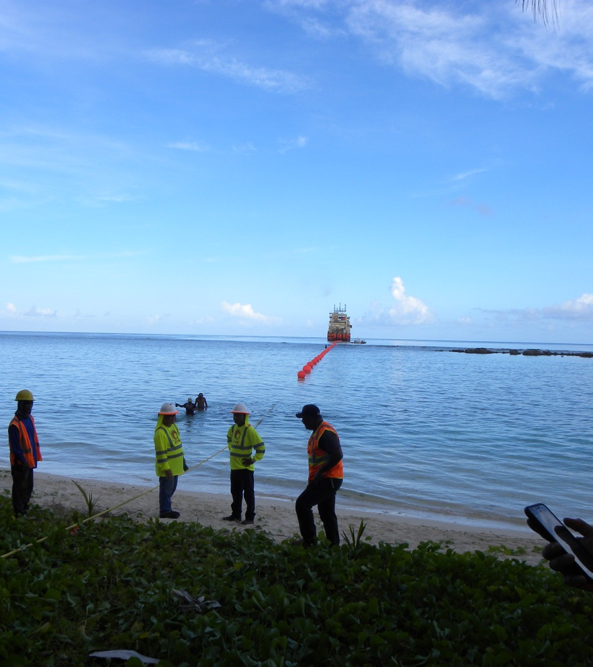
:60 mins
Submarine Cable History
Submarine Cable Equipment Evolution
Review the subsea and satellite ecosystems.
Discuss the birth of the Satellite Industry
Understand complimentary Subsea and Satellite networks.
Overview of the dynamics of coverage and price.
Future Trends in Subsea and Satellite.

Slide 4
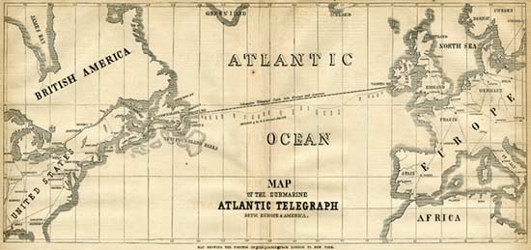
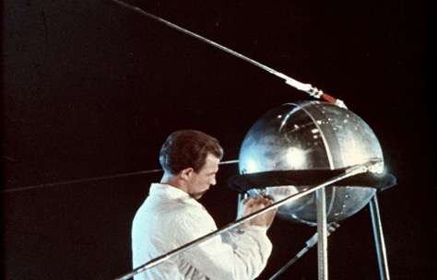
Key Takeaways
The key takeaway from this course:
Submarine cables power the unseen Internet infrastructure on the seabed.
Satellites have the capability to provide broadband services nearly anywhere on earth.
Map of the 1858 Atlantic Cable route from
Frank Leslie's Illustrated Newspaper, August 21, 1858

Slide 5
Communications Starters
Before we begin, it’s important to point out that 99.5% of all intercontinental global data traffic is carried on Submarine Cables.
The remaining .5% is Satellite.
Although there is a large disparity in the amounts of data traffic, these two services are complimentary and vital to serving the global community of nations.

Slide 6
73.4%

Slide 7

All of Humanity
We have some work to do to provide service to the unconnected! As broadband is now considered a human right.
6 Billion People Connected
8.2 Billion People
World Demographics
ITU

Slide 8
Some Submarine Cable Facts
Roughly 576 Submarine Cables
1.5 million kms of cable on the Ocean Floor
As deep as Marianas Trench over 11,000 kms. (36,089 ft.)
Carry over 18 trillion US dollars in economic transactions every day
Submarine cables are roughly the same circumference as a garden hose.
The longest submarine cable is 45kms (2Africa)

Slide 9
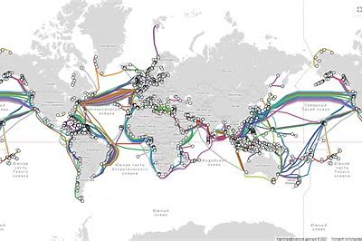
World Cable Map
Telegeography 2025

Slide 10
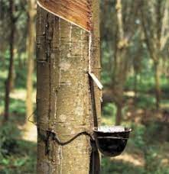
The History of Submarine Cables
1840: Telegraph cables start to be laid across rivers and harbors, but initially had a limited life
1843-1845: Gutta-percha (a type of gum found in a Malaysian tree) was brought to Britain and starts to replace other materials that were used for electrical insulation, thus extending the life of the cable (India rubber)
1850: 1st international telegraph cable laid between UK and France, followed by a stronger cable in 1851
1858: 1st transatlantic cable laid between Ireland and Newfoundland by Great Eastern. This failed after only 26 days and another was laid in 1866

Slide 11
The History II
1884: 1st underwater telephone cable - San Francisco to Oakland
1920s: Short-wave radio superseded cables for voice and telex traffic, but capacity limited and affected by atmosphere
1956: Invention of repeaters (1940s) and their use in TAT-1, the first transatlantic telephone cable, began an era of rapid and reliable transoceanic communications
1961: Beginning of a high-quality global network
1986: 1st international fiber-optic cable connects Belgium to the UK
1988: TAT-8, the 1st transoceanic fiber-optic cable system, connects the USA to the UK and France (satellite was superior)

Slide 12
Older versus New Cable Systems
1866: 1st transatlantic cable carried telegraph messages at seven words a minute and cost £20 for 20 words = 2025 money £ 3045
1948: Telegram cost reduced to 4 pence a word for transmission across the Atlantic 2025 money £ 6.05
1956: 1st transatlantic telephone cable (TAT-1) initially had capacity of 36 telephone calls at a time. Each call cost US$12 for the first 3 minutes
Modern Cable Systems:
1988: 1st transatlantic fibre-optic cable, TAT-8, carried 40,000 simultaneous phone calls, 10 times that of the last copper-based telephone cable
Today, a single cable can carry millions of telephone calls, together with huge amounts video and internet data 24 FP MEDUSA 480 Tbps
Telecom Pricing Story!!
www.iscpc.org

Slide 13
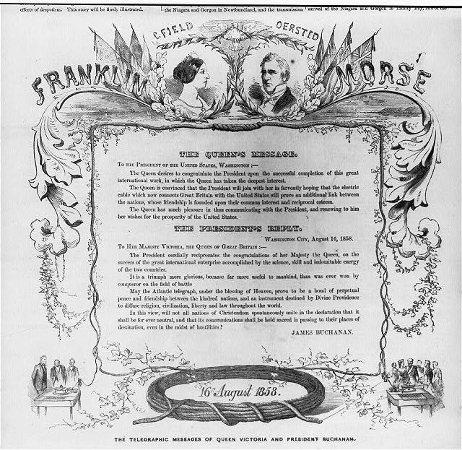

Slide 14
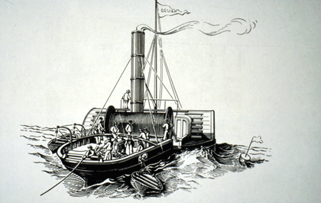
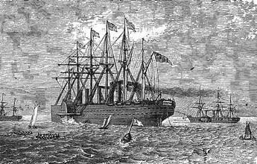
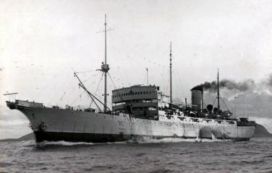
Early Cable Ships
Goliath: lays 1st international cable, UK-France, 1850-1
Source: Illustrated London News
Great Eastern: laying cable off Newfoundland, 1866
Source: Canadian Government
Monarch: laid 1st transatlantic telephone cable, 1955/6
John Pender, named after pioneer cable maker, 1900
Source: Cable & Wireless
Source: www.atlantic-cable.com
www.iscpc.org

Slide 15
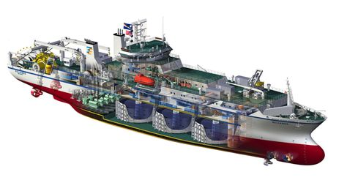
Cable Ship Compartment View (current day)
C.S. Dependable

Slide 16
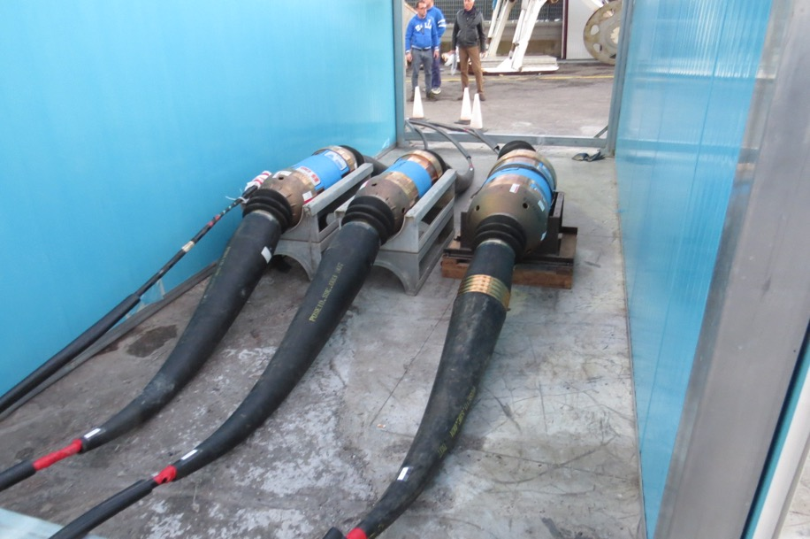
Copper Telegraph to Fiber
Fiber-optic submarine cables rely on a property of pure glass fiber whereby light is guided by internal reflection
Because the light signal loses strength repeaters are required at regular intervals to restore it
Repeaters are now based on optical amplifying technology, which requires short lengths of erbium-doped optical fiber to be spliced into the cable system.
These are then energized by lasers that cause them to ‘lase’, thus boosting the incoming light signal

Slide 17
How Submarine Cables Work
Fiber-optic submarine cables rely on a property of pure glass fibres whereby light is guided by internal reflection
Because the light signal loses strength en route, repeaters are required at regular intervals 65-100km to restore it
Repeaters are now based on optical amplifying technology, which requires short lengths of erbium-doped optical fibre to be spliced into the cable system. Doping energized by lasers that causes them to ‘lase’, thus boosting the incoming light signal
www.iscpc.org

Slide 18
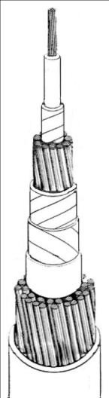
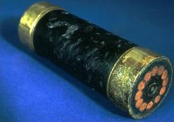
Submarine Cable – Telegraph Era
conductor - usually copper
insulation - gutta percha resin cushioning - jute yarn
inner protection - wire armour
jute wrap to contain wire
Atlantic cable 1866
Source: Porthcurno Telegraph Museum
outer protection - wire armour
jute wrap to contain armour
www.iscpc.org

Slide 19
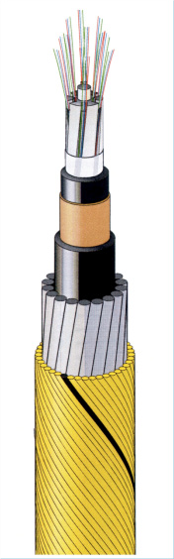
Modern Submarine Cable
optical fibres - silica glass
core for strength and fibre separation - polyethylene/fibreglass jacket - polyethylene
conductor - copper jacket - polyethylene
protective armour - steel wire
outer protection and wire containment - polypropylene yarn
 Construction varies with manufacturer and seabed conditions
 Cables may have no armour in stable, deep-ocean sites or one or more armour layers for energetic zones, e.g. coastal seas
Source: Ericsson
www.iscpc.org

Slide 20
Typical Fiberoptic Submarine Cable
Modern Day Fiber Cables subsea fiber cables can carry 32 FP

Slide 21
Typical Fiberoptic Submarine Repeater

Slide 22
Typical Phase Approach To Building A Cable System
PLANNING
PROJECT DEVELOPMENT
CONSTRUCTION
OPERATIONS
Proceed with Procurement
Commit Funds
Provisional Acceptance
Financial C&MA Close
Contract Negotiation
Permitting & Regulatory Approval
Route Survey
Program Management, Supplier Oversight & Contract Management
Wet & Dry Plant Manufacture
Landing Party Prep, Station Fronthaul, Backhaul Readiness
System Installation Oversight
Test, Commission & Acceptance
Develop Technical & Commercial Requirements
Issue RFP
Adjudicate Bid, BAFO and select Vendor
Develop C&MA, Partnership Agreements & Pre-sales
Landing Access & Backhaul
Issue ITP
Desk Top Study
O&M Contracts
Establish NOC
Backhaul Agreements
Onward Capacity Procurement
Pre-Sales & Sales
Network Readiness Test
Provisioning
Customer Support
Operations, Maintenance & Restoration
Upgrades
Demand, Market & Revenue Analysis
System Design and Cost Analysis
Feasibility Study
Configuration Review
Landing Party and Partner MOU
Seed Financing
Business Model
4-6 Months
6-12 Months
Ongoing
12-30 Months

Slide 23
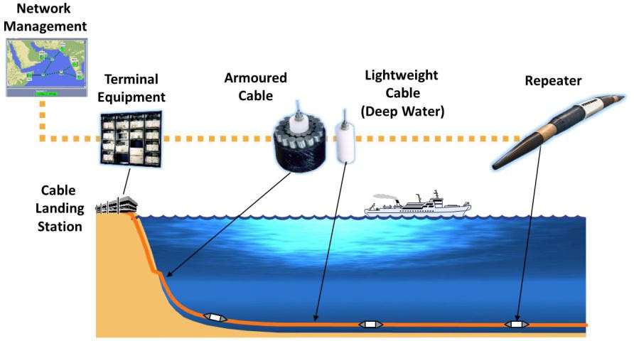
Typical Submarine Cable System Setup

Slide 24
Installing a Submarine Cable
Installing a submarine cable typically involves:
Selection of provisional route (feasibility study and DTS)
Obtaining permission from the relevant authorities
Full survey of route and its final selection
Design cable system to meet conditions of selected route
Laying the cable, including burial in appropriate areas
In some cases, a post-lay inspection may be necessary
Notification of cable position to other marine users
www.iscpc.org

Slide 25
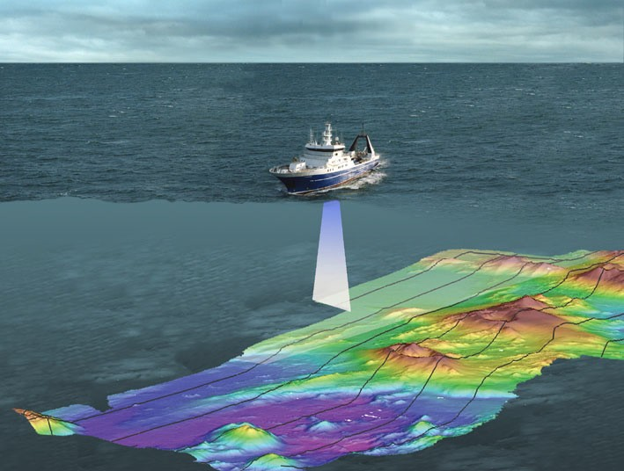
Cable Route Survey
Cable routes are carefully surveyed and selected to minimize environmental impacts and maximize cable protection
Seabed mapping systems accurately chart depth, topography, slope angles and seabed type
Source: NIWA
www.iscpc.org

Slide 26
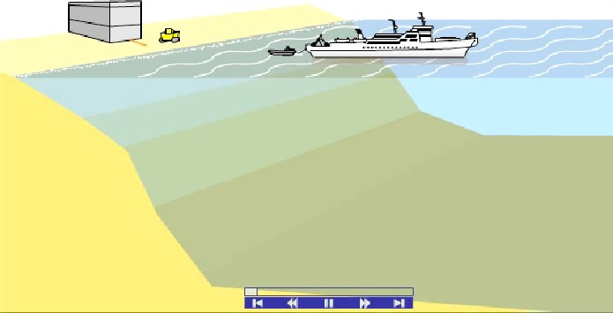
Cable Laying
Guided by the route survey, specially designed ships are used to accurately place cables on or beneath the seabed
Shallow water laying may be aided by divers ; Deep water laying may involve remotely operated vehicles
Source: Alcatel-Lucent Submarine Networks
www.iscpc.org

Slide 27
Cable System Configurations
Festoon
TM
TM
TM
TM
TM
TM
TM
TM
TM
TM
BU
TM
Mesh
TM
Point to
Point
Mesh
Point to
Point
BU
TM
TM
TM
TM
TM
TM
TM
TM
TM
TM
Trunk and Branch

Slide 28
Cable System Configurations- 2
TM
TM
TM
Ring
Collapsed
ring
TM
TM
TM
TM

Slide 29
Annual Cable Faults
2025- 206 Cable Faults
Mostly Shallow water -84%
External Aggression
  Fishing and Anchoring
  An outage every 2-3 days for 560 submarine cables that carry 99.5% of all interregional data traffic.
ICPC.org

Slide 30
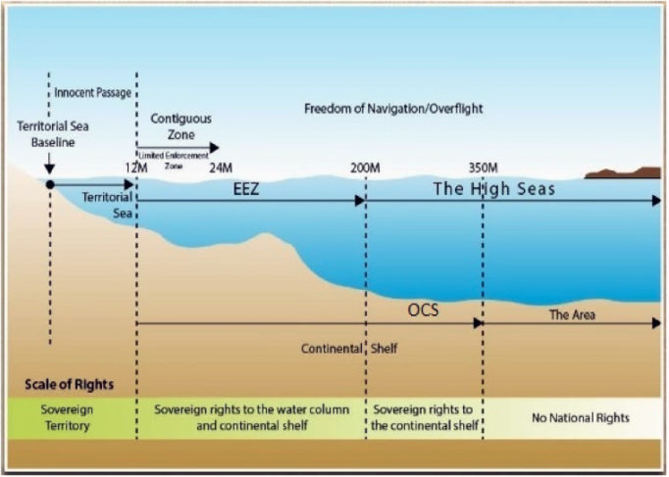
Submarine Cables and the Law
UNCLOS

Slide 31
On to the Sky
Satellite Communications

Slide 32
Topic in the Satellite Module
Birth of Satellite Communications
The Basics
Satellite Orbits
Orbital Positions and Radio Interference
Services
Satellite Lifecycle Management
Technology Trends

Slide 33
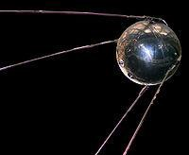
Birth of Satellite Communications
First satellite was launched in 1957 by Russia. It was named “Sputnik 1”

Slide 34
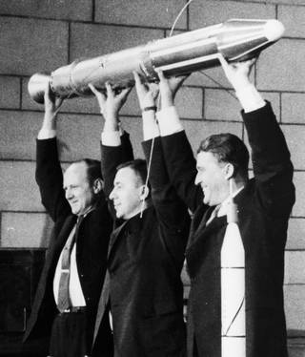
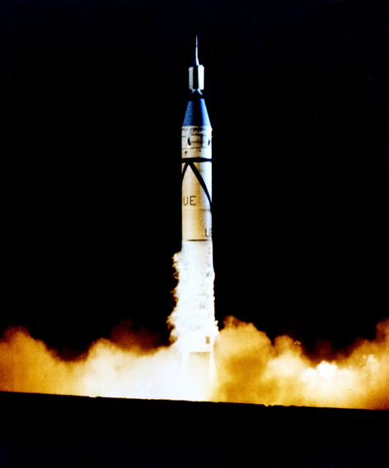
The Space Race –US and USSR
The Explorer 1958

Slide 35
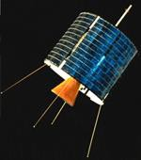
Birth of Satellite Communications
INTELSAT I (nicknamed Early Bird for the proverb "The early bird catches the worm") was the first (commercial) communications satellite to be placed in geosynchronous orbit, on April 6, 1965.

Slide 36
The Basics
A satellite communications (satcom) system maybe looked at as comprising of three parts “space segment”, the “ground segment” and the transmission medium ( the space between the Earth and the satellite)

Slide 37
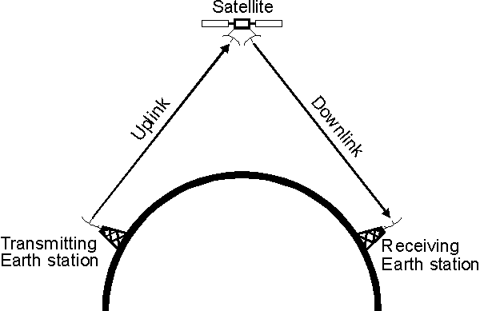
Satellite Communications Basics
A communications satellite acts as a repeater

Slide 38
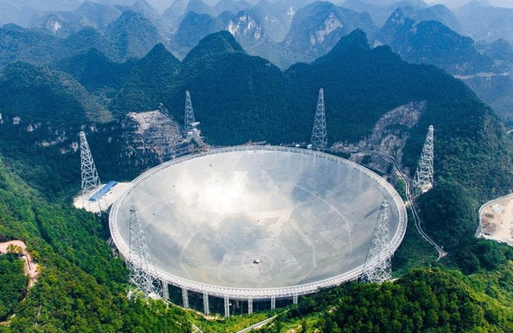
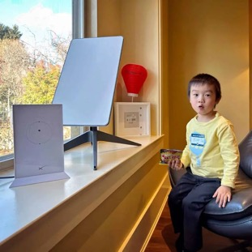
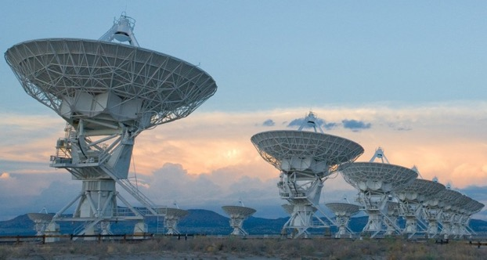
Dish Sizes

Slide 39
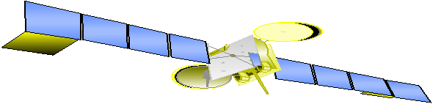










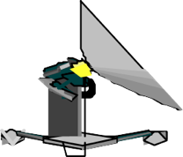




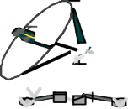




_{Communication Links}
Uplink
Uplink - The transmission of signals to the satellite

Slide 40
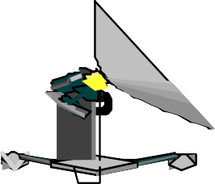
_{Communications Links}
Downlinks
Downlink - The transmission of information from the satellite. Many Earth Stations can be covered by one satellite beam footprint

Slide 41



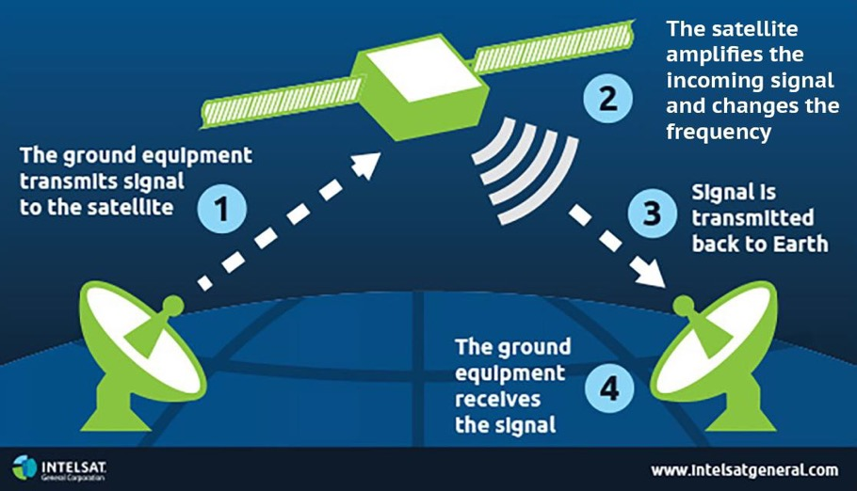
Basics: Key Satellite Network Elements
Space Segment
─ Satellites in geostationary orbit or non-geostationary orbit (medium earth orbit, or low earth orbit)
Ground Segment
─ Telemetry, Tracking, and Control (TT&C): used to “fly” the satellite
─ Gateway/Hub: used to manage communications
─ User Terminals: devices used to connect the customer to the satellite network
  Can be receive-only or transmit; mobile or fixed; a dish, a laptop, or a handheld, depending on the application, site, etc.
4

Slide 42
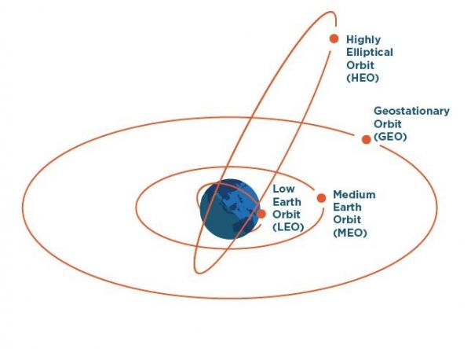
Satellite Orbits
Commonly Used Orbits
  Geostationary Orbit (GSO)
  Non-Geostationary Orbit (NGSO)
    Low-Earth Orbit (LEO)
    Medium-Earth Orbit (MEO)
    Highly-Elliptical Orbit (HEO)

Slide 43
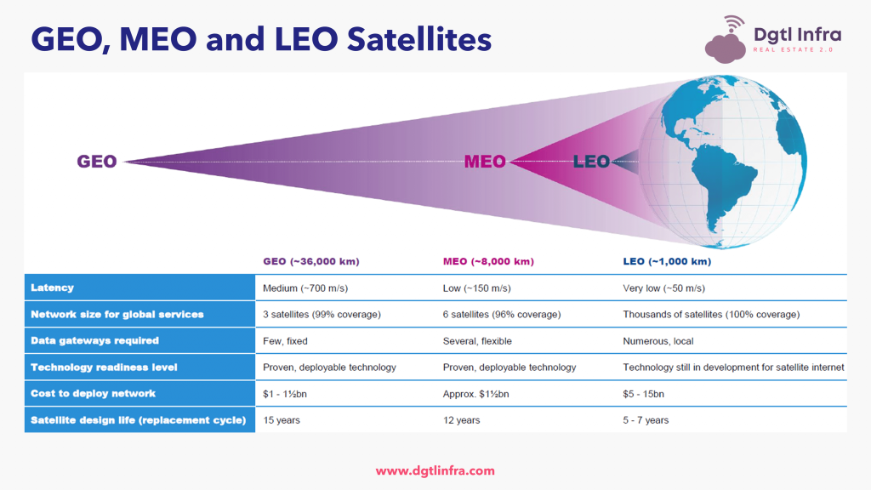

Slide 44
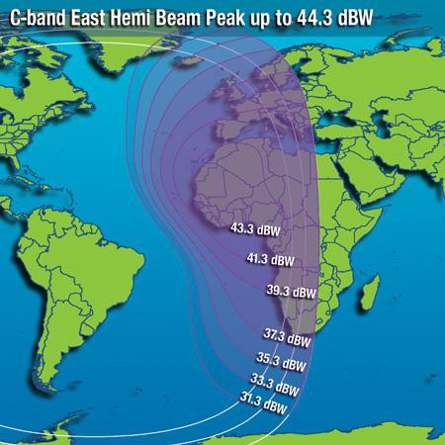
_{Communications Links}
A satellite beam “footprint”

Slide 45
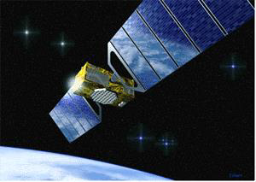
_{Satellite Communications}
Communications satellites may be used for many applications:
relaying telephone calls
providing communications to remote areas of the Earth,
TV direct-to-user broadcasting
providing communications to ships, aircraft and other mobile vehicles
etc .

Slide 46
Satellite Communications Benefits
Benefits of Satellites
Adaptable to customer requirements
Mobility
Cost advantage
Not affected by geographical obstructions
Quick implementation
Alternate routing or redundancy
Cost is independent of distance
Cost effective for short term requirements

Slide 47
Satelite Services
GPS/Navigation
Position Location
Timing
Search and Rescue
Mapping
Fleet Management
Security & Database Access
Emergency Services
Remote Sensing
Pipeline Monitoring
Infrastructure Planning
Forest Fire Prevention
Urban Planning
Flood and Storm watches
Air Pollution Management
Geo-spatial Services
Voice/Video/Data Communications
Rural Telephony
News Gathering/Distribution
Internet Trunking
Corporate VSAT Networks
Tele-Medicine
Distance-Learning
Mobile Telephony
Videoconferencing
Business Television
Broadcast and Cable Relay
VOIP & Multi-media over IP
Direct-To-Consumer
Broadband IP
DTH/DBS Television
Digital Audio Radio
Interactive Entertainment & Games
Video & Data to handhelds
The Commercial Satellite Industry

Slide 48
Technology trends
Market trends for capacity
Continues to grow despite fibre deployment
Potential shortage of capacity in some areas due to heavy cutbacks in launches
Bandwidth is ever increasing on a per link basis

Slide 49
Technology trends
User demands
Smaller terminals
High throughput
Enhanced capability
Constellations
Responsive space
Lower costs - $1000 now and lower! – STARLINK
Easier access to space segment
Easier licensing regimes
Open standards

Slide 50
Submarine Cables and Satellites
Advantages of cables
 High reliability, capacity and security
 Insignificant delay compared to satellite
 Most cost-effective on major routes, hence rates cheaper than satellites
Carry >95% of transoceanic voice and data traffic
Advantages of satellites
 Suitable for regions that are vulnerable to disasters
 Provide wide broadcast coverage, e.g. for TV
 Suitable for minor routes such as links between small island nations
Carry <5% of transoceanic voice and data traffic
www.iscpc.org

Slide 51
Best Websites for further Background
Satellites
Satellite Explorer
https://geoxc-apps.bd.esri.com/space/satellite-explorer/
Chopstick Catch
https://www.youtube.com/watch?v=b28zbsnk-48
Satellite History – No Heavenly Bodies MIT Press
https://direct.mit.edu/books/oa-monograph/5696/No-Heavenly-BodiesA-History-of-Satellite
Space Junk Article
https://arstechnica.com/space/2025/10/everyone-but-china-has-pretty-much-stopped-littering-in-low-earth-orbit/
Submarine Cables
International Cable Protection Committee
www.icpc.org
CNBC Internet Cable Overview
https://www.cnbc.com/amp/2025/11/08/big-tech-ai-underwater-cables.html
Submarine Cable Global Security Review
https://www.youtube.com/live/I2bRzYWHZj4?t=1894s CSIS Resilience Redundancy and Submarine Cables
International Telecommunications Union Submarine Cable International Advisory Body
https://www.itu.int/digital-resilience/submarine-cables/advisory-body/

Slide 52
Thank You and Questions!

Slide 54
Aloha! PTC is a leading non-profit membership organization dedicated to advancing global digital infrastructure, telecom, and ICT. Through collaboration, innovation, and knowledge-sharing, we help shape the future of connectivity worldwide.

