Slide 1
Sustainability – Building sustainable digital infrastructure
Bulk Infrastructure
Merete Caubet
Classification: Public

Slide 2
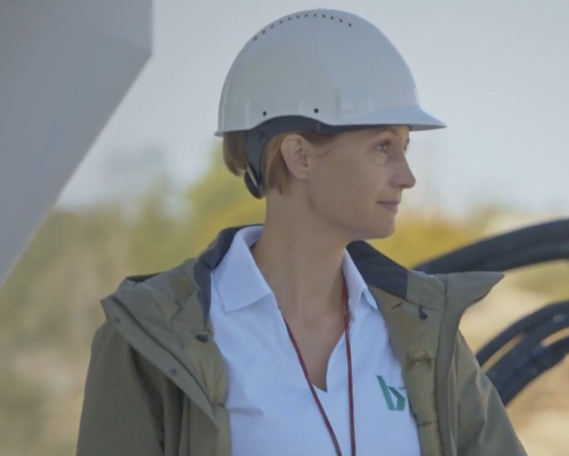
Merete Caubet
SVP Fiber Networks, BULK Infrastructure

Slide 3
Building Sustainable Digital Infrastructure
Agenda
Introduction to Bulk Infrastructure
Sustainability Framework
    Location
    Asset
    Ecosystem
    Society
Climate Budget and reporting
Finding solutions
Notes:
We define sustainability through an ESG-lens, covering environmental, social and governance factors. Bulk has developed and implemented a sustainability framework on how we work with sustainability that consists of four perspectives; Location, Asset, Ecosystem and Society

Slide 4
Building Sustainable digital infrastructure
Introduction to Bulk Infrastructure
Sustainability Framework
  Location
  Asset
  Ecosystem
  Society
Climate Budget and reporting
Finding solutions

Slide 5
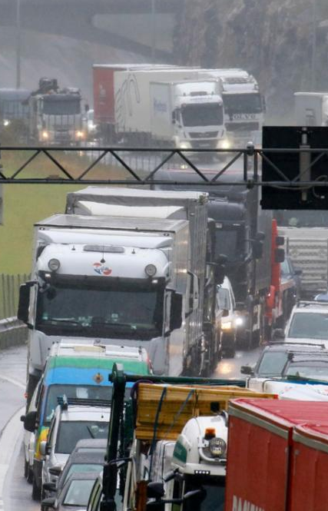

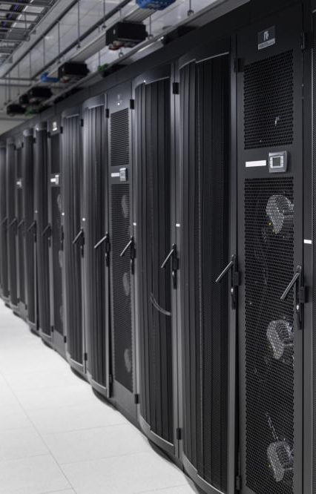
Solving a problem
Notes:
Sustainability as a business – identifying ways to make a positive impact on our environment
Our VISION:
Racing to bring sustainable infrastructure to a global audience

Slide 6
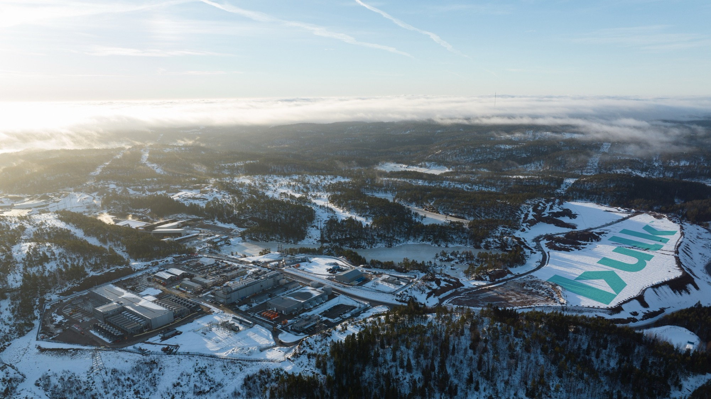





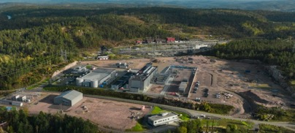
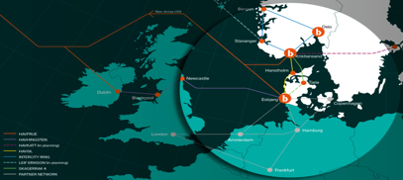
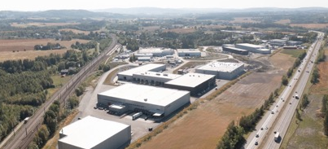
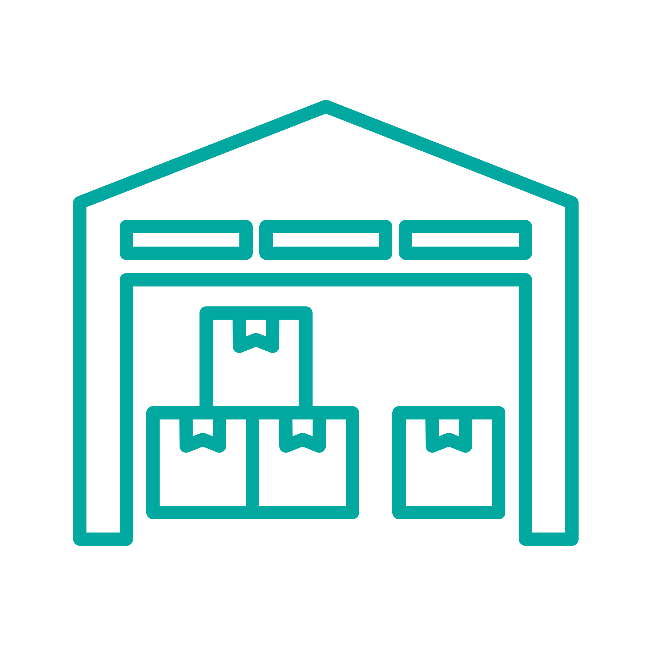




Bulk Infrastructure Group is a leading provider of sustainable infrastructure
Key investment criteria
Bulk Digital Infrastructure
Bulk Industrial Real Estate
Sustainable
Infrastructure
Scalable
Data Centers
Fiber
Logistics
Nordics

Slide 7
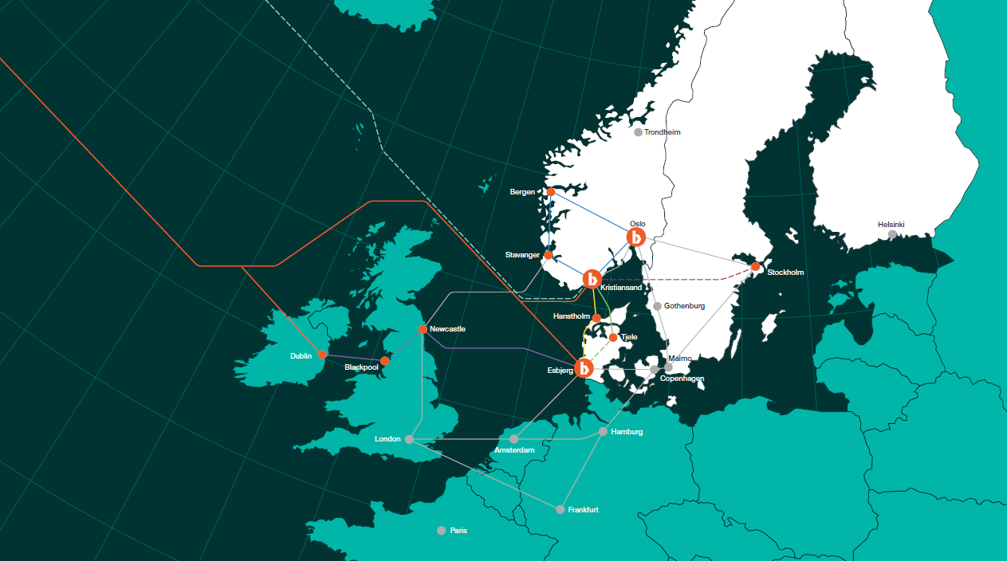

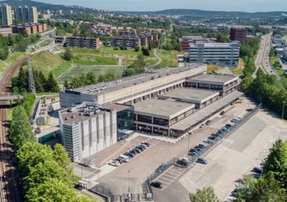
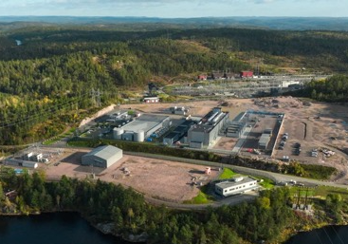
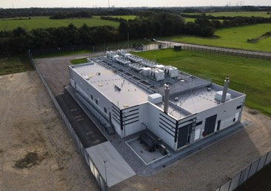
Bulk’s digital infrastructure platform
+200
employees*
Oslo Internet Exchange (OS-IX)
Oslo
headquarter
3
data center sites
N01 Campus (Kristiansand)
10’ km
fiber routes
inc. USA, Ireland
and Denmark
92 MW
IT installed &
under construction
DK01 Campus (Esbjerg)
NOK ~1.0bn
signed ARR

Slide 8
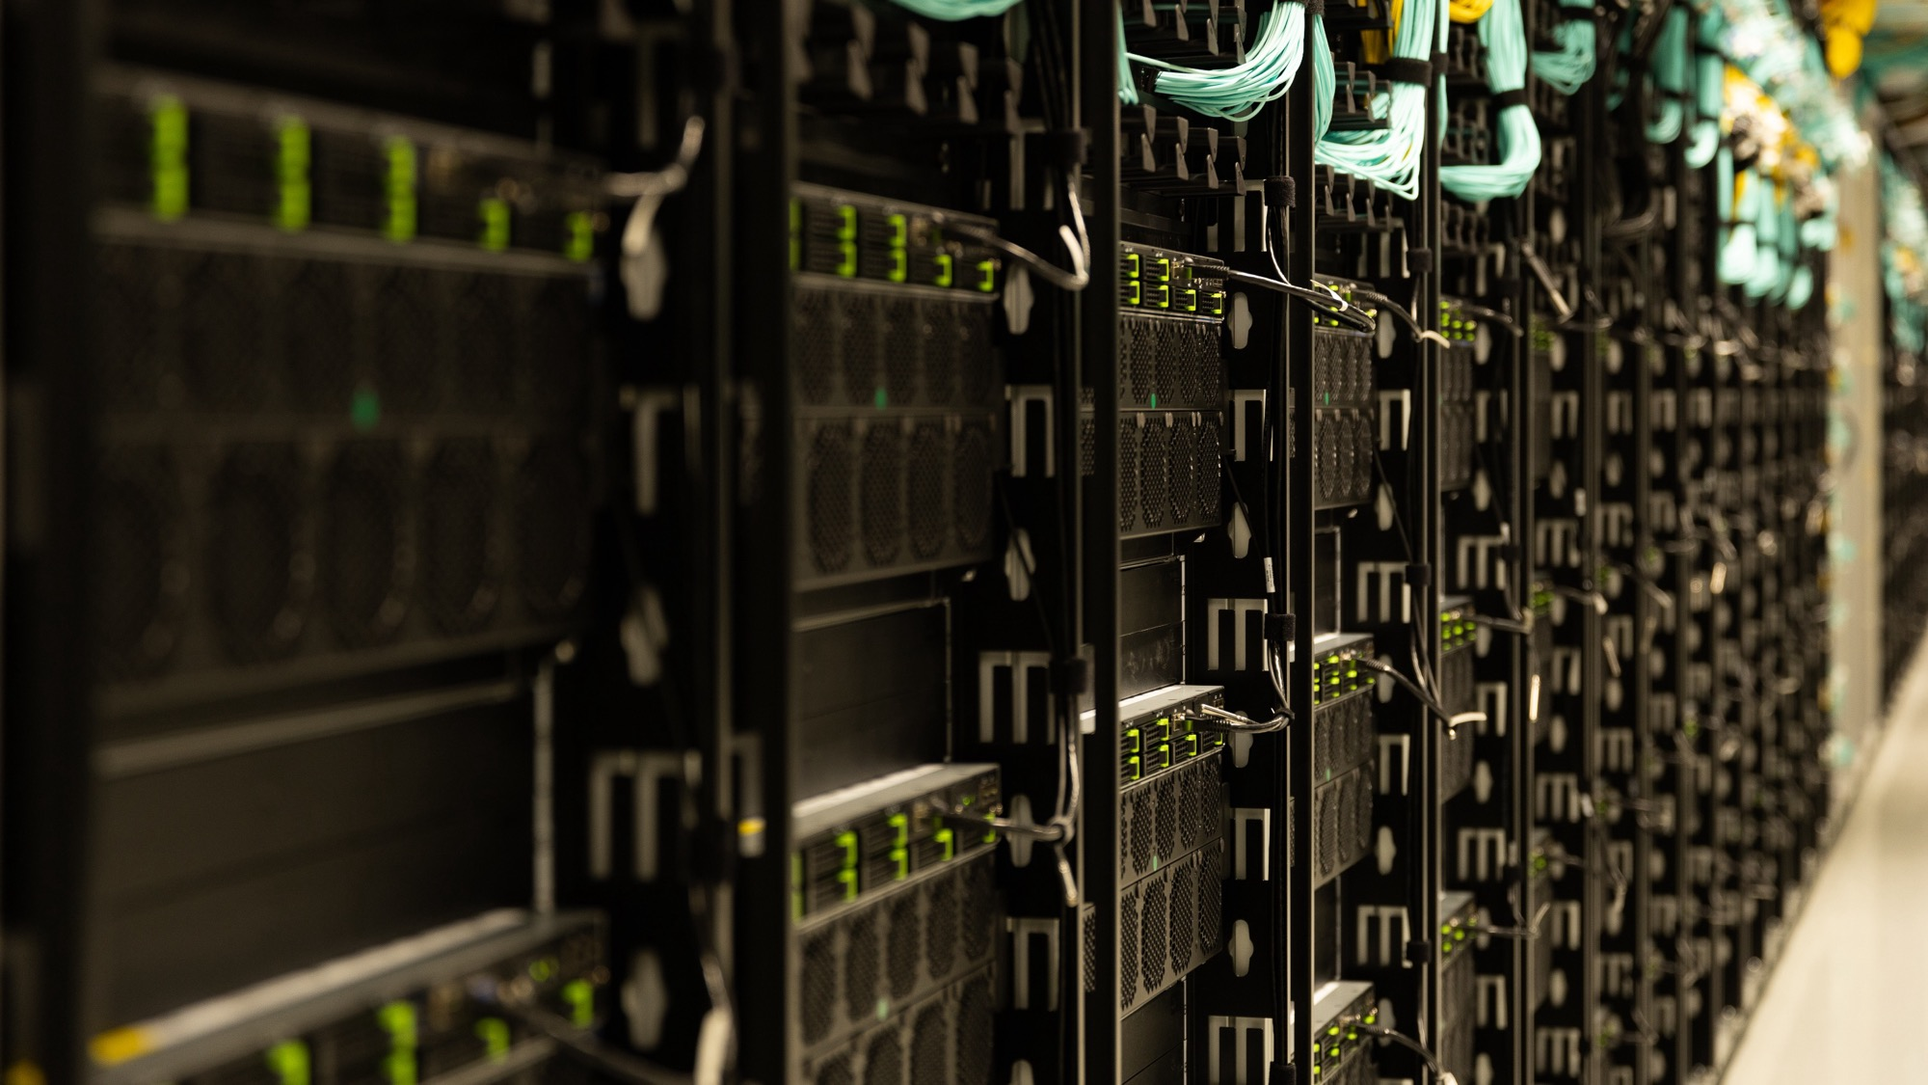





Gen AI revolution continues to drive massive increase in demand
Exponential data consumption growth
…fuelled by AI compute intensity
… driving GPU and data center demand
Example
Amount of data created, consumed, stored (zettabytes)⁽¹⁾
Example
AI compute power required vs. Google search⁽²⁾
Example
NVIDIA quarterly Data Center revenue (USDbn)⁽³⁾
10,000x
“Norway should sell intelligence, not power”
– Jensen Huang, CEO Nvidia
39.1
22.6
50x
10x
3.8
4.3
1x
2010
2012
2014
2016
2018
2020
2022
2024E
2028E
Internet Search
Language AI
Image AI
Video AI
Q1/22
Q1/23
Q1/24
Q1/25
Social media/cloud
Streaming/content
AI

Slide 9
Building Sustainable digital infrastructure
Introduction to Bulk Infrastructure
Sustainability Framework
  Location
  Asset
  Ecosystem
  Society
Climate Budget and reporting
Finding solutions

Slide 10
What do we mean by “Sustainable Digital Infrastructure”?
  We continuously seek to make impact as per our Sustainability Framework.
  At present we define “sustainable digital infrastructure” as infrastructure that is meeting the below criteria:
  Located in Norway, benefiting from the largely renewable electricity mix
  Have a design or actual average annual Power Usage Effectiveness (PUE) of:
    Actual PUE 1.40 or below for data centers housed in renovated and repurposed buildings
    Design PUE 1.20 or below for new data centers
  A physical climate risk assessment has been carried out in accordance with Annex A of the EU Taxonomy Regulation
  Relevant practices listed as “expected practices” in the European Code of Conduct on Data Centre Energy Efficiency have been implemented
  Existing / new data centers are being / will be assessed for additional features and implemented when practical and cost-effective (e.g. for on-site renewable generation and heat re-use)
Public
Notes:
Sustainability is a work in progress, and we continuously seek to make impact as per our Sustainability framework.
When we say “sustainable digital infrastructure”, we mean projects that align with the following criteria:
Are located in Norway and benefit from its predominantly renewable electricity mix
Achieve either:
Actual PUE ≤ 1.40 for renovated or repurposed buildings
Design PUE ≤ 1.20 for new builds
Have completed a physical climate risk assessment aligned with Annex A of the EU Taxonomy Regulation
Have implemented all “expected practices” from the European Code of Conduct on Data Centre Energy Efficiency
Are assessed for additional practical and cost‑effective features, such as on-site renewable energy generation or heat re-use infrastructure
What is PUE?
PUE = Total data center facility power consumption / Customer power consumption
PUE is defined as the targeted PUE value for a data center based on its engineering design under ideal operating conditions, including customer loads and ambient temperature.

Slide 11
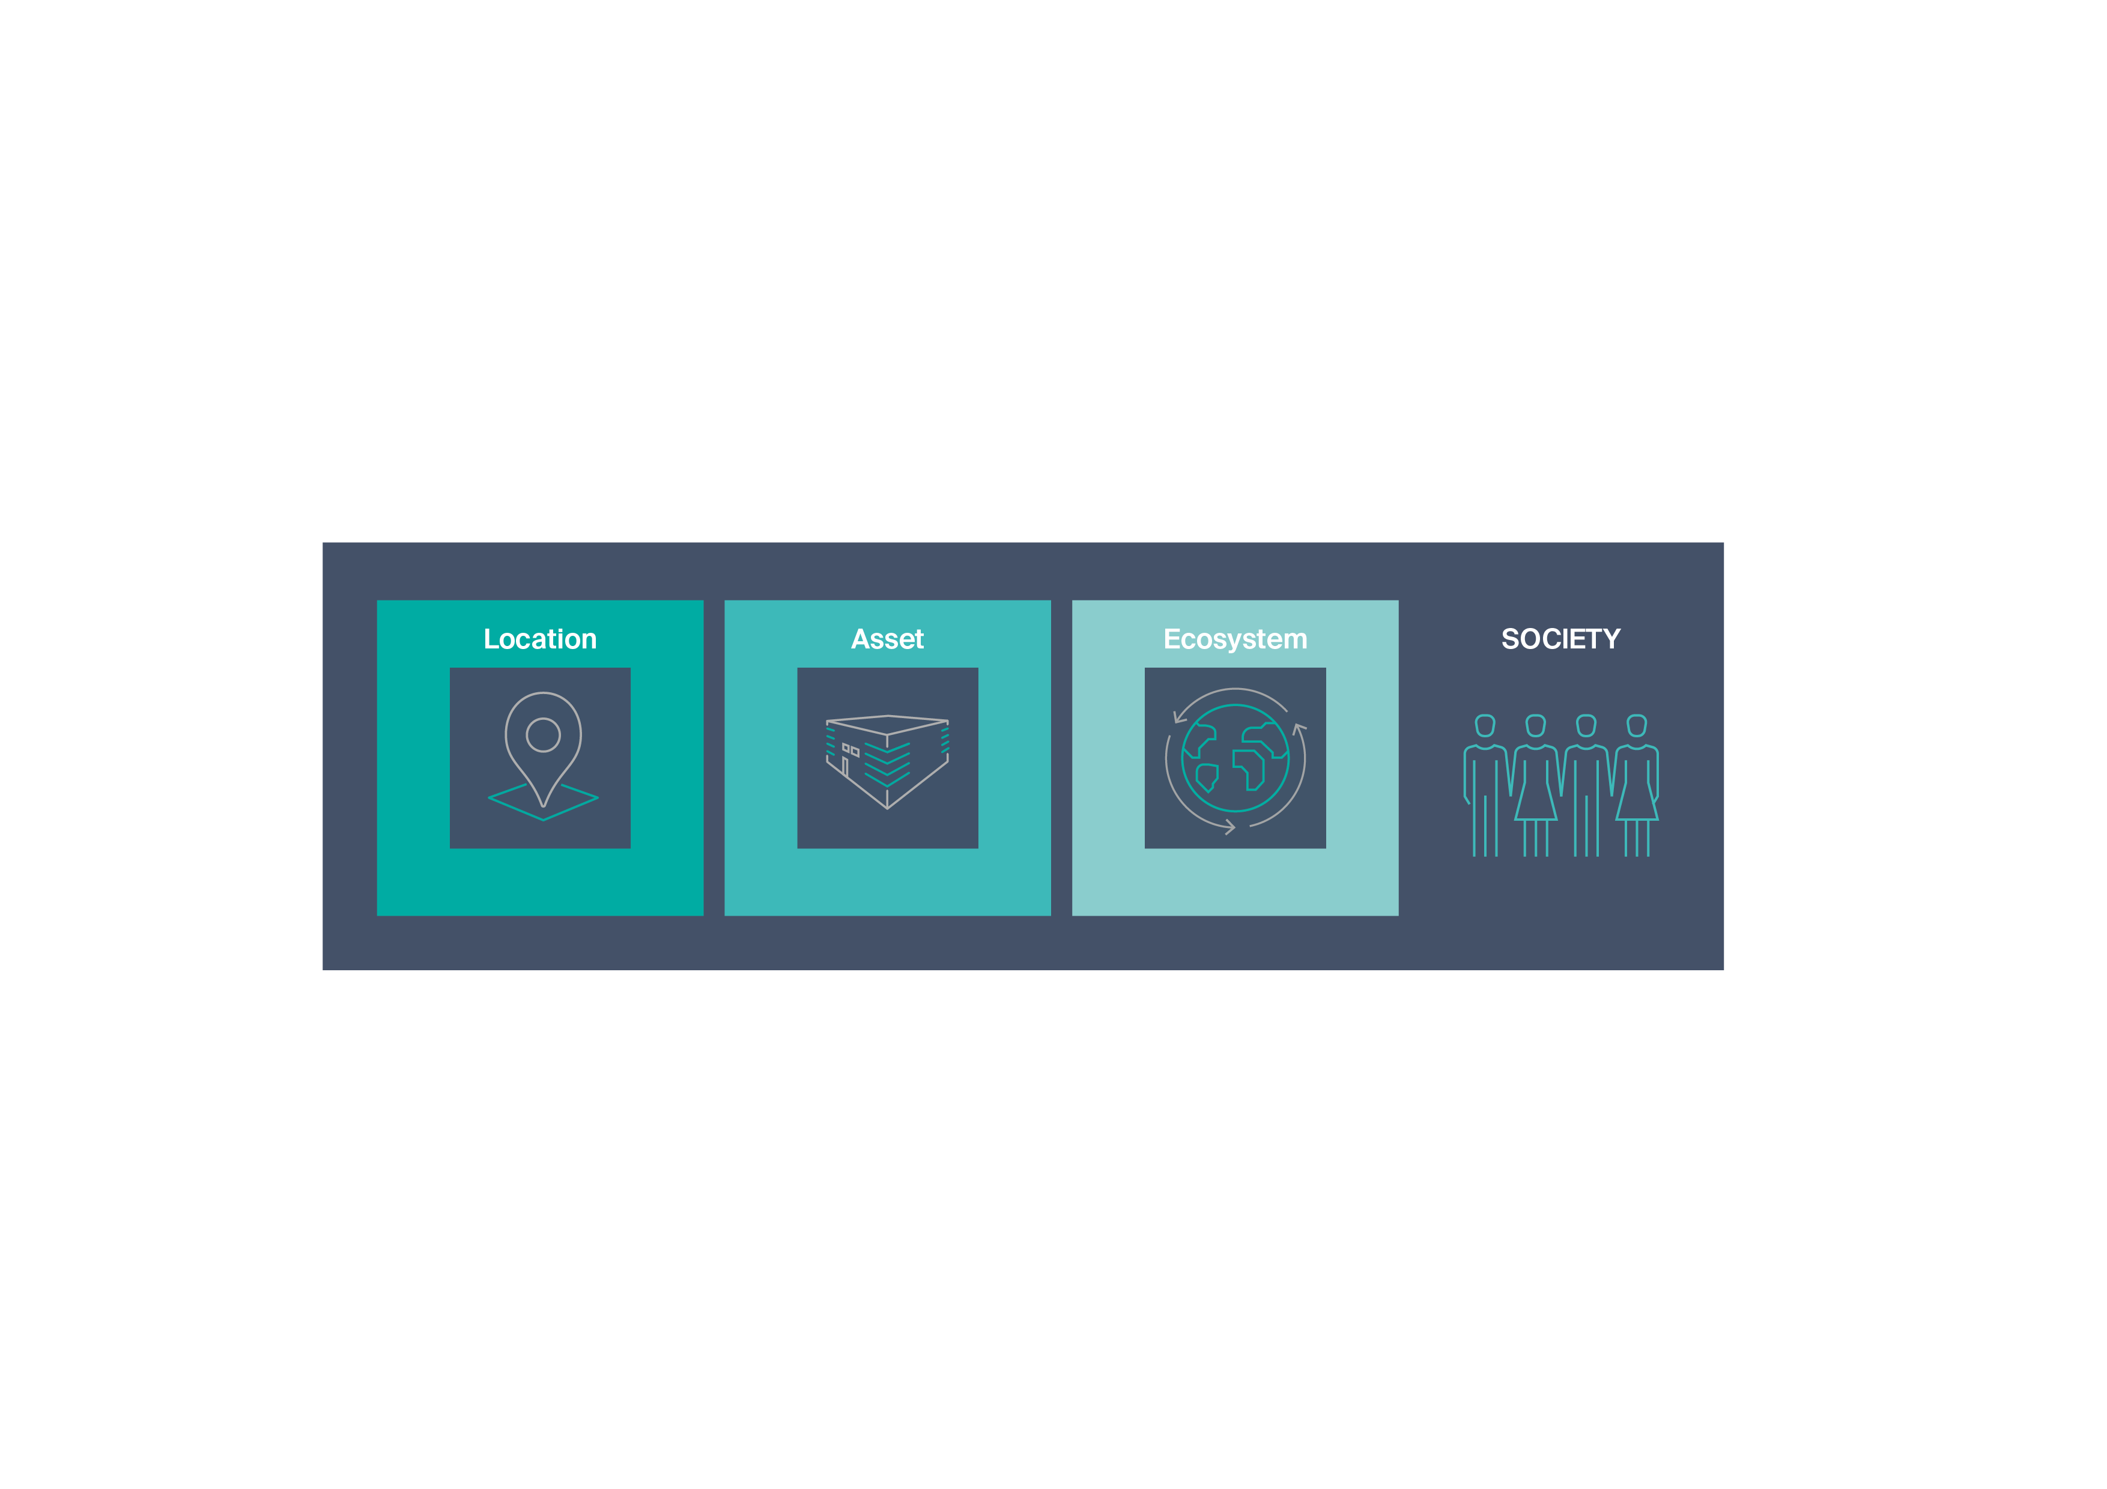
Sustainability Framework
Racing to bring sustainable infrastructure to a global audience
Notes:
We define sustainability through an ESG-lens, covering environmental, social and governance factors.
We support a pre-cautionary approach to environmental challenges and undertake initiatives to promote responsible business conduct.
Bulk has developed and implemented a sustainability framework on how we work with sustainability that consists of four perspectives; Location, Asset, Ecosystem and Society
What does it really mean??
Location
Assets
Ecosystem
Society
How do we minimize the negative effect our choices have to the society in short and long-term.
How can we optimize the positive effect of our choices.

Slide 12
Building Sustainable digital infrastructure
Introduction to Bulk Infrastructure
Sustainability Framework
  Location
  Asset
  Ecosystem
  Society
Climate Budget and reporting
Finding solutions

Slide 13

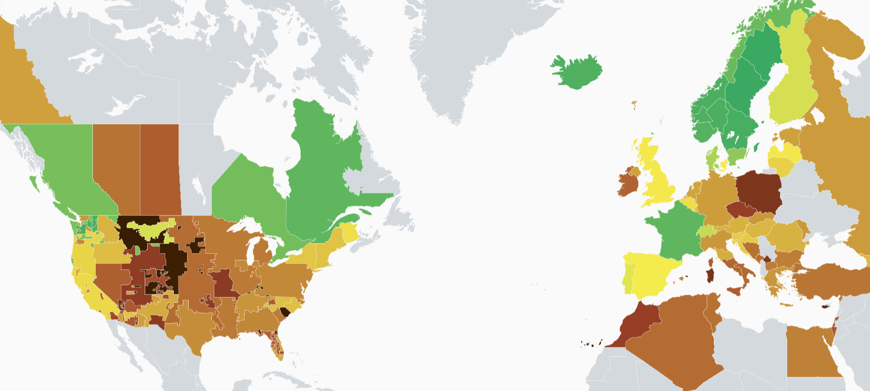

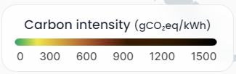
Location
Source: Electricity Maps | Live 24/7 CO₂ emissions of electricity consumption
30 days average December 2024
Public
Notes:
How we see the world Through energy carbon emmission – Electricity Map
and why we think location is the most important regarding sustainability for digital infrastructure (data processing and the digitalization of our society)
We started with a local environmental problem we wanted to fix – it lead to the DC and renewable energy.
We see improved renewable energy production every year, however it is intermittent (not always on) sun, wind etc. Moving energy is a challenge. Storage, migrating loads Moving gigabytes instead of gigawatts
The N01 campus is located in southwest Norway, which is an area with 100% renewable and low-carbon production over the last 6 years
The location has high grid resilience backed up by large over-capacity power generation, which leads to minimum run-on generators and backup solutions
We see improved sustainable energy production every year, however it is intermittent sun, wind etc. Moving large power loads in the grid gives a grid loss. Average 8-10%

Slide 14
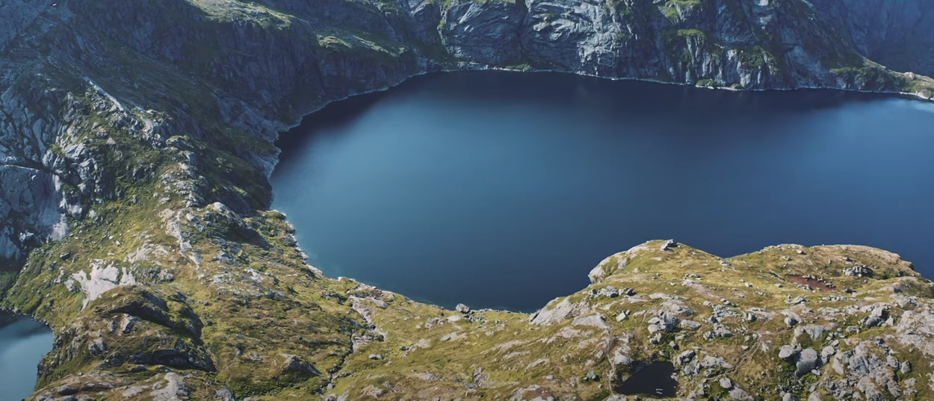
Why the Nordics?
Public

Slide 15
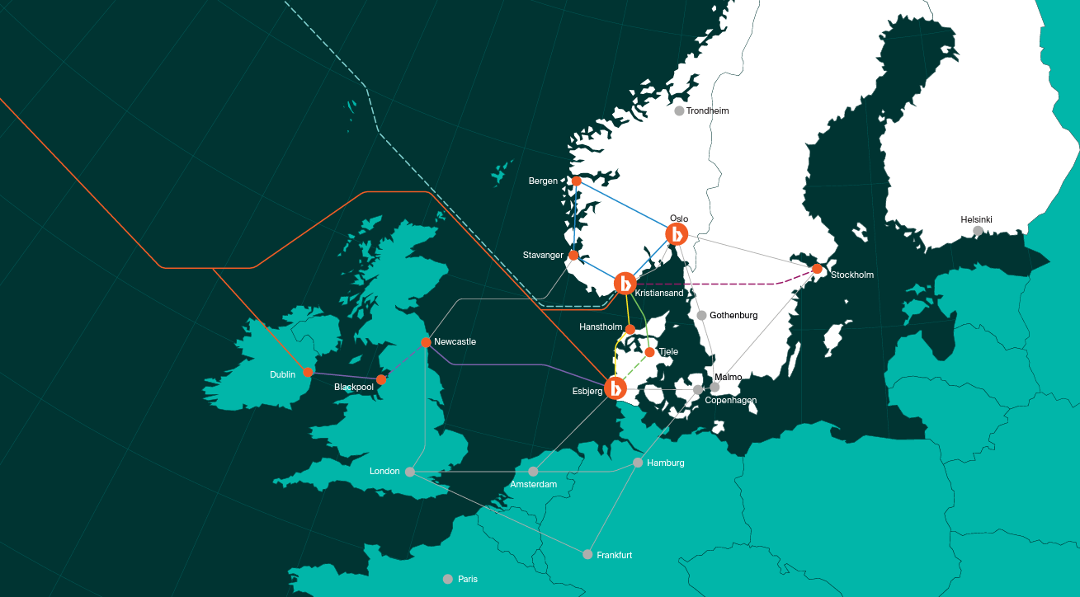
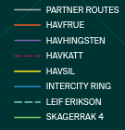
Enabling the Nordics by connecting the region with fiber optic networks
Notes:
Reaching the energy surplus by building fiber network to and from places with an energy abundance
Move GigaBytes instead of GigaWatts

Slide 16
Building Sustainable digital infrastructure
Introduction to Bulk Infrastructure
Sustainability Framework
  Location
  Asset
  Ecosystem
  Society
Climate Budget and reporting
Finding solutions

Slide 17

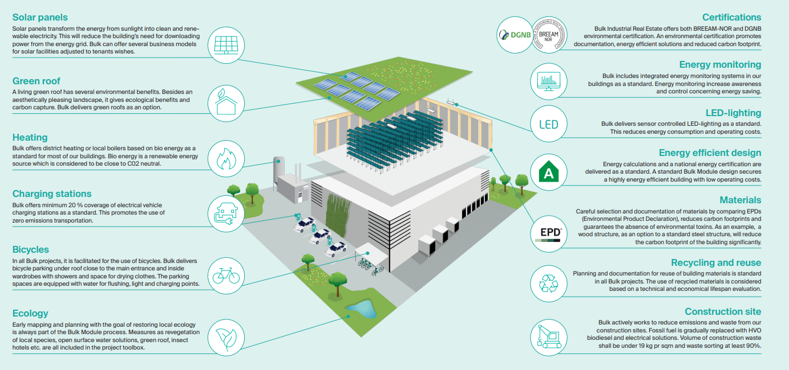
Asset – industrial real estate modular building
Notes:
We focus on minimizing and optimizing the use of resources:
Climate mitigation and adaptation
Energy optimization
Protection of nature
Material management the Asset Realestate (buildings, land preparations and fiber cable build and production) - Systematic work: Choices in projects
– where we zoom in on our product and how we systematic work to maximize the positive effect of our products and minimize the negative footprint.
Example from our Industrial real estate, where we have worked to optimize our modular building from using LED-lighting to replace the steel construction with wood.
You need to find the right balance between positive impact and profitability, it must be competitive in the market in which you operate. ex. Bulk Wood

Slide 18
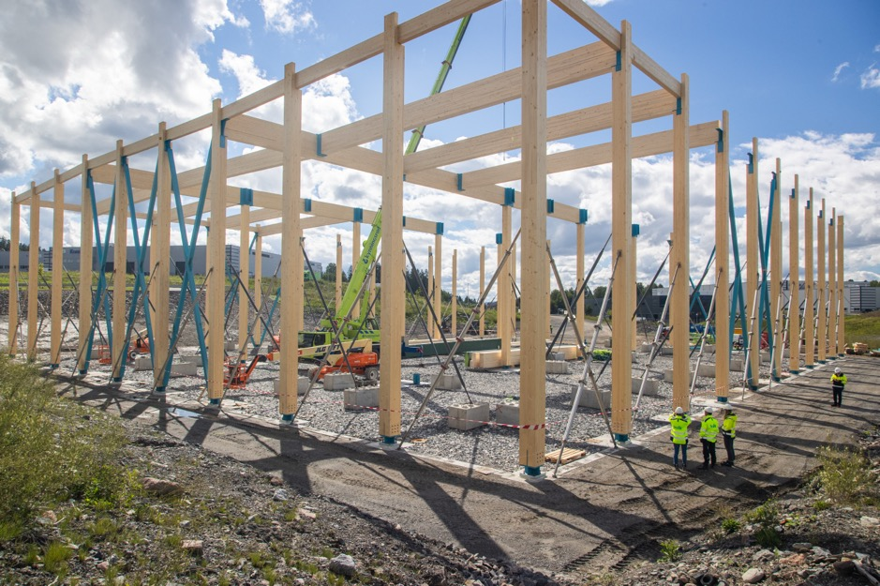


Example: Bulk Wood
Steel construction
= 310 000 kg CO2e
Bulk Wood avoided emissions:
165 000 kg CO2e
Savings equal to:
41 250 kg plastic
or
833 000 km with fuel combustion
New construction
= 145 000 kg CO2e
Wood construction with steel footplate, wind bracing, and joints
Public
Notes:
From words to action. This is a great example of working towards net zero emissions. Here we have avoided emissions by replacing steel construction with wood. (Scope 3 for Bulk, which we will come back to)
We managed to do this with only 5 % increase in cost, and we found a tenant who was willing to pay for a more sustainable building..
Fotplater, vindkryss og knytepunkter i stål – det vi har sett er at disse delene utgjør 2/3 av klimagassutslippet til bæresystemet.
Ved at vi har valgt bærekonstruksjon i limtre – har vi redusert klimagassutslipp med 165 000 kg Co2 ekvivalenter.
Det høres ut som ett stort tall, men hva tilsvarer det egentlig – jeg ba ingeniørene våre eksemplifisere:
Det er det samme som:
Eller produksjonen av 41 tonn plast
Evt kan man kjøre tur/retur Oslo- Hemsedal over 2000 ganger med bensinbil

Slide 19
Building Sustainable digital infrastructure
Introduction to Bulk Infrastructure
Sustainability Framework
  Location
  Asset
  Ecosystem
  Society
Climate Budget and reporting
Finding solutions

Slide 20
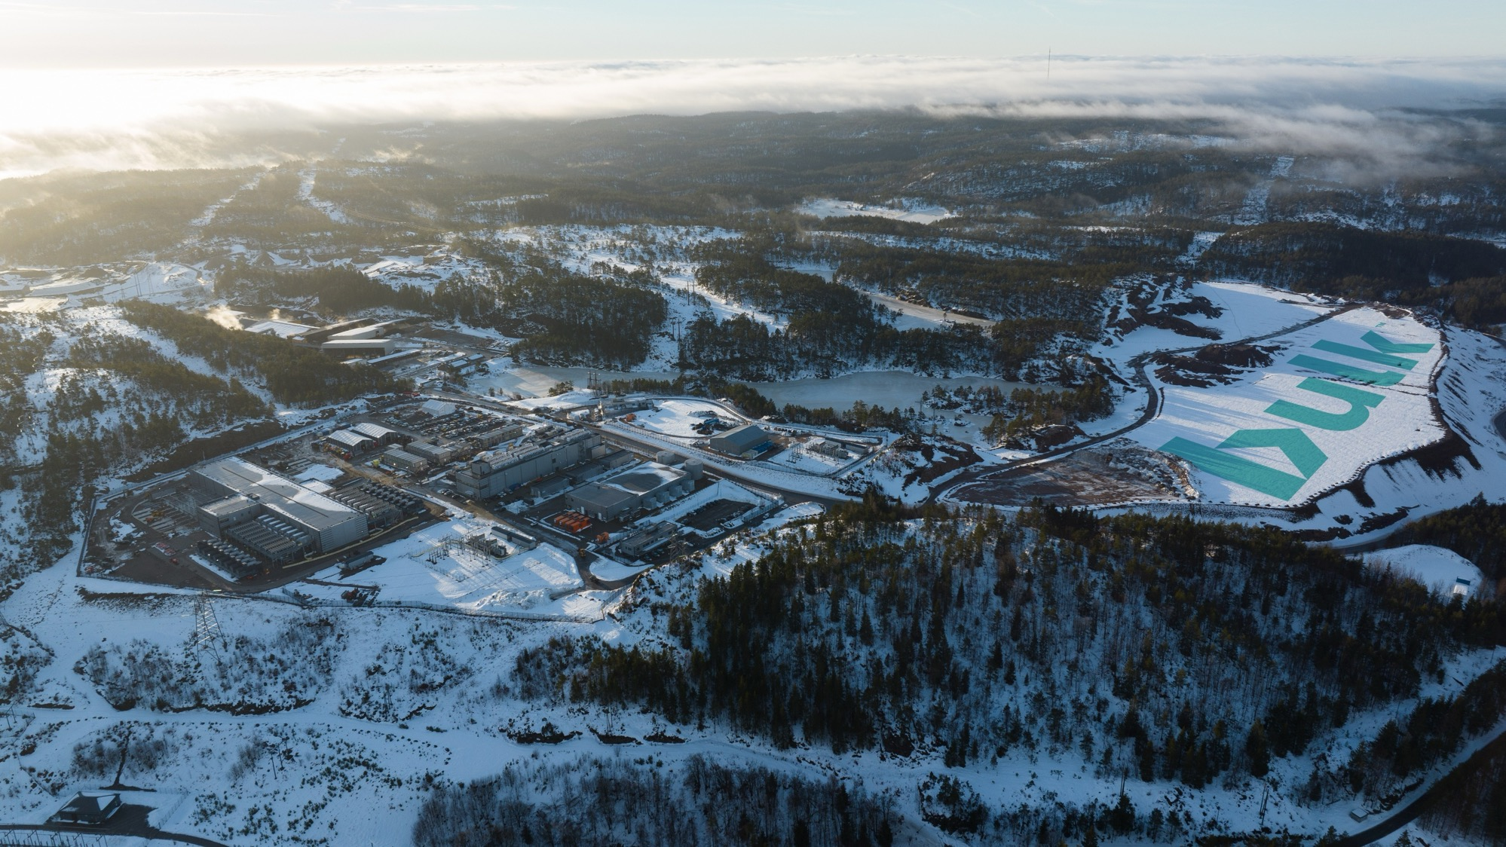

Ecosystem at N01 Data Center Campus
Notes:
Why do you cut the threes? Embedded carbon in the nature trees, marsh-land (peat-land) terrestrial wetland ecosystem.
Significant impact can only be achieved by defining ourselves as part of a larger Ecosystem and cooperating with partners, customers, suppliers and employes to change the way we all operate. One example of an Ecosystem is to reuse the residual heat from the DC into another industry that use heat, or to district heating.
Another eco system is the national grid, where DC with its UPS and gen.sets can contribute to the energy balance, and to balance the frequency of the grid, we see that with more wind and solar power, DC can help with balance of frequence and also with peak shaving. This can enable the green shift to go faster.

Slide 21
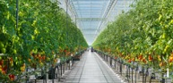

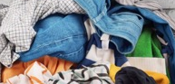
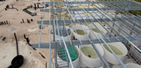
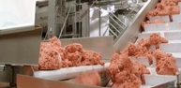
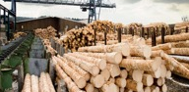
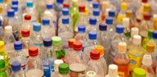
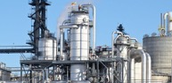
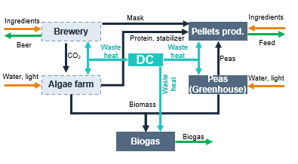
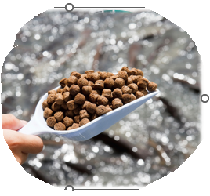
Ecosystem – heat reuse in a circular industry cluster
Vegetables
Insects
Recycling of clothes
Algae
Food
Wood processing
Bioplastic
Biofuel
Example production of fish feed
Biogas
Biogas
Bioplastic
Ingredients
Notes:
The exhaust from DCs are low grade heat (35-37 degrees celcius/95-100 degrees farenheit) Per nå 28 grader, AI opptil 50 grader
Eksempel på sirkulær alternativ protein produksjon med ølbrygging, alger og erter:
Mask etter ølbrygging utgjør ca 31 % av original maltvekt og i Norge blir totalsummen 17 000 tonn.
Mask omfatter rundt 85 % av de restprodukter som produseres ved ølbrygging. De øvrige
restproduktene er humle og gjær. I dag brukes mesteparten av masken som produseres i Norge til dyrefôr. Om vi summerer så blir det årlig totalt i Norge, fra møller og ølproduksjon, produsert 86 823 tonn
restråstoff, hvorav 61 000 tonn hvetekli, 7 500 tonn havreskall, 1 200 tonn byggskall, 123 tonn
speltskall og 17 000 tonn mask. Rapport+67-2016.pdf (unit.no)

Slide 22
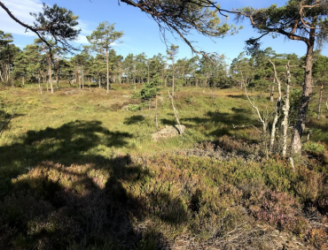
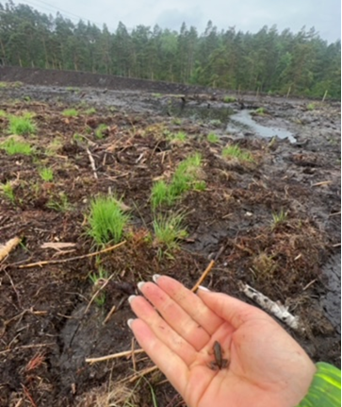
Example: Ecosystem – reestablishing marshland
Notes:
Biodiversity in action, how can we contribute to the local biodiversity where we operate. Example from N01 where we have moved and also restored marshland. Also important because marshland is our natural carbon capture system.
Moved and reestablished – Research ongoing on how much CO2 has been embedded and restored.

Slide 23
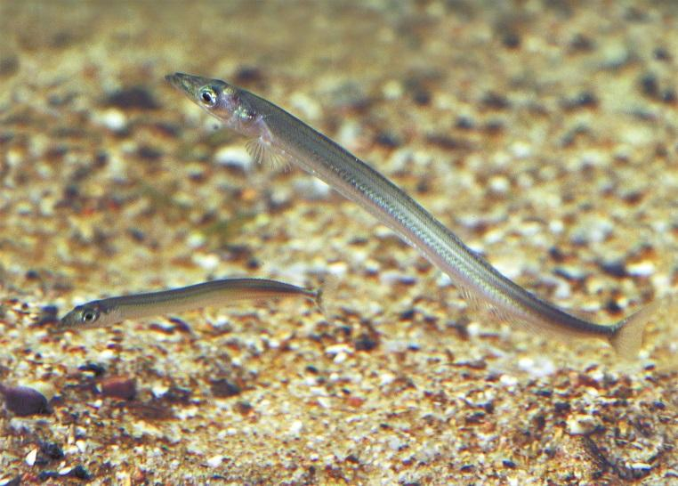
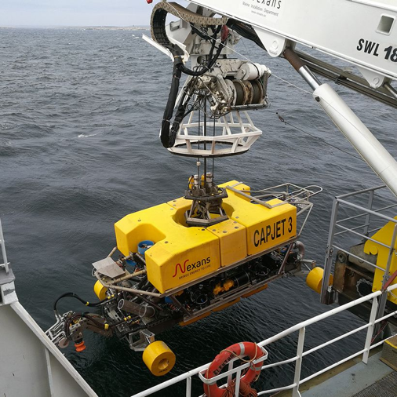
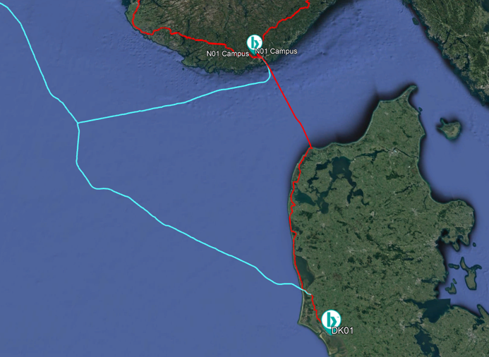
Example: Ecosystem – biodiversity in the ocean
https://www.nature.scot/plants-animals-and-fungi/fish/sea-fish/sandeel
Notes:
Easy to forget, subsea impacts – Fish trawlers – Ecosystem - Fish Sand Eel – lowest in the eco system – Birds, other fish pray on it. Reouting the cable path.

Slide 24
Building Sustainable digital infrastructure
Introduction to Bulk Infrastructure
Sustainability Framework
  Location
  Asset
  Ecosystem
  Society
Climate Budget and reporting
Finding solutions

Slide 25

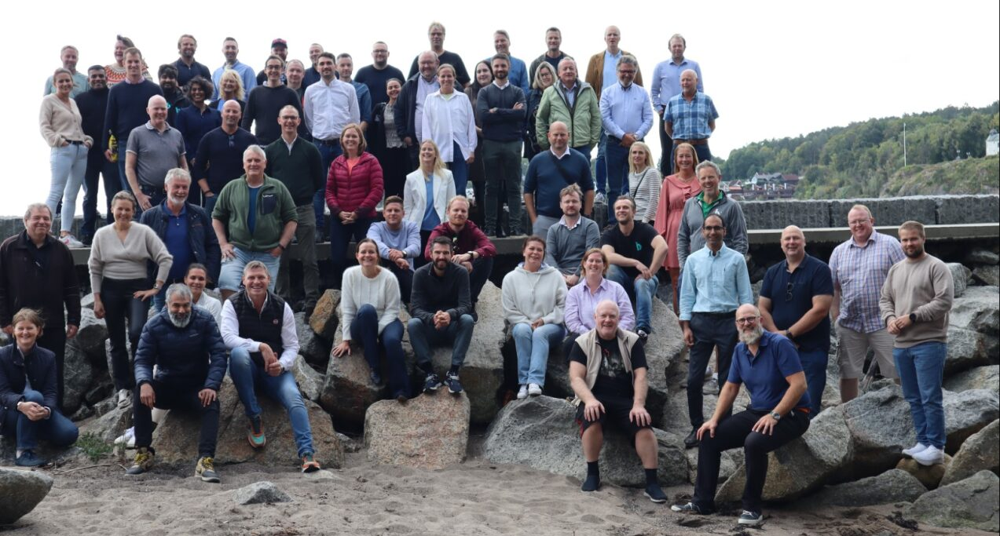
Society
“For us, it's about integrity and the value of respect, both for the environment and for the society”
Notes:
Of course we act in accordance with national and international laws and regulation, but there is more…
How do we treat partners, colleagues
High integrity
Suppliers, sub suppliers
Social Responsibility &
Good Governance
To the betterment of the society
Our values: Respect, Creative Power and Passion

Slide 26
Building Sustainable digital infrastructure
Introduction to Bulk Infrastructure
Sustainability Framework
  Location
  Asset
  Ecosystem
  Society
Climate Budget and reporting
Finding solutions

Slide 27
What are your targets? Focus areas?
Public

Slide 28
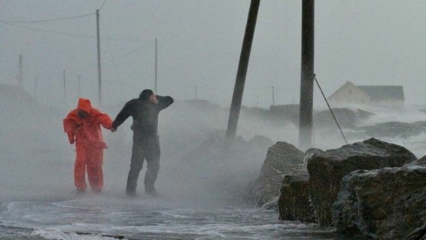
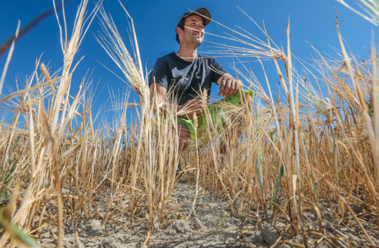
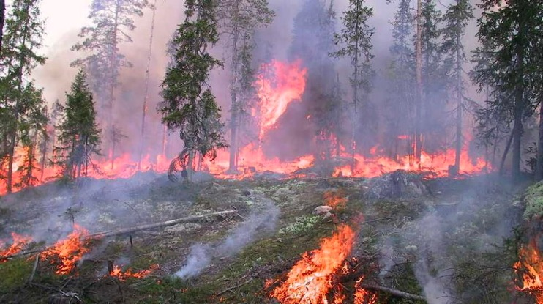
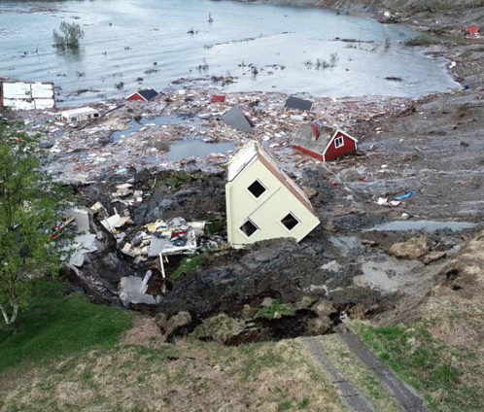
Our Climate Targets
By 2030:
Reduce our scope 1 and 2 emissions by 50 per cent
Decrease our emissions intensity by 30 per cent for scope 3.
By 2050:
Net-zero emissions across all scopes (1, 2, and 3) by 2050
Notes:
Bulk has set a net-zero target by 2050 across its scope 1, 2, and 3 emissions. We will seek to reduce our scope 1 and 2 emissions by 50 per cent by 2030 and our emissions by
30 per cent for scope 3 by 2030. The combination of absolute and intensity targets has been chosen because we are
a company in growth. Intensity targets enable a visible effect of climate actions, even when a company is expanding, by measuring emissions per unit, such as MNOK.
The base-line year for most of our emissions-related activities is 2022. However, obtaining emissions data from suppliers regarding technical equipment remains challenging. Consequently, spend-based estimates are still required. A formal baseline will be established once sufficient and reliable data becomes available.

Slide 29
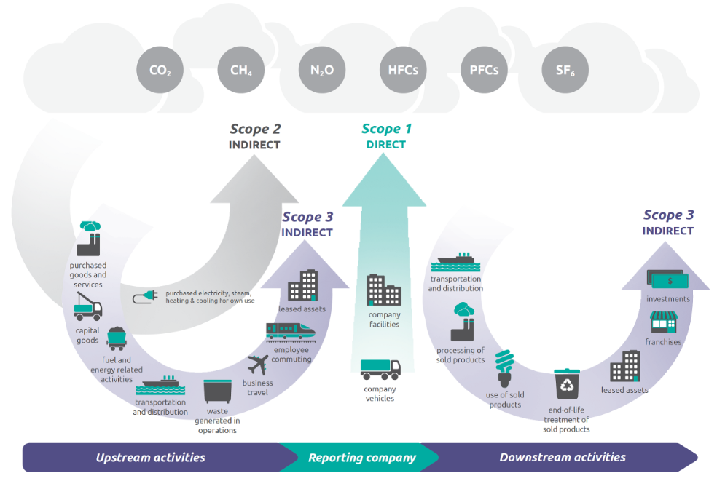
GHG Protocol – GHG Emissions Accounting
Source: https://ghgprotocol.org/
Public
Notes:
Bulk has set ambitious emissions targets to combat climate change, including a goal to achieve net-zero emissions across all scopes (1, 2, and 3) by 2050. Additionally, we will reduce our scope 1 and 2 emissions by 50 per cent and decrease our emissions intensity by 30 per cent for scope 3 by 2030.
The first step to setting this target has been to measure our climate impact.
The base-line year for most of our emissions-related activities is 2022. However, obtaining emissions data from suppliers regarding technical equipment remains challenging. Consequently, spend-based estimates are still required. A formal baseline will be established once sufficient and reliable data becomes available.
Scopes 1 and 2 include direct/indirect emissions from locations owned or controlled by the company. Scope 3 covers indirect emissions in a company’s upstream and downstream value chain. Bulk reports on all its Scope 1 and 2 emissions using the location-based and market-based methodologies. Reported Scope 3 categories include Waste, Capital Goods, Business Travel and Upstream Leased Assets. Scope 3 Capital Goods emissions are recorded in the year a project is completed.
Our GHG emissions accounting objectives:
We aim to move from cost-based estimates to precise data from suppliers based on life cycle assessments. We have implemented life cycle assessments in our construction projects, providing better data on emissions from materials. However, data from many technical components is still lacking. We are actively working to obtain this data and are requesting Environmental Product Declarations (EPDs) from our suppliers. Category 2 Capital goods is the largest source of scope 3 emissions, including embodied emissions from manufacturing and transporting building materials and technical components, as well as fuel consumption for land preparation.
More on our choice of targets:
The combination of absolute and intensity targets fits a company in growth
Intensity targets enables visible effect of climate actions even when a company is expanding by measuring emissions per unit such as MNOK invested, revenue, m2 etc.
Intensity targets for specific units must be established based on today’s situation and the overall emission targets.
Absolute emission targets fits for delimited operations such as a construction project, even when the company is increasing the total number of such projects.

Slide 30
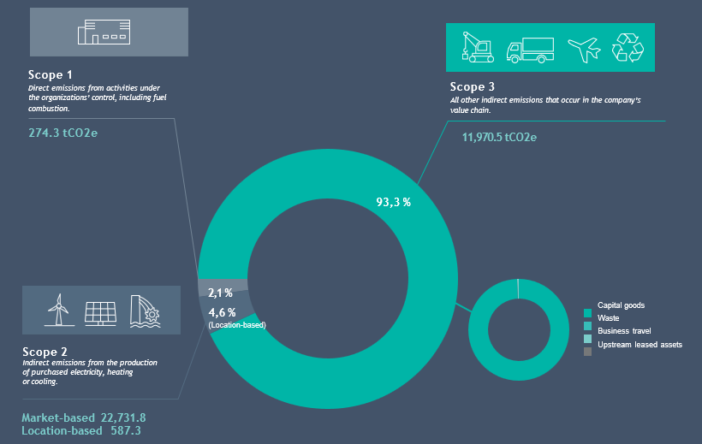
Bulk Data Centers – GHG Emissions 2024
Public
Notes:
Our GHG emissions accounting for our Data Centers Campuses N01, OSIX and DK01 for 2024
Scope 1 – use of vehicles and diesel generators (testing in DC)
Scope 2 – location – sustainable energy.
Our Bulk locations in the Nordics provide us with the advantage of renewable power and a stable energy grid. As a result, Bulk’s emissions in scope 1 and 2 are very low. The majority of Bulk’s emission derive from activities in our supply chain and is reflected in scope 3 emissions.

Slide 31
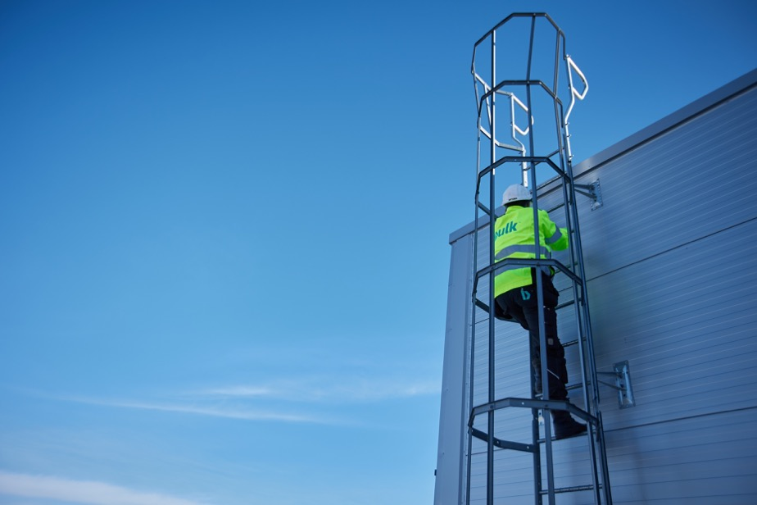
Climate Budgeting – a pathway to achieving ambitions
Providing a pathway to achieving climate targets linking targets with key areas for emissions reductions
Building credibility in the market and the finance sector by providing a plan to report on progress
A tool for internal and external communication of emission reduction ambitions and targets – aligned with emerging demands and expectations
Public
Notes:
Climate budgeting is without doubt an ambition of ours. What is it?
It is the process of defining a pathway to achieving climate targets, linking targets with key areas for emissions reductions. By establishing a transparent plan to monitor and report progress, it builds credibility in the market and finance sector. Climate budgeting is also a powerful tool for internal and external communication of emission reduction ambitions and targets, and aligns with emerging demands and expectations.

Slide 32
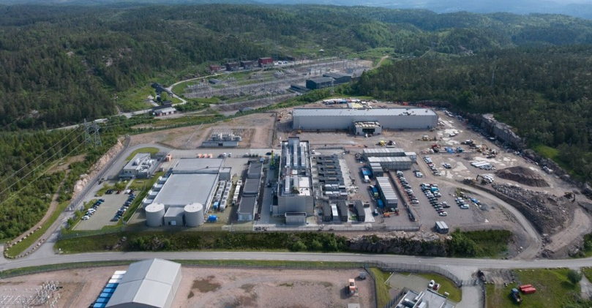
Bulk’s identified climate-related risks and opportunities
Transitional
  Opportunities
    Increased market opportunities due to access to renewable energy
    Increased market opportunities due to growing customer demand for climate-resilient and low-carbon digital infra-structure
    Green and sustainable financing
    Advancing technologies
  Risks
    Stricter land use regulations
    Changes in climate-related regulations
Physical
  Risks
    Intense rainfall and ground instability
    Wildfires
Public
Notes:
Bulk is committed to sustainability and mitigating climate-related risks. The company has, since 2022, conducted a thorough climate analysis based on the Task Force on Climate-related Financial Disclosures (TCFD) framework. In 2025, we started conducting a Gap assessment of our TCFD disclosures to IFRS S1 and S2, which has the same four pillars as the TCFD framework (Governance, Strategy, Risk Management, and Metrics and Targets).
In the TCFD framework, Transitional risks and opportunities relate to those associated with the transition to a low-carbon economy. These may be a result of Policy and regulation, technology, market and reputation and legal changes. Physical risks and opportunities are those that are associated with the physical impacts of climate change. This slide highlights the most material transitional and physical risks and opportunities identified by Bulk.
Our analysis has identified rising temperatures (causing wildfires and extreme weather events) as key risks regarding physical assets, and an evolving landscape of legislative regulations at both the national and EU levels as a transitional risk that may affect the industry. Bulk is actively working to be prepared for the challenges posed by climate change and rising temperatures.
We have implemented robust strategies to mitigate the impact of extreme weather events such as downpours and storms, ensuring minimal disruptions to our operations. Our proactive approach includes strategically selecting locations for site development and enhancing the resilience of our building infrastructure. Careful assessment of climate risk is a key criterion in our site selection process to ensure robust infrastructure. Location has been one of the key elements in our sustainability framework from the beginning, of which availability of renewable energy and further plans for development in the area are among the main decision criteria.
Deep-dive into our climate-related data center R&Os – with focus on expected impact and capitalising efforts:
Transitional
Opportunities
Increased market opportunities due to access to renewable energy: Access to energy is becoming a growing challenge for power-intensive industries. Bulk operates in Norway and Denmark, lever-aging a location-based renewable-dominated energy mix to strengthen its position in a market focused on low-carbon solutions and energy efficiency. Its sites are strategically located near renewable hubs, with plans to expand capacity.
Increased market opportunities due to growing customer demand for climate-resilient and low-carbon digital infra-structure. As climate change increases, customers increasingly prioritize the physical resilience and carbon footprint of digital infrastructure. Bulk takes a proactive approach to climate adaptation with strategic site selection, locating data centers in colder regions, offers a strategic advantage by reducing cooling needs and enabling access to renewable energy, positioning operators to meet rising sustainability demands and regulatory expectations.
Green and sustainable financing. The efforts made by Bulk to increase the environmental performance of its assets will make green, sustainable and sustainability-linked financing available. Bulk has established a competitive edge by issuing a green bond with Medium green shading by Cicero.
Advancing technologies. New legislation and stakeholders’ expectations for sustainable solutions create an opportunity for Bulk to be a front runner that can contribute to finding new solutions. Bulk has a strong focus on R&D, and climate-related risks and opportunities. Feasibility studies have been undertaken to explore the use of heat from our data centers and to develop partnerships to find solutions for circular industry clusters.
Risks
Stricter land use regulations: Stricter land use regulations may limit development areas and increase time and cost for project approvals. Bulk addresses this risk by allocating more time and resources to project planning, including close collaboration with local and national authorities. External experts such as ecologists are engaged to assess sites and implement biodiversity restoration measures.
Changes in climate-related regulations. Operators of digital infrasrcuture face transition risks from tightening climate regulations and sustainability reporting, potentially leading to increased project costs. Bulk collaborates with industry leaders through the Climate-Neutral Data Center Pact, iMasons, and local organisations like ZERO (Zero-emissisons resource organisation in Oslo, Norway) to stay ahead of regulatory changes.
Physical
Risks
Intense rainfall and ground instability: to mitigate climate risks, Bulk conducts due diligence before investing in new sites, prioritizing locations with low exposure to flooding, landslides or surface erosion. None of Bulk’s current data centers are in areas exposed to land-slides or surface erosion. All assets are built with proper drainage and in compliance with the Planning and Building Acts in Norway and Denmark.
Wildfires: Wildfires are seen as a compound risk in Norway, although Norway with the colder climate is less exposed to wild-fires than in Southern Europe. Wildfires can potentially occur in connection with chronic risks such as drought, and sea-sonal extreme episodes like heatwaves. Each Bulk site has a business continuity plan that includes fire response procedures. Bulk also collaborated with local municipalities and emergency services on fire safety and response.

Slide 33
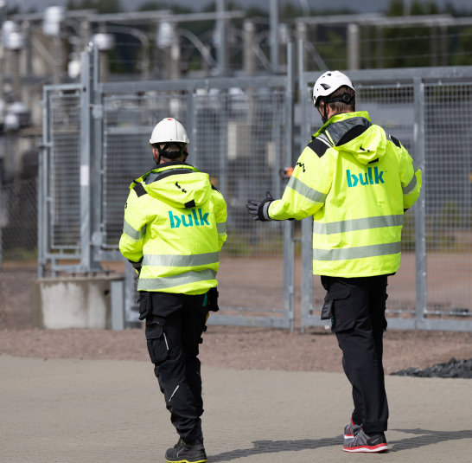
Looking Ahead - Focus Areas
Continuous improvement of GHG emissions accounting (Scope 3 value chain emissions)
Further developing our CSRD-aligned double-materiality assessment
Ensuring sustainability-related impacts, risks and opportunity management remains a fully integrated part of our business
Climate Budgeting
Assessing Applicability of EU Taxonomy
Notes:
Bulk continuously strives to improve our sustainability practices and reporting. By actively responding to evolving stakeholder expectations and regulatory requirements, we aim to enhance transparency, accountability and long-term value creation.
Our main sustainability action and reporting focus areas going forwards include:
Continuously improving our GHG emissions accounting when it comes to our indirect value chain impacts (Scope 3)
Further developing our CSRD-aligned Double materiality assessment which assesses how our company impacts people and the environment and in turn how our company may be financially impacted by environmental and social dependencies (e.g. through physical effects of climate change). As a result of omnibus, and CSRD no longer targeting companies with less than 1000 employees, Bulk is no longer preparing a fully CSRD-compliant report. We are in the process of evaluating whether the EFRAG Voluntary SME standard would make sense for us.
Ensuring our sustainability-related impacts, risks and opportunity management remains a fully integrated part of our business
- Climate budgeting: developing our emission-reduction plan
- As part of our commitment to aligning with emerging standards, we are actively assessing the relevance and applicability of the EU Taxonomy, particularly Annex A. Although full reporting under the taxonomy is not yet mandatory for our operations, we recognize the value of its framework in guiding robust climate risk assessments. We are therefore working
to integrate its principles into our internal processes on how we identify, evaluate, and manage climate-related risks and opportunities.

Slide 34
Building Sustainable digital infrastructure
Introduction to Bulk Infrastructure
Sustainability Framework
  Location
  Asset
  Ecosystem
  Society
Climate Budget and reporting
Finding solutions

Slide 35
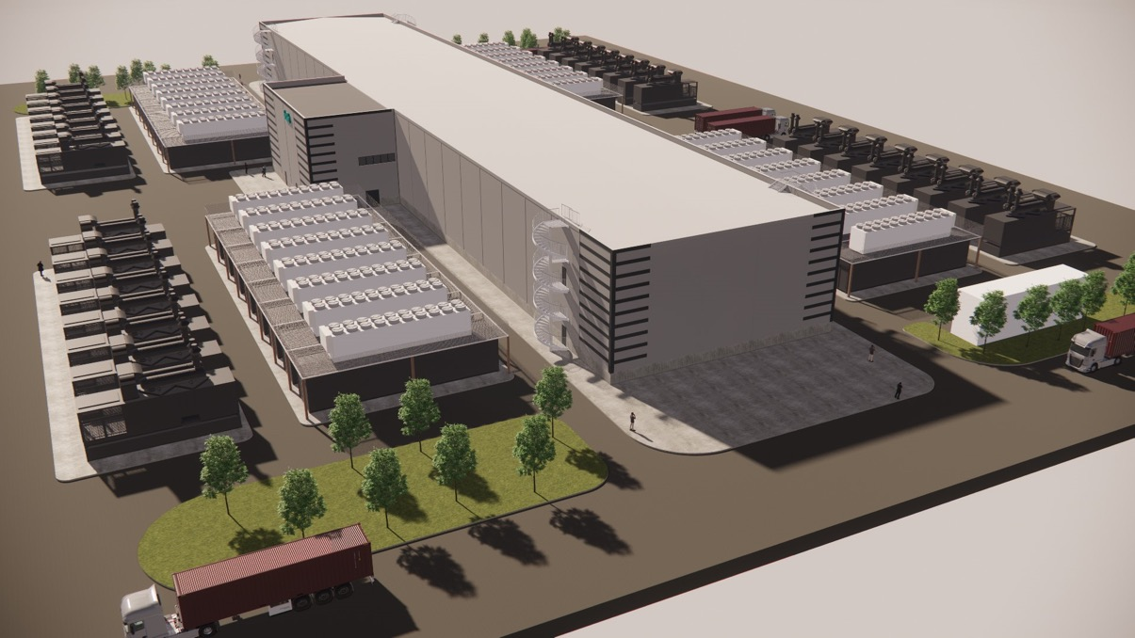
Digital Infrastructure is part of the solution
A large part of a data center's investment and land use is for generators and batteries
Data centers can offer flexibility
100% backup with generators plus a production unit in reserve
Battery bank that can operate the center for 6-10 minutes at maximum load during sudden outages or disconnections from the grid
Data centers have counter-cyclical power consumption. Much of the power consumption in a data center is for cooling, so consumption is highest in the summer
Cooling
Backup power and batteries
Confidential
35
Notes:
Batterier og nødstrømsaggregater er allerede velegnet for å levere tjenester til ovenforliggende nett
I dag er ikke styringssystemene på datasentrene rigget for å kunne eksportere kraft fra nødstrømsaggregatene inn til overliggende regional- og distribusjonsnett. Men dette er det mulig å tilpasse, og sentrene vil da framstå med betydelig produksjonskapasitet inn mot det norske kraftmarkedet.

Slide 36
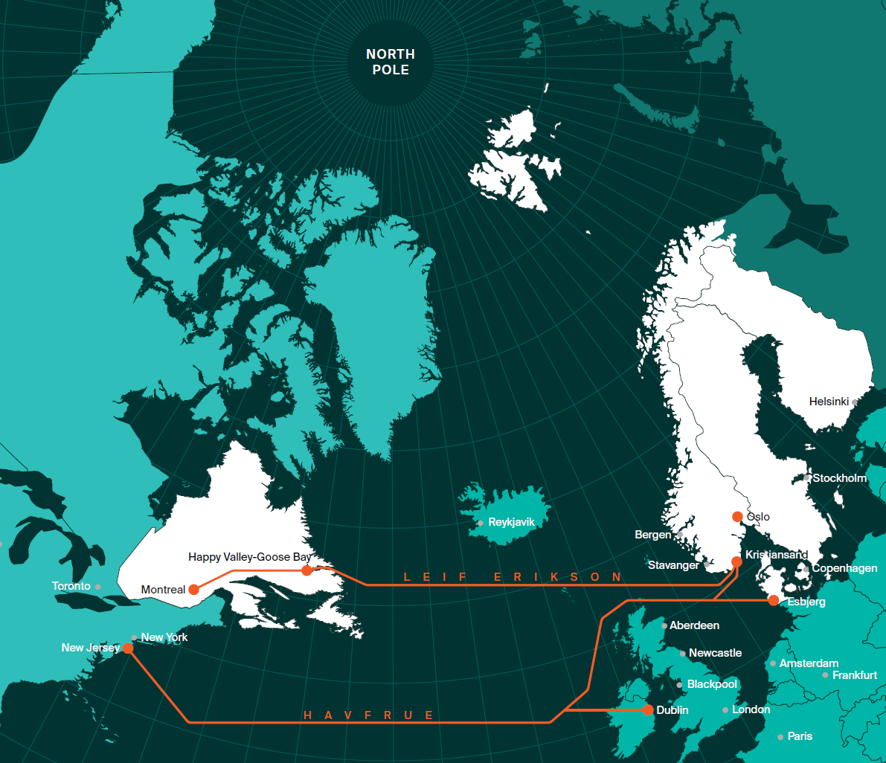
LEIF ERIKSON
- a sustainability project
Unlocking the global renewable giants
Moving Giga Bytes instead of Giga Watts, leveraging the advantages of the North
Cold climate
Abundant renewable energy
Robust core infrastructure (grid)
Shorter distances between continents
Political and financial stability
Secure connectivity between NATO allies
First trans-Atlantic system powered with 100% renewable energy
Bulk’s vision: Racing to bring sustainable infrastructure to a global audience
22g
carbon
intensity
27g
carbon
intensity
525g
carbon
intensity
420g
carbon
intensity
Public

Slide 37
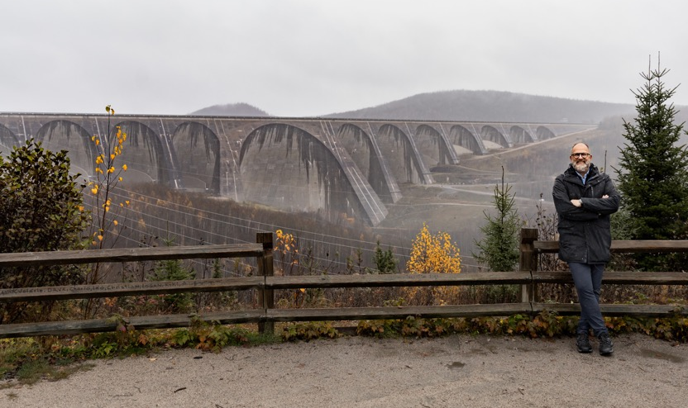
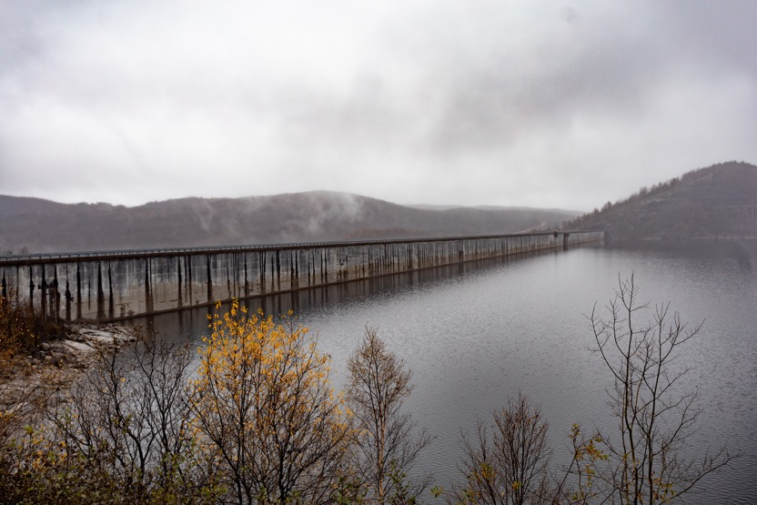
LEIF ERIKSON
27g
carbon
intensity
22g
carbon
intensity
525g
carbon
intensity
420g
carbon
intensity
Notes:
Har lagt inn hyperlink til Leif Erikson filmen i tittelen

Slide 38

Looking forward!
Confidential

