Slide 1
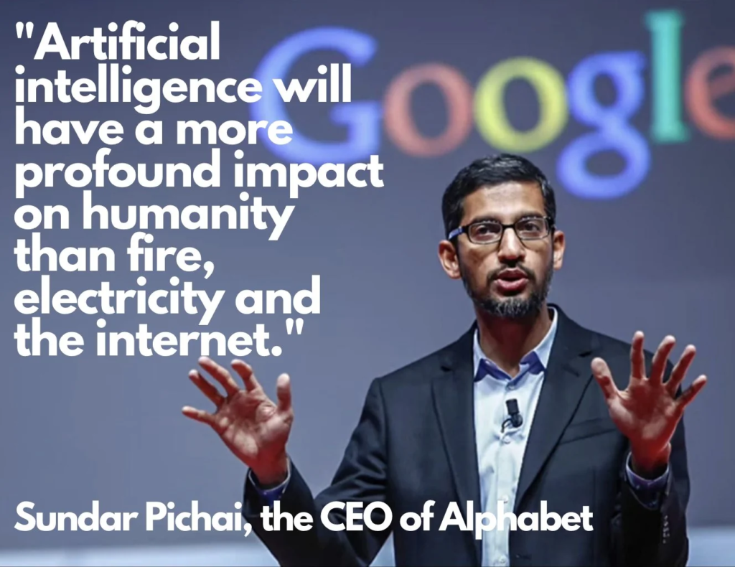
Generative AI for Industries, Firms, Investors
By Gary Kim, industry analyst, gary@fatpipes.biz

Slide 2
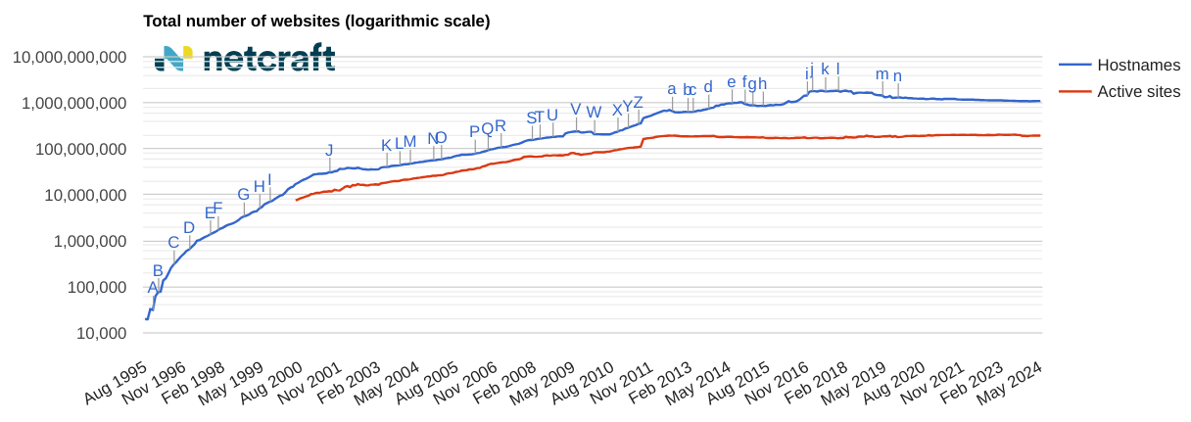
Still Really Early (AltaVista Example)

Slide 3
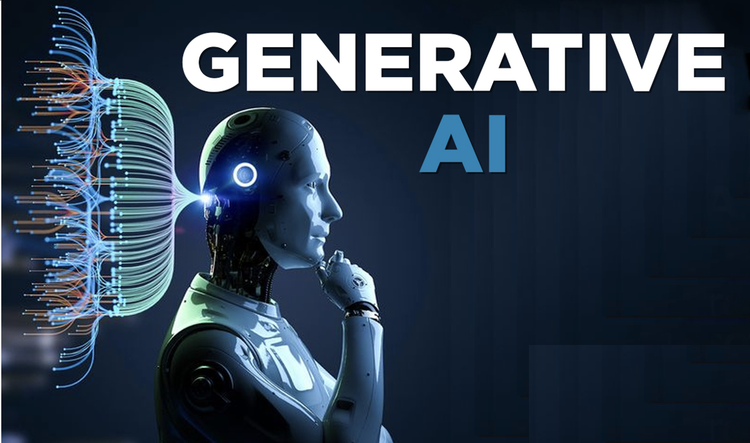
Today’s scope
Generative AI only (not machine learning, general intelligence)
Impact on business models, firms, individuals, investors
Assumes AI is a general-purpose technology
Assumes past GPT adoption pattern is prologue
Compare to one recent GPT (the internet)

Slide 4
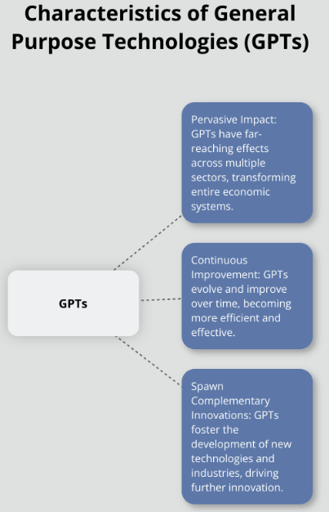
General Purpose Technologies
Steam Engine
Enabled mass production, railroads, and industrialization.
Electricity
Power generation, lighting, appliances, and industrial automation.
Internal Combustion Engine
Automobiles, trucks, airplanes, and motorized transport.
Railroads
Mass transportation, logistics, and commerce.
Telegraph and Telephone
Instant long-distance communication.
Computers
Information processing, automation, digital revolution.
Semiconductors
Enabled microprocessors, electronics, and digital devices.
Internet
Global communication, e-commerce, information sharing.

Slide 5
GenAI vs. AI Agents
Generative AI (Here now):
A class of AI models designed to generate content, such as text, images, audio, or code, based on input prompts.
AI Agents (Coming):
Autonomous systems capable of perceiving their environment, reasoning about it, making decisions, and acting to achieve specified goals.

Slide 6
Caveats
AI might not develop as a full GPT
Might just be “important” (cloud computing, e-commerce, social media, search)
Might be important in some verticals, not others
Might affect some economic functions, not others

Slide 7
Impact Might Vary
More Likely to be Affected | Less Likely to be Affected
Customer operations | Creative arts
Marketing and sales | Complex decision-making
Software engineering | Emotional labor
Research and development | Physical skilled trades
Data analysis | Interpersonal negotiations
Supply chain management | Ethics and policy-making
Financial services | Caregiving
Manufacturing | Education (teaching)
Transportation and logistics | Social work

Slide 8
AI Might be Useful but not GPT
Graphics Processing Units (GPUs)
Field-Programmable Gate Arrays (FPGAs)
Relational Databases
Digital Signal Processors (DSPs)
Computer Vision Systems
Embedded Systems
Quantum Computers
Blockchain Technology
Virtual Reality (VR) Systems
Speech Recognition Systems

Slide 9
Gen AI Impact?
Significant, over time
At least as much as other computing innovations
Possible disruption as great, or greater, than internet
Data centers: capex, power, cooling
Capacity: quantity rather than quality

Slide 10
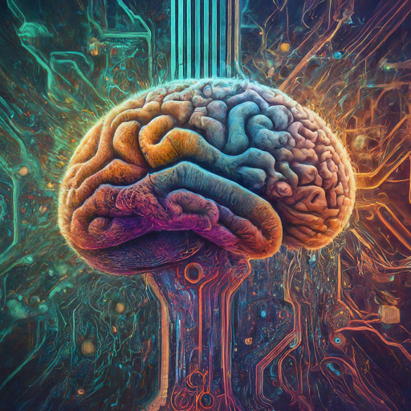
What is Generative AI?
A type of AI that can create entirely new data, such as text, images, music, and code.
Creates new data: Text, images, music, code, etc.
Learns from existing data: Trained on massive datasets to understand patterns and relationships.
Generates similar, but unique outputs: Creates new content inspired by the data it learned from
Notes:
Generative AI is a type of AI that can create entirely new data, such as text, images, music, and even code. It achieves this by learning from massive amounts of existing data. This data allows the AI to understand the underlying patterns and relationships within the information. Once trained, the AI can then use this knowledge to generate new content that is similar to, but unique from, the data it learned from.

Slide 11
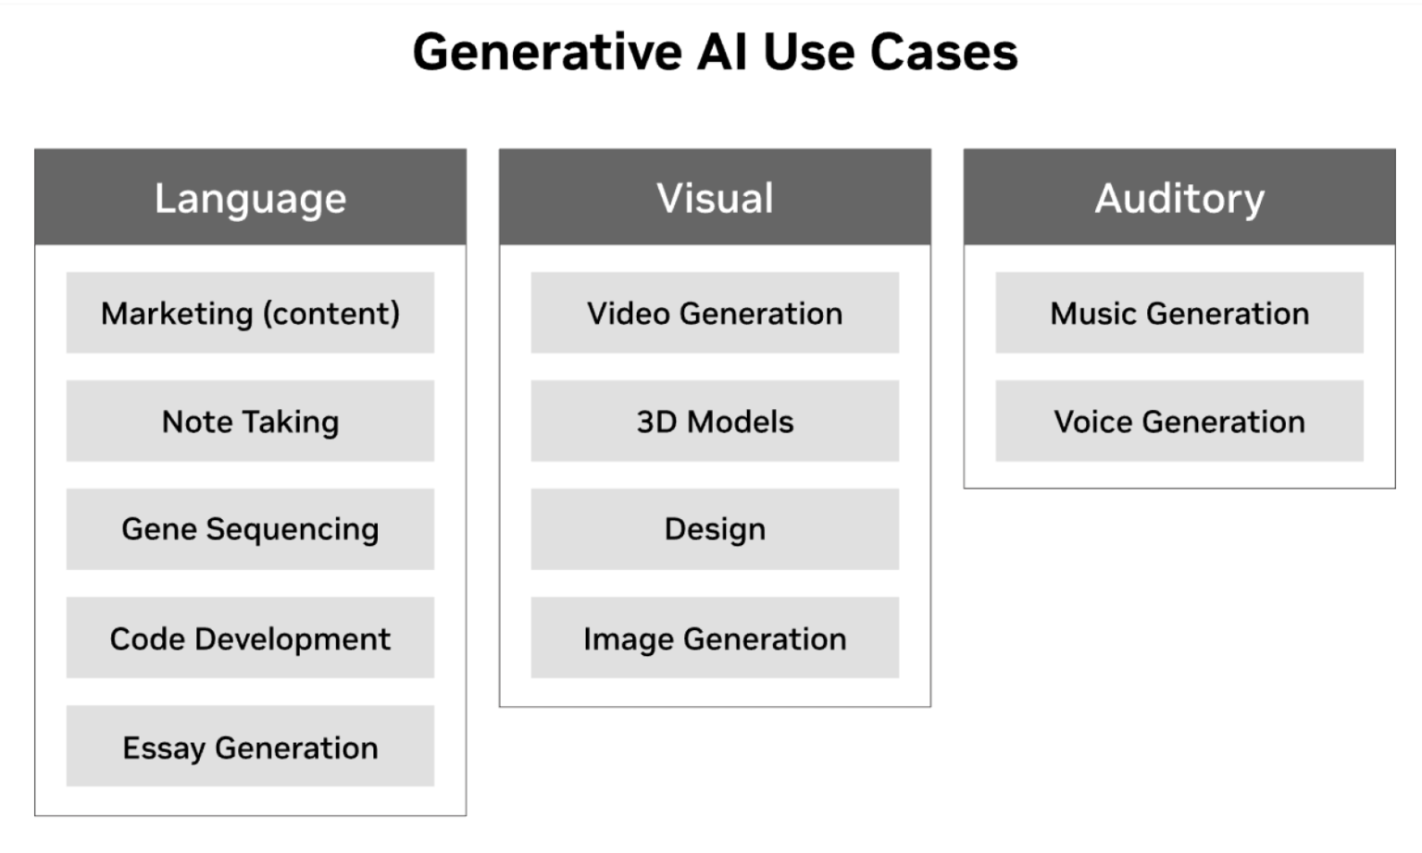
Existing GenAI Use Cases
Email drafting
Chatbots
Grammar checks
Written content
Code generation
Image generation and editing
Photo enhancement
Audio and Video Use Cases
Voice-to-Text
Create music
Video captions and editing
Voiceovers
Text-to-speech
Video effects
Homework help and study aids
Presentations

Slide 12
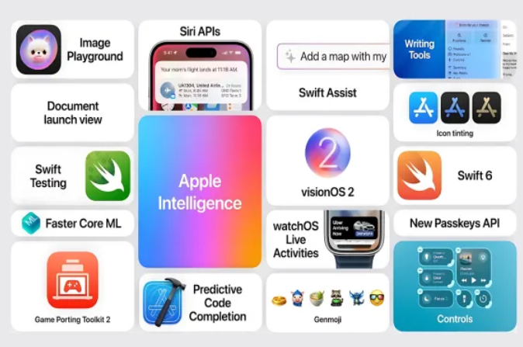
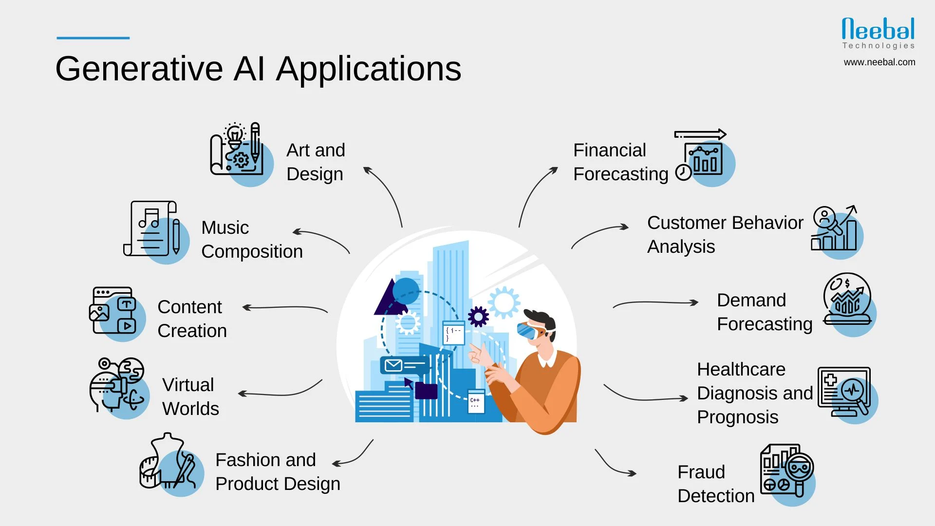
Smartphones More than Enterprise Apps?

Slide 13
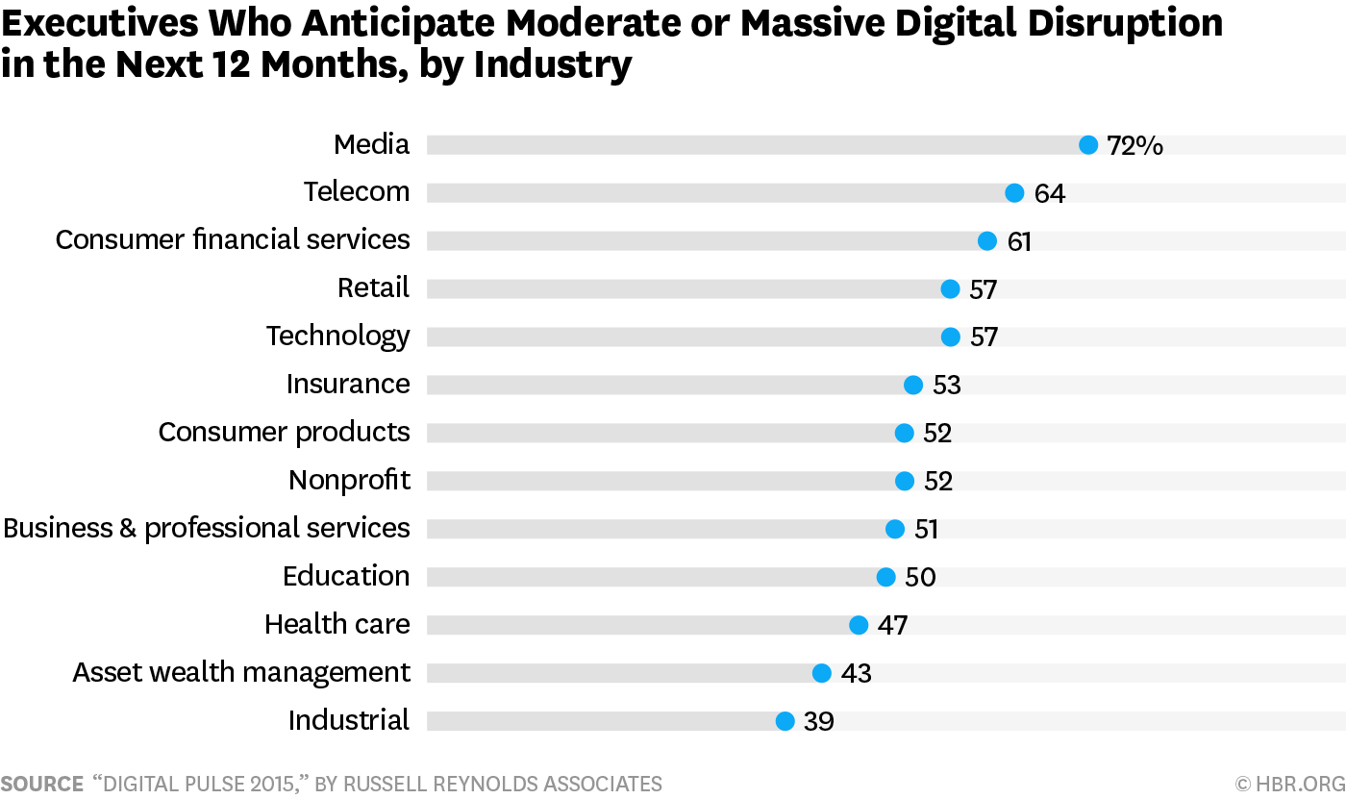
Pre-AI Expectations about Digital Disruption

Slide 14
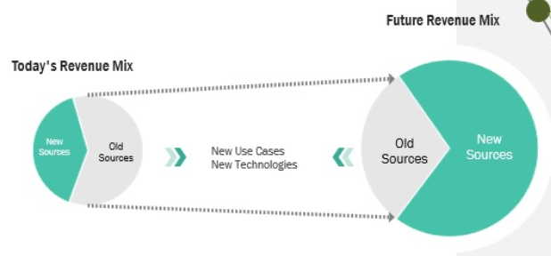
AI Disruption Danger

Slide 15
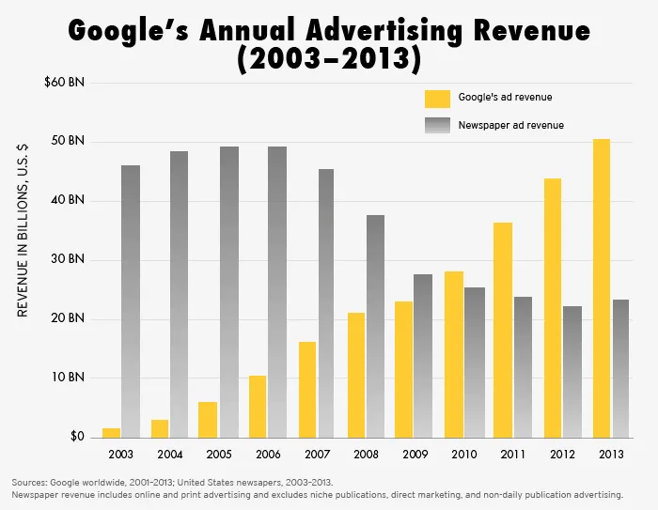
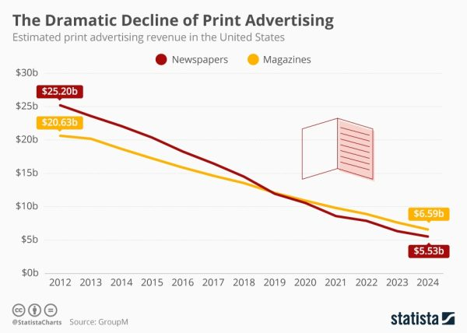
We’ve Seen it Happen

Slide 16
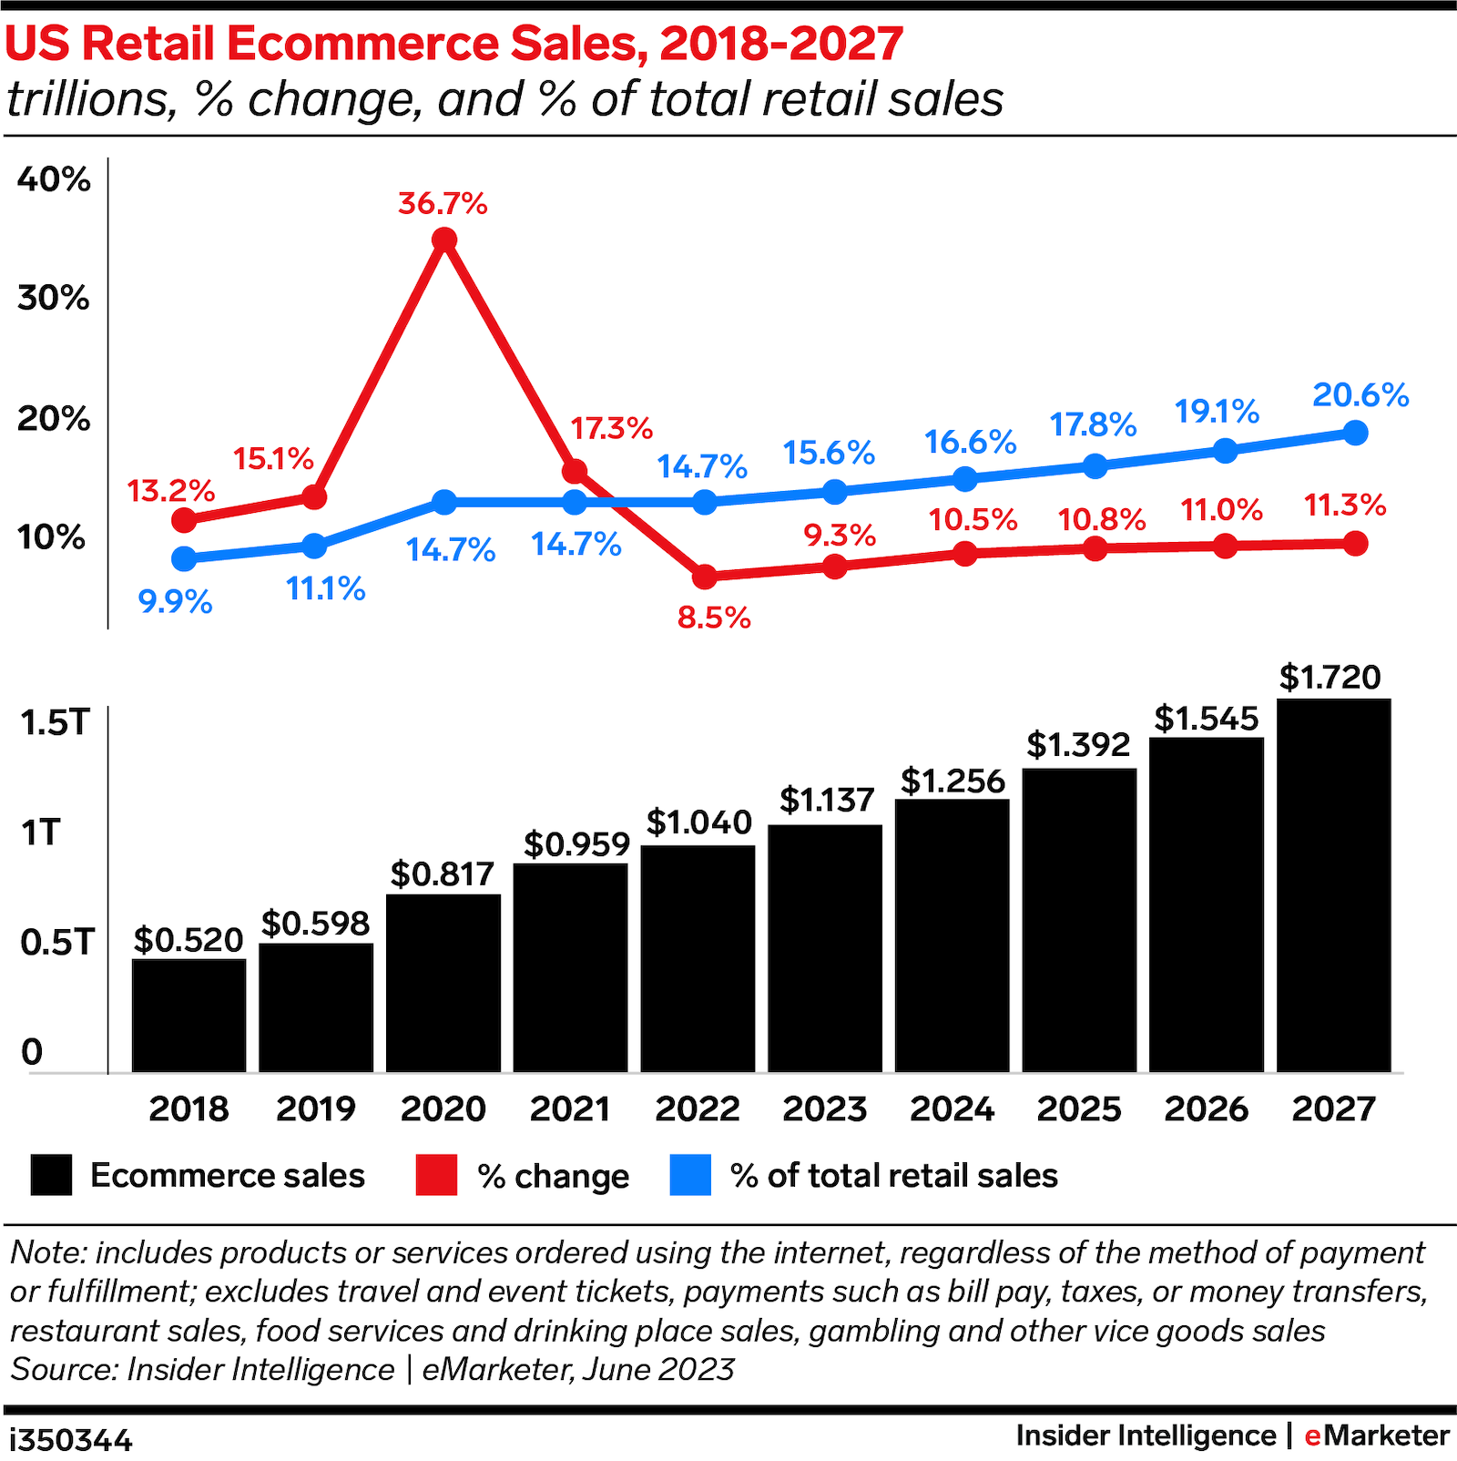
Most Industries “Somewhat” Affected

Slide 17
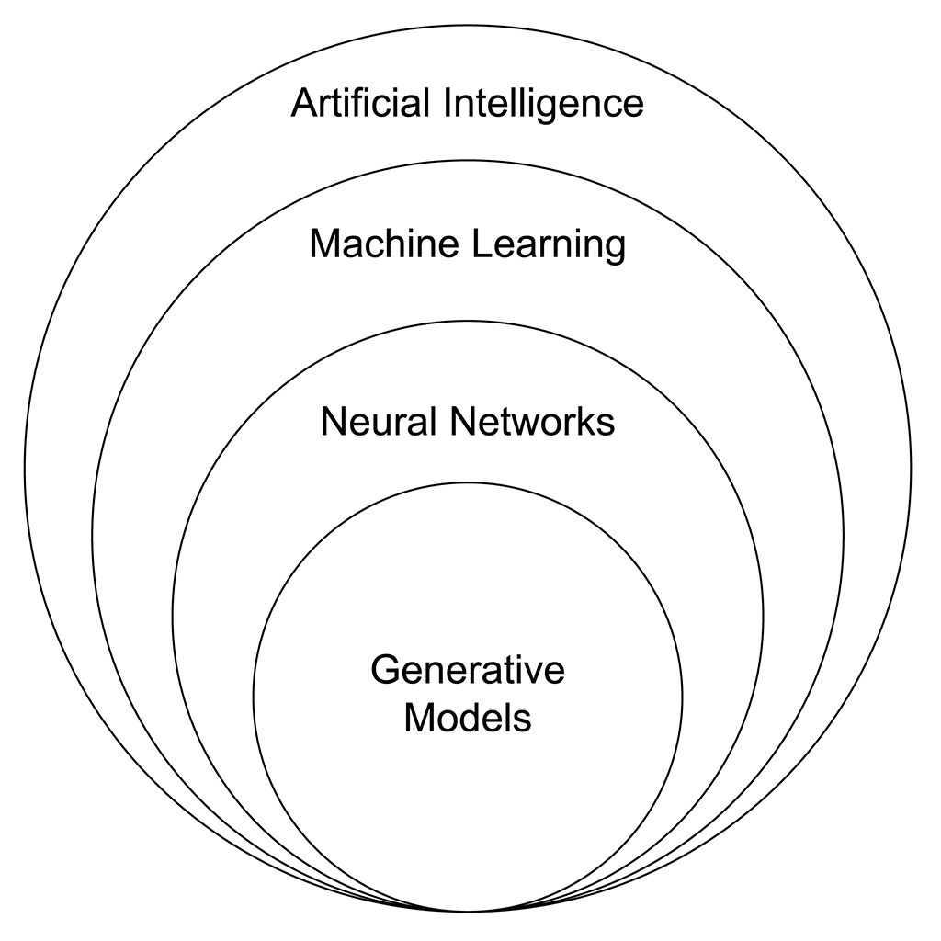
One form of “AI”
AI: Learning, reasoning, perception, problem-solving
Machine Learning: Unsupervised learning
Neural Networks: Pattern recognition (deep learning)
Generative AI: Creates new data or content

Slide 18
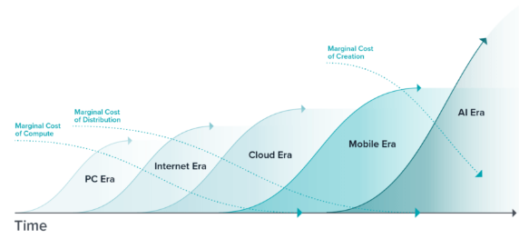
AI and marginal cost

Slide 19
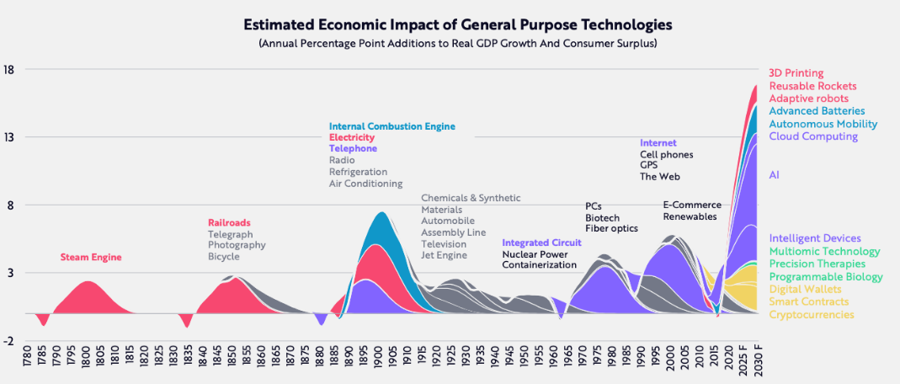
GPTs are a big deal

Slide 20


But it takes time

Slide 21
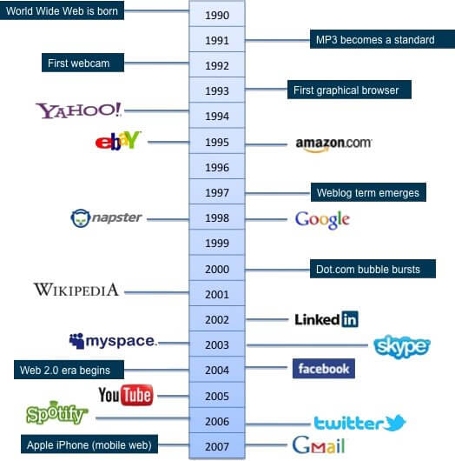
Innovation might take even longer
From World Wide Web:
Google founded 8 years later
LinkedIn 12 years later
Facebook 14 years later
Gmail 17 years later

Slide 22
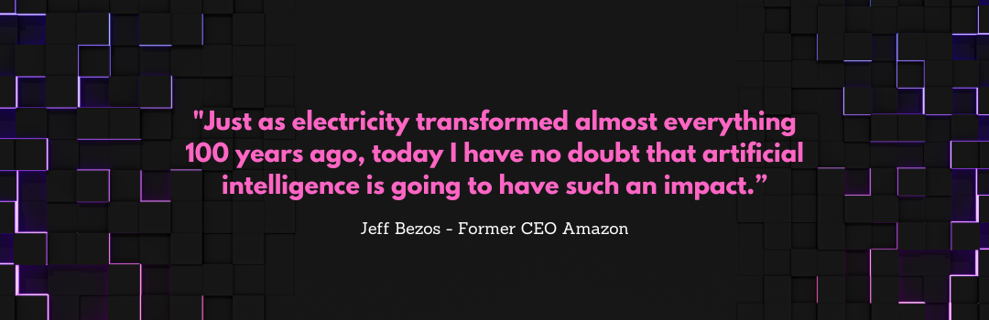
Is AI a “general purpose technology”?

Slide 23
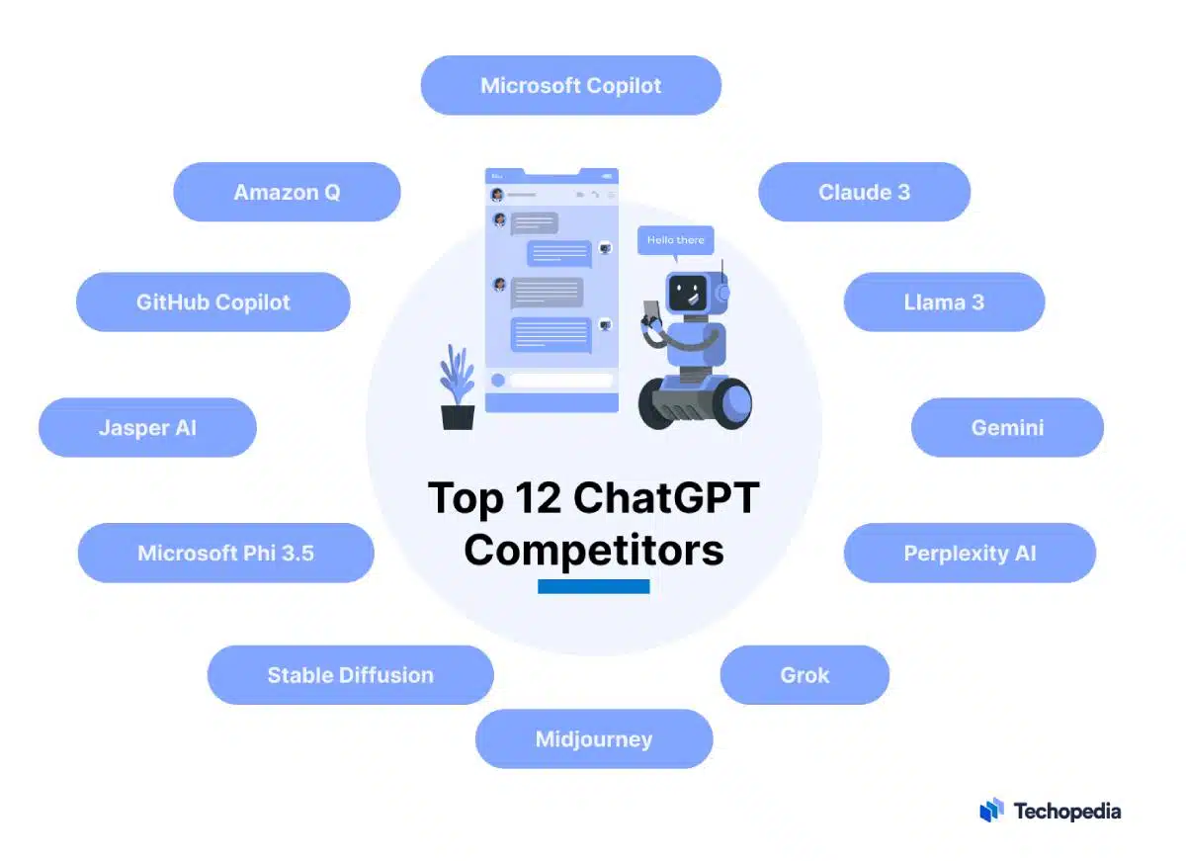
Many platforms
*Eventual “winners” still unclear
Large and small models
Specialty models (image, code, video, text, function)
Notes:
US:
OpenAI: A prominent player, known for its GPT-3/4 series of LLMs with strong text generation capabilities.
Google Gemini : Focuses on providing informative and comprehensive responses across various domains.
Europe:
Mistral (different from China’s Mistral; got Microsoft as an investor)
China:
Mistral: A leading LLM developed in China, known for its capabilities in areas like translation and text summarization.

Slide 24
General-Purpose Technologies)
Technology | Work Impact | Life Impact
Agriculture | Hunter-gatherer to settled communities, specialized roles | Increased lifespan, population growth, development of civilizations
Writing | Record-keeping, administration, communication, education | Preservation of knowledge, development of complex societies
Printing Press | Mass production of books, knowledge transfer, increased literacy | Spread of ideas, religious reformation, scientific advancement
Steam Engine | Industrial revolution, mechanization of production, transportation | Urbanization, productivity, improved living standards
Electricity | Powering machinery, lighting, communication, transportation | Improved quality of life, extended work hours
Computer | Automation, data processing, communication, design | Increased efficiency, globalization, digital revolution
Internet | E-commerce, remote work, global communication, information access | Connected world, social networking, digital lifestyle
AI?

Slide 25
Quantity Becomes Quality
Industry | Traditional Model | Subscription Model
Software | Perpetual License | Software as a Service (SaaS)
Music | Album Purchase | Streaming Services (Spotify, Apple Music)
Video | DVD/Blu-ray Purchase | Video Streaming (Netflix, Disney+)
Gaming | Game Purchase | Game Subscription (Xbox Game Pass, PlayStation Plus)
Automobiles | Vehicle Purchase | Car Subscriptions (Cadillac Subscribe, Porsche Passport)
Fashion | Clothing Purchase | Rental Services (Rent the Runway)
Fitness | Gym Membership | Fitness App Subscriptions (Peloton, Fitbit Premium)

Slide 26
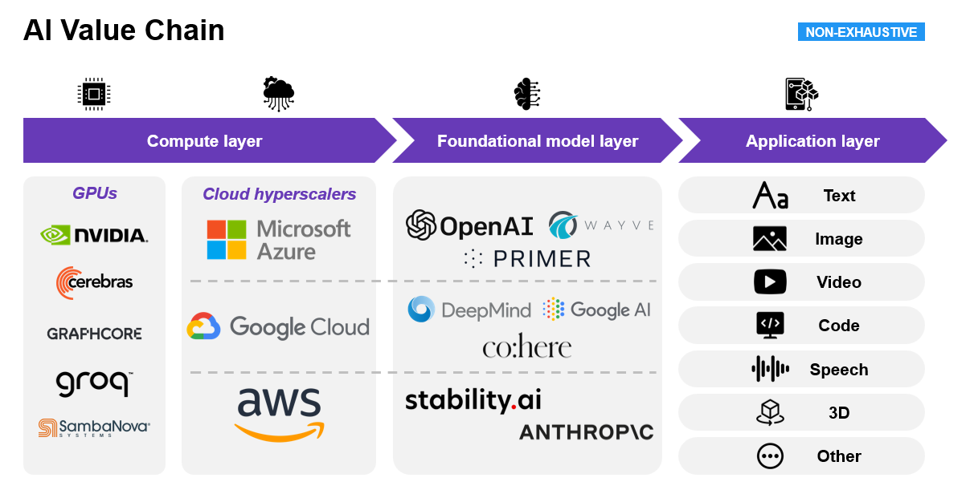
Heavy Capex: Where?

Slide 27
Impact on Data Centers, Connectivity Providers
Impact | Data Centers | Connectivity Providers
Positive | Increased demand for data center capacity due to AI workloads | Increased demand for high-speed, low-latency connectivity to support AI applications
Positive | Opportunity to offer specialized AI-optimized infrastructure and services | Opportunity to develop new services like AI-powered network optimization and management
Positive | Potential for increased revenue from high-performance computing | Increased revenue from higher bandwidth usage and new connectivity services
Negative | Increased power consumption and cooling challenges | Increased network congestion and latency concerns
Negative | Need for specialized hardware and expertise to support AI workloads | Increased competition from new entrants offering AI-specific connectivity solutions

Slide 28
Capex, Opex Impact Varies
Industry/Sector | Capex/Opex Focus
GPU Suppliers (e.g., Nvidia) | Massive capex (but already monetized)
AI as a Service (e.g., Google Cloud, Azure, AWS) | Significant capex
PC Hardware Firms | Increasing capex
Consumer Electronics Firms | Moderate capex
Data centers | Moderate capex boost (partly AI related)
Connectivity firms | Moderate capex boost (not AI related)
Software Firms | Primarily opex
Content Firms (e.g., Disney, Warner Bros.) | Moderate opex
Retail | Increased opex
Transportation | Significant capacity capex, incremental
Business Services | Primarily opex
Entertainment | Increased opex

Slide 29
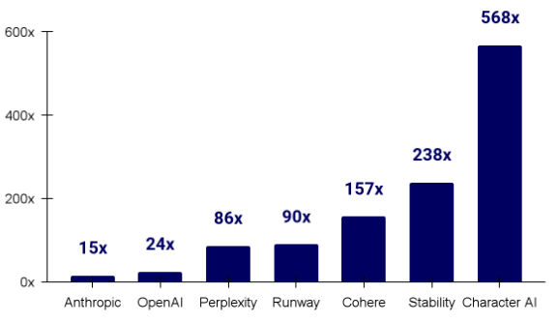
Model Profitability?

Slide 30
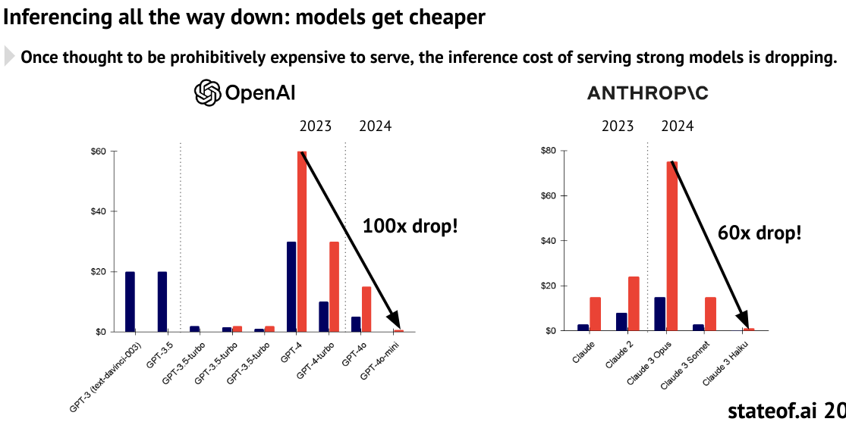
Costs are Dropping

Slide 31
Gamechanger? Maybe
Industry | Revenue Impact | Impact on Profit | Study/Source
Retail & CPG | +5% to +10% | +2% to +5% | McKinsey & Company (2023)
Manufacturing | +3% to +7% | +1% to +4% | Accenture (2023)
Healthcare | +2% to +5% | +1% to +3% | PWC (2022)
Finance & Insurance | +4% to +8% | +2% to +4% | Capgemini (2024)
Media & Entertainment | +7% to +12% | +3% to +6% | Deloitte (2023)
Professional Services | +2% to +5% | +1% to +3% | Gartner (2022)
Transportation & Logistics | +4% to +8% | +2% to +4% | IBM (2023)

Slide 32
Other Computing Innovations Impact
Industry | Revenue Change | Profit Change | Source
Retail | 15-25% | 10-15% | McKinsey
Manufacturing | 10-20% | 5-10% | BCG
Healthcare | 8-15% | 5-10% | Accenture
Financial Services | 12-20% | 8-15% | Forrester
Transportation & Logistics | 8-18% | 5-12% | Gartner

Slide 33
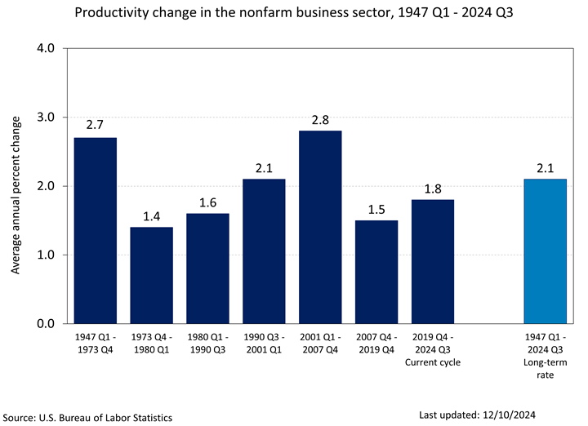
Impact Likely Exaggerated

Slide 34
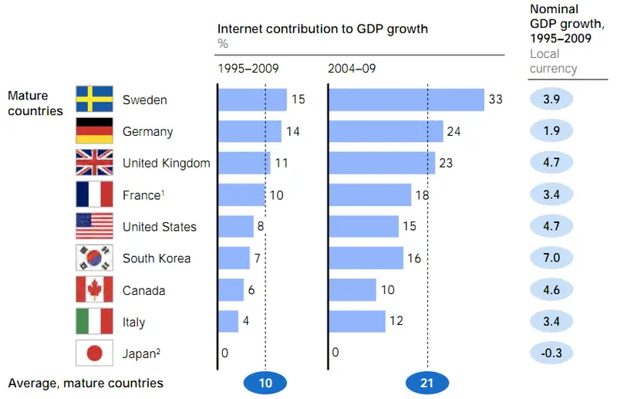
Summary: Disproportionate Impact
The internet contribution to the U.S. GDP: 22% per year since 2016
National economy grows 2- to 3% per year.

