Slide 1
Innovation in the Submarine Cable Industry
Darren Griffiths
Rene d'Avezac de Moran

Slide 2
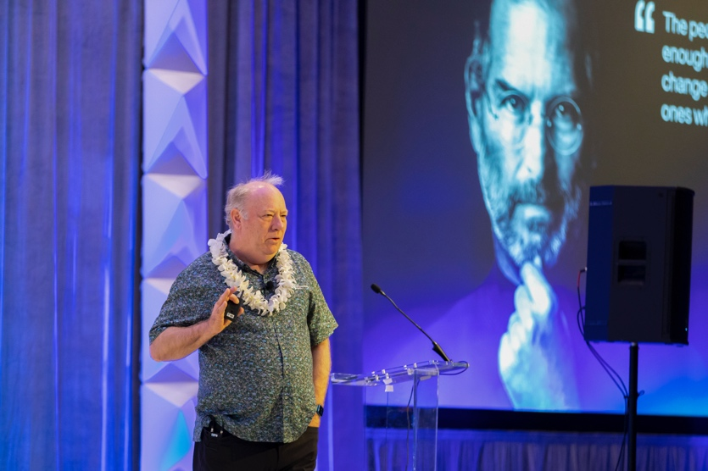
Who lead’s innovation?
Ideas should be able to come from anyone at any time in an organisation
It's key to allow your teams to question current practices and techniques
New technology maybe not known to all, so it's key to highlight and draw attention
Image description (14px)
Can pre-existing technology in other industries be adapted quickly into the industry?
Who: Companies / Industry organisations support development and improvements?

Slide 3
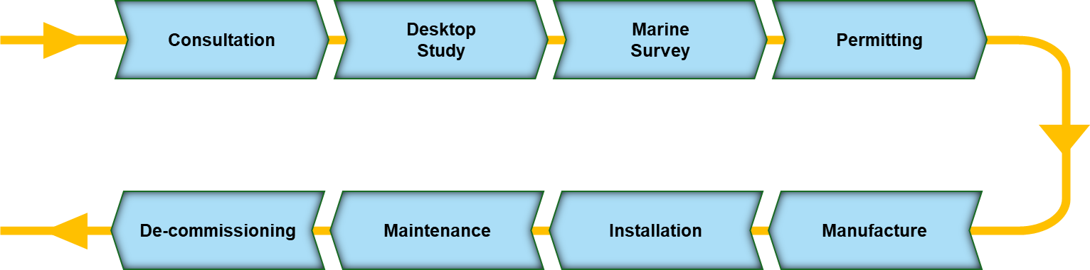
Submarine Cable Project Lifecycle

Slide 4
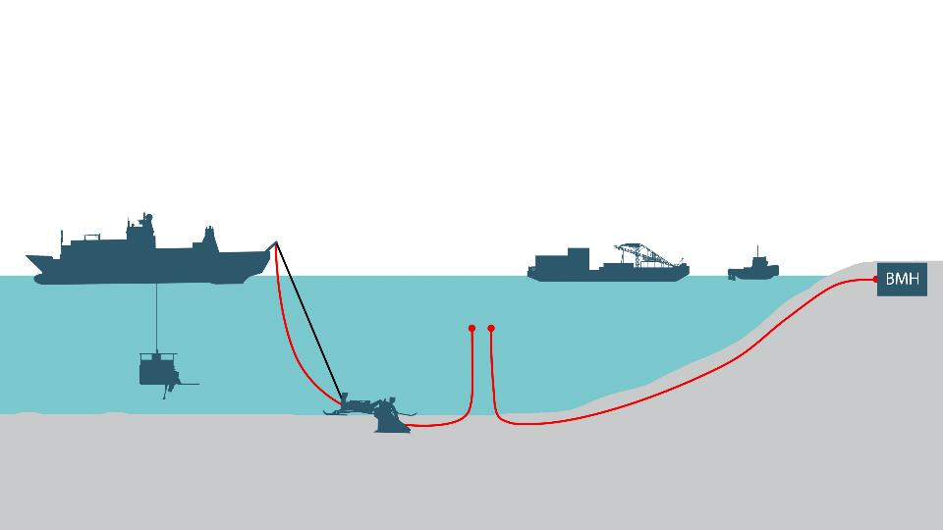

Submarine Cable Project Lifecycle
Permitting
Obtain necessary Permit-in-Principles (PIP) and Environment Impact Assessment (EIA) required for cable laying or landing with local regulators
Installation
1. Pre lay Grapnel Run (PLGR)
2. Cable Installation (Deep
Water and Shallow Water)
3. Post Lay Inspection &
Burial (PLIB)
Maintenance
Dedicated Vessels to maintain and repair cable in the event of any cable cuts/faults reported
Cableship
Cable Landing
Cable Barge
Tugboat
UJ Service
Deep Water
Shallow Water
ROV
Plough
PLIB
Cable Burial
5

Slide 5
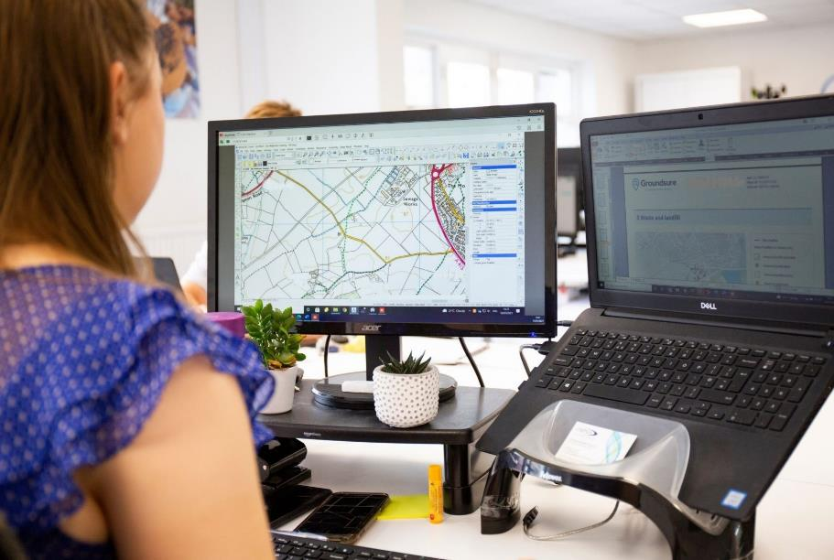
Desk Top Studies
Use of extended GIS Modelling – Aid cable route planners by defining areas of seafloor to avoid
AI Platforms to support the review, summary and key points of concern from polices or regulations
Improved turnaround time
Risk reduction and quicker to apply new approach's – cable spacing rules etc.
Speed up data acquisition and processing
Source: OMNIA

Slide 6
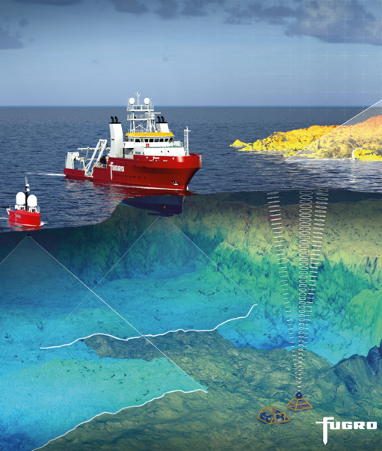
Acoustic Surveys
Reduce QHSSE risks
Reduce Carbon footprint of project
Increase project flexibility
Global approach
Speed up data acquisition and processing
Quicker site situational awareness on repairs

Slide 7
Survey Scopes
Shallow Water & Inshore
Deep Water
Operation / Parameter | Definition
Shallow Water survey water depth limits | About 15m to End of Burial (EOB) typically 1000m or 1500m water depth LAT The ‘Shallow Water’ definition includes all Mid-Ocean rises along the route with depths shallower than EOB
Overlap between Inshore and Offshore Survey | 500m inline overlap
Corridor width, centred on proposed route | 500m wide corridor for all areas
Sediment sampling interval (Coring/Grab) | 1 per 5 or 10 km (nominal) in shallow water; 1 per 500 m in inshore section
Burial Assessment Study Requirement (CPT) | 1 per 5km (nominal) in shallow water
Target Burial Depth | 1 to 3 m, depending on target burial depth
Operation / Parameter | Definition
Deep Water survey water depth limits | > EOB
Corridor width, centred on proposed route | 3 x Water Depth or a maximum of 10km
Sediment sampling interval (Coring) | N/A
BAS Requirement (CPT) | N/A
Target Burial Depth | N/A
Beach
Operation / Parameter | Definition
Corridor width and survey limits | 500m wide corridor, extending 250m inland of the BMH
Sediment Depth Determination across the Beach (BMH to LWM) | 2m depth at a nominal frequency of 25m spacing

Slide 8

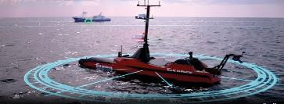
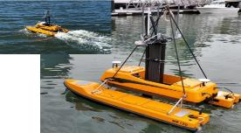
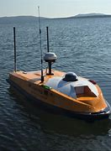
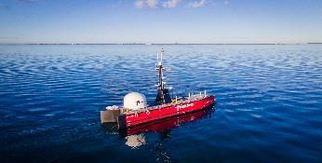
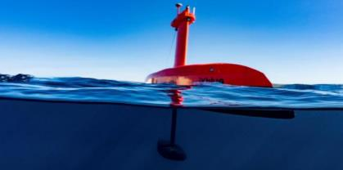
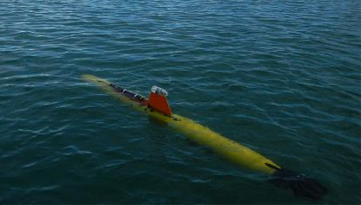
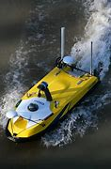
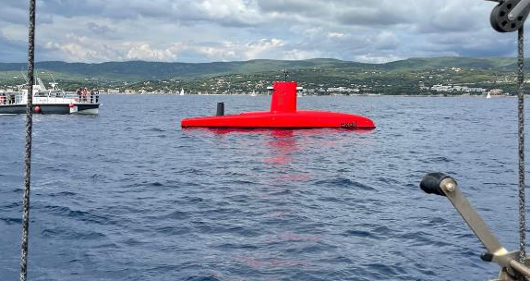
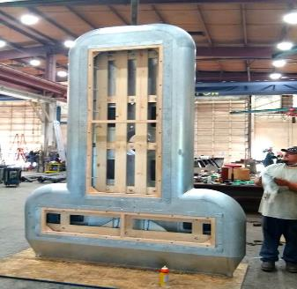
Shallow & Deep-Water Surveys
From Shallow water to End Of Burial (EOB)
Remote geophysical survey works
    AUV
    USV
Remote geotechnical solutions are not yet available
Permitting is complex, local flags, etc.
Deep water beyond EOB (~ 1,000m WD)
Bigger equipment
No geotechnical work
Less permit issues
One multibeam line
Simple operation to control remotely
Source Teledyne, Exail, Fugro, Bintang Subsea
Source Fugro, Exail, Saildrone, Kongsberg

Slide 9
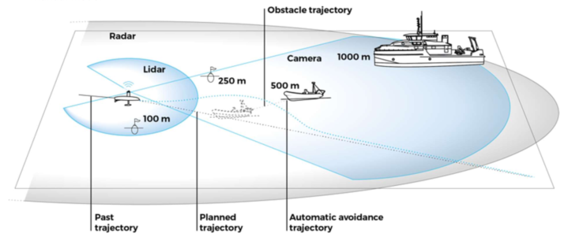
Smart Autonomy
Mission management
Over The Horizon operations
Survey data acquisition
Survey data processing
Obstacle Avoidance System - Main mission display
  3D LIDAR
  360-degree optical (RGB and IR camera) coverage
  Automated Identification System (AIS)
  Radar
  Inertial Navigation System
  Differential GNSS
  Forward Looking Sonar
Source Exail

Slide 10
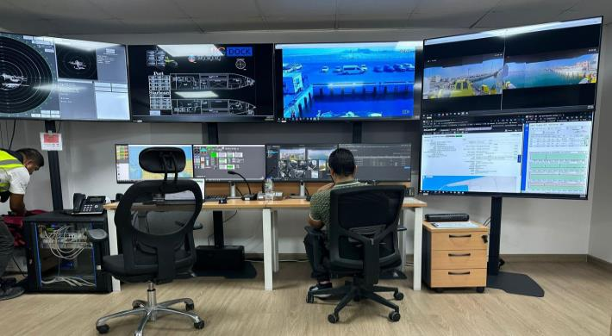
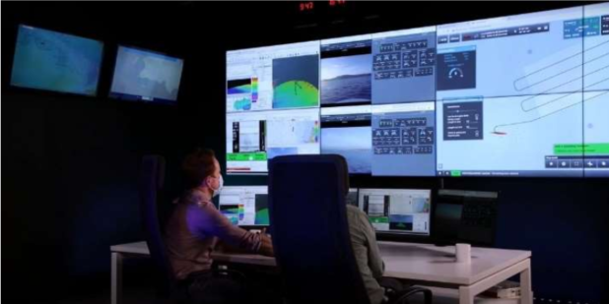
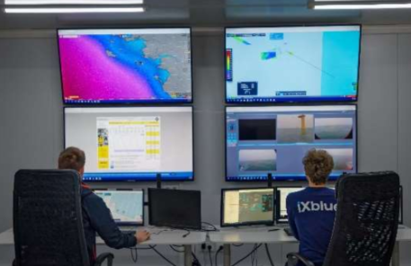
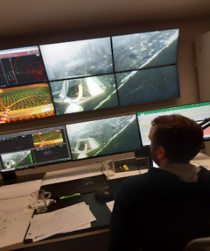
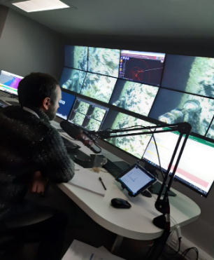
Supervised autonomy or remote control
Command & Control
Remote oversight of vessel activities
  Main mission display
  Cameras’ display
  Health Monitoring
  Deck surveillance/awareness
  Survey navigation and data quality
Video streaming over low bandwidth
Automatic online client updates
Remote client representatives / decisions
Augmented reality for skilled ops.
AI aided data interpretation
Sources Exail, Fugro,
  Shelf Subsea
8

Slide 11
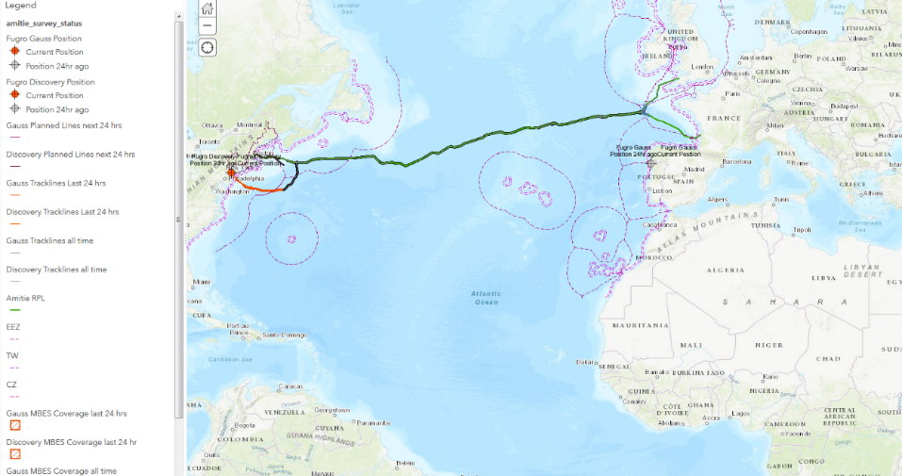
Online GIS
  Up / Download of result files
  Online gridding on demand
  Contour lines on demand
  Geophysical Information on demand
  Reporting capability on demand
  Data Management and long-term storage
  AI to support data lake analysis
  Integrate other available date
  Route Engineering on demand
  Merging of data bases
  BAS on demand
Source Fugro

Slide 12
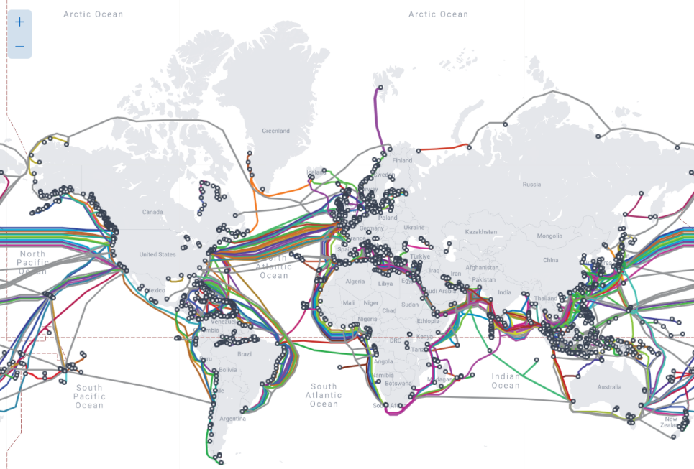
Installation – Key Time & Cost to a project
Reduce GHG emissions
  New propulsion for cable ships?
  Alternative energy source?
How can we reduce the time at sea?
Cable protection index
Avoid over-protection
Source Telegeography

Slide 13
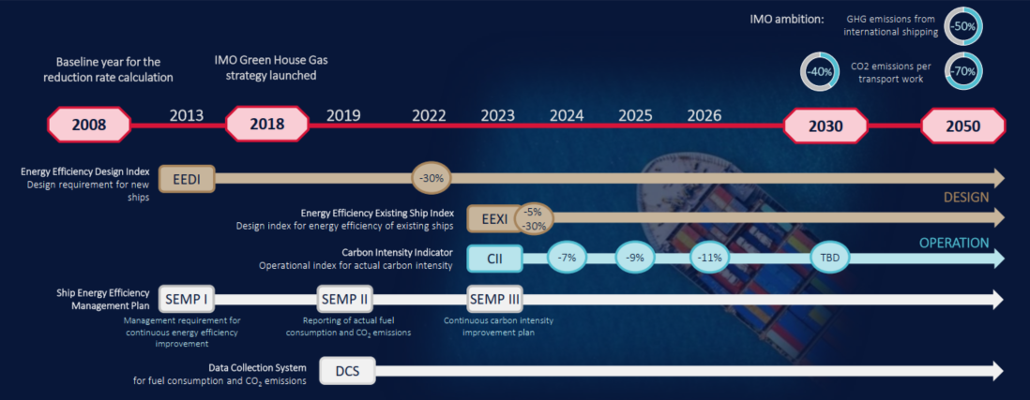
IMO GHG Regulations
Source IMO / Kongsberg

Slide 14
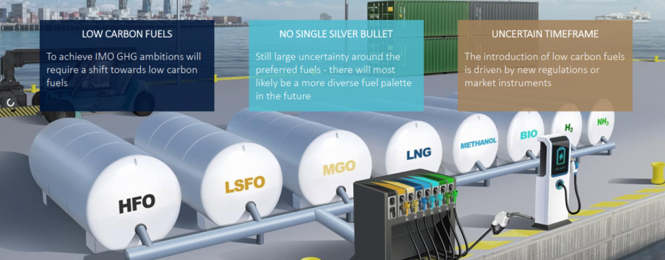
Fuel Transitioning
Source Kongsberg

Slide 15
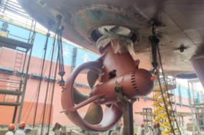
Efficiency – Impact on the Power System
New propulsion Azimuth thrusters, compared to traditional mechanical thrusters are, in average, 10% more energy efficient (source ABB Azipod® comparison).
Some of the newer systems have less moving mechanical parts, some a gearless for example.
  Reduced lubrication oil
  Reduced fuel consumption
  Reduced maintenance
  Increased reliability
Switch to LED lighting onboard reducing power needs and increased lifespan
Photovoltaic paste – application in future EV Cars for vessels?
Source ABB

Slide 16
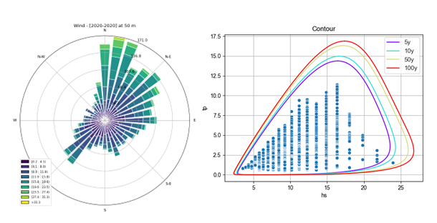
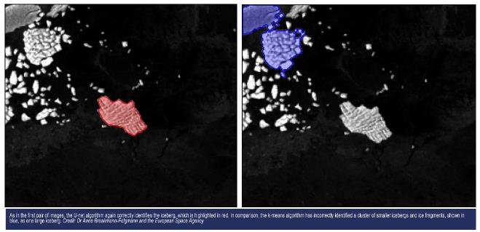
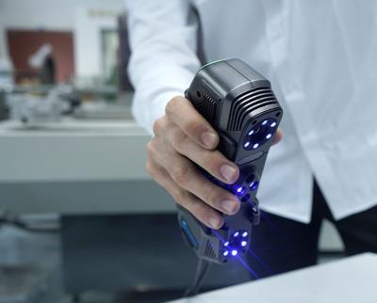
Efficiency – Installation
Laying Software – use of simulations to train and anticipate scenarios
Weather & Current models – anticipate and install in the correct windows
Touch down monitoring tools – accurate positioning to high levels
Plough – deeper burial, reduction tow tensions
Satellite / Drone use for scouting risks ahead (FAD's / Ice etc.)
3D Scanning - allow for measurements to be sent ashore and parts ready
Vessel Management system – anticipate issues, order spares in advance
Source
SINTEFblog
GeoConnexion
Scantech

Slide 17
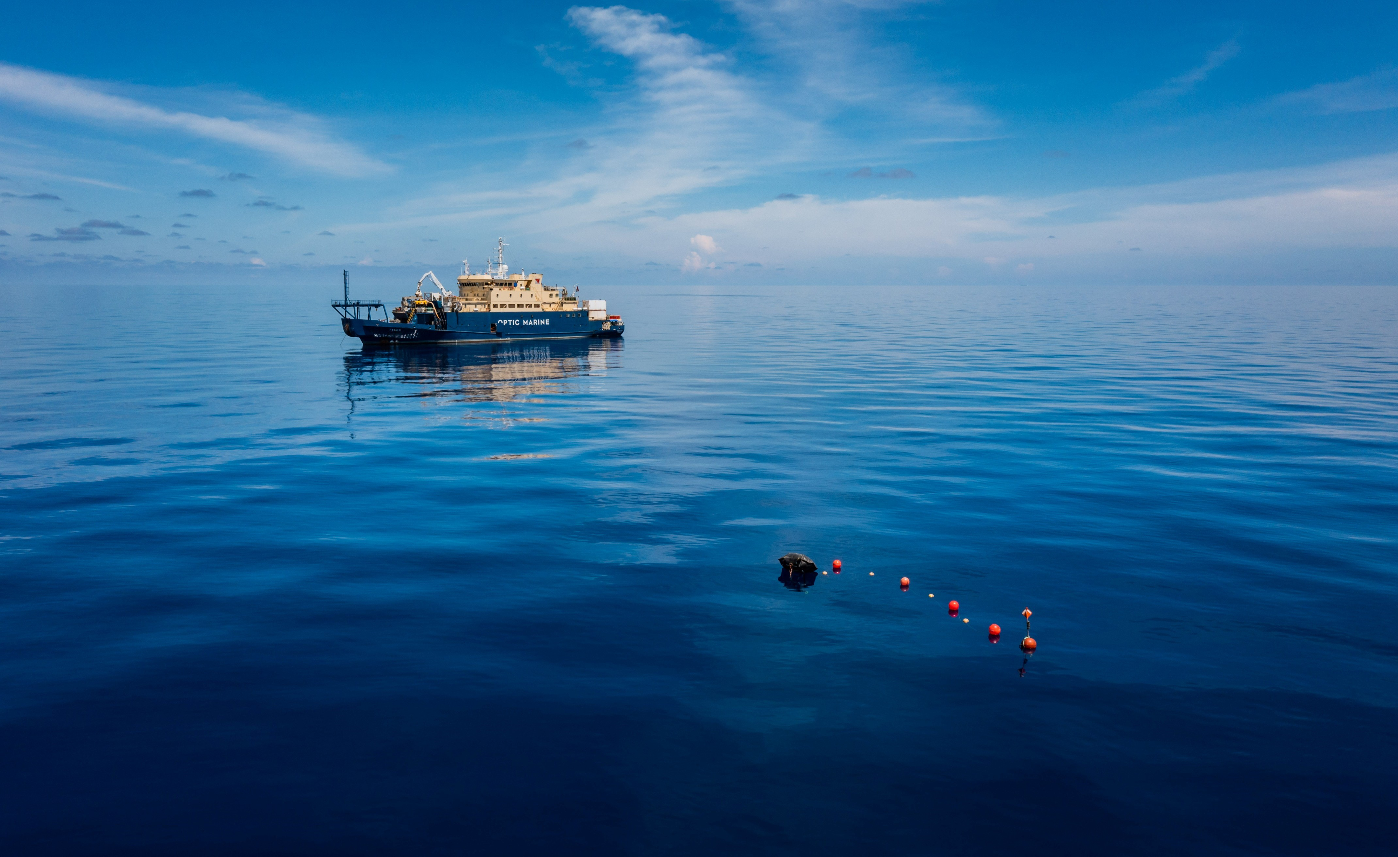
Efficiency – Maintenance
Efficient and mobile survey equipment – assess and scan the repair site
Optimising jointing & Testing timings on repairs – efficient testing from CLS’s and Vessels to speed up repair time and risk on the cable
Accessing spares efficiently and safely – Onboard / Depot access
Tooling to optimise time and efficiency – C&H grapnel
New tooling to de-bury and repair 3m buried cable
Source: OMS Group

Slide 18
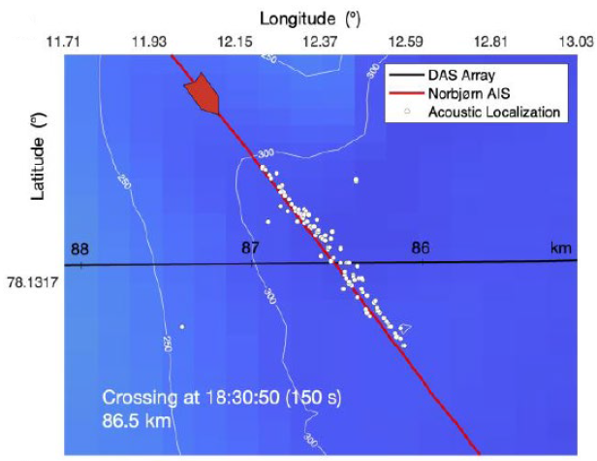
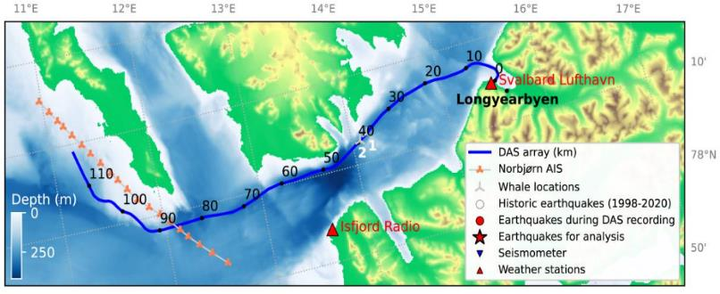
Other Innovations
Distributed Acoustic Sensing (DAS)
  Preventative maintenance
  De-risk system interference / locating source of faults
  Permitting and regulation restrictions – what’s to come?
Source ASN

Slide 19
What is DAS?
Distributed Acoustic Sensing
  Preventative maintenance
  De-risk system interference / locating source of faults
  Permitting and regulation restrictions – what’s to come?
Source Telegeography

Slide 20
What is DAS?
DAS detects movement in the water & seafloor nearby the cable.
2km+
Detected seabed activities on each side of the cable.
Turn optical communication networks into highly sensitive sensors
Image description (14px)
150-200 km
monitoring range, from the location of the OptoDAS unit. Testing to increase range to 1,000km+.
1 single fiber
needed to deploy the solution. Potentially in parallel with traffic.

Slide 21
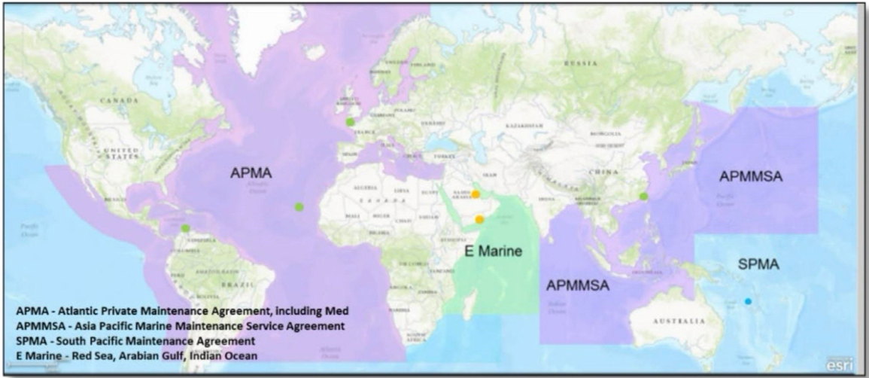
Is it time to rethink maintenance zones agreements?

