Slide 1


Optimizing Colocation: Search. Compare. Buy Smarter.
Your Career / Your Ladder
Building Relationships & Professional Networking

Slide 2
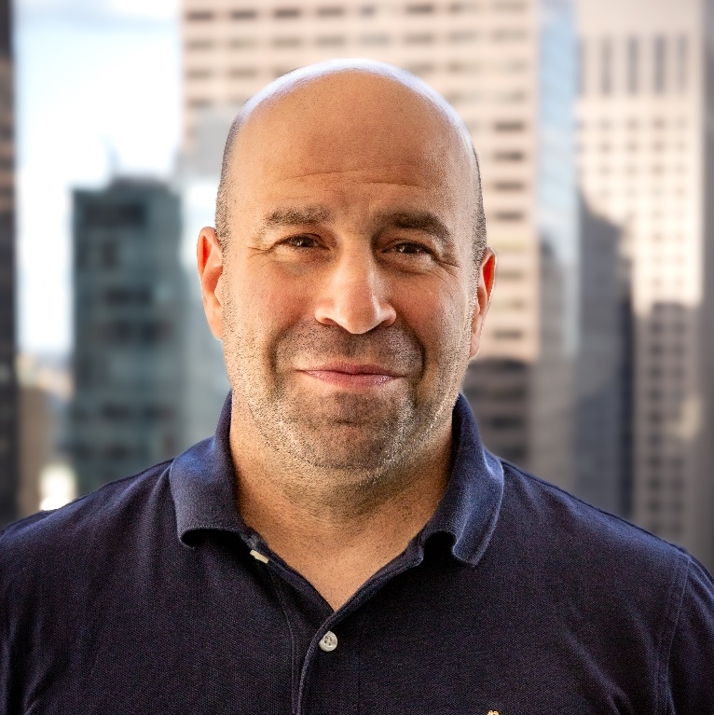


















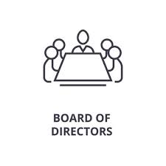


Introduction
  TONY ROSSABI, Founder and Managing Member, OCOLO
  Tony Rossabi is Founder and Managing Member of OCOLO, a unique and innovative marketplace for data centers, Founder and Managing Member of Aura Principal Group, and Chairman and CEO of Beyond Data Centers. Tony is the former CEO and a Board Member of Recovery Point Systems (RPS), a provider of data center and recovery services. Tony is an Independent director for Connectbase, Vantage Data Centers, 1623 Farnam, C-Connex, Mach Networks, and Contract Leasing Corporation.
  With more than 25 years of experience driving growth and innovation for technology and telecommunications enterprises, Tony has guided several companies to successful turnarounds and exits.
  Prior to RPS, Tony worked for TierPoint as Executive Vice President and Chief Revenue Officer, where he was responsible for overseeing revenue growth, managing the daily operations of TierPoint’s national sales organization, and devising the company’s strategic plan. He was part of the 3-person executive team that raised $325 million to drive the company’s growth.
  Prior to TierPoint, Tony served as Managing Director for Digital Realty Trust’s colocation and connectivity business unit, and earlier was Executive Vice President of Sales, Marketing, and Strategy for Telx Group, Inc. (acquired by DRT). In 2015, Tony was part of the executive team that sold the business to Digital Realty Trust for $1.98 billion, realizing a 43% IRR.
  Tony supports several organizations as a member of non-profit Boards, including the Pacific Telecommunications Council (PTC) and the Board of Surgeons Overseas.
  Past Corporate Board roles: PCTEL formerly listed on NASDAQ (acquired in December 2023), National Express Wash, and Qarbon Technology.
  Tony holds BA, MBA, and Juris Doctor (JD) degrees.
Career Journey
Legal
Telecom
Data Centers
Entrepreneur
Board/Advisor

Slide 3
What can you learn from me?
I am a technology professional
I am respected in my field
I hustle and work hard
I am known for my networking
  Tens of thousands of LinkedIn connections
  Consistent calendar of impactful meetings, lunches, and dinners and calls
I am a life-long learner
I have earned the luxury of being selective in the tasks I take on and the positions I accept
I am successful
I am content

Slide 4


Agenda
Career Planning & Goal Setting
I.R.A.R.T.I.C. (The Plan)
Remain Current & Relevant
Mastering Networking!
Summary: Key Takeaways
Notes:
1. Opening Remarks
Welcome and introductions
Approval of the agenda

Slide 5

Career Planning
& Goal Setting
It’s YOUR Future!
YOU Create It!

Slide 6


Aspirations
Identify and define your aspirations
  How does it tie to your core ambitions?
  How can you hone and refine them?
Build and nurture your goals and objectives
  Take initiative — don’t hold back!
  Stay focused in times of uncertainty
  Be flexible and adaptable
Learn to lead yourself
  Stay positive!
  Be intuitive
  Adapt to new learnings
  Be Bold!
  Take Chances
  Don’t sit around!

Slide 7
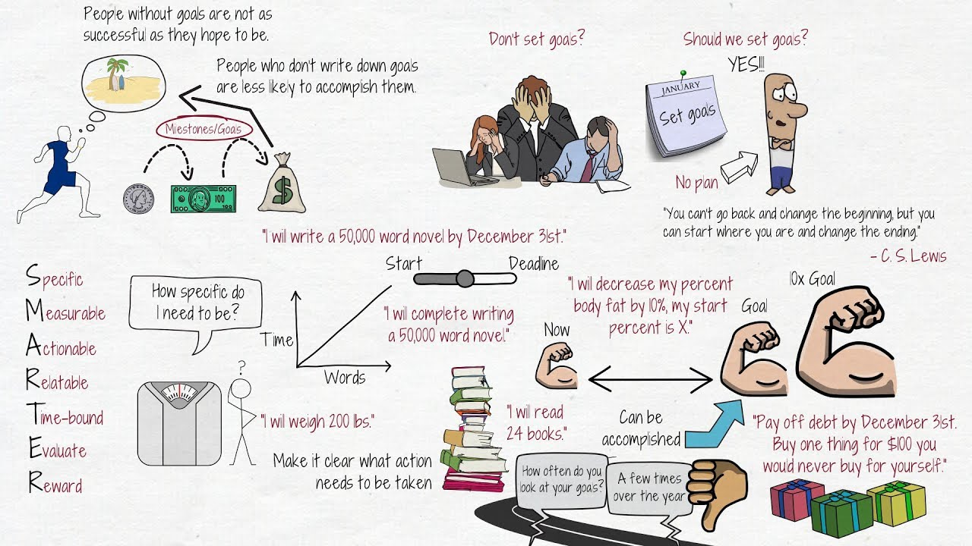
Execution
Develop your plan!
Set goals that motivate you
Set S.M.A.R.T.(ER) Goals
I.R.A.R.T.I.C. (The Plan)
  Issue
  Reasoning
  Analysis
  Recommendation
  Timeline
  Implementation Plan
  Conclusion
Hold yourself accountable
  Make notes & track your progress
  Create clear & actionable steps
  Stay committed & stick with it!

Slide 8
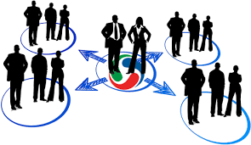

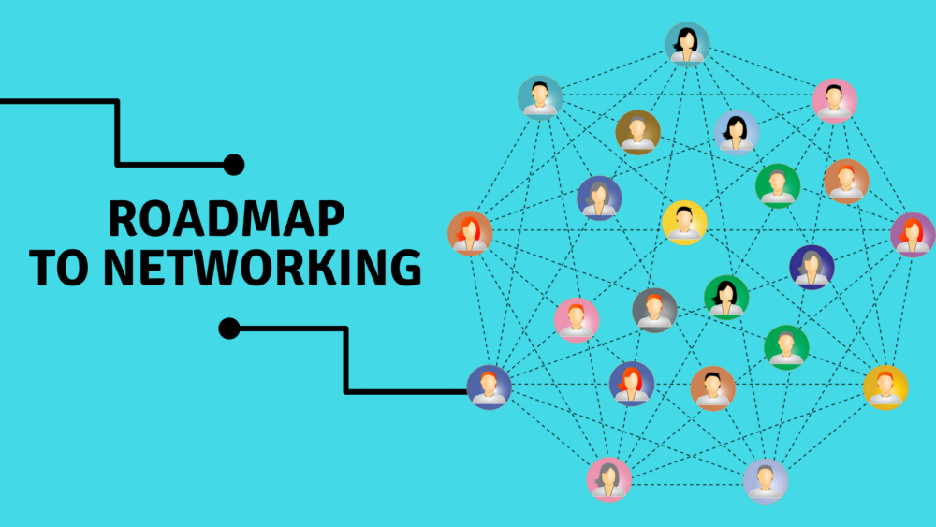
Be Active!
Three ways to ensure you’re always actively growing your network
1. Be Engaged
2. Be an Active Learner
3. Network with EVERYONE
  Participate
  Socialize – ideally in person
    Leverage social media
      Be present
      Be smart / sensitive
  Join relevant organizations
  Lead by example
  Give back / Pay it forward
  Read everything!
  Pursue training / certifications
  Check out blogs / podcasts / webinars
  Become a subject matter expert
  Attend events in person whenever possible
  Be an active listener
Ask yourself what you can teach others
  Focus on them, not you
    Show interest – listen curiously
    Ask yourself: what can you learn vs. what can you get
    Always follow up
  Cross-pollinate
    Make introductions
    Help when asked & don’t be afraid to seek help
Prioritize mentorship
  Find one & be one

Slide 9
Staying Current & Relevant in the Age of AI
AI Is Now a Career Accelerator
Artificial Intelligence is no longer a future concept. It is a daily tool used by top performers across every industry. The professionals who stand out are not replaced by AI, that are augmented by it.
High performers use AI to:
Learn faster and stay current in their industry
Prepare more effectively for meetings and conversations
Communicate more clearly and confidently
Make better informed decisions
AI doesn't replace experience, judgement or relationships; it amplifies them.

Slide 10
Using AI to Execute & Network Smarter
AI Supports Preparation; People Build Trust
AI is a powerful support tool for execution and networking, but success still depends on human connection.
Practical ways to use AI:
Research people, companies and industries before meetings
Prepare thoughtful questions and talking points
Draft clearer follow-up emails and LinkedIn messages
Organize ideas, plans and next steps more efficiently
AI helps you show-up better prepared. You still show up with credibility, authenticity and intent.

Slide 11
How to Take This Forward
Get Your Game On
Design your roadmap
Execute
Set your timeline
Stick with it
Never let down
Follow-through
Enjoy it and have fun with it
You will crush it!

Slide 12
Key Takeaways
Think it through and set your goals
Stay engaged
Stay current, learn your business and know your industry
Work at networking – it takes time and effort
Use AI to prepare better – lead with people skills
Have a focused plan!
Drive yourself!
Be positive!
Take initiative and be intuitive!
Have fun with it!
Final Thoughts
Planning
Devise a clear and measurable plan
Stick to it
Be accountable
Be honest – with yourself and others
Patience
Take it one step at a time
Don’t send an email or text, or make a call, when you’re upset
When frustration sets in, take a break
Be a good listener
Perspective
Remember: There’s more to life than work
It’s your friends and family who love you, not your job!
Learn something new every day
Enjoy what you’re doing!

Slide 13
Final Thoughts – Bonus Round
Finding the “fine line”
Persistent
Resilient
Relentless
Annoying
Irritating
Bothersome
Confident
Arrogance
Active, engaged listener
Waiting for your chance to jump in
Proactive
Taking initiative
Waiting to be asked /
told what to do
Sincere
Do it
Be loyal
Play well
Be Bold!!
Don’t be afraid, take chances!
Fake
Don’t just talk about it
Don’t rock the boat
Don’t try to be cool
Bring Your “A” Game, Your True Self, & Your Best Intentions!

Slide 14



THANK YOU!
  Tony Rossabi
  Managing Member, OCOLO
  +1917-370-4901
  tony.rossabi@ocolo.io

