Slide 1

Aloha!
Ivo Ivanov
CEO & Chair of the Board
DE-CIX

Slide 2
The Future of Interconnection:
Enabling Seamless
Global Connectivity

Slide 3





What is interconnection?
LEO
Satellites
Cloud networks
Wireless networks
Interconnection
Subsea
cables
Fiber networks
Notes:
Interconnection platforms blend high-capacity subsea cables for long-haul data, low-earth orbit satellites for remote coverage, and terrestrial fiber for urban density, creating redundant global pathways. This hybrid approach mitigates single-point failures, ensuring seamless failover during outages. Scalability supports explosive growth in data-intensive applications.
Designer note: Please have the pictures pop up of these things with titles

Slide 4
What is interconnection?
Legacy Interconnection
Current Day Interconnection
Conventional connectivity model for data exchange & cloud applications: N-N connections
Principle of interconnection:
direct connections
Network 4
Financial Services
Network 4
Subsea Cables
Netflix
Netflix
Network 3
Network 5
Network 3
Network 5
Network 2
….
LEO Satellites
Interconnection Platform
….
Carrier/ISP
Microsoft
Carrier/ISP
Network 1
Network 1
Google
Google
Oracle
Network 6

Slide 5




Interconnection Platforms
Software
Defined
Data
Centers
IXPs
Carriers
Neutral hubs where networks connect.
Virtualized fabrics where networks connect.
Traditional telco products for hybrid WAN connectivity.
Physical sites hosting multiple networks, clouds, and enterprises.
Notes:
Pictures with titles pop up with text one by one

Slide 6



Why is interconnection important?
Hybrid
Multicloud Enablement
Resilience
Performance
  Improves reliability
  Avoids public internet risks
  Adds redundancy
  Lowers latency
  Lowers jitter
  Increased bandwidth
  90% of enterprises have a hybrid and/or multicloud strategy requiring inter-connection between on‑
  premises, colocation, and multiple cloud providers.
Notes:
Designer note: One by one – pics+text
When you need low-latency –think interconnection.
Need to confirm source of statistic

Slide 7


Barriers to interconnection
Regional
Gaps
Knowledge
limitations
Notes:
Designer note – have each of these pop up separately
Ivo notes:
Regional gaps
Not all regions have dense interconnection hubs; enterprises may face limited options outside major metros.​
Knowledge limitations
enterprises need skilled network engineers who understand the value and network architecture to create a successful interconnection the academy strategy. ​
Call our Interconnection Academy and transition to the next slide

Slide 8



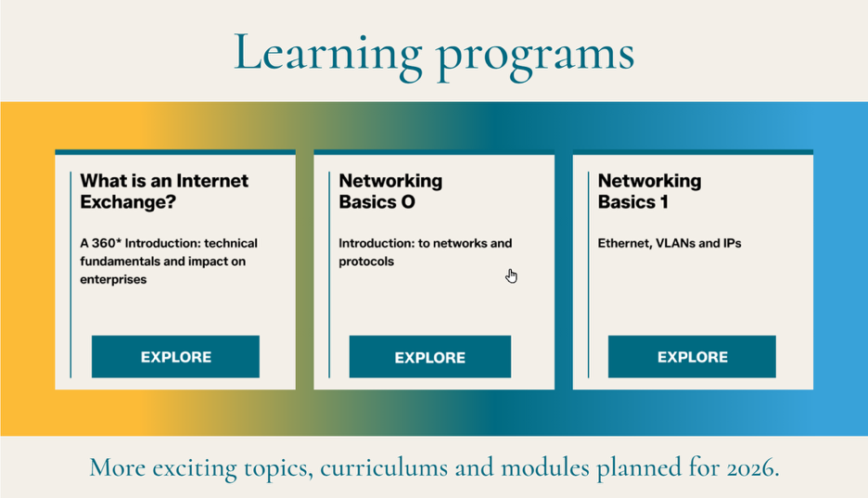
World-class training that blends technical expertise with business insight to power smarter, future-ready connectivity strategies.
Learn more
Notes:
Lay out, however – but no DE-CIX logo needed

Slide 9










Use case: Gaming
Transit
Provider
3rd Party Network
Home
Network
Interconnection platform
Gamer
Gaming Networks
Notes:
Designer notes:
Please feel free to redo this diagram or use these pieces.
General animation guidance:
Gamer, Home Network, Transit Provider, 3rd Party, Gamer networks – appear
Route from gamer to gamer network animate highlights along the line
Interconnection platform line appears
Route from gamer to gamer logos along interconnection platform highlights
Let’s talk about Interconnection use cases – using gaming as the first example.
Gamers are some of the ISPs biggest complainers as the latency (and lag caused by it) is incredibly frustrating for gamers playing live games.
Interconnection allows ISPs to connect directly to the gaming networks making it the shortest, lowest-latency path and improving
Statstics
Previously, Middle East gamers suffered high delays as traffic routed through European exchanges; now, Arabic-localized AAA games host locally with sub-20ms latency. This boosted user reach to 80% of regional end-users, quadrupled capacity in 2021, and fueled market growth for 300M+ global players
In competitive gaming, even 10ms delays mean lost matches; hybrids like Square Enix's Equinix setup cut latency over 50%, enabling smooth HD streaming and global eSports without lag spikes. i3D.net's RETN partnership delivers <10ms across continents, preventing player dropouts during peak events and boosting retention by ensuring 99.99% uptime.
HAND OUT PREVENT GAMER RAGE STICKERS
Transition –When you need low-latency low-latency,– think interconnection. – Speaking about low latency – let’s talk about Interconnection and AI

Slide 10

The hot topic:
AI

Slide 11




AI Training
Develop the model in the first place, periodic retraining of the model
Data
Computing
AI model
Looking inside
Transmission
technologies
AI model
AI Inference (“AI in action”)
AI-based diagnostics,
simulate, predict, pilot
Connected
devices

Slide 12
?
Data
Computing
AI model
DATA JOURNEY
Transmission
technologies
AI model
Connected
devices

Slide 13



!
Data
Computing
AI model
CONTROL THE DATA JOURNEY
Transmission
technologies
AI model
SIMPLICITY
SECURITY & COMPLIANCE
PERFORMANCE
Connected
devices

Slide 14





AI Training requires manageability of multi-cloud data sourcing & computing
SENSITIVITY
Latency
Bandwidth
Comp. Power
Risk
Data
everywhere
Computing power
somewhere

Slide 15



AI Inference Triangle
Transmission
technologies
AI model
SENSITIVITY
Latency
Bandwidth
Comp. Power
Risk
Connected
devices

Slide 16
AI Inference Triangle
Transmission
technologies
AI model
SENSITIVITY
Latency
Bandwidth
Comp. Power
Risk
Connected
devices

Slide 17







AI Inference requires manageability of multi-AI models
Perception models
Learning
model
Movement model
SENSITIVITY
Multi-AI models.
At the speed of human perception. Anywhere.
Latency
Bandwidth
Comp. Power
Risk

Slide 18
AI Inference requires manageability of multi-AI models
Perception models
Learning
model
Movement model
SENSITIVITY
Multi-AI models.
At the speed of human perception. Anywhere.
Latency
Bandwidth
Comp. Power
Risk

Slide 19











AI Inference requires manageability of multi-AI models
Synchronize
multi-AI models
Interoperability,
towards real time

Slide 20
AI Inference requires manageability of multi-AI models

Slide 21








AI Inference requires the speed of human perception
Standard
applications
0.5 ms
13 ms
20 ms
65 ms
< 50 miles
< 750 miles
< 1,100 miles
< 3,200 miles
Distance

Slide 22












Use case: Healthcare – a community where the seamless interconnection of the end-to-end value chain is vital
Smart Home
providers
Patients
& Caregivers
Pharmacies &
Pharmacy Benefit Managers
Payers
& insurers
Research &
Development
Supply Chain,
Distributors & Wholesalers
Ambulances
& Emergency Vehicles
Suppliers MedTech
& Pharma Companies
Public Health Authorities
& Registries
Diagnostics
(Labs & Imaging)
Pre-hospital &
Emergency Medical Services
Notes:
It is vast ecosystem with multiple stakeholders involved.
People’s life rely on the ability to interconnect and make all these stakeholders working seamlessly.
Designer Note: Lighter color

Slide 23


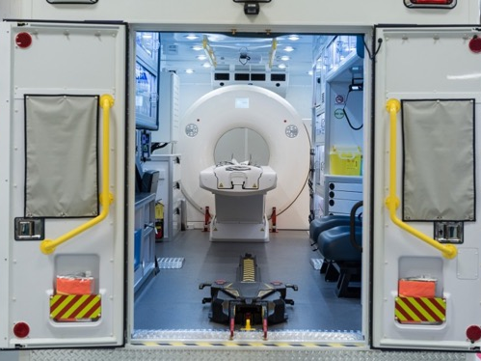





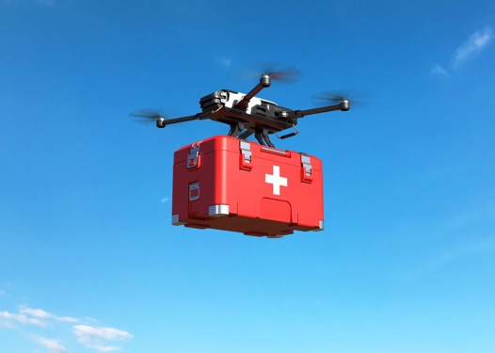

Elderly Care
with Smart Homes
AR/VR for Medical
Training & Simulation
Mobile Stroke Units
(MSUs)
Real-Time
Patient Monitoring
Healthcare powered by AI
in real life
AI-Powered
Diagnostics
Remote Surgery
AI models
Bio Medical Research
Health Drone
Always Connected Ambulance
Notes:
These fast growth stimulated by heavy investments, innovations and also challenges are reflected in the large number and diversity of healthcare projects and real live initiatives.
From the most sophisticated and avantguardist to the most ‚basic or ‚standard‘ services, today almost all of them are powered by‘ AI models directly or indirectly.
Designer Note: Lighter color

Slide 24


5G Connected Ambulance & Haptic enabled remote surgery
In motion
On accident site
Remote diagnostics & assistance
Remote patient monitoring
Real time Data exchange with hospital & preparation for surgery
Intelligent traffic control for fastest
route to hospital
Tele-triage
High-res VR/AR video link to remote surgeon
Haptic enabled robotic arm – surgeon ‘feels’ what the robot is doing
Remote specialist intervention to prepare patient for transport to hospital
Network
Latency:
<3ms
AI model
5G
AI model
5G
Bandwidth:
>20 Mbit/s
Connected
Ambulance
Connected
VR/AR and robotic arm
Notes:
Designer Note: Lighter color
Haptic-enabled remote surgery > more precise than other forms of remote surgery. Efficient use of surgeon’s time in emergencies
Remote patient monitoring: patient wearables (e.g. smart watch with heart monitoring) can be connected to the ambulance before the ambulance even arrives on the scene. Paramedics can monitor the condition of the patient and prepare in advance.
Remote diagnostics: AI-supported image analysis for fast diagnostics & treatment suggestions
Augmented Reality video link: remote surgeon & AI can guide paramedic - AI can create AR overlay of vital organs on the patient, show paramedic the right location for cutting (e.g. to intubate a patient so they can breathe), setting needles, etc.
Intelligent traffic control: navigation of shortest route to hospital, prioritization of Ambulance over traffic light controls
______________________________________________________________________
Connected ambulance in India – latency under 5 milliseconds
https://www.apollohospitals.com/health-library/5g-connected-ambulance-1066
Triage Real-Time analytics and feedback
AI-driven triage systems enhance Emergency Department (ED) efficiency by providing real-time analytics and feedback, enabling clinicians to make swift, informed decisions, especially during peak hours or mass casualty incidents. Studies indicate that instant feedback mechanisms help prioritize patients effectively, reducing treatment delays even in high-stress environments [16]. For example, AI can detect sudden spikes in vital signs indicative of sepsis, prompting immediate evaluation and intervention. Additionally, real-time analytics optimize resource management, dynamically adjusting prioritization based on patient load, bed availability, and on-call specialists. This adaptability improves patient throughput, preventing bottlenecks that could lead to deterioration [16]. By reducing clinician cognitive load, AI-driven triage allows providers to focus on critical decision-making rather than continuously monitoring for sudden patient status changes.
https://www.sciencedirect.com/science/article/pii/S1386505625000553

Slide 25
5G Connected Ambulance & Haptic enabled remote surgery
In motion
On accident site
up to 50% faster
response times in urban areas
40%
reduction in medical errors
20mn faster
to definitive treatment
+30% survival rate
AI model
5G
AI model
5G
Connected
Ambulance
Connected
VR/AR and robotic arm
Notes:
Designer Note: Lighter color
Haptic-enabled remote surgery > more precise than other forms of remote surgery. Efficient use of surgeon’s time in emergencies
Remote patient monitoring: patient wearables (e.g. smart watch with heart monitoring) can be connected to the ambulance before the ambulance even arrives on the scene. Paramedics can monitor the condition of the patient and prepare in advance.
Remote diagnostics: AI-supported image analysis for fast diagnostics & treatment suggestions
Augmented Reality video link: remote surgeon & AI can guide paramedic - AI can create AR overlay of vital organs on the patient, show paramedic the right location for cutting (e.g. to intubate a patient so they can breathe), setting needles, etc.
Intelligent traffic control: navigation of shortest route to hospital, prioritization of Ambulance over traffic light controls
______________________________________________________________________
Connected ambulance in India – latency under 5 milliseconds
https://www.apollohospitals.com/health-library/5g-connected-ambulance-1066
Triage Real-Time analytics and feedback
AI-driven triage systems enhance Emergency Department (ED) efficiency by providing real-time analytics and feedback, enabling clinicians to make swift, informed decisions, especially during peak hours or mass casualty incidents. Studies indicate that instant feedback mechanisms help prioritize patients effectively, reducing treatment delays even in high-stress environments [16]. For example, AI can detect sudden spikes in vital signs indicative of sepsis, prompting immediate evaluation and intervention. Additionally, real-time analytics optimize resource management, dynamically adjusting prioritization based on patient load, bed availability, and on-call specialists. This adaptability improves patient throughput, preventing bottlenecks that could lead to deterioration [16]. By reducing clinician cognitive load, AI-driven triage allows providers to focus on critical decision-making rather than continuously monitoring for sudden patient status changes.
https://www.sciencedirect.com/science/article/pii/S1386505625000553

Slide 26





Cloud networks
LEO
Satellites
Wireless networks
Interconnection
Subsea
cables
Fiber networks
Notes:
Closing Statement:
“Interconnection is not just about connecting networks; it’s about connecting possibilities. Together, we can shape a more connected and sustainable future.”

Slide 27


What’s next?
Dive
deeper
with
Examine your business’s
interconnection strategy
and future connectivity needs

Slide 28
Notes:
I will make this slide in canva with the branding for the event
Linked in link: https://www.linkedin.com/in/ivo-ivanov-de-cix/

