Slide 1
“Neither Operationally Desirable Nor Economically Practical”: A Political Economic Analysis of the Emergency Alert System
18-21 January 2026
Matthew L. Conaty, J.D.
University of Pennsylvania The Annenberg School for Communication

Slide 2

January 13, 2018: The State of Hawaiʻi

Slide 3
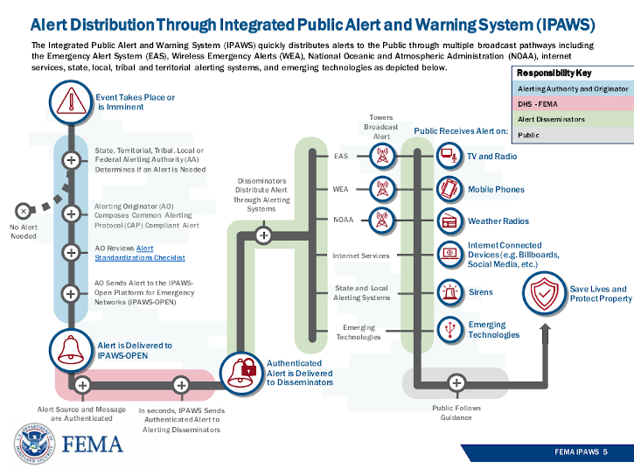
Introduction
“On January 1, 1997, the new Emergency Alert System will go on-line. There’s a story waiting to be told behind this event and possibly some day, it will be told.”
- Morris H. Blum, founder, WANN-AM, and 50-year emergency alerting executive

Slide 4
“Who can put a pricetag on human life? We have a tremendous opportunity to save lives and prevent human injury and suffering by warning people about coming disasters” (USDA, et. al, 1999)
“[A]ll Americans in the contemporary media ecosystem” have a “critical information need” for “access to emergency information on platforms that are universally accessible” (Friedland, et al., 2013)
“The establishment of complete separate standby communication facilities solely for use in a nuclear emergency is neither operationally desirable nor economically practical” (Cone, Baer, & Shapiro, 1965)
Emergency alerting is “a readily available, reliable, and low-cost means of emergency communications with the American people” (OTP, 1974)
Emergency alerting is “a network of broadcast stations designated to provide information and communication during emergencies” (“FCC Halts Random Alert Tests”, 1971)
Emergency alerting is “a warning system, not a news and information network” (Harter, 1993) intended to enable “the President to address the American people within 10 minutes during a national emergency” (FEMA, 2025)

Slide 5
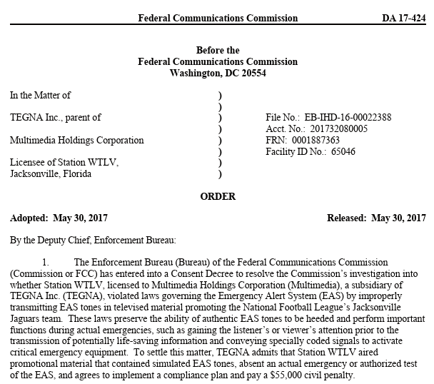



Professional Background

Slide 6
Q
What is the political economy of the federal government’s decision to “put a price tag on human life” (USDA, et al. 1999) with respect to emergency alerting, and what are the implications for the future of emergency alerting?

Slide 7
Theoretical Framework
A dialectical appraisal of policymaking centered on “how elusive, interpenetrating structures multiply determine and mutually constitute lived experience”, per the “the ‘critical junctures’ when media structures and institutions are forged through struggle” (Corrigan 2018, 2753-54; cf. Beyers et al., 2014)
A denaturalization of EAS’s failure to effectuate its essential praxis (cf. Mosco, 2009) via a deconstruction of seemingly deterministic historical processes and “the more immediate fluid political currents of particular moments” (Cumbers & Paul, 2022).
  An appraisal of affective elements such as fear as resources that “the powerful and the power-seeking entities in a society” use as “an overall pedagogy” (Fisher, 2012)
  The liminal, as that moment when “hierarchies and standing norms disappear” and “authority in any form is questioned, taken apart, and subverted” (Thomassen, 2014)
  The Foucauldian notion of “correlation”, as that “specific form of relation that enables heterogeneous phenomena to remain aligned” (Anderson and Adley, 2011) with respect to such psychological concepts as “milling” and “overwarning” (Bean, 2019)
Political Economy
  Cultural Criticism
Per a paucity of research, I seek “not only to correct the historical record by reclaiming agency and resistance, but also to inspire future reform efforts” (Pickard, 2013)

Slide 8
Methodology
Initial Archival Research
“A realist, inclusive, constitutive, and critical epistemology” (Mosco, 2009, p. 12)
A “multilevel, interdisciplinary, historical, and structural” ontology (Corrigan, 2018, p. 2753)
Targeted Fieldwork
Document Analysis
Fieldwork Analysis
An Agenda for Reform
Electronic (e.g., Defense Technical Information Center)
Freedom of Information Act (e.g., City of Parkersburg, WV)
Physical (e.g., Presidential Libraries, NARA; Smithsonian’s WANN-AM Collection)
Policymakers (semi-structured interviews with select FCC attorneys and engineers, delimited by current political climate)
Snowball Approach (personal documentary holdings and research recommendations for offered by interviewees)
Triangulation of data (Bowen, 2009; Karppinen & Moe, 2012; cf. Reddy, 2023, against independent corpuses of data (Lee, 2001) and its production and dissemination (Brown & Jacobs, 2015; Corrigan, 2018; Herzog & Ali, 2015)
Constant comparative method of grounded discursive theory (Charmaz, 2012; cf. Tardy, 2011; Spinzi & Terminiello, 2010)
Jet plane/helicopter method (Havens, Lotz, & Tinic, 2009) of ensuring “the voices and views of ordinary people [can] be heard” (Bowen, 2009, p. 28).

Slide 9


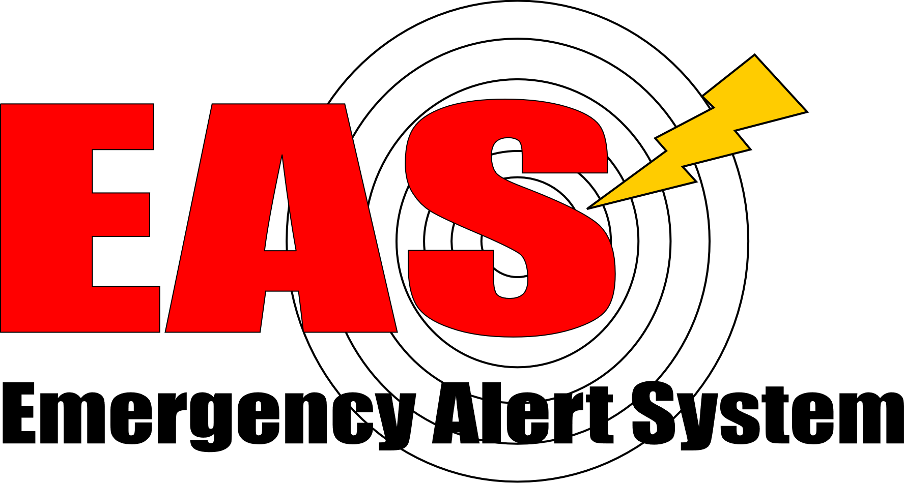
Preliminary Findings
CONtrol of ELectromagnetic RADiation (1953-1964)
Emergency Broadcast System (1964-1994)
Emergency Alert System (1994-Present)
CONELRAD (1953-1964)
EBS (1964-1994)
EAS (1994-Present)
Covered two radio bands in metropolitan areas
Product of a partnership between the FCC, U.S. Air Force, and National Association of Broadcasters
Permitted the President to address citizens over select radio bands in advance of an atomic attack
Hampered by high cost and technological complexity
Covered radio and broadcast/cable television
Upgraded in 1976 to permit state and local governments to warn of extreme weather and industrial accidents
A series of proposed enhancements rejected on grounds of cost; EBS remained dependent on “the listening and viewing habits of the public for its effectiveness”
Covers satellite, cellular and digital communications (but not streaming services) as part of an Integrated Public Alert and Warning System;
Linked to National Public Radio and the Public Broadcasting Service
Upgrades largely controlled by private entities via State Emergency Communications Committees

Slide 10

The Resonance of Emergency Alerting
Politicization: Might EAS be used to serve illiberal ends?
Neoliberalism: Will the do-it-yourself, consumerist bent of the system endanger lives?
Trust: Can EAS serve as a trusted interlocutor in today’s fraught communicative and media spaces?
Infrastructure: Is a 70-year-old system, relying on a patchwork of commercial software, capable of dealing with heretofore unseen threats?
How do we confront the fact that disaster preparedness is a subject of “low salience and visibility”? (McLean & Whang, 2019, p. 402).
What about the structural dialectics (Fuchs, 2020) and “heterogeneous production logics” (Miège, 1989, p. 136) in operating a public communications system according to market logics? (cf. Brown & Jacobs, 2008)
Does the historical record demonstrate a paucity of leadership and meaningful investment on the part of federal authorities?

Slide 11
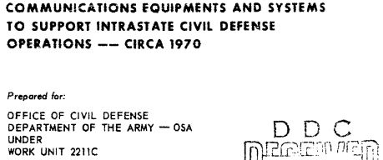
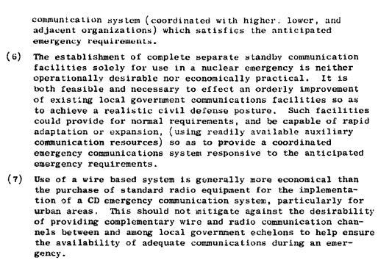
A Path Forward
Universality: EAS’s ability to consistently warn every affected individual within a disaster’s sphere of influence (e.g., 93.6% success rate on 2024 nationwide EAS test)
Reliability: EAS’s resistance to false alerts and security breaches (e.g., January 13, 2018 Hawaii false ballistic missile alarm; cybersecurity breaches)
Responsiveness: EAS’s adaptation to and accommodation for a nation of ever-widening linguistic, geographic, socio-economic, and biophysical diversity (e.g., “milling” and information blackouts after Katrina amongst non-English speakers)
→ A reclaiming of emergency alerting (public investment in and divesture of private interests from EAS as a “re-municipalized” good (Loftus, March, & Purcell, 2018); a reconfiguration (discarding a binary approach to emergencies per Bowker and Star’s (1999) notion of “boundary objects”); or a reimagining (integrating EAS with nascent United Nations’ transnational emergency communication networks).

Slide 12
Matthew L. Conaty, J.D.
matthew.conaty@asc.upenn.edu

