Slide 1
Next-Gen Prefabricated Digital Infrastructure – Earth Stations, Cable Systems and Data Centres – Powering Regional Asia Pacific
18-21 January 2026
Shalini Lagrutta
Managing Director,
DXN Limited, Australia

Slide 2
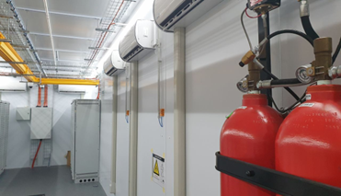
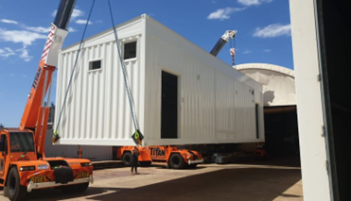
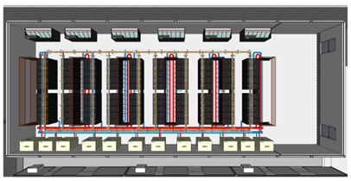
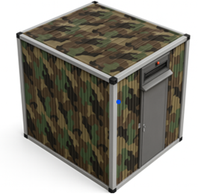
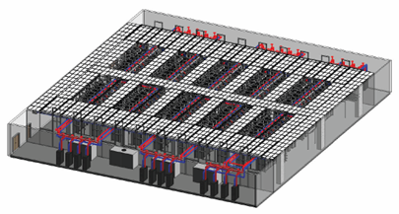
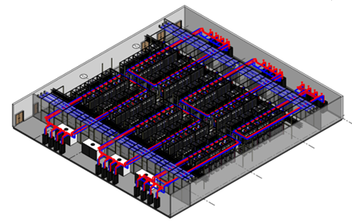
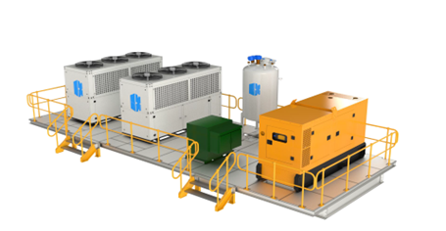
Prefabricated Digital Infrastructure now can be seen across market segments
EDGE Market Segments
Cable and Satellite Landing Stations
Mining Modules
Edge Data Centres
Defence & Government
1.
2.
3.
4.
30kw to 2MW
100 to 500kW Modules
50kw to 10MW multi module edge sites (AI HPC Modules, Edge Colo DC’s)
Portable Data Centres
Hyperscale Market Segments
Hyperscale Data Hall Super-Structures
Critical Support Infrastructure Rooms for Hyperscalers
5.
6.
(DXN StructCoreHAC)²
100MW to 1GW Data Centres
Power Train Units (PTU’s), Chiller rooms, Pump Rooms

Slide 3
Diversified exposure reduces concentration risk
Cable and Satellite Landing Stations
30kw to 2 MW designs
Subsea and LEO technology expanding at a high-rate
High growth
Average volumes
Historically brick and mortar, prefab adoption now high
Mining Modules
30kw to 250kw designs
AI is driving on-prem requirements
Average growth
Average volume
Prefab adoption is high
Prefab EDGE Data Centres
Colo/ telco end users for 50kw to 10MW
Also 1-2MW per module AI HPC for NeoCloud² operators
High-growth in APAC markets
Prefab adoption increasing
High Growth, Average volumes. High customization
Defense and Government Portable DC
Sovereign Government and Defense workloads with unique custom requirements
Prefab adoption increasing
Contracts typically for global deployment
Hyperscale Prefabricated Data Hall Super-Structures (DXN StructCoreHAC)
Target Customer: Hyperscalers and global internet companies
High growth, High volume
Growth with traditional Hyperscalers in both AU and SEA
100MW to 1GW Data Centres with multiple Data Halls (20 to 50 Data Halls in each DC)
Volume manufacturing of standardized solution
Critical Support Infrastructure Rooms
Target Customer: Hyperscalers and global internet companies.
High Growth, High volume
PTU (Power train Unit)
Skids (Base of a chiller/ generator)
Chiller rooms, pump rooms
MMR rooms

Slide 4
Why Prefabricated Modular Data Centres for Hyperscale Builds?
High Level Project Schedule for a 100MW HAC deployment in 7 data Halls
6 weeks
DXN StructCoreHAC for a Hyperscale customer
Design
6 weeks
3 weeks
DH1 - Fabrication & production
DH1 – On-Site Install
5 weeks
3 weeks
DH2 - Fabrication & production
DH2 – On-Site Install
4 weeks
3 weeks
DH3 - Fabrication & production
DH3 – On-Site Install
4 weeks
3 weeks
43 weeks
DH4 - Fabrication & production
DH4 – On-Site Install
4 weeks
3 weeks
DH5 - Fabrication & production
DH5– On-Site Install
4 weeks
3 weeks
DH6 - Fabrication & production
DH6– On-Site Install
4 weeks
3 weeks
DH7 - Fabrication & production
DH7– On-Site Install

Slide 5
Why Prefabricated Modular Data Centres for Edge Builds?
Time to Market
PO
Project Delivery
Ready for Service
Prefab Solutions delivers 50%-75% quicker than typical brick and mortar construction.
Prefab Construction 24 weeks from PO to fully installed and ready for service against a 78 week estimate for Brick and Mortar
Permits/
Approval
Civil foundation
Civil ground works & modules production occurs in parallel - saving time
4 wks
8 wks
DXN
Design
Fabrication & Production
2 wks
Shipping
16 wks
I&C
4 wks
2 wks
B&M Civil construction
Permits/
Approval
Civil foundation
Building Construction
Internal fitouts
Testing
4 wks
8 wks
26 wks
38 wks
2 wks
All the work happens in series takes more time for complete construction on Site
PO
Project Delivery
Ready for Service
78 weeks

Slide 6





About DXN
Established in 2010 with prefabrication focused projects, starting in 2020
DXN live module deployment
Trusted technical advisor with market-leading innovation, consistently exceeding customer expectations
End-to-end capability from design to delivery
Ability to deliver high-quality bespoke digital infrastructure that meets, clients changing and growing demands
Demonstrated track record of supporting mission-critical environments
Quicker to manufacture than traditional brick and mortar data centres
Reduces end customer cost and time to build
Avoids concentration of heat and strain on grid
DXN deployments
DXN manufacturing facility
~100
Modular DC’s delivered
~80%
Capacity utilization (FY25)
~95%
Proportion of deliveries
made on time
4,200m²
Facility size
0
LTIFR

Slide 7





























Diverse, high-quality & growing customer base underpins long term growth
Mining
Energy & Gas
Telco
Cable Landing Station(CLS)/ Satellite
Government and Defence
Data centres
Hyperscalers
Global internet company

Slide 8
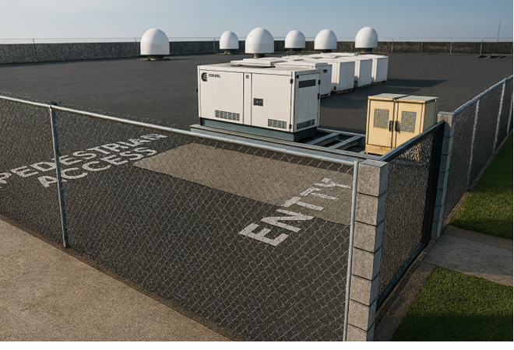
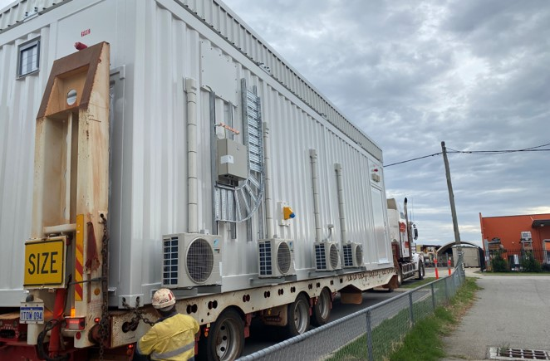
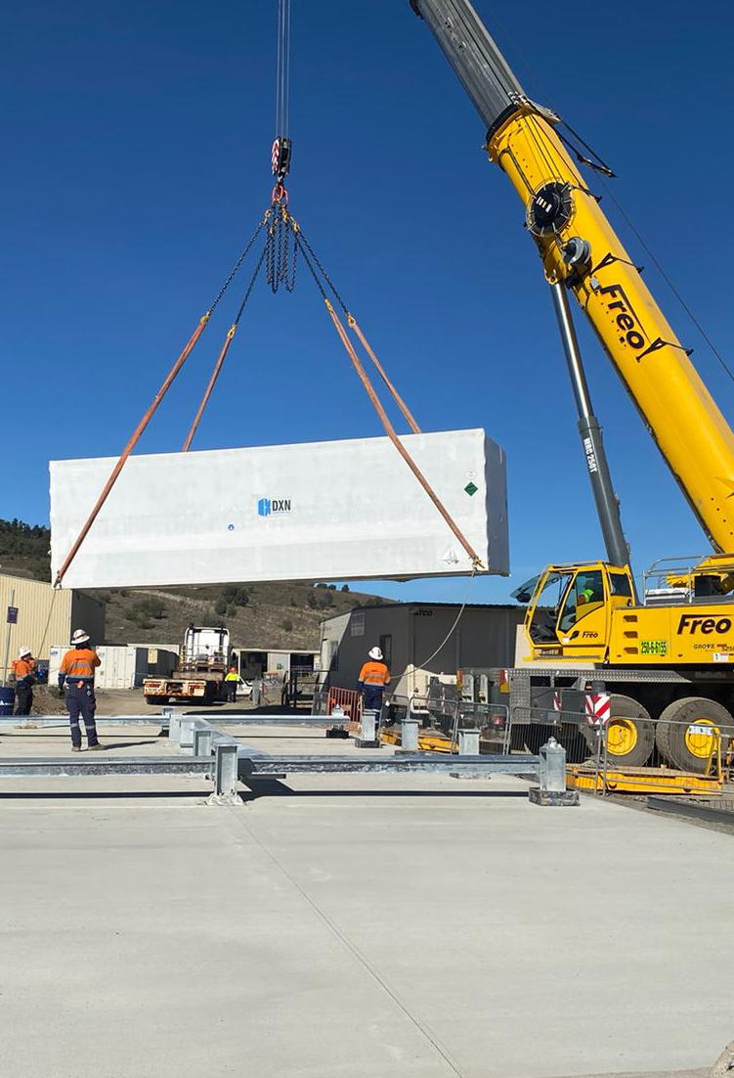
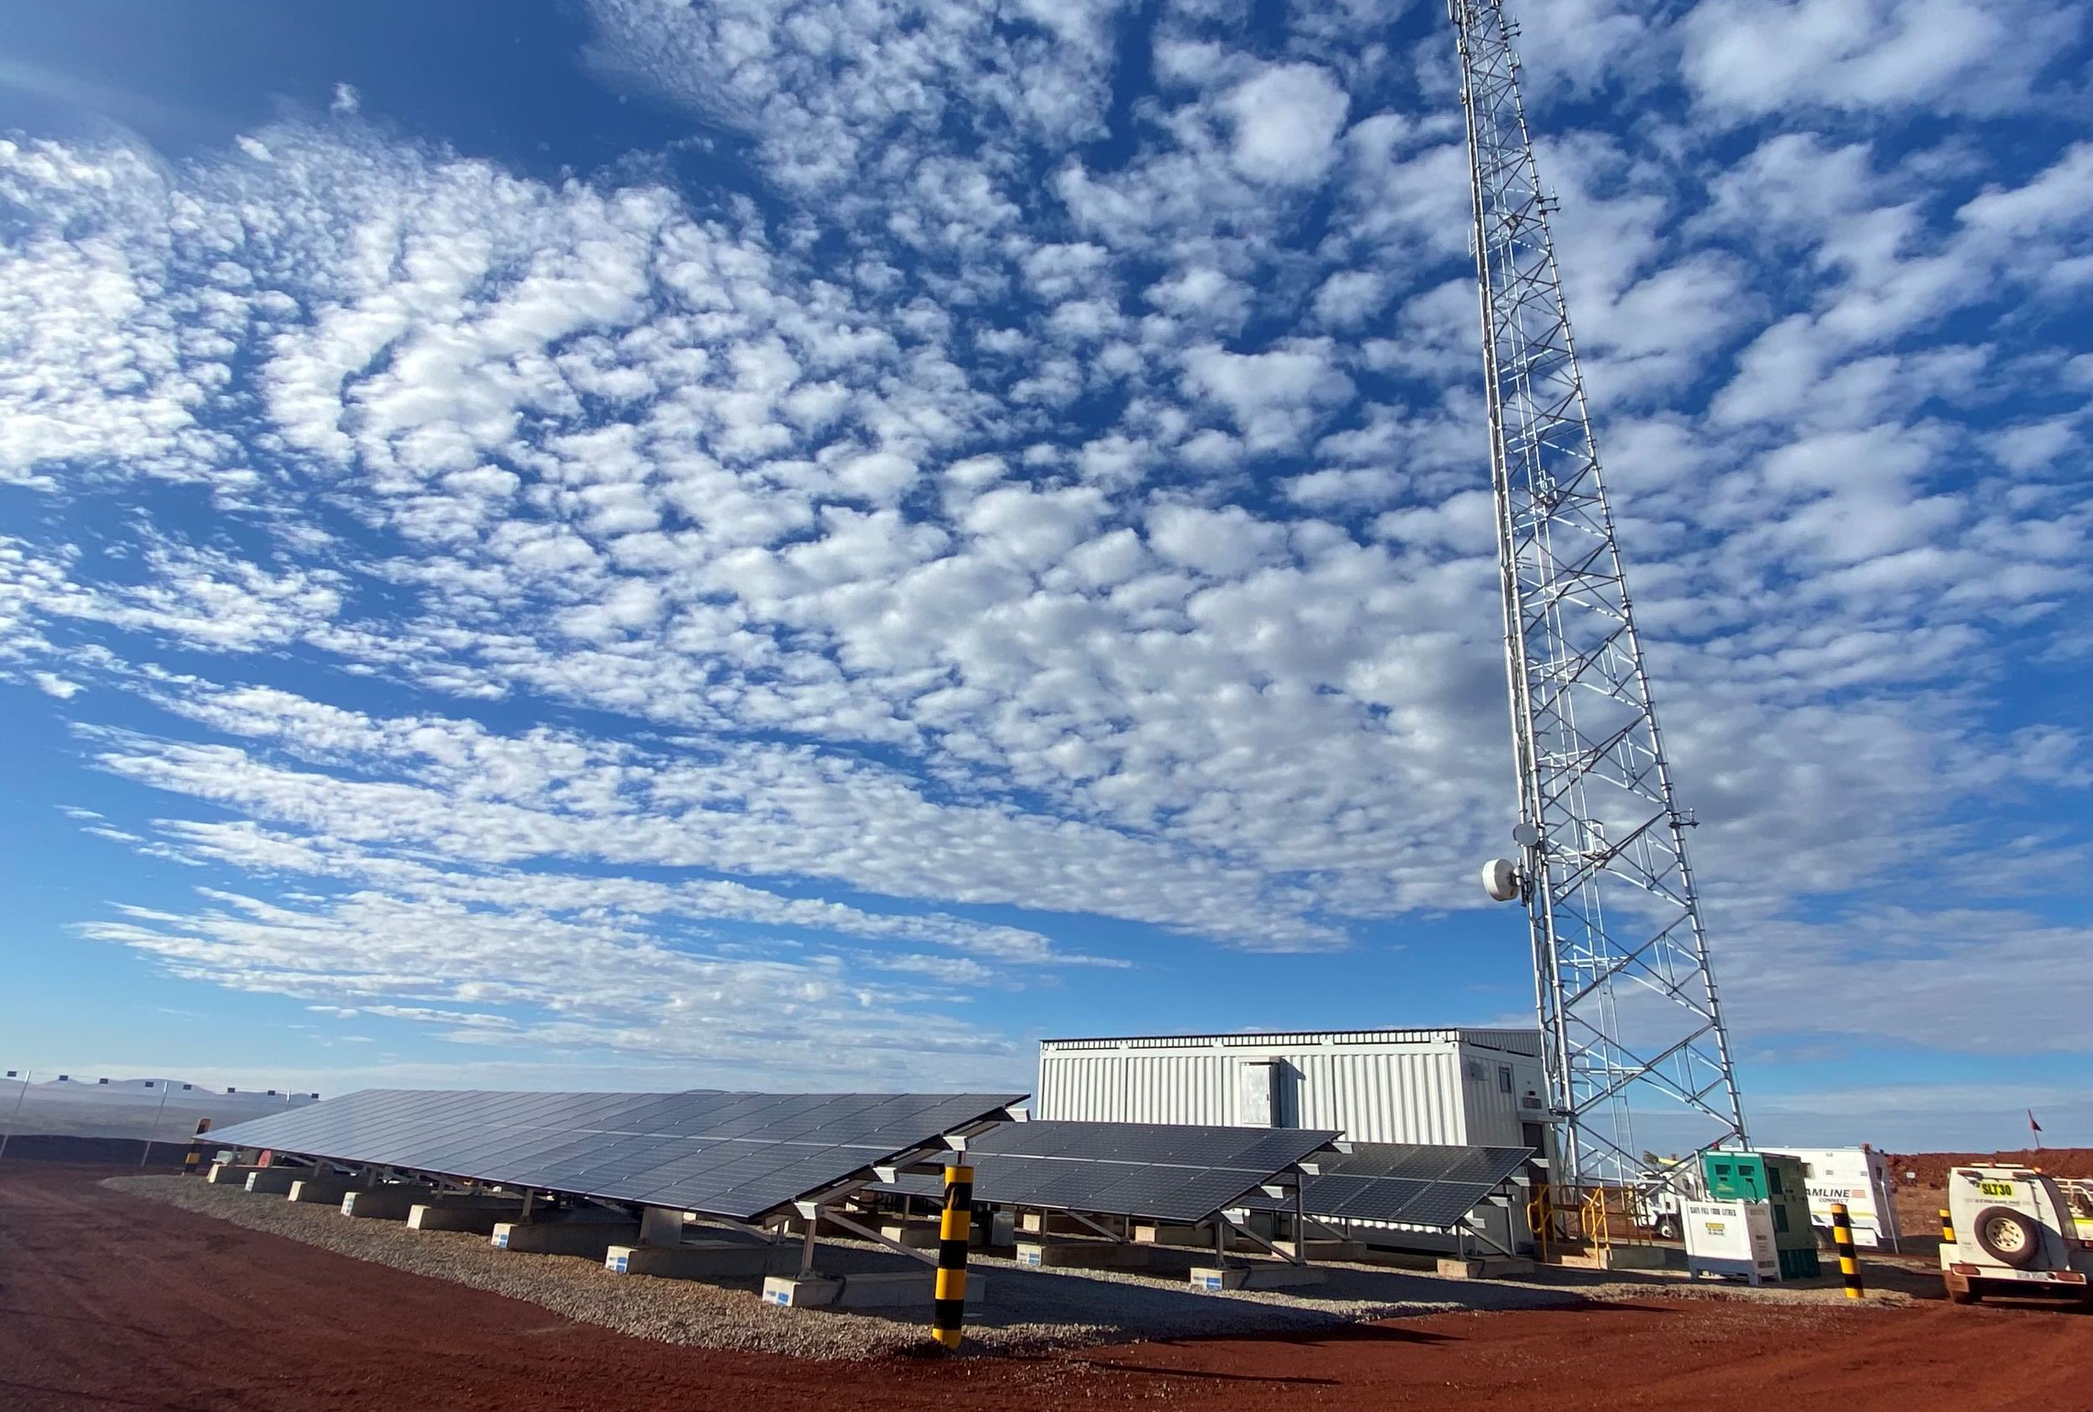
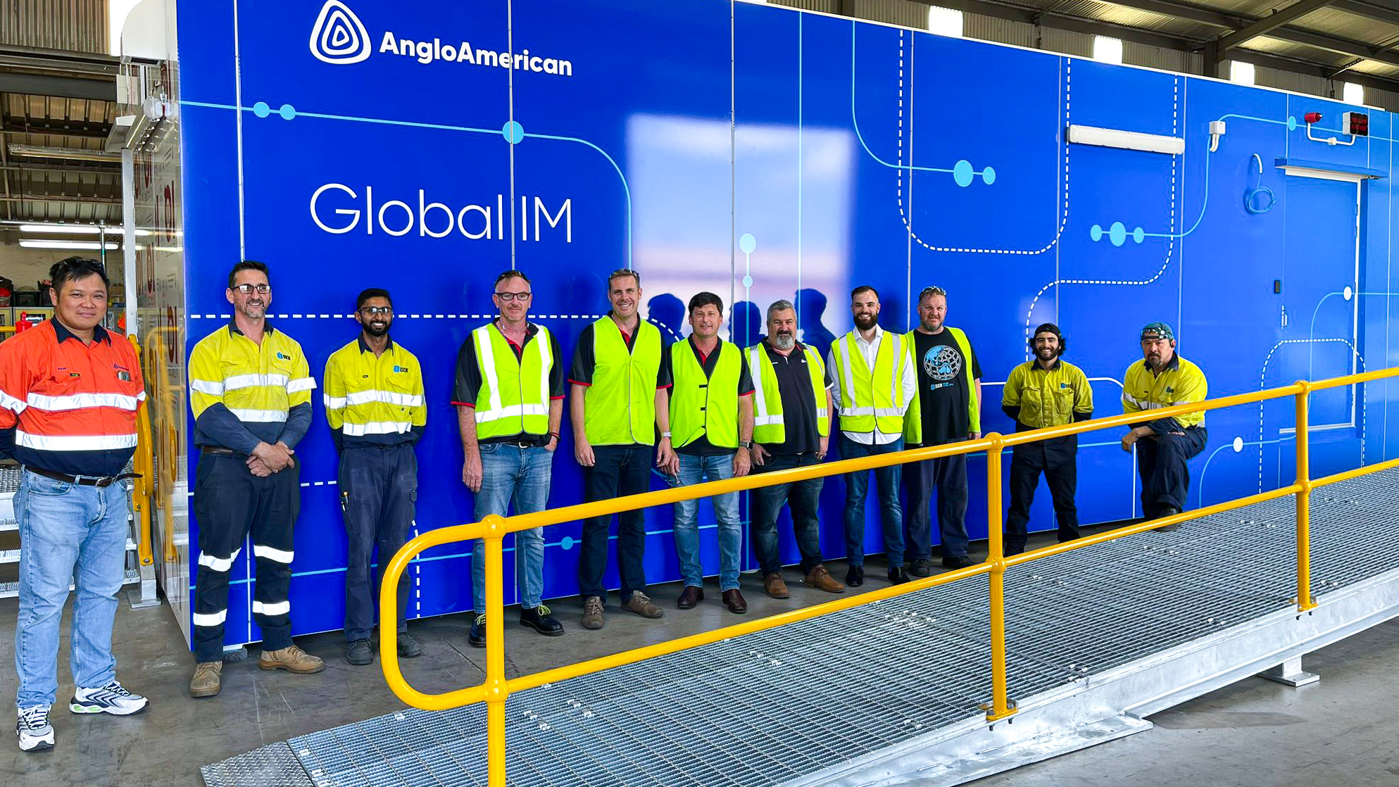
Examples of prefabricated modular deployments around the world

