Slide 1
Not the Death Knell for Jobs: Why AI Will Serve as A Positive Co-Pilot in Our Future Careers
18-21 January 2026
Jack Backes
Principal Strategist,
Provident Data Centers

Slide 2


Introduction
Jack Backes
Principal Strategist,
Provident Data Centers

Slide 3
There’s a bell tolling

Slide 4
vouchcraft, n.
The capacity of an organization or individual to stand behind their work.

Slide 5
AI Value
AI is creating real value.
Right now.
At scale.

Slide 6
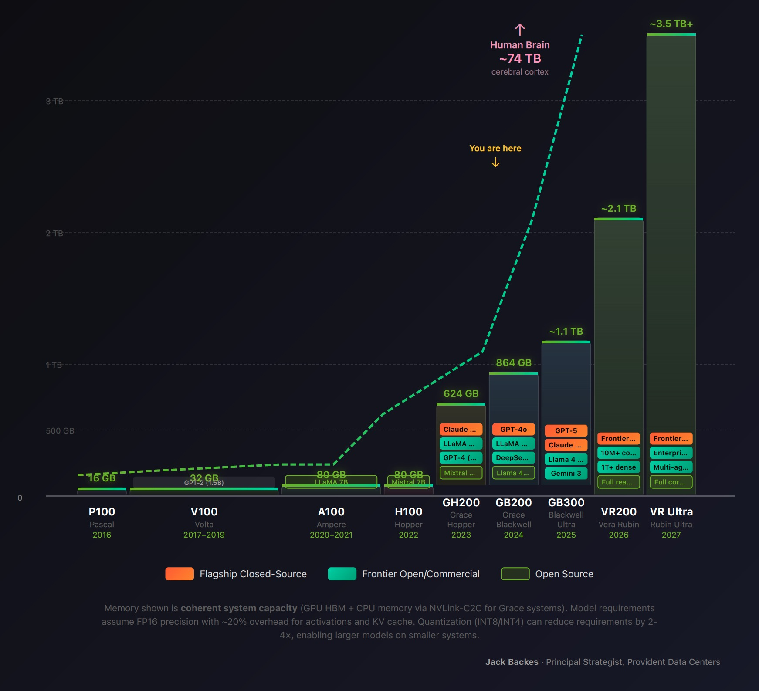
Where We're Going
GPU Architecture as LLM Inference Ceiling
Coherent memory capacity determines which models can run on a single system

Slide 7
The Credibility Problem
Can you stand behind what you produce?
Can your organization?

Slide 8
Slop.
Hollowing.
Invisibility.

Slide 9
vouchcraft, n.
The capacity of an organization or individual to stand behind their work.

Slide 10
The Quadrant
High Vouchcraft
The only quadrant that wins.
Stagnant
High AI Risk Appetite
Low AI Risk Appetite
Liability
Irrelevant
Low Vouchcraft

Slide 11
What We Did at Provident
At Provident, when we rolled out AI tools, we didn't just give people access. We built the scaffolding for vouchcraft.

Slide 12
The Mitigation
1 Bring your own thesis.
2 Own your outputs.
3 Force the friction.

Slide 13
Work With Us
Every model trained, every query answered—it runs on infrastructure.
Power. Connectivity. Cooling. We build it.

Slide 14
Thank You

