Slide 1
Observations of AI ecosystems for Enterprise outcomes
18-21 January 2026
Michael Piccininni
Director, Global Alliances
Dell Technologies
Michael.Piccininni@dell.com
+1 (917) 612-9354

Slide 2
Enterprise customers win when
~Telcos, Data Center Providers, and GPU/AI cloud providers work together and align around enterprise outcomes, specialize deeply, integrate tightly, and sell simply.
~It may not always be all on one contract, however an ecosystem relationships with all providers in the value chain, working together reduce complexity, risk and offer optimized time to market.
~Reference architecture of the stack, timed and coordinated with the Data Center Provider around timelines for space, power along with connectivity set up – in the most optimized way possible.
~Enterprise AI workloads increasingly need:
  GPUs close to data sources (factories, hospitals, cities)
  High-speed backhaul to core GPU & CPU clusters
  Burst capacity into public or sovereign clouds
Best practice
~Co-locate GPU & CPU nodes inside carrier hotels or telco edge DCs
~Use telco network slicing or private connectivity to guarantee performance
~Allow workloads to move seamlessly across:
  On-prem legacy systems and data sources
  Public Hyperscaler
  Edge DC
  Core DC
  GPU cloud
Notes:
Past examples where this worked; Business consulting led ERP projects; Cap/SAP/EMC/VMW/Cisco/Data Centers…Dell OEM with ISVs and Edge providers with industry specific consultants

Slide 3
The ecosystem around enterprise outcomes
Enterprises don’t want to buy “fiber + racks + GPUs” with no coordination — they want to buy an outcome:
~AI-ready platforms with Low-latency, compliance
~Predictable performance, simplicity and optimized cost
~Operational simplicity
~Jointly defined reference use cases (AI inference at the edge, private GenAI, regulated industry workloads – with plan for deploy and deliver to space, power, region requirements)
~Package solutions as vertical-specific offerings (manufacturing, finance, healthcare) rather than infrastructure SKUs
~Measure success with shared KPIs for the enterprise customer with the best of latency, uptime, cost per inference, time-to-deploy
~Reference architected bundles examples:
  “AI Edge Pod”
  “Private GenAI Stack”
  “Sovereign AI Zone”
The ecosystem needs to deliver

Slide 4
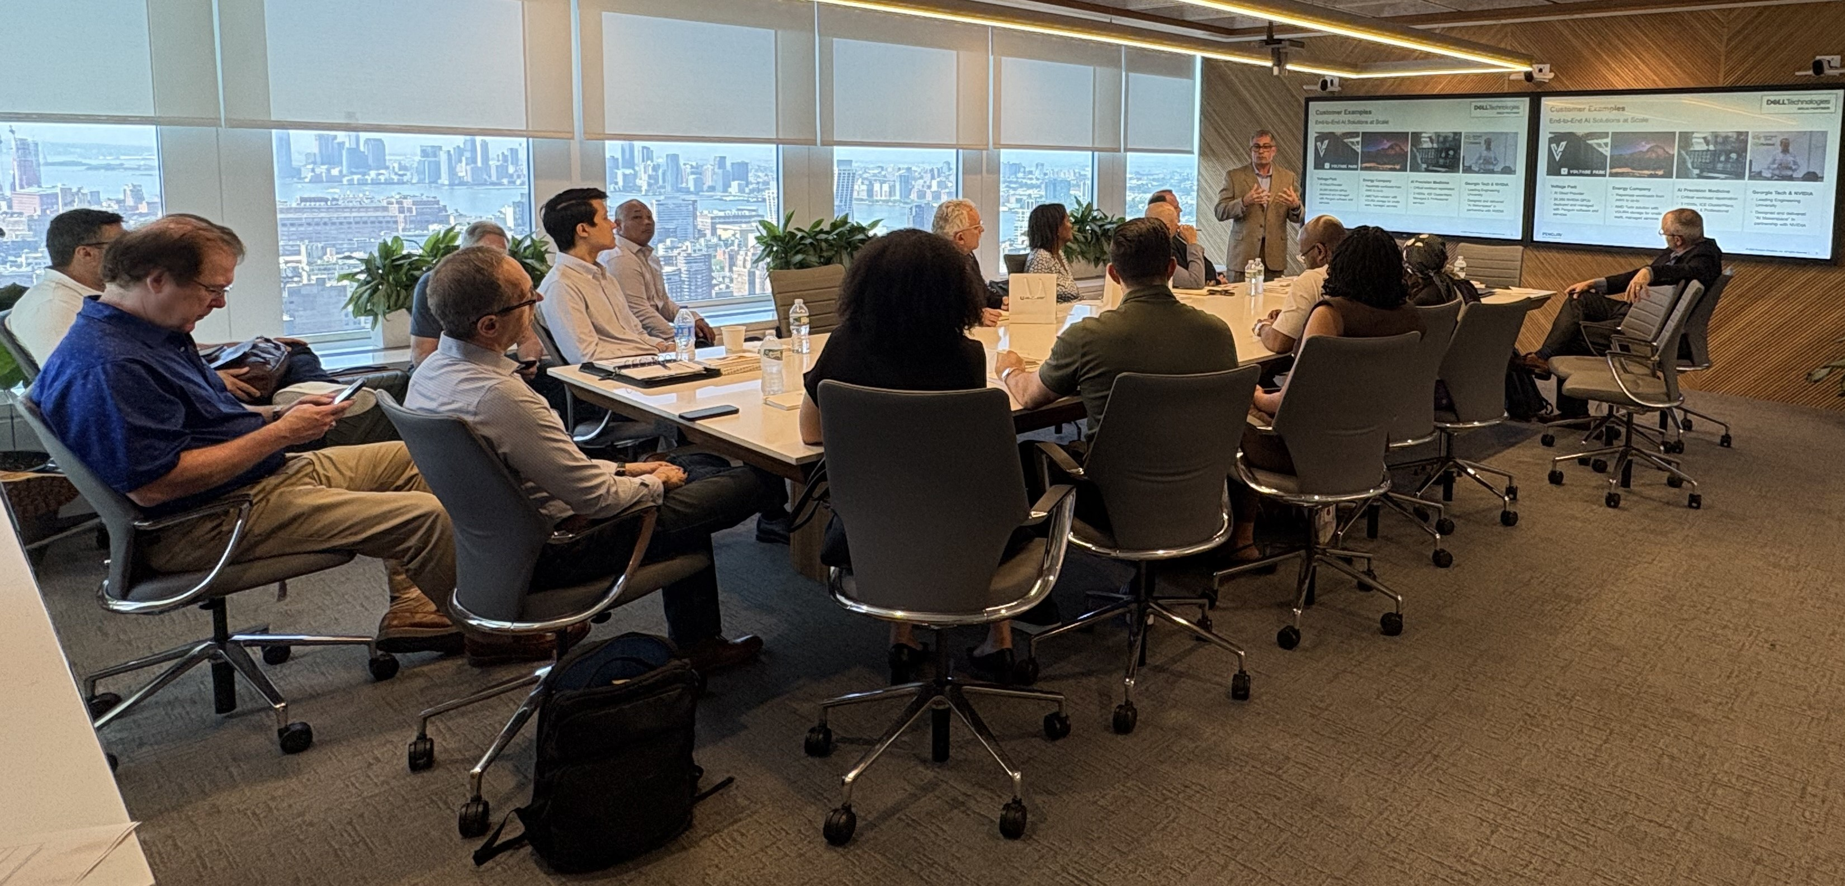
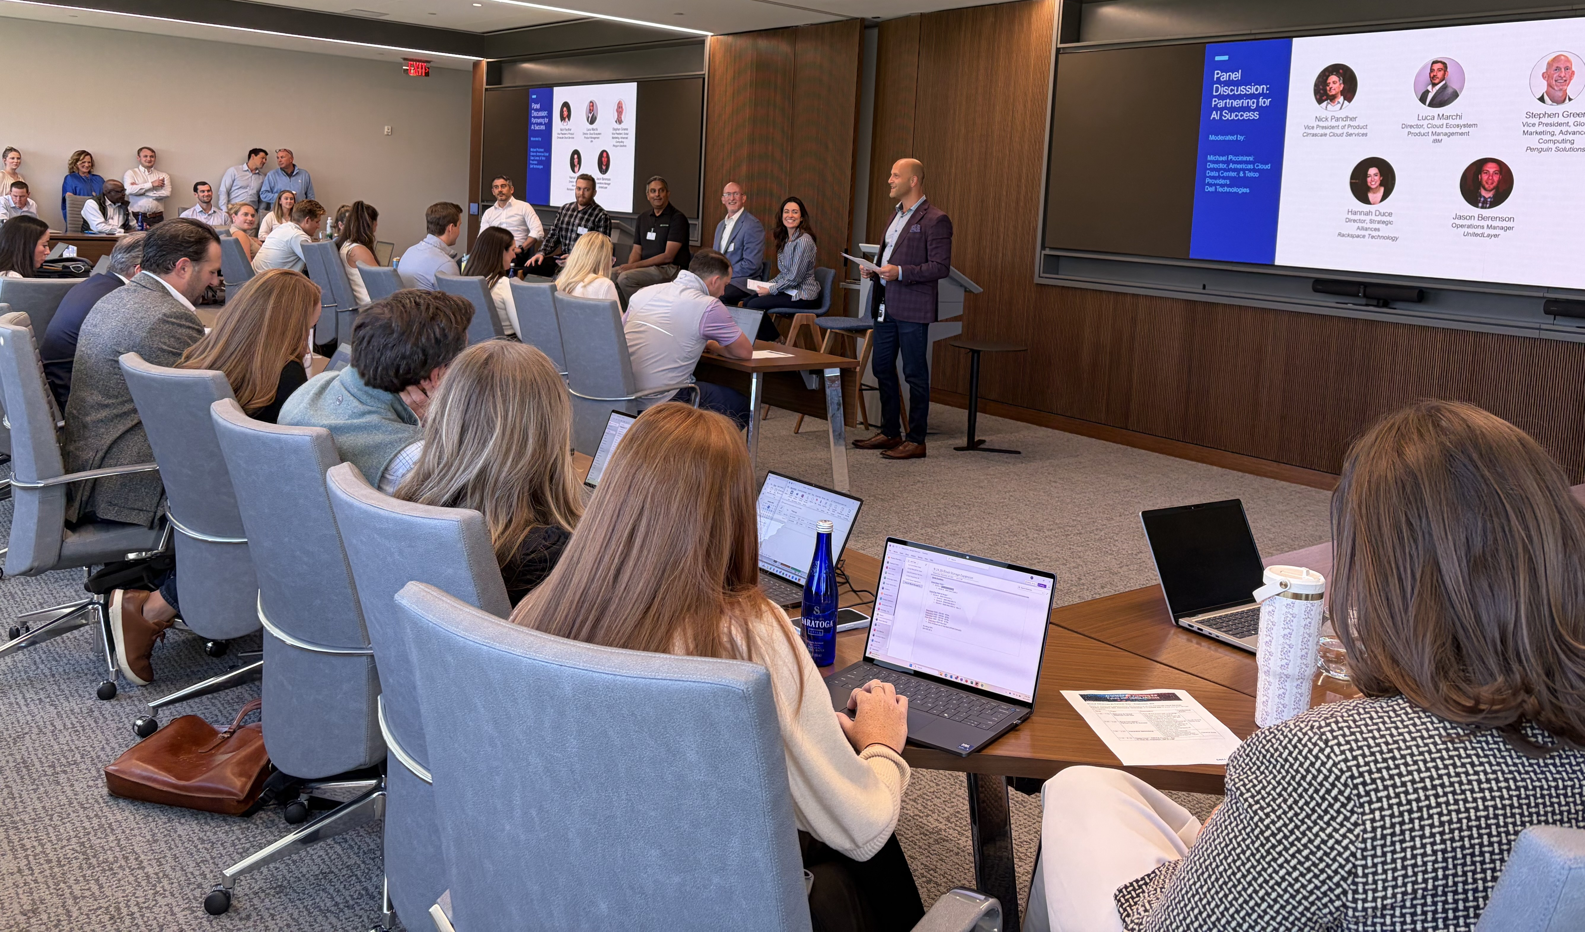
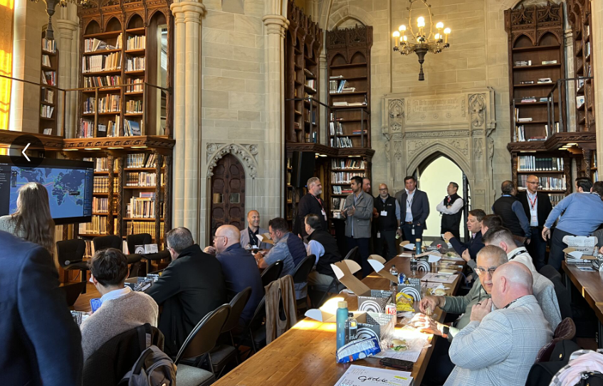
In practice
Throughout the second half of 2025 we held multiple field events hosted by Dell, DCPs, Telcos, and CSPs inviting sales, end users, channel partners
AI/HPC Partner Days & Live Virtual Sessions
Enterprise workshops – pulling together the ecosystem for panels, workshops and demos sharing experiences and recommendations for POC to Production examples
Joint customer testimonials
~500+ attendees
~ecosystem development
~targeting 4x impact in 2026

Slide 5
Thank you!

