Slide 1
Powering North America’s Data Center Boom
18-21 January 2026
Anabel España

Slide 2
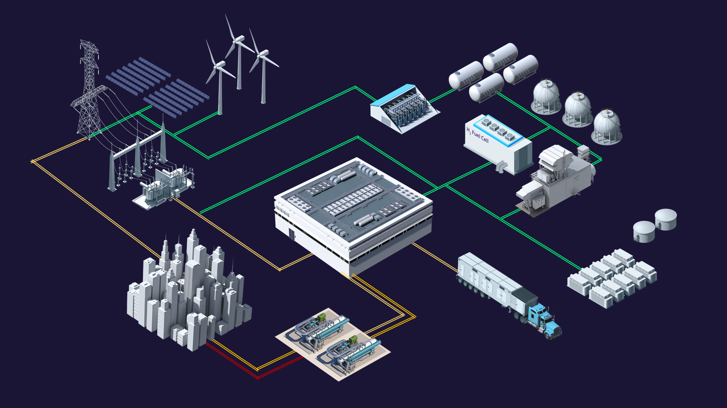













Siemens Energy is an
Energy Technology Company
Gas Turbine Engines (4-600 MW)
Generators (25 to 1,300 MVA)
Hydrogen Electrolyzers
Power-to-X-Solutions
Wind Turbine Generators
High voltage DC transmission
Flexible AC Transmission
Grid Stabilization Technologies
Energy Storage Technologies
Digital Grid Technologies
Service and Energy Consulting
High-voltage Switchgears and Transformers
Industrial Heat Pumps ($≤$ 150C + 70 MWth)
Electrification, Automation, and Digitalization
Renewable Energy
H₂ Production
Power Generation
Grid Technologies
Electrification, Automation, Digitalization
Waste Heat Recovery
Energy Storage
Restricted © Siemens Energy, 2026
3
Notes:
Worldwide energy demand is predicted to rise by around 25% before 2030 – and with it a surge of climate-damaging greenhouse gases. Yet, some 775 million people still live without access to electricity. All the while, the pressure is on to keep our planet below 1.5°C.
Energy is the foundation of everyday life as well as economic progress – for individuals and companies, for cultures and communities.
Siemens Energy is leading the way in accelerating the uninterrupted availability of reliable energy sources at an affordable price. In doing so, we are adhering to changing economic and environmental requirements with a keen understanding of the significant financial investment necessary – some €50 trillion by 2030.
It’s a serious undertaking – one that requires innovating with the knowledge that reliability, sustainability and affordability must work in balance.
Reliable: Being a reliable partner and fulfilling our commitments to customers and partners so all communities have access to energy when and where they need it.
Sustainable: Driving the energy transition and responsibly meeting the increased demand for electricity.
Affordable: Being able to respond to global economic challenges such as high inflation, raw material shortages and price increases in a responsible way for both our company and our customers.

Slide 3
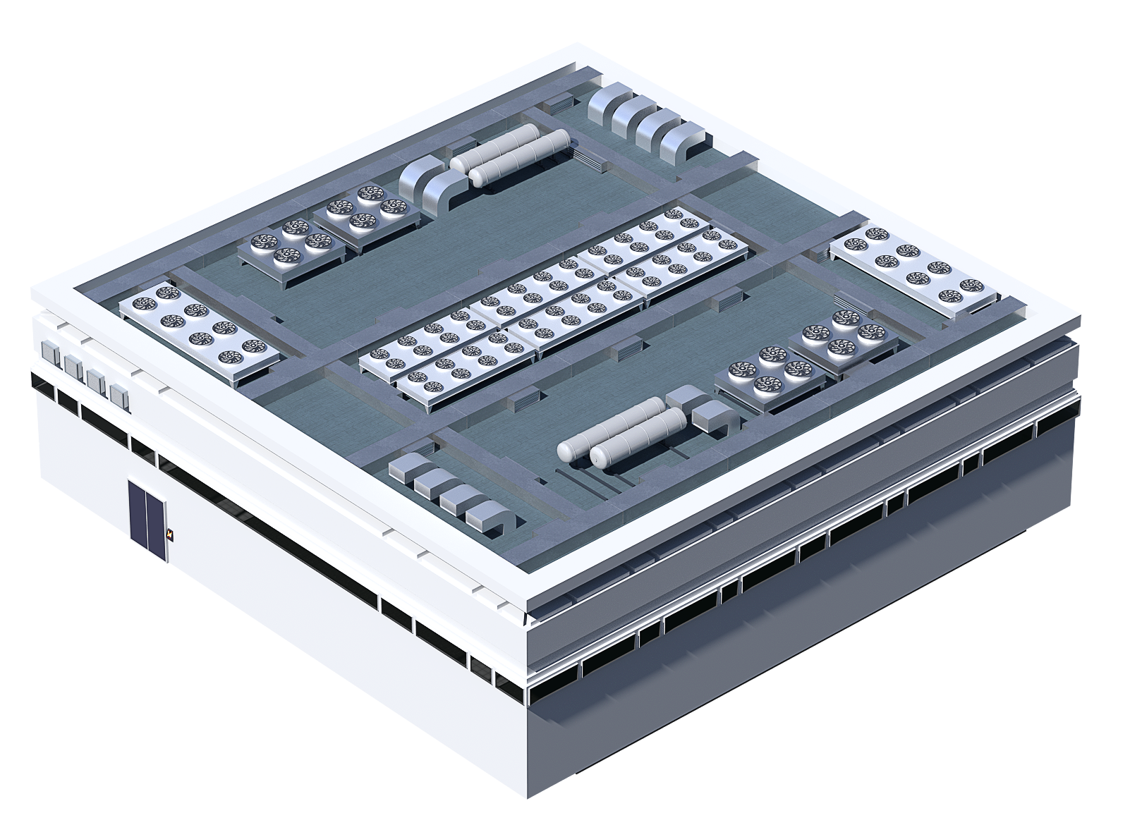
Data Center Challenges
Demanding up to 12% of US power by 2030, up from 3-4% today ¹
Availability of power supply
Behind-the-meter vs front-of-the-meter power
Time to power and capacity expansion planning
Grid connection wait time and availability
Extreme load volatility and system stability
Energy efficiency
Sustainable energy
Backup power startup time
Permitting, and public acceptance
Electricity rates
Restricted © Siemens Energy, 2026
¹ McKinsey and Company, DOE, and EPRI
4
Notes:
Sourcing enough power, which can be difficult in some locations.
due to limited power, developers are looking at alternative sources of energy and even building their own electricity supply onsite.
Europe is battling a record-breaking surge in energy prices
Facing delays in building materials, as well as labor.
Stringent regulations in Europe and regional diversity are additional challenges to the data center market
The European Commission’s paper “Shaping Europe’s Digital Future” states that data centers must be carbon-neutral by 2030 (energy-efficient, utilize waste energy such as heat, and employ more renewable energy sources)

Slide 4
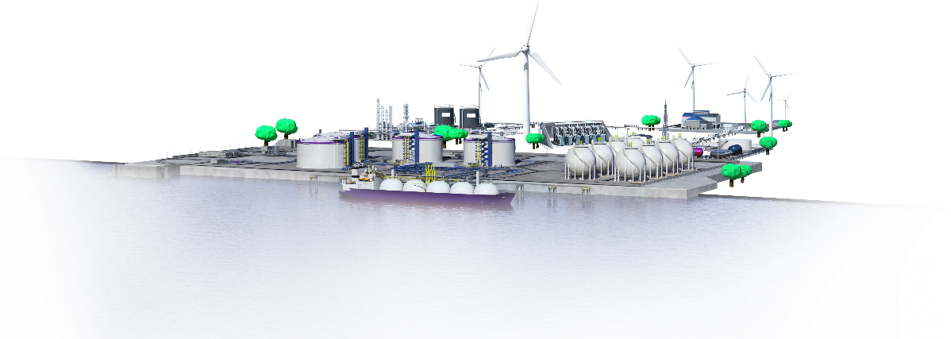
Key Levers for Optimization
Energy System Design
Objective
Achieve minimum total expenditures, CO₂ emissions, or primary
energy consumption.
ESD optimizes the design of an energy system
with respect to a
certain objective
under given
constraints.
Constraints
Limits on the energy system such as time of use tariffs, CO₂ emissions, CAPEX, OPEX, land space, interconnect limits, tax incentives etc. …
Energy system
Combination of energy conversion technologies, energy storages, loads, grids and industrial processes.
Optimization
Solving a mathematical optimization problem.
Design
Technology selection and sizing, including operation.

Slide 5
Key Takeaways
Compromise: There is a quantifiable trade-off between low-cost and low-carbon power.
Optimum: The overall “best” energy system for a given data center must perform against cost, carbon, acquisition timeline, complexity, and water intensity.
Affordability: The overall economically “best” system must outperform alternatives in consideration of capital cost (including overbuilding for availability), O&M cost, efficiency, and land required.
Availability: Ensuring available power to data centers requires careful planning of the types and number of generation assets.
Flexibility: To both increase availability and position for low-carbon fuel available futures, generation asset fuel-flexibility should be considered for data center power systems.
Dispatchability: Generation assets must be designed to meet the quickly changing, highly-dynamic loads demanded by data centers.
Hybridization: Hybrid generation systems can be used to cover all of these requirements, and formulating hybrid designs requires a system’s engineering approach and careful analysis during earliest stages of a project’s development.
6
6
Restricted © Siemens Energy, 2024 | Dr. Joshua Brooks, PE, SE NA PSS PSD
Restricted © Siemens Energy, 2026

