Slide 1
Retail pricing in Tonga
Noelle Jones & Suella Hansen
Presentation for PTC
19 January 2026

Slide 2

Study objective
Identify potential for improvements for domestic RSPs to compete effectively with emerging LEO service providers.

Slide 3
Approach based largely on primary research
Stakeholder engagement
Online consumer survey
  433 respondents with a mobile
  169 with a home service
  survey in both English and Tongan

Slide 4
Situation analysis

Slide 5
Tongan market: key facts
Population: 97,600 (2024)
  declined by 5.5% since 2011
Labor force: 45% of population aged 15+ years (2023)
  unemployment rate: 2.2%
  ‘informal employment’: 53% of employed Tongans
GNI/capita: USD8,800 (2024)
Remittances comprise 31% of household income
Sources: Tonga Statistics Department, World Bank

Slide 6
Affordability will be a constraining factor for many consumers wishing to take up broadband or increase their usage.

Slide 7
Traffic increasing while subscriptions flat
Note: Graph includes Starlink subscriptions but not traffic

Slide 8
We estimate Starlink achieved over 33% share of the fixed broadband market within a year.
[as at November 2025]

Slide 9
Over 2020-24, capital investment was 15% of Tongan revenue

Slide 10
Potential opportunities to reduce costs
EBITDA margin lower in Tonga than in a sample of other island-based operators

Slide 11
Submarine cable accounts for 12-13% of total operator costs
This is a reasonable level of expenditure for a small island nation

Slide 12
Tongan cable prices are relatively low
Price per Mbps decreases as committed capacity increases

Slide 13
Electricity prices are comparable with other
Pacific countries
Utility costs can be a significant component of operating costs
Power sourced primarily through diesel generators
Prices are dependent on diesel fuel costs.

Slide 14
Retail prices

Slide 15
Retail prices have been relatively stable
TCC | ADSL prices reduced significantly since 2023 Most recent mobile price change was in 2021
Digicel | Mobile postpaid prices unchanged since 2020 but increased usage allowances Most mobile prepaid plans largely unchanged since 2020, with three new plans introduced

Slide 16
Unlimited plans are available
TCC | Unlimited ADSL plan introduced in December 2024 No unlimited mobile data plans
Digicel | Unlimited mobile prepaid plan available
WanTok | Fixed wireless plans are unlimited
Starlink | Residential plans are unlimited.

Slide 17
Fixed broadband: least expensive plans

Slide 18
Fixed broadband: affordability
Note: Omitted data points for Tuvalu and Kiribati greater than 70%

Slide 19
Mobile data: least expensive plans

Slide 20
Mobile data: affordability

Slide 21
Survey findings: mobile

Slide 22
87% of respondents want to use more data but it is too expensive
n=405

Slide 23
Users purchase data as and when required
46% of respondents spent less than USD27 on their mobile in the previous month
  USD27 = 3.7% of GNI/capita
51% of respondents top up at least four times a month
  78% top up at least twice a month
Users are also very sensitive to price increases

Slide 24
48% of respondents used less than 20GB in the previous month
n=422

Slide 25
43% used more than one mobile provider
n=189

Slide 26
72% of respondents experienced problems over the previous three months
n=403
n=292

Slide 27
Survey findings: home broadband

Slide 28
58% of respondents had no home service
n=237

Slide 29
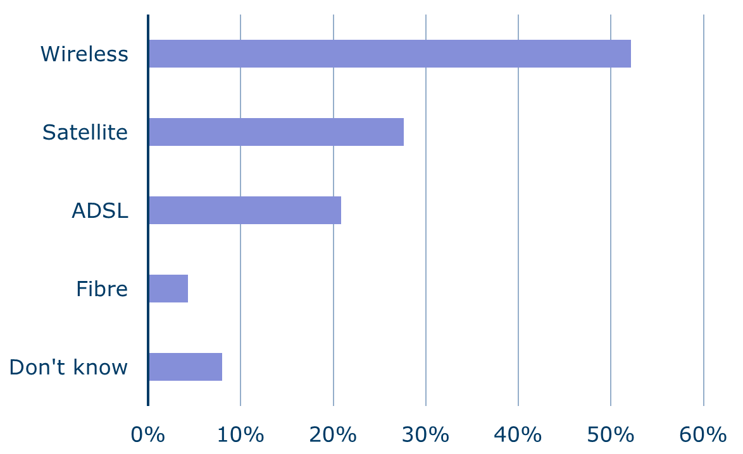
Most respondents used wireless at home
13% had more than one type of home service, mostly for resilience
n=163

Slide 30
39% of respondents spent USD55-82 on their home service in the previous month
Equivalent to 7.6% to 11.2% of GNI/capita
Respondents are also price sensitive
n=151

Slide 31
52% of respondents see cost as a constraint for increasing usage
n=154

Slide 32
44% used less than 200GB in the previous month
77% of users had unlimited data plans
n=161

Slide 33
66% experienced problems with home broadband over the previous three months
n=151
n=101

Slide 34
Concluding remarks

Slide 35
Creating an effective competitive response will be a challenge for industry.

Slide 36
Observations on the Tongan market
Affordability is a major barrier to improving take-up
There is considerable unmet demand for more data
Users are price sensitive
Many users have multiple or diverse service offerings to ensure connectivity
Limited industry resources.

Slide 37
Suggestions for consideration
Operators
Government
More responsive pricing strategies
Improve communication of service offerings and prices
Improve coverage and quality of service
Examine opportunities for efficiency improvements.
Timely market monitoring
Implement a USO regime
Introduce quality of service framework.

Slide 38
Contact: Noelle Jones
WhatsApp: +61418354894
n.jones@strategies.nzl.com
www.nslconsulting.co
Auckland • London • Melbourne

