Slide 1
The Evolution of Cyber Deterrence by Punishment through Offensive Cyber Operations by the USA & the UK since the Late 2010s
~ Implication for Japan’s ‘Active Cyber Defense’ ~
18-21 January 2026
Akira Ichida
Doctoral Student at Keio Univ.
Senior Advisor, Nihon Cyber Defense, Co. Ltd.
Notes:
Good morning, Ladies & Gentlemen.（自己紹介）I’m Akira Ichida, doctoral student at Keio University, studying under Professor Motohiro Tsuchiya.
(NCD勤務) & I am working at NCD Corporation as a Senior Advisor.
(自衛隊勤務) My background is a JMSDF officer for 35 years.
（感謝）Today, I am truly grateful to be here and to have a presentation in front of such a prestigious members who are IT experts, researchers, & government officials.
So, I would like to explain The Evolution of Cyber Deterrence by Punishment through Offensive Cyber Operations by the USA & the UK since the Late 2010s
(日本の能動的サイバー防御法) The reason I am explaining this title is that Japan enacted new legislation as for the Active Cyber Defense Act last year. It enables us not only to take down malicious servers but more strong actions if severe attack occur in Japan.
(課題ありだから教訓) But there are some challenges. So, Lesson & Learn must be needed.
（米英から日本への示唆抽出）This is why my research examines the evolution of US & UK’s cyber strategy posture related deterrence.

Slide 2
Framework of research
(1) Background:
a. The shift in US & UK strategy by the late 2010s.
b. ACD^{*1}evolved, HFO^{*2} started, and OCO^{*3} with disclosure have come to light.
(2) RQ: “How does the active employment of these operations enhance cyber deterrence?”
(3) Hypothesis: “OCO enhances deterrence by punishment and ACD & HFO improve deterrence by denial in some degree.”
(4) Scope of this research: the policies a nation adopt against severe cyber incidents.
*1 ACD: Active Cyber Defense, *2 HFO: Hunt Forward Operations, *3 OCO: Offensive Cyber Operations
Notes:
Screen shows the framework of my research; As a background,
(1)a. (政策の進展) The shift in US & UK deterrence strategy & actual policy measures appears to occur by the late 2010s
b. (ACD, HFO) Main factors are ACD, HFO, and OCO.
ACD, which is the operations to find and fix vulnerability proactively and disrupt cyber-attacks (UK2022), and HFO (which is the operations) to intercept and halt cyber threats in the allies and partner countries (DoD2018).
b. (攻勢的サイバー作戦) Through intentional public disclosure, actual OCO for counterattack cases come to light.
(2) (RQ) Therefore, my RQ is, “How does the active employment of these operations enhance cyber deterrence?”
(RQ~HYPOへの理由) When I looked through these operations, I found as follows; ACD and HFO contribute to resilience in some degree. Meanwhile, OCO with public disclosure increases the credibility of retaliation.
(3) (HYPO) Therefore, I set the following Hypothesis: OCO strengthen deterrence by punishment while ACD and HFO improve deterrence by denial in some degree.
(4) (SCOPE) But I limit the scope of research for national policy level against severe cyber attacks.

Slide 3
1. Findings in my research
(1) From prior researches;
a. Deterrence ≒ ① by Punishment & ② by Denial
b. Until the late 2010s, almost only cyber deterrence by denial.
c. Attribution problem is a matter. ⇨ Political Attribution
(2) Findings;
a. Since then, OCO with public disclosure has been seen.
b. Essence of cyber deterrence is not existence but continuous operations (CISR^{*4})
*4: Cyber Intelligence, Surveillance & Reconnaissance
Notes:
Findings in my research at 1st, from prior researches,
(1)a. (抑止の定義) Cyber deterrence has many definitions. But I quote Joseph Nye’s one.
(伝統的抑止) ‘dissuading someone from doing something by making them believe that the costs to them will exceed their expected benefit.’
① Det by punishment, which a country force the others by showing the fear of retaliation, and Det by denial, which a country make the others realize the cost is higher than expected.
b. c. (アトリ問題、解決、米英実施) Deterrence by denial has long been a core concept in cyber domain because cyber deterrence has faced attribution problem which Government can’t determine ‘who did it.’
c. (政治的アトリビューション) US & UK appears to overcome by political attribution in the late 2010s.
(2)a. (積極的作戦のメリット) So, OCO makes possible to clearly articulate national intent for deterrence.
(物理・核抑止とサイバー抑止の違い) I also found the deference between phyisical such as nuclear det and cyber det.
b. (サイバー抑止の核心) As Takahisa Kawaguchi pointed out, the essence of cyber deterrence lies in continuous operations such as continuous surveillance activities (exemplified by OCO's preposition activities) while the very existence of nuclear weapons serves as deterrence.
(次の２個ページの事例検証導入) The following two pages present case studies of positive operations like OCO by the US and UK.

Slide 4
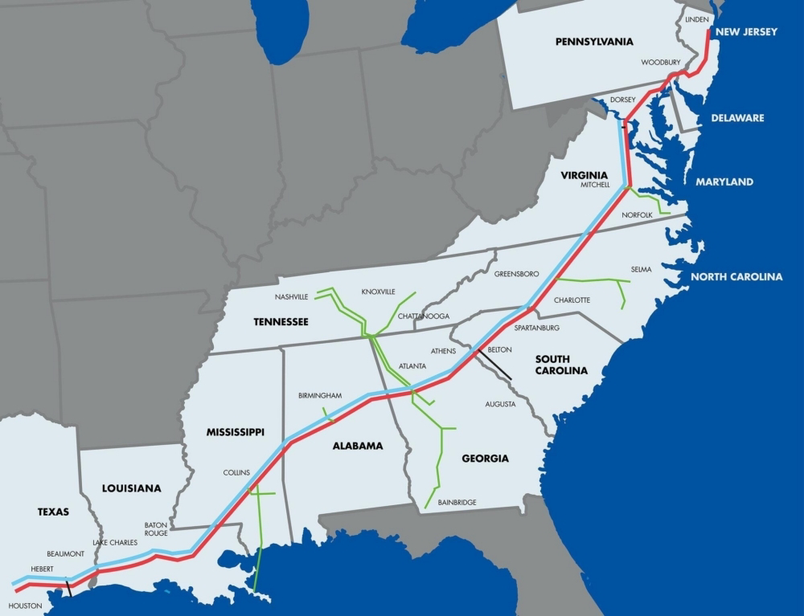
2. The Transition of US Deterrence Posture (Case Studies; 1,2. HFO, 3,4. OCO)
(1) DoD Cyber Strategy 2018:
‘To deter hostility and to respond with any means’
(2) Case 1 (Ukraine), 2 (Lithuania); HFO
⇨ Improve cyber defense
(3) Case 3 (Colonial Pipeline), 4 (Counterattack
to Russia); OCO with disclosure
⇨ Enhance credibility of retaliation
^{From Query}
Notes:
This slide has 4 case studies in USA.
(1) (拒否的抑止が中心) Even in USA, deterrence by denial is the main concept in the early 2010s & earlier.
(2018年戦略) Still, it is important, but DoD Cyber Strategy 2018 stated that, ‘US will ‘take measures to deter hostile cyber operations maintain capabilities to respond with any necessary means.’
This means achieving deterrence not only by defensive operations including HFO, but also through OCO.
(2) (ケーススタディHFO) HFO has been conducted to 21 countries 40 times from 2018 to 2023.
[受入国と米にメリット] The benefits include not only strengthening the host nation's defense capabilities but also enhancing the defense of the U.S. homeland” by obtaining the tactics, techniques, and procedures of attackers prior to an attack.
[相手戦術知ることはOCOに繋る] It also enables the acquisition of useful information for exploiting vulnerabilities necessary for executing OCO.
[貢献]Therefore, HFO contributes to not only DCO but also prepositioning for OCO.
(ケーススタディOCO) In the Case 3, 4; OCO with public disclosure - ‘Colonial Pipeline,’ & ‘Cyber attack to Russia against invasion to Ukraine.’
[事例３ ハッカー破壊] In case 3, Gen. Nakasone admitted that retaliatory strike against hackers (DarkSide)
[事例４ 国家へ反撃] in case 4, conducting OCO in support of Ukraine defense from Russian invasion.
[露による報復なし] Details remain unclear but, a senior official of the Defense Intelligence Agency commented that Russia "has not carried out a clear retaliatory cyberattack" because it appears to seeks to "avoid further escalation & focus on its improvement of national defense capability."
(攻勢的作戦等の重要性向上) These means that OCO has become more important than ever as a deterrent power .
『参考 HFOにブロックする役割』
But an interesting fact is that HFO includes aspects such as ‘disrupting or blocking at the source’ on its capability.
Colonial Pipeline, 2021.11 Counterattack to Russia, 2022.6

Slide 5
2. The Transition of UK Deterrence Posture (Case Studies; 3. ACD, 4. OCO)
(1) GCHQ^{*5} is the center of policy, intel and OCO, and NCSC^{*6} is for ACD.
a. Under Investigatory Powers Act 2016 etc.
b. Case 1; ACD by NCSC
⇨ Improve cyber defense
(2) Case 2; OCO against ISIS in 2018
⇨ Enhance credibility of retaliation
*5: GCHQ; Government Communication Head Quarters
*6 : NCSC: National Cyber Security Centre
Notes:
(拒否的抑止中心) As same as the other countries, cyber deterrence by denial was main framework and it heavily depended on the resiliency of the system in UK.
(GCHQとNCSC役割) in UK, GCHQ is the centre of Cyber policy & opearitons such as cyber intelligence & OCO, and NCSC is the hub for information sharing & cooperations, and ACD as well.
（法令遵守）These 2 organizations are carrying out missions legally approved under Investigatory Power Act (Intelligence Services Act 1994).
(オズワルド NCSC) Case 1; Chief Executive Officer of the NCSC, Felicity Oswald, commented that “through ACD, NCSC are proactively discovering threat intelligence & similar data, removing over two million malicious websites, & collecting intelligence in a proportionate & transparent way.”
(ジェレミー GCHQ) Case 2; Jeremy Fleming, Director of GCHQ stated at the ‘CYBERUK’ conference the UK had conducted cyberattacks on the so-called ISIS (Islamic State of Iraq & Syria) to its servers which ISIS used as a tool for propaganda, drone control etc.
(コスト計算 / 抑止力) Similar to the Colonial Pipeline case, Case 2 signifies that the UK's retaliation risk has significantly increased for non-state actors in terms of cost calculations..
This suggests OCO as a substantial effect in the deterrence.

Slide 6
Results of research
1. ACD & HFO are effective for proactive defense & improve deterrence by denial.
2. OCO with disclosure obliges attackers to consider the risk of genuine retaliation.
⇨ OCO + sustained CISR may have altered the landscape for deterrence by punishment.
Notes:
Two broad features emerge from my research.
1 - (変容させた) 1st, ACD & HFO are effective for proactive defense. Consequently, these enhance deterrence by denial.
2 -(公開OCOリスク評価強制) Secondly, the employment of OCO with public disclosure obliges attackers to consider the risk of genuine retaliation whenever they try to attack.
(多くのOCOは非公開) Looking back OCO, it has disclosed almost no facts regarding its actual operations for reasons of secrecy.
(懲罰的抑止) The OCO with disclosure plus continuous CISR like maintaining the preposition may have significantly altered the landscape for deterrence by punishment.
(結論) Consequently, whenever the attackers try to launch cyberattacks against US & UK, they have to consider the risk of retaliation.

Slide 7
3. Visualization of the Deterrence Effect by means of HFO, ACD & OCO
In the early 2010s
In the late 2010s
DCO
DCO
ACD, HFO
OCO
⇦Visibility
⇦Visibility
OCO
Cost Effectiveness ⇨
Cost Effectiveness ⇨
Figure 2: Positioning of deterrence capabilities based on traditional cyber deterrence (Diagram created by the author.)
Notes:
Visualizing the results so far would look like this figure. Off course this is just an image to stimulate your thought.
In this diagram, the vertical axis represents visibility, and the horizontal axis represents cost effectiveness of deterrence.
ACD, HFO expand capability of Effectiveness of deterrence mainly by punishment. And OCO also enable effective deterrence by punishment.

Slide 8
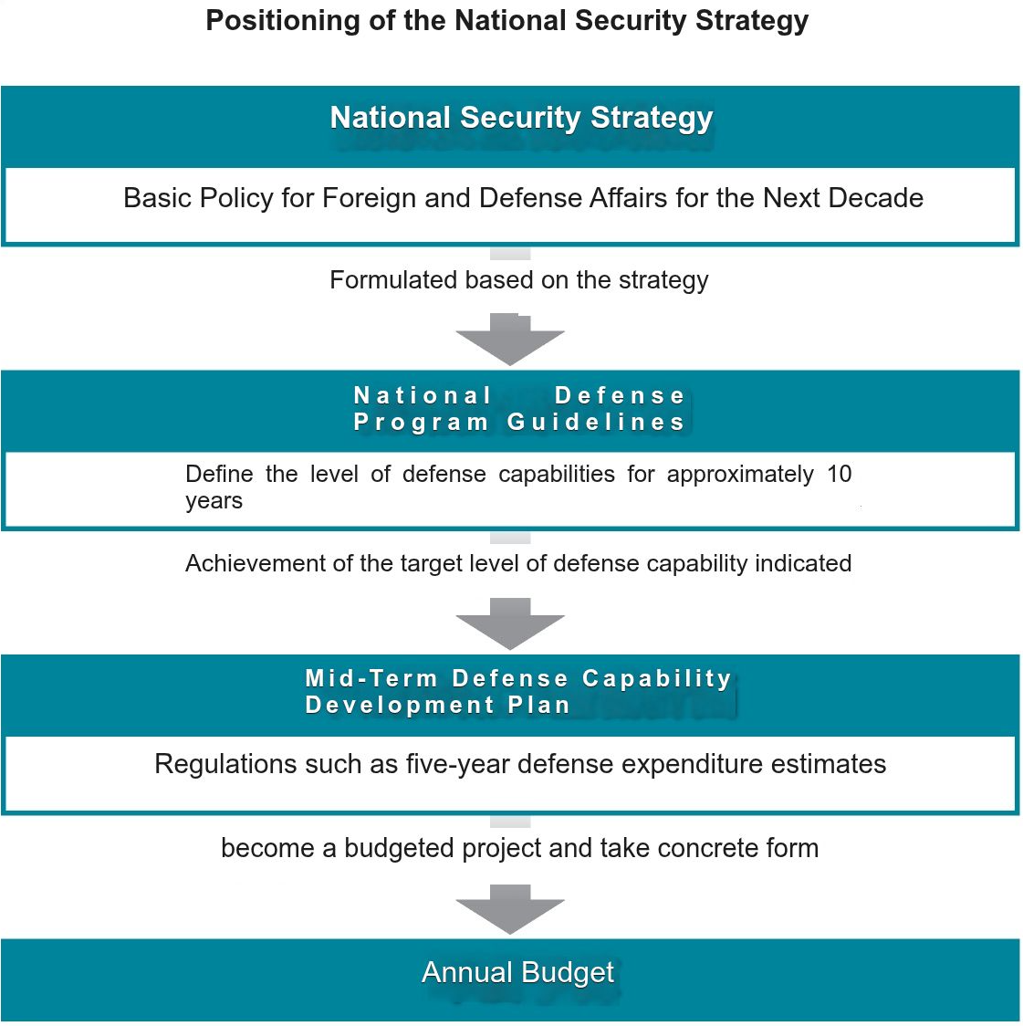
4. Implication for Japan’s Active Cyber Defense ~ Current Status
(1) National Security Strategy 2022 has declared ‘ACD’
(2) Promulgation of ‘ACD’ Acts 2025 and enforce 2026.
a. ‘ACD’ mainly by JMOD & NPA^{*8}.
b. NCO^{*9} is responsible of “strong comprehensive
Coordination.”
⇨ Definition of ‘ACD’ in Japan? / HQs?
^{*7} : National Police Agency
^{*8} : National Cyber Office
Reference: From Nikkei News 19 Mar. 2022
Notes:
In Japan, Deterrence by denial is the only concept for national cyber security to make system resilient, But in 2022, Japan's National Security Strategy has declared
‘ACD’ which substantially implies ACD & patial OCO, is to be implemented.
On that context, Japan promulgated the Act on Enhancement of Cyber Response Capabilities on May 23, 2025. & it will enforce on Nov. 2026.
Act can allow Gov organization to execute ACD, mainly by JMOD & NPA.
& the establishment of NCO has largely resolved the absent of command post or headquarters for cyber attack response.
But Questions are here, what does Active defense mean? & NCO is headquarters?
Cyber Response Capability Enhance -ment Acts

Slide 9
4. Implication for Japan’s Active Cyber Defense ~ Challenges
(1) To execute effective ‘ACD’:
a. Public-Private Cooperation Framework
b. Framework of CISR for ‘ACD’
c. Make NCO literally be a HQs for effective ‘ACD’
d. The coordination framework for ‘ACD’ between JMOD & NPA
(2) Uncertainty remains ⇨ ‘ACD’ ≒ ACD + partial OCO
Notes:
(1) Therefore, this study proposes 4 challenges to make Japan’s posture to be effective on the cyber defense & deterrence.
a (官民連携／双方向) Refined Public-Private Cooperation Framework for information sharing should be needed. Critical National Infrastructure (CNI) have mandated a report in case cyber incident happens without no delay. Because it just seems like one way system, the framework should have to have dual channels like the U.S. Defense Industrial Base.
b (独自の情報収集体制) Second, as a nation able to decide on implementing neutralization measures, it will be necessary to establish an independent information collection frameworks to objectively determine the validity of identifying the source of the attack etc. (情報局：Intelligence Bureau)
c Although previously mentioned the role of HQ, NCO has a role strong comprehensive coordination. There is a need to clarify the substantial comm& headquarters role.
d Concerned relationship between JMOD & NPA in the actual joint operations of ACD. In case both entities do mission, tight cooperation is the must. Therefore, unified joint center run by JMOD & NPA is a desirable objective.
(2) Definition of ACD in Japan still be unclear but it should be ACD + partial OCO whenever I look through its article
I believe Japan will succeed in transforming to be more effective cyber posture.

Slide 10
Thank you for your patience.

Slide 11
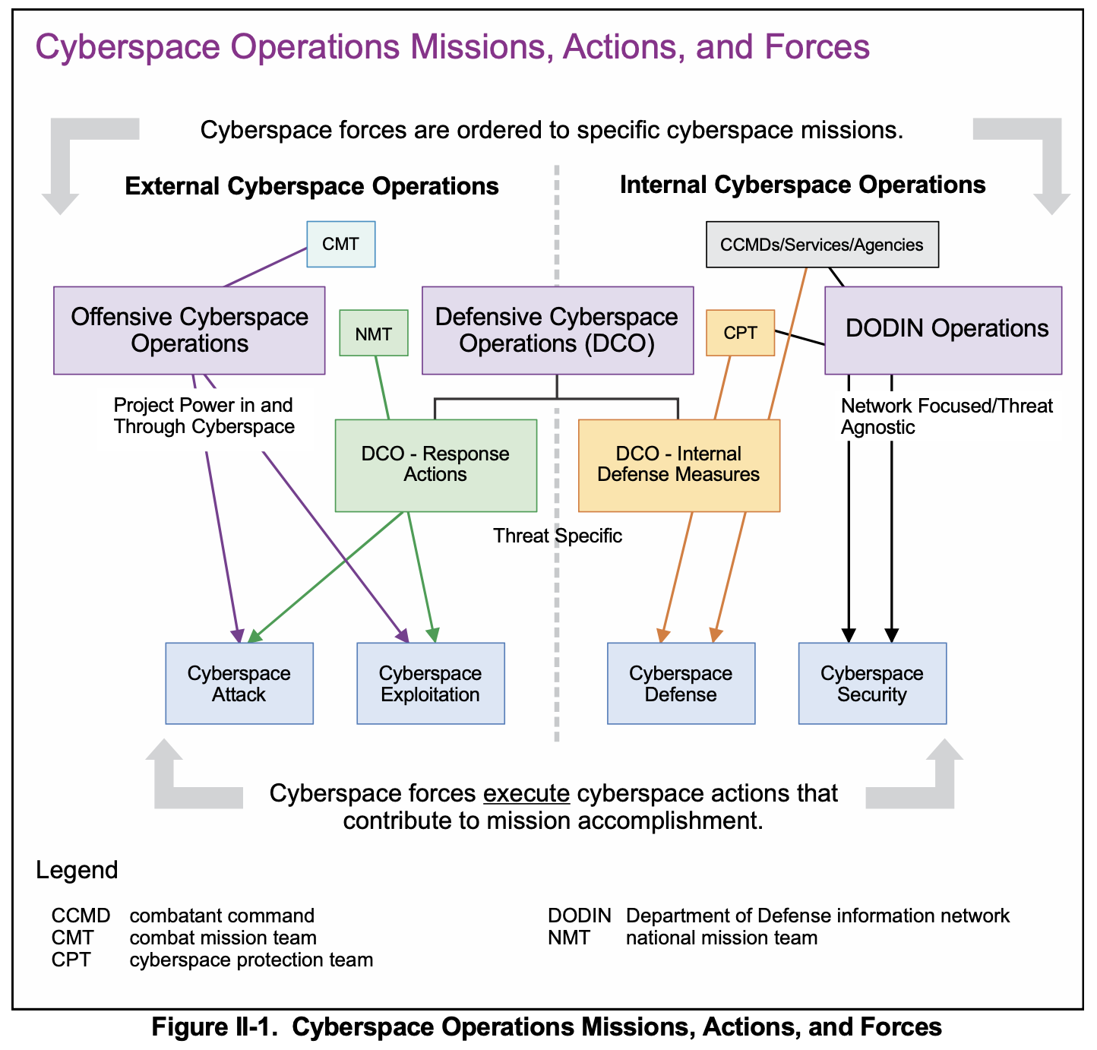
Fm JP3-12

Slide 12
Contents
Framework of research
1. Prior Research on the Definition, Challenges, & Solutions of Cyber Deterrence
2. The Transition of US/UK Deterrence Posture by positive operations (ACD, HFO & OCO) & Actual Case Studies
3. Visualization of the Deterrence Effect by means of HFO, ACD & OCO under the Grey-Zone in US & UK
4. Implication for Japan’s Active Cyber Defense
Notes:
The contents is as follows,
1st, this research will explain Framework of research, such as Research question, Hypothesis & Scope of this research
& as a fundamental premise, I will define cyber deterrence, emphasizing that around the mid-2010s marked a turning point in the evolution of cyber deterrence frameworks within democratic nations, particularly the US & UK. Specifically, the emphasis has shifted from deterrence by denial to a certain focus on deterrence by punishment.
2nd, I’ll show you the definition, challenges, & directions for improvement of cyber deterrence, analyzing amongst prior research.
3rd, In the late 2010s onwards, the transition of U.S. & U.K. deterrence posture, including Hunt Forward Operations (HFO), Active Cyber Defense (ACD), & Offensive Cyber Operations (OCO), with case studies.
4th, Visualization of the changes brought by these measures to U.S. & U.K. cyber deterrence.
Lastly, as a Conclusion, the implications for Japan’s active cyber defense posture under the new Acts..

Slide 13
4. Deferences between US& UK & Japan

Slide 14
UK Cyber Organization

Slide 15
Cyber Kill Chain

Slide 16
OODA LOOP

