Slide 1
The Fragile Backbone of
West Africa’s Digital Infrastructure
18-21 January 2026
Henry el Bahnasawy, Free University of Berlin
Notes:
Thank you for the opportunity to present my research today.
My name is Henry el Bahnasawy, and I am a graduate student at the Free University of Berlin in Germany.
In an era in which digital connectivity has become a critical backbone for social development and economic growth, several West African countries continue to lag behind in building the foundations for digital transformation. While global internet capacity has expanded rapidly, the benefits of this growth are not evenly distributed.
In my paper, “The Fragile Backbone of West Africa’s Digital Infrastructure,” I take a closer look at a group of West African countries where connectivity remains structurally fragile despite rising demand.

Slide 2

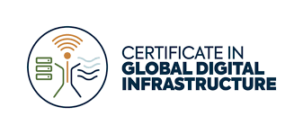
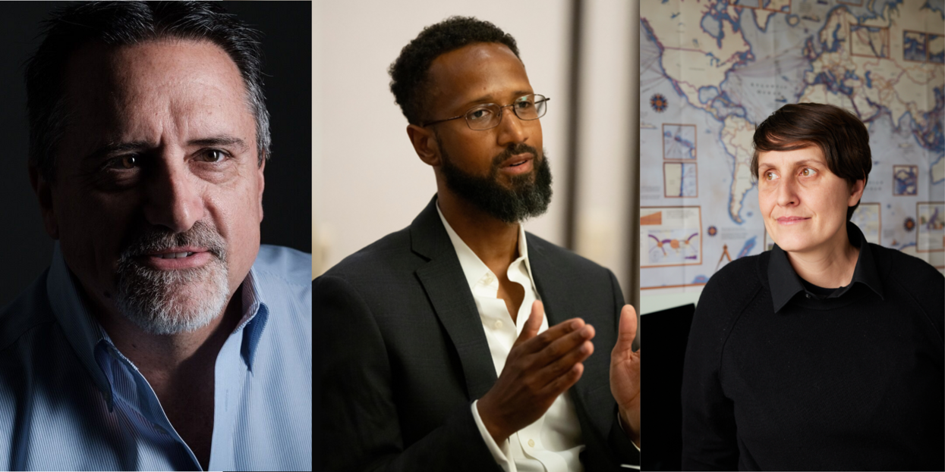
The GDI certificate inspired me to explore West Africa's Digital Infrastructure
The Certificate in Global Digital Infrastructure (GDI) is the world’s first academic program focused on the backbone of the internet, offered at UC Berkeley
Developed in collaboration with SubOptic Foundation and Infrastructure Masons (iMasons)
Nicole Starosielski Erick Contag Joseph B. Keller
Digital Infrastructure 101 How to Build a Global Internet Tech Wars
Notes:
This research was inspired by my exchange semester at UC Berkeley last summer, where I participated in the Certificate in Global Digital Infrastructure the first program of its kind, consisting of three courses. There I had the opportunity to work with Professor Nicole Starosielski and Eric Contag

Slide 3
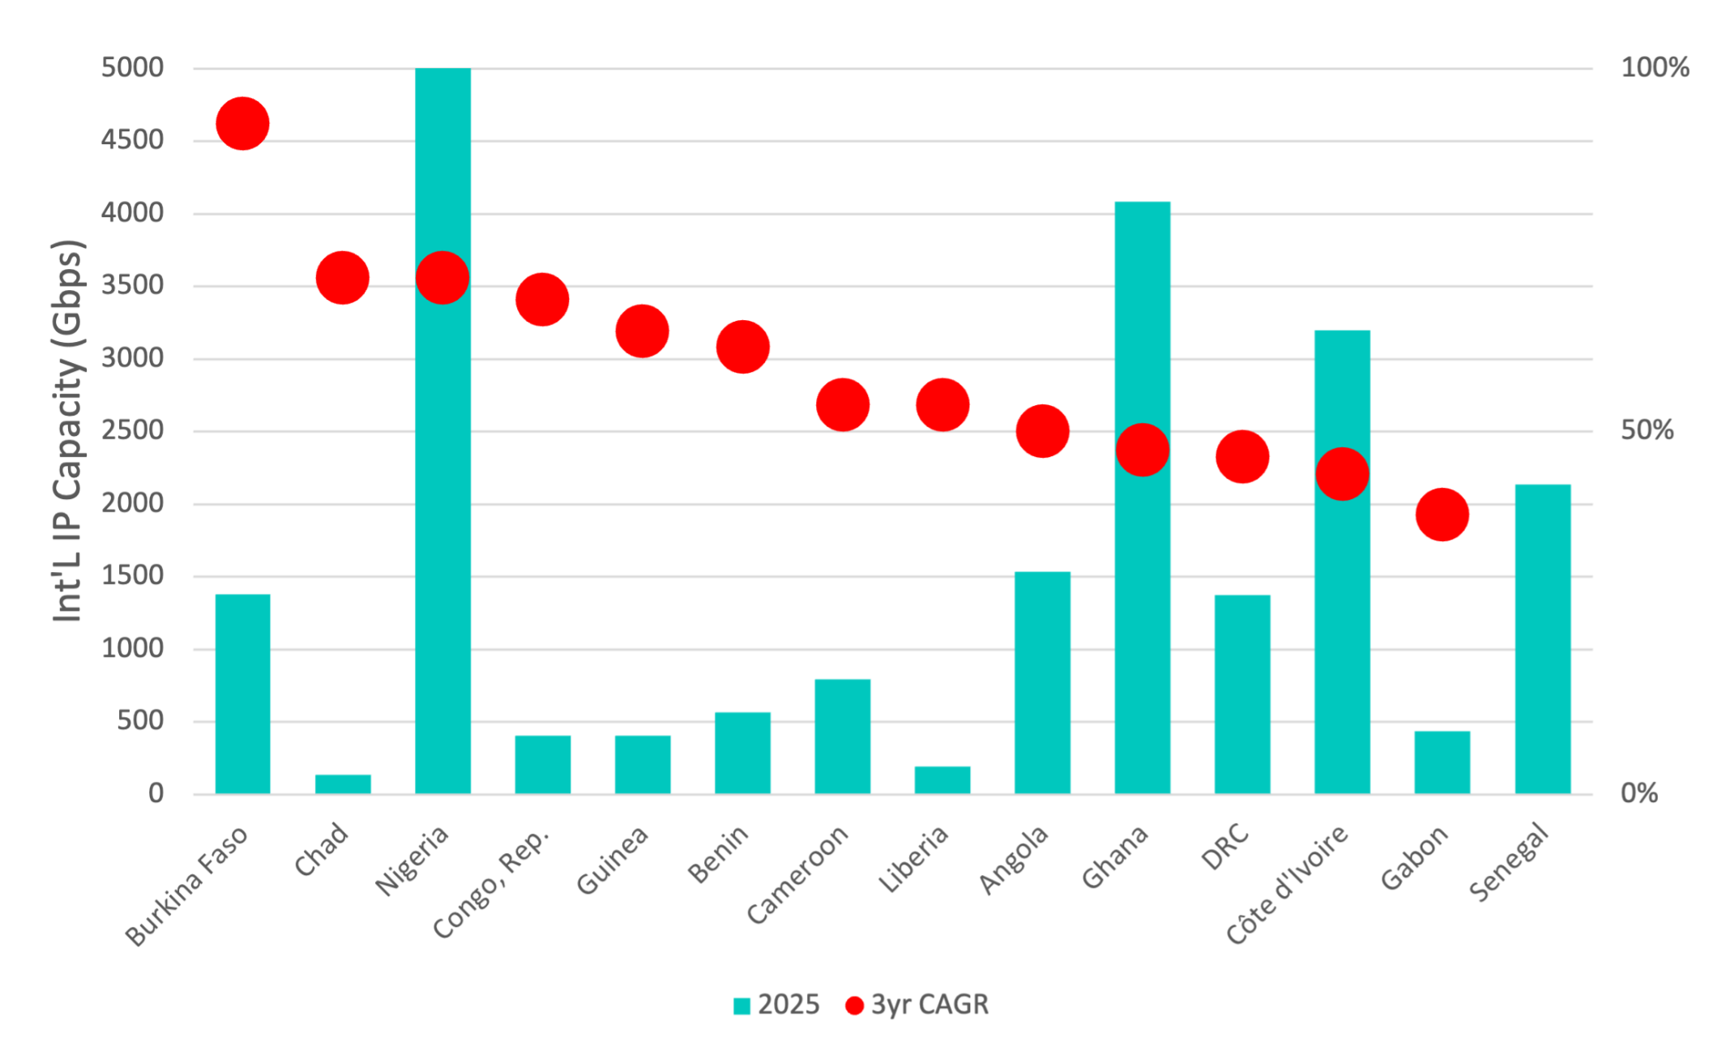
West Africa is Leading in Internet Traffic Growth Worldwide
> 50% annual traffic growth in most countries
Strong growth in both emerging and mature markets (e.g. Nigeria, Ghana)
Young, rapidly growing population driving demand
Rising smartphone and mobile broadband (4G/5G) adoption
Growing use of data-intensive services (e.g. video streaming, cloud and gaming)
Source: TeleGeography, IP Networks
Notes:
Over the past decade, West Africa has significantly expanded its international internet connectivity. Internet traffic growth in the region is now the fastest worldwide, with many countries recording annual growth rates of more than 50 percent. This growth is visible not only in emerging markets, but also in more mature ones such as Nigeria and Ghana. It is driven by a young and rapidly expanding population, rising smartphone penetration, and the increasing use of data-intensive services such as video streaming.
But there is a problem

Slide 4
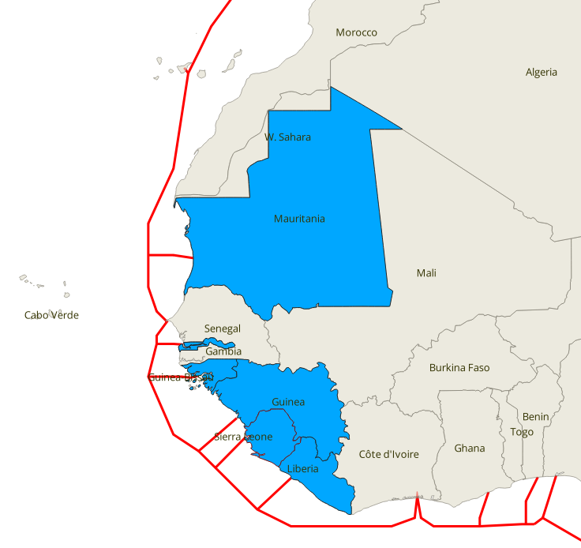
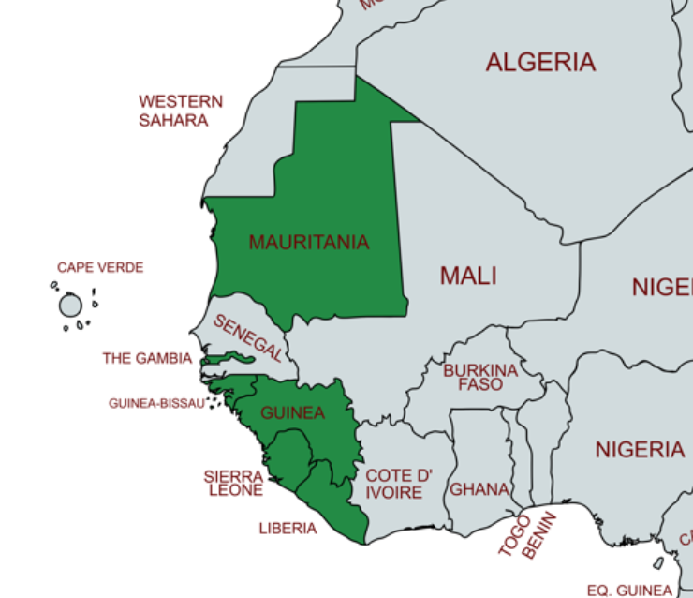
Focusing on West African Countries with a Single Subsea Cable Landing
ACE
Six West African Countries Still Rely on a Single Subsea Cable:
Mauritania
Gambia
Guinea-Bissau
Guinea
Sierra Leone
Liberia
Notes:
There a six countries alongside the west African coast that sill rely on a single subsea cable—the Africa Coast to Europe (ACE) system—for access to the global internet. These countries are Mauritania, The Gambia, Guinea-Bissau, Guinea, Sierra Leone, and Liberia.

Slide 5
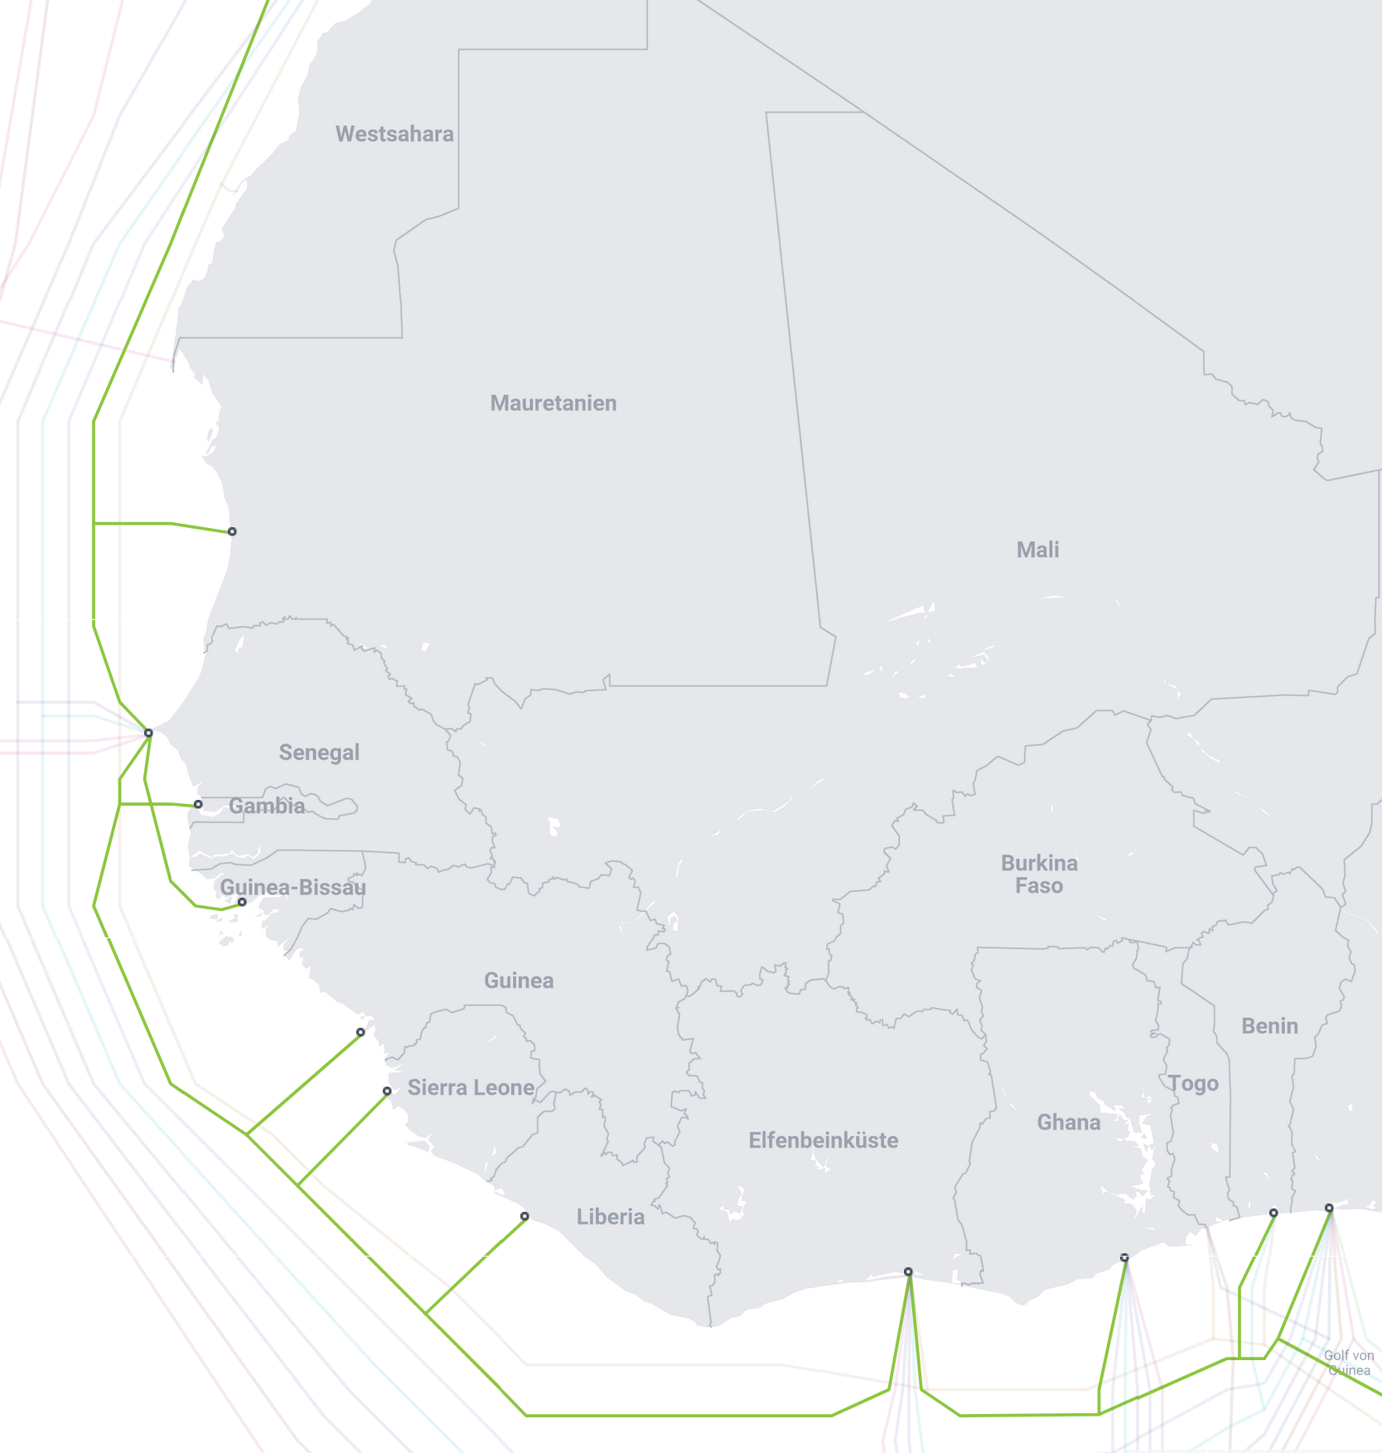
Region Overview - A snapshot at Internet penetration and Resilience
ACE
Six West African Countries Still Rely on a Single Subsea Cable:
Mauritania
Gambia
Guinea-Bissau
Guinea
Sierra Leone
Liberia
Population: 38.2 Million (+2.33% p.a.)
Avg. Internet Penetration: 31.3% (+6.6% p.a.)
25 Million people still offline
Digital Infrastructure Resilience Score: 21.8%
Sources: https://data.worldbank.org/indicator/SP.POP.TOTL
https://data.worldbank.org/indicator/IT.NET.USER.ZS
https://pulse.internetsociety.org/resilience
https://www.cia.gov/the-world-factbook/field/population-growth-rate/country-comparison
https://en.wikipedia.org/wiki/Internet_in_Africa
Notes:
While internet penetration in this region has grown—reaching an average of 32,6% with a growth rate of 3.12% between 2024 and 2025—the foundations of connectivity remain fragile. It means that over 25 million people are still offline. With a combined population of approximately 39.1 million people growing at 2.43% per year, these countries are home to millions of individuals whose access to the digital economy depends on a single point of failure. Any disruption to the ACE cable can have outsized consequences—cutting off entire nations and slowing progress toward digital inclusion, resilience, and long-term economic growth.

Slide 6
Challenges
All international connectivity relies largely on the ACE subsea cable
  No alternative subsea cables → no redundancy
Limited cross-border terrestrial fiber networks
Very few or no local data centers
  Almost all content is hosted/cached abroad
Very few or no Internet Exchange Points (IXPs)
  small ISP markets, lack of regulatory push, and weak incentives to peer
  No or limited interconnections between ISPs → local traffic routed internationally, increasing latency and transit costs
  ➔ High costs, low competition, fragile connectivity despite rising demand
Notes:
One of the central findings of my research is that the challenges faced by these countries are not isolated technical gaps, but the result of reinforcing structural factors.
International connectivity in these countries relies almost entirely on a single subsea cable, ACE. There are no alternative subsea routes and only limited cross-border terrestrial fiber connections. This means that any disruption immediately becomes a national-scale problem. However, this single-cable dependency also shapes incentives further down the value chain.
Cable landing stations are typically controlled by incumbents and are not operated on a carrier-neutral basis. Access is often closed or subject to high cross-connect and capacity fees. As a result, smaller and new operators face significant barriers to accessing international bandwidth. This limits wholesale competition and keeps prices high, even when global capacity is abundant. High prices, in turn, suppress demand and slow the development of local digital markets.
These market conditions help explain why Internet Exchange Points are largely absent. In theory, IXPs allow local traffic to stay local, reducing costs and improving performance. In practice, however, IXPs require a minimum number of participating networks, trust among operators, and clear economic incentives to peer. In many of the countries I studied, the number of ISPs is small, traffic volumes are limited, and incumbents have little incentive to support IXPs because they benefit from international transit revenues. In addition, regulatory frameworks often do not actively encourage or mandate local interconnection, leaving coordination to the market.
A similar dynamic affects the development of local data centers., Data centers require reliable power significant upfront investment, and predictable demand. In many of these markets, electricity supply is unstable and heavily dependent on diesel generation, which raises operating costs. At the same time, high international bandwidth prices and weak local interconnection limit traffic volumes, making it difficult to build a viable business case for local hosting. As a result, most content continues to be hosted in Europe, reinforcing dependence on international connectivity.

Slide 7
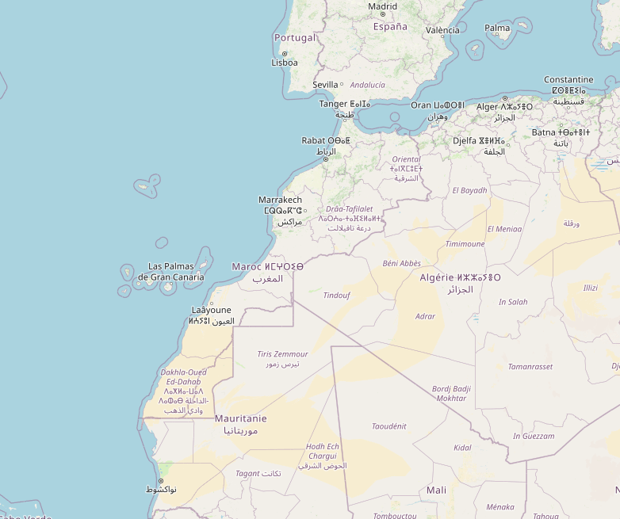

Challenges
All international connectivity relies largely on the ACE subsea cable
  No alternative subsea cables → no redundancy
Limited cross-border terrestrial fiber networks
Very few or no local data centers
  Almost all content is hosted/cached abroad
Very few or no Internet Exchange Points (IXPs)
  small ISP markets, lack of regulatory push, and weak incentives to peer
  No or limited interconnections between ISPs → local traffic routed internationally, increasing latency and transit costs
RTT 106ms
  ➔ High costs, low competition, fragile connectivity despite rising demand
Notes:
To illustrate the impact of weak local interconnection, I conducted latency measurements between two ISPs in Mauritania. Although both were located in the same city only a few kilometers apart, they did not peer with each other, and traffic was routed via the ACE cable to Europe and back, resulting in latencies of over 100 milliseconds.

Slide 8
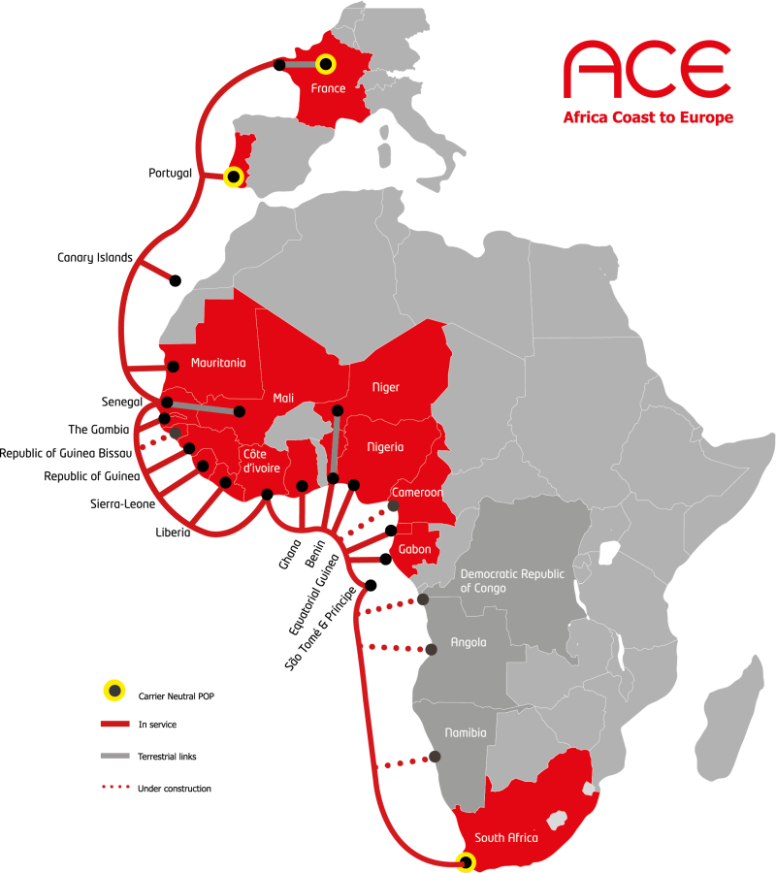
ACE (Africa Coast to Europe) Subsea Cable System
Consortium subsea cable system, led by Orange (formerly France Télécom)
RFS: December 2012
Lands in 19 countries, serving as the first fiber-optic subsea cable for 6 countries
Many landing stations financed by the World Bank
Length: ~17,000 km
Build cost: ~US$700 million
Design capacity: 20 Tbps (2 fiber pairs)

Slide 9
ACE (Africa Coast to Europe) Subsea Cable System
Consortium subsea cable system, led by Orange (formerly France Télécom)
RFS: December 2012
Lands in 19 countries, serving as the first fiber-optic subsea cable for 6 countries
Many landing stations financed by the World Bank
Length: ~17,000 km
Build cost: ~US$700 million
Design capacity: 20 Tbps (2 fiber pairs)
Reputation for outages and network disruptions
  Traverses two subterranean canyons (debris slides)
No carrier-neutral CLS’s → access controlled by incumbents, limiting use by smaller operators
  High cost of international bandwidth and cross-connects
Limited capacity → will not meet future demand
Some cable segments exceed 50% of it’s 25-year design lifespan
Notes:
Let‘s talk about ACE issues and limitations. Here it is important to highlight its operational fragility. Over the years, ACE has developed a reputation for outages and network disruptions. One reason is its physical route: the cable traverses two major submarine canyons for example the congo river, where debris slides significantly increase the risk of cable damage.

Slide 10
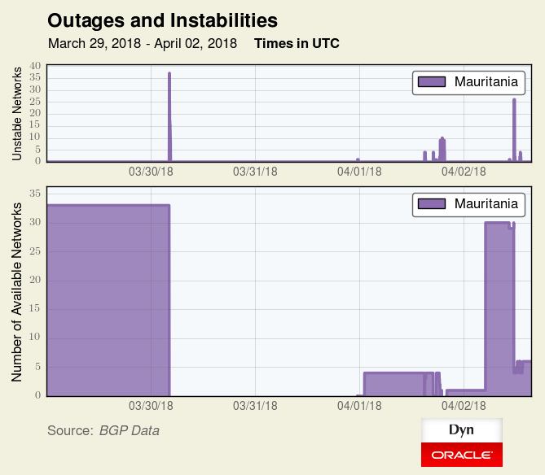
ACE (Africa Coast to Europe) Subsea Cable System
Mauritania: 48-Hour Internet Outage After ACE Cable Cut
RFS: 2012 December
Lands in 19 countries (first fiber-optic subsea cable for 6 countries)
Length: 17,000 km
Capacity: 20 Tbps (2 fiber pairs)
Reputation for outages and network disruptions
  Traverses two subterranean canyons (debris slides)
No carrier-neutral CLS’s → access controlled by incumbents, limiting use by smaller operators
  High cost of international bandwidth and cross-connects
Limited capacity → will not meet future demand
Some cable segments exceed 50% of it’s 25-year design lifespan
Source: https://web.archive.org/web/20180807085008/https://dyn.com/blog/ace-submarine-cable-cut-impacts-ten-countries/
Notes:
A concrete example occurred in Mauritania, where a cable cut in 2018 on the ACE system led to a complete nationwide internet outage lasting more than 48 hours. During this period, the entire country was effectively disconnected from the global internet
Another structural limitation of the ACE system lies in how its cable landing stations are operated. Most ACE landing stations are not carrier-neutral. Access is typically controlled by incumbents, which gives them significant market power over international connectivity. This limits the ability of smaller operators to use the system on fair terms and reduces wholesale competition.
As a result, the cost of international bandwidth and cross-connects remains high, even though global capacity prices have fallen dramatically. In practice, access conditions at the landing station often matter more than the availability of capacity on the cable itself. This creates a situation where connectivity exists, but its not affordable and competitive for almost all market participants.

Slide 11
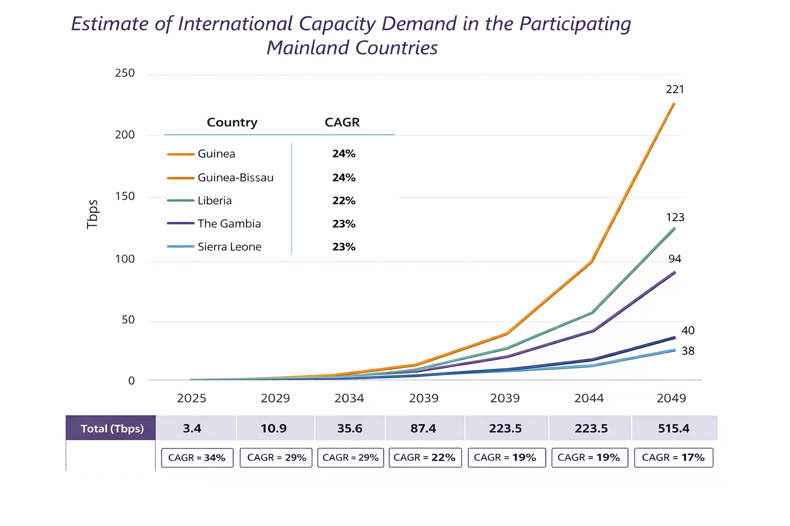
ACE (Africa Coast to Europe) Subsea Cable System
Reputation for outages and network disruptions
  Traverses two subterranean canyons (debris slides)
No carrier-neutral CLS’s → access controlled by incumbents, limiting use by smaller operators
  High cost of international bandwidth and cross-connects
Limited capacity → will not meet future demand
Some cable segments exceed 50% of it’s 25-year design lifespan
Source:
Feasibility Study for the Development of the Amílcar Cabral Submarine Cable, João da Luz R. Ramos
Notes:
In the countries that rely exclusively on ACE, internet traffic is expected to grow at annual rates between 17 and 34 percent between 2025 and 2049.
As a result, total international capacity demand in these ACE-only countries is projected to increase from around 10.9 terabits per second by 2029 to well over 500 terabits by 2049. This growth far exceeds the practical upgrade potential of the ACE system.
Some cable segments exceed 50% of it’s 25-year design lifespan. If there is no new cable in the next 10 years… there is a risk that these countries will lose their entire subsea capacity.

Slide 12
Capacity Prices
Notes:
Let’s take a quick look at capacity prices in West Africa. Here, I will focus on the wholesale prices for subsea cable capacity.

Slide 13
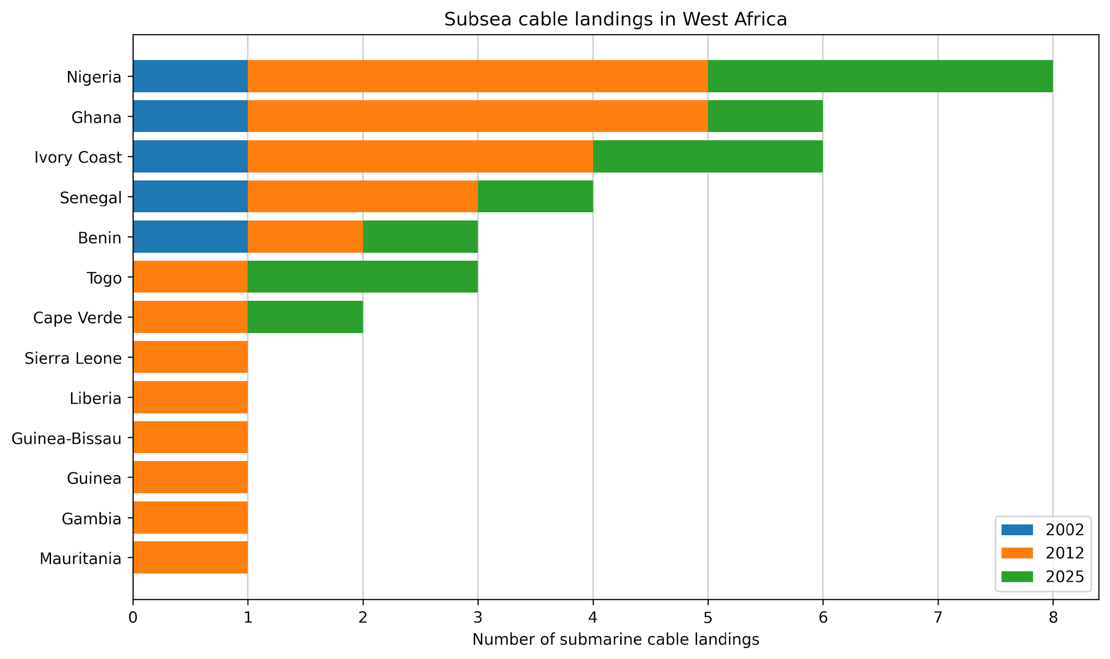
Subsea cable landings in West Africa
Earliest major int’l cable
  SAT-3 (2002)
First wave of new private and consortium int’l cables
  MainOne Glo-1 (2010) then ACE & WACS (2012)
Second wave
  Equiano (2023): 4 African countries
  2Africa (2024): 33 African, ME, Europe & South Asia
Source: TeleGeography, IP Networks
Notes:
To better understand these pricing outcomes, it helps to look at the history of subsea cable landings in West Africa.
As this chart shows, the region’s connectivity has developed in distinct waves.
The earliest major international cable was SAT-3, which entered service in the early 2000s and marked the first step toward fiber-based international connectivity for africa.
Around 2010 to 2012, a first wave of new private and consortium cables followed, including MainOne and Glo-1, and later ACE. This significantly increased the number of landings in larger markets such as Nigeria and Ghana, while many smaller countries received only a single landing.
More recently, we see a second wave of large-scale systems, such as Equiano and 2Africa. These systems have added substantial capacity, but their landings remain concentrated in a limited number of countries.
As a result, while markets like Nigeria and Ghana now benefit from multiple cable landings, others — particularly smaller coastal states — remain dependent on a single international cable. This uneven landing pattern helps explain why global capacity growth translates into very different pricing and resilience outcomes across the region.

Slide 14
Subsea cable landings in West Africa
Earliest major int’l cable
  SAT-3 (2002)
First wave of new private and consortium int’l cables
  MainOne Glo-1 (2010) then ACE & WACS (2012)
Second wave
  Equiano (2023): 4 African countries
  2Africa (2024): 33 African, ME, Europe & South Asia
Source: TeleGeography, IP Networks
Notes:
In the following, I will compare capacity prices in Ghana and Sierra Leone, one of the ACE-only countries.

Slide 15
Diverging Capacity Prices in West Africa: Ghana vs. Sierra Leone
Ghana
Large Market with Multiple Cable Landings
  Large and growing market: higher demand, stronger economy, more ISPs
  Stronger incentives for competition and scale
  Multiple subsea cable landings (SAT-3, ACE, MainOne, WACS, 2Africa)
  Direct landing of new hyperscale systems
Notes:
These two markets are not directly comparable. Ghana is a large and growing market, with much bigger population which results in a higher demand, a stronger economy, and a larger number of ISPs, which creates stronger incentives for competition and scale.

Slide 16
Diverging Capacity Prices in West Africa: Ghana vs. Sierra Leone
Ghana
Large Market with Multiple Cable Landings
  Pre-subsea era (pre-2002):
    Satellite connectivity at ~US$15,000 per Mbps (MRC)
  Early subsea era (SAT-3):
    2002: prices fall to ~US$6,000 per Mbps (MRC)
    2006: SAT-3 prices up to ~ US$2,005 per Mbps (MRC)
  2015: international capacity prices drop to ~US$85 per Mbps (MRC)
  Today (2Africa):
    100 Gbps wave ≈ US$25,000 (MRC) → ~US$0.25 per Mbps
    cross-connect fees capped at ~US$150 by the consortium
Notes:
Before 2002 international connectivity relied on expensive satellite links . Bandwidth was extremely limited (often only a few Mbps for the whole country)
Extremely high Latency → poor quality for voice and video services
No true broadband services were possible

Slide 17
Diverging Capacity Prices in West Africa: Ghana vs. Sierra Leone
Ghana
Large Market with Multiple Cable Landings
Sierra Leone
Small Market with Single-Cable Dependency
  Pre-subsea era (pre-2002):
    Satellite connectivity at ~US$15,000 per Mbps (MRC)
  Early subsea era (SAT-3):
    2002: prices fall to ~US$6,000 per Mbps (MRC)
    2006: SAT-3 prices up to ~ US$2,005 per Mbps (MRC)
  2015: international capacity prices drop to ~US$85 per Mbps (MRC)
  Today (2Africa):
    100 Gbps wave ≈ US$25,000 (MRC) → ~US$0.25 per Mbps
    cross-connect fees capped at ~US$150 by the consortium
Only one international subsea landing (ACE)
No landing of new hyperscale systems
Smaller market with lower aggregate demand
Limited wholesale competition at the CLS

Slide 18
Diverging Capacity Prices in West Africa: Ghana vs. Sierra Leone
Ghana
Large Market with Multiple Cable Landings
Sierra Leone
Small Market with Single-Cable Dependency
  Pre-subsea era (pre-2002):
    Satellite connectivity at ~US$15,000 per Mbps (MRC)
  Early subsea era (SAT-3):
    2002: prices fall to ~US$6,000 per Mbps (MRC)
    2006: SAT-3 prices up to ~ US$2,005 per Mbps (MRC)
  2015: international capacity prices drop to ~US$85 per Mbps (MRC)
  Today (2Africa):
    100 Gbps wave ≈ US$25,000 (MRC) → ~US$0.25 per Mbps
    cross-connect fees capped at ~US$150 by the consortium
Today (ACE):
  International capacity: US$30–50 per Mbps (MRC)
  Cross-connect fees: up to US$15,000 MRC
Notes:
One of the highest in the world. Price per mbps up to 200x higher than in ghana. And monthly corss connect fees in the cable landing station up to 100x as high.

Slide 19
What Is Needed to Build Long-Term Resilience?
Physical redundancy through new subsea cable systems and cross-border terrestrial fiber backbones → enable failover during disruptions and add capacity to meet future demand growth
Policy & governance reform: Open-access frameworks to dismantle monopolistic landing station control → reduce cost and access barriers by preventing international capacity from being controlled by a single incumbent
Development bank financing (e.g. World Bank, DFIs) → to enable projects with weak commercial business cases
Regional interconnection via Internet Exchange Points (IXPs) and (carrier-neutral) data centers → keeps local traffic local, reducing dependence on international subsea capacity during outages
Leveraging existing subsea systems through available branching units → (e.g. 2Africa, Equiano) to create additional landing points more quickly and at lower cost than new cable builds
Notes:
To build long-term resilience and, at the same time, lower wholesale capacity prices — and ultimately prices for end users — several elements need to come together.
First, physical redundancy is essential. New subsea cable systems, combined with cross-border terrestrial fiber backbones, allow traffic to be rerouted when disruptions occur. This enables failover during outages and reduces the risk of nationwide disconnections. At the same time, additional routes increase overall capacity, which is critical to meet the strong demand growth expected in the coming years. More routes and more capacity also put downward pressure on wholesale prices.
However, infrastructure alone is not sufficient. Policy and governance reform plays a central role in determining whether redundancy actually translates into lower costs. Open-access frameworks at cable landing stations are crucial to dismantle monopolistic control. When international capacity is no longer controlled by a single incumbent, cost and access barriers fall, competition increases, and wholesale prices become more closely aligned with global benchmarks.
In many West African markets, purely commercial investment is often difficult. This is where development bank financing, such as support from the World Bank or other development finance institutions, becomes important.
Regional interconnection is another key point. Internet Exchange Points and carrier-neutral data centers allow local and regional traffic to stay local. This reduces reliance on international subsea capacity, especially during outages, lowers operating costs for ISPs, and improves performance for end users. Stronger interconnection also creates the traffic volumes needed to support local hosting and data center investment.
Finally, there is the option of leveraging existing subsea systems through available branching units, such as those on 2Africa or Equiano. In some cases, these branching units can provide additional landing points more quickly and at lower cost than building entirely new cable systems. However, this option becomes less likely over time. As remaining capacity on these systems is allocated to the original landing points, the economic case for connecting new branches weakens, making early action critical.

Slide 20
Key Takeaway
Resilience is not only a capacity issue — it is primarily a governance, market design, and coordination challenge.
Goal: Building a more resilient and inclusive ecosystem to close the digital divide
Notes:
Taken together, these measures show that lowering wholesale prices and building resilience are closely linked. Redundancy, open access, interconnection, and targeted financing reinforce each other. Without this combination, global capacity growth will continue to bypass smaller and more vulnerable markets.
Key Takeaway
Resilience is not only a capacity issue — it is primarily a governance, market design, and coordination challenge.
Goal: Building a more resilient and inclusive ecosystem to close the digital divide

Slide 21
Sources
Africa Coast to Europe (ACE): https://www.submarinenetworks.com/en/systems/euro-africa/ace
ACE Submarine Cable Cut Impacts Ten Countries – David Belson: https://web.archive.org/web/20180807085008/https://dyn.com/blog/ace-submarine-cable-cut-impacts-ten-countries/
Africa: Trends in Submarine, Cloud, and Terrestrial Networks – Patrick Christian (Telegeography): https://isoc.app.box.com/s/kr1k46twn41lz142z4um17663x366xs9
The case for Open Access communications infrastructure in Africa: impact of international submarine cable infrastructure [SAT- 3/WASC] in four African countries – Abi Jagun: https://www.itu.int/net/wsis/c2/docs/2008-May-19/mdocs/Jagun%20et%20al%20_Telecom%20Africa%202008_final%20_2_.pdf
The Case for “Open Access” Communications Infrastructure in Africa: The SAT-3/WASC cable Ghana case study – Eric Osiakwan: https://www.apc.org/sites/default/files/APC_SAT3Ghana_20080516_1.pdf
Sierra Leone's infrastructure : a continental perspective – Nataliya Pushak, Vivien Foster https://documents.worldbank.org/en/publication/documents-reports/documentdetail/345051467990934557/sierra-leones-infrastructure-a-continental-perspective
Harmonising the Regulation of Access to Submarine Cable Landing Stations in the ECOWAS: A Review of Regulation C/REG/06/06/12 – Uchenna Jerome Orji: https://www.researchgate.net/publication/328559598_Harmonising_the_Regulation_of_Access_to_Submarine_Cable_Landing_Stations_in_the_ECOWAS_A_Review_of_Regulation_CREG060612
Anchoring the African Internet Ecosystem: Lessons from Kenya and Nigeria’s Internet Exchange Point Growth – Michael Kende: https://www.internetsociety.org/wp-content/uploads/2020/06/Anchoring-the-African-Internet-Ecosystem-Lessons-from-Kenya-and-Nigeria.pdf
What Will It Take to Get the Internet Access We Need in The Gambia?: https://www.finnpartners.com/news-insights/what-will-it-take-to-get-the-internet-access-we-need-in-the-gambia/
Equiano Subsea Cable: Regional Economic Impact Assessment -- Google: https://africapractice.com/wp-content/uploads/2021/10/REIA-7-February-2022.pdf

Slide 22
Henry el Bahnasawy
henry.bahnasawy@gmail.com
https://www.linkedin.com/in/henry-el-bahnasawy-747583231/

