Slide 1

Top Ten Business and Legal Issues in Data Center Leasing, Assemblages, and Development
Jeffrey A. Moerdler

Slide 2

OUR TOP TEN LIST IN HONOR OF THE DAVID LETTERMAN SHOW

Slide 3

10. SHIFT FROM USING LEASES TO MSA’S IN DATA CENTER TRANSACTIONS
Deals were led by real estate side
Now most are led by IT/Tech side
  Importance of availability of data to business continuity
  Increased use of Cloud
Finance also more involved
  Risk mitigation
  Pricing of services and expense control
  Financial consequences of outage
  Enterprise risk of data breach
Form document: Lease or MSA?
  MSA concepts now in leases

Slide 4

9. THE RISE OF SALE-LEASEBACK TRANSACTIONS
Originally only off-balance sheet financing for single user credit tenant data centers
Expanded to include non-credit tenant leases
Transitioned to allow user to phase out or reduce space and power
  Allows buyer phased conversion to multi-tenant facility
  Gives buyer a credit tenant lease to support financing
Now includes immediate or staged transition to multi-tenant facility

Slide 5

8. SUSTAINABILITY
Sustainable data centers – is it an oxymoron?
Power
  Power Usage Effectiveness (PUE)
    A metric for energy usage not sustainability or emissions
  Renewable energy usage
    Carbon credits and energy purchase agreements – Greenwashing
  Energy conservation
  Use of underutilized stranded power
Water conservation
Reusing surplus heat
Sustainable construction
Waste management

Slide 6

7. OPTIONALITY, OPTIONALITY, AND STILL MORE OPTIONALITY
Power and space ramp ups and downs
Partial termination rights
Expansion and contraction rights
Renewal rights as to all or part of space and power
Rights of first refusal and/or first offer
Rights to last available power and/or space
How do you manage all those
conflicting rights?

Slide 7

6. POWERED LAND ASSEMBLAGES
Power – The New Showstopper
  Generation
  Transmission
  Network Reliability
  Power Cost
  Timing of Availability
Behind the meter/off the Grid
Water – The Next Showstopper
Connectivity
Location, Zoning and Local Support/Opposition
Environmental Issues

Slide 8

5. IMPACT OF AI ON THE DATA CENTER MARKET
How much capacity does AI really require?
  AI demand exploded after ChatGPT 3 release in 11/22
Where does it need to be located?
  Training
  Inference
  Agentic
It is a land grab?
Pressure on enterprise customers
Agentic AI – agents that act, decide and adapt

Slide 9
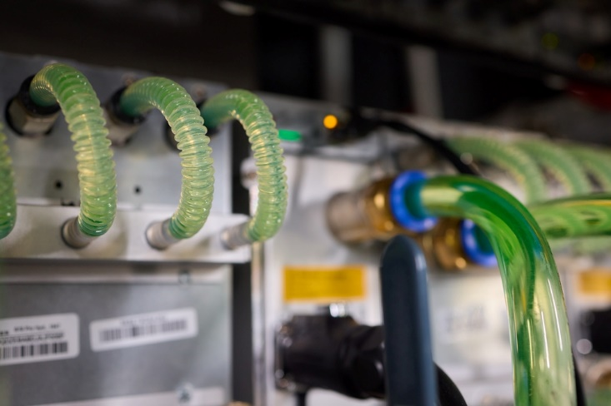
4. LIQUID COOLING
Required by Increased Thermal Demand and High-Performance Compute (HPC) Density
  Liquid to Rack (Rear Door Heat Exchangers)
  Cold Plate Cooling
  Direct to Chip Cooling
  Immersion Cooling
Issues
  Additional CapEx and OpEx
  Scope of Work
  Leak Detection
  Facilitating vs. Providing
  Liability
  Decommissioning and Restoration

Slide 10
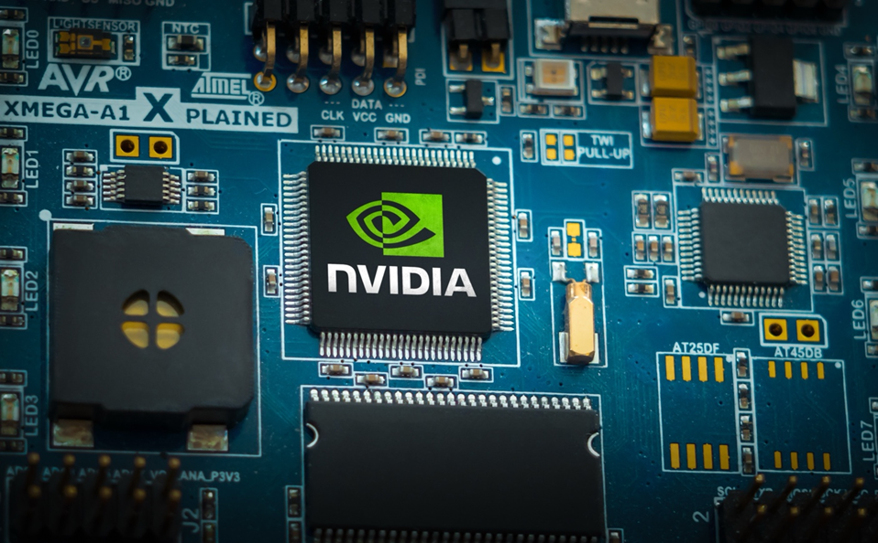
3. RISE OF THE NEOCLOUDS
AI optimized cloud GPU as a Service (GPUaaS)
  Renting raw compute power
On demand graphics processing units
Elastic and scalable
Shifts CapEx to OpEx
High density and quickly scalable
Main customers are Hyperscalers
Potential problems

Slide 11
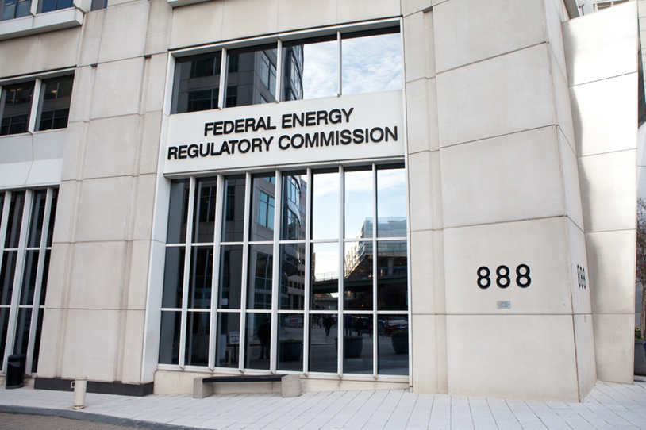

2. POWER REGULATORY ISSUES
Regulation shifting from States to Regional and Federal Levels
Federal rulemaking in process
  Targeting April 2026
Regional developments
  ERCOT SB6 establishes standard rules
  SPP HILLGA and CHILLS encourage bring your own generation
  PJM no consensus yet
Utilities require extraordinary deposits and guarantees
  Exelon Transmission Security Agreement
  AES Constructive Service Agreement for large loads

Slide 12
2. POWER REGULATORY ISSUES
Regulation shifting from States to Regional and Federal Levels
Federal rulemaking in process
  Targeting April 2026
Regional developments
  ERCOT SB6 establishes standard rules
  SPP HILLGA and CHILLS encourage bring your own generation
  PJM no consensus yet
Utilities require extraordinary deposits and guarantees
  Exelon Transmission Security Agreement
  AES Constructive Service Agreement for large loads

Slide 13
NOW FOR THE DRUMROLL

Slide 14

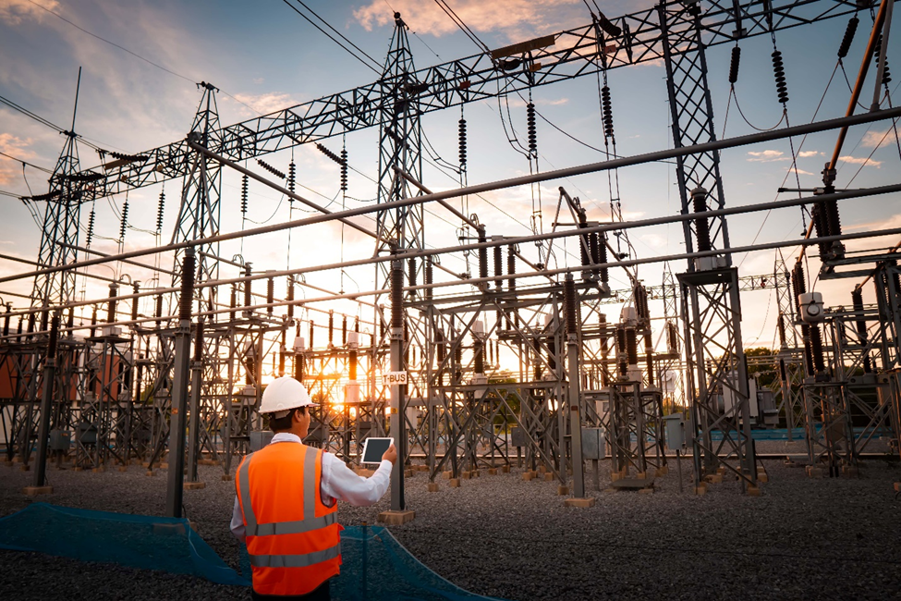
1. AVAILABILITY OF POWER
Data center power needs double by 2030
  Who gets power first?
Generation vs. transmission
Availability, quantity and timing
  Agreement with utility
  Long lead time items
  Co-location with generation
  Bridging power
Alternatives
  Natural Gas – Bridging or Permanent
  Solar, Wind, Geothermal, Hydro
  Battery storage
  Hydrogen
  Small Modular Nuclear Reactors (SMR)

Slide 15
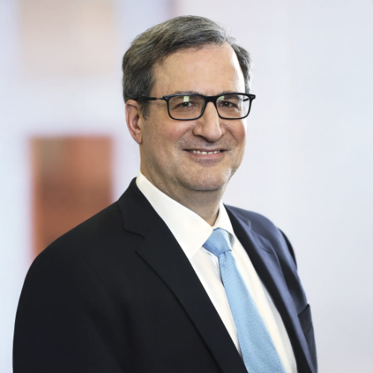
Jeffrey Moerdler
Partner | | Chair - Data Center and Digital Infrastructure Practice Group
New York
+1 212.835.4854
Jeffrey.Moerdler@haynesboone.com
Jeff Moerdler is chair of the Haynes Boone Data Center and Digital Infrastructure Practice and a real estate partner in the New York office. He has more than 40 years’ experience in general commercial real estate law. Jeff’s real estate practice includes acquisitions, sales, development, leasing, and borrower’s side financing. Jeff also has a particular focus on real estate challenges facing communications, technology and energy companies, and represents property owners and telecom companies in telecom real estate matters, particularly in data center development, acquisitions, sales, leases, colocation agreements and service level agreements. His clients include both large national companies and smaller, local clients, and includes representation of landlords and tenants in all types of leases; counseling owners and developers in the acquisition, sale, joint venture, development, and renovation of property as well as sale-leaseback transactions; advising lenders and borrowers in commercial loans; and the representation of all parties in real estate litigation. He is actively involved in settling real estate, partnership, and inter-family disputes. He also represents many not-for-profit entities and is active in health care, senior living, and educational real estate. During the past 35 years, Jeff has developed considerable experience in the intersection of real estate with communications, technology, and energy issues. He has extensive experience representing landlords, tenants, developers, and communications service providers in the leasing, purchase, sale, and financing of data centers, colocation facilities, radio and television broadcast antennas, distributed and in-building wireless systems, rooftop antennas, and fiber-optic transactions as well as the wiring of buildings for broadband communications access. Jeff has also negotiated thousands of data center leases, master services agreements, colocation agreements and service level agreements, rooftop and cellular antenna leases, inside wiring agreements, and antenna tower leases throughout the country – covering over 500 million square feet.
He has also devoted a considerable portion of his practice to power and energy issues related to real estate and other technology matters, including large solar and wind installations, battery storage facilities, and bulk power purchases. Jeff is a frequent speaker on real estate, data center, and telecom topics around the country. He is Fellow of the American College of Real Estate Lawyers and on the faculty of the Advanced Commercial Leasing Institute. He regularly speaks as a panelist at data center, digital infrastructure and real estate conference around the United States. In addition, he is regularly quoted in the New York Times, the Wall Street Journal, Bisnow, Commercial Property News, Real Estate Weekly, and other publications. He co-authored the first treatise chapter on telecom real law for Powell on Real Property in 1999. Jeff has previously served in numerous governmental positions, including as a Commissioner of the Port Authority of New York and New Jersey, a member of the New York State Banking Board, a member of the New York State Financial Control Board, a member of the Departmental Disciplinary Committee of the Appellate Division of the First Department of the New York State Supreme Court, Assistant to the First Deputy Mayor of the City of New York, and assistant to the Deputy Borough President of the Borough of Manhattan. From 1981 to 1982, Jeff served as a law clerk to the Honorable Charles L. Brieant, US District Judge, and later Chief Judge, for the Southern District of New York. Jeff is also an emergency medical technician on his local volunteer ambulance and President of his local chapter, as well as having served for 8 years on the Board of Trustees of the umbrella organization which is the largest volunteer ambulance service in the United States.
Practice Areas
AI and Technology Commercial Real Estate Leasing Bitcoin Mining Companies Networking Real Estate
Education and Clerkships
Columbia University in the City of New York (B.A.) New York University School of Law (J.D.)
Admissions
District of Columbia Florida Massachusetts New York
15

Slide 16
QUESTIONS? FEEL FREE TO CONTACT ME:
Jeffrey A. Moerdler
Partner | Chair - Data Center and
Digital Infrastructure Practice Group
Jeffrey.Moerdler@haynesboone.com
+1 212.835.4854

