Slide 1

Transforming SME management with AI-Driven Insights to Maximize Human Skills
Kenta Saito, CEO of KUROCO
Ekaterina Vinogradova
January 19, 2026

Slide 2

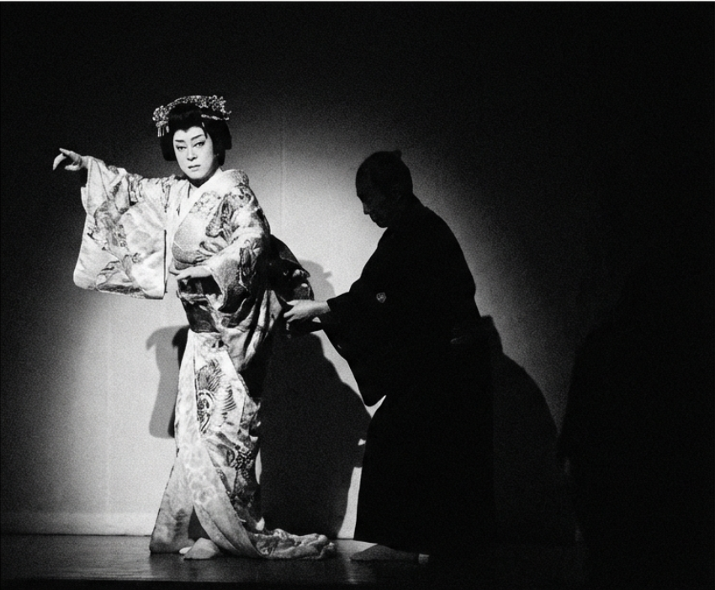
The KUROCO Spirit — Invisible Hands of Data, from Kabuki to Today
[c]吉田修一／朝日新聞出版 [c]2025映画「国宝」製作委員会

Slide 3
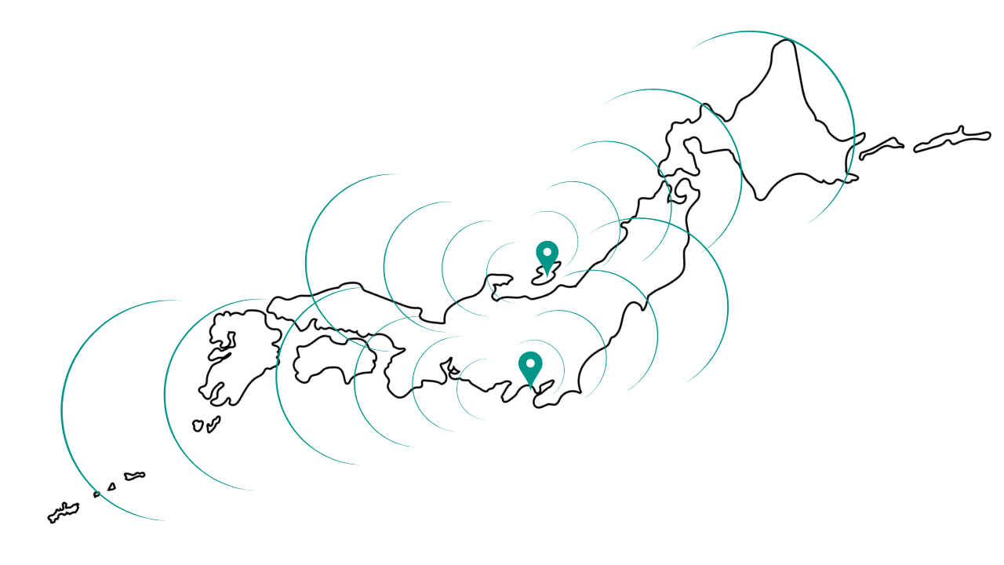
The KUROCO Spirit — Invisible Hands of Data, from Kabuki to Today
Without the KUROCO, the Star Cannot Shine

Slide 4






Quietly Empowering People — The Modern KUROCO
Data and AI

Slide 5
Why Do Most DX Projects Fail?
How many of you have experienced a DX project that didn’t go well?”

Slide 6
Why Do Most DX Projects Fail?
〇
DX
×

Slide 7
Beyond Efficiency — Empowering People Through Human-Centered AI
AI
Revealing potential
Amplifying humanity
Replace Humans

Slide 8

KUROCO’s Answer — The AI Management Board
AI exists to unlock human potential

Slide 9
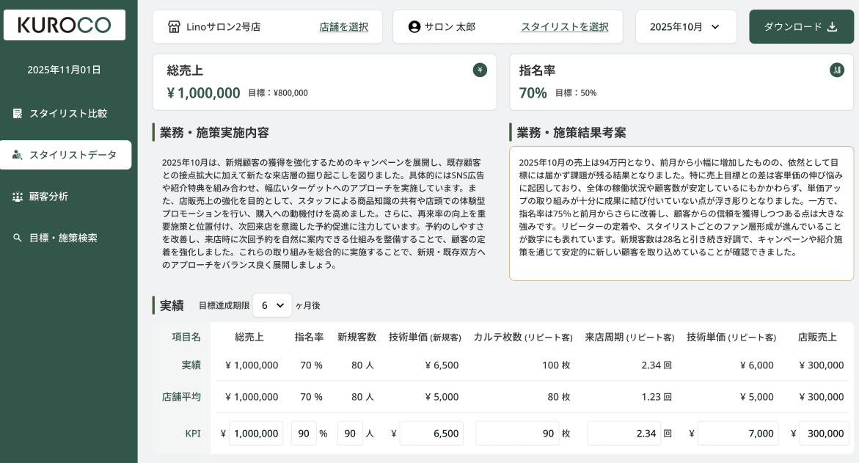
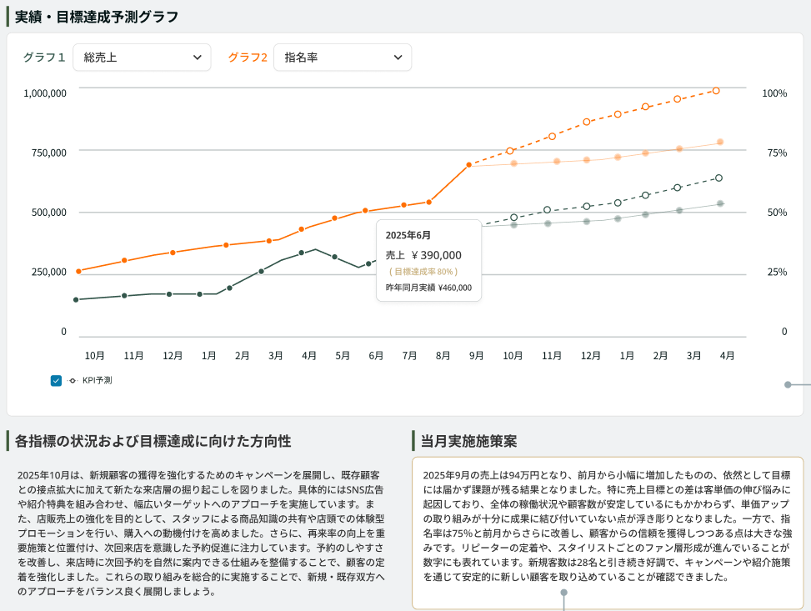
Why We Started in the Beauty Salon Industry
AI-generated comment

Slide 10
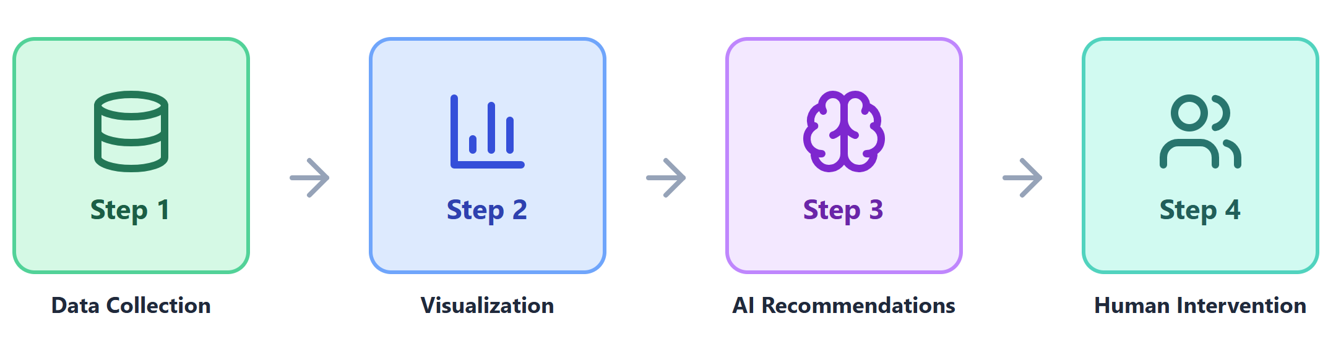
How the Management Board Works
Not just AI - Business Intelligence + Peer Learning + Simulation

Slide 11
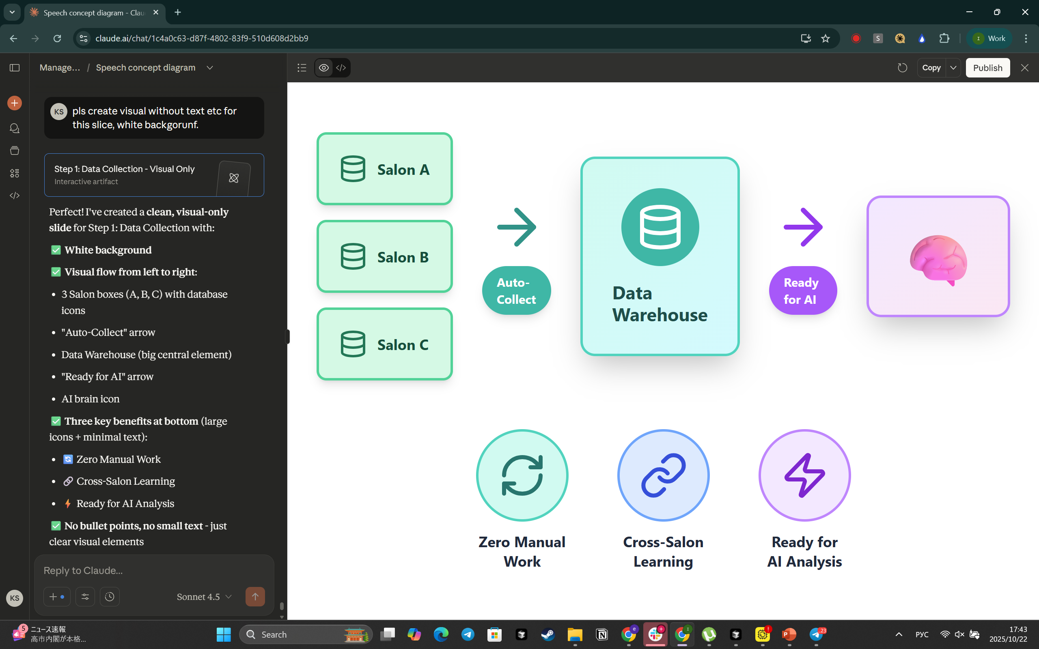
Step 1: Data Collection

Slide 12
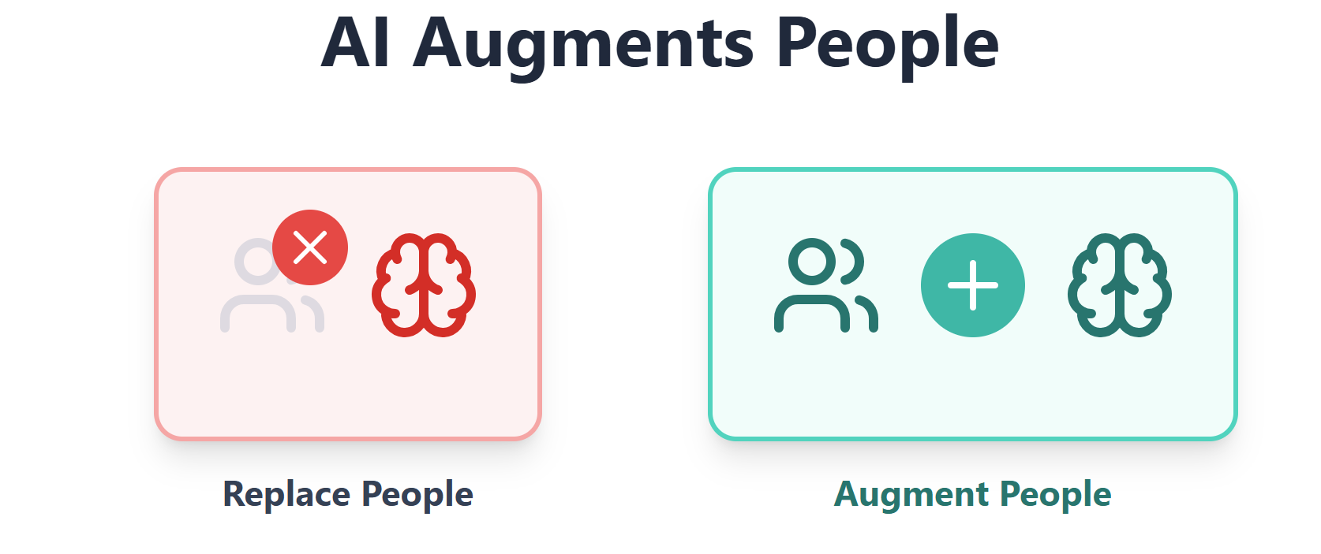
Step 2: Visualization and Business Logic

Slide 13
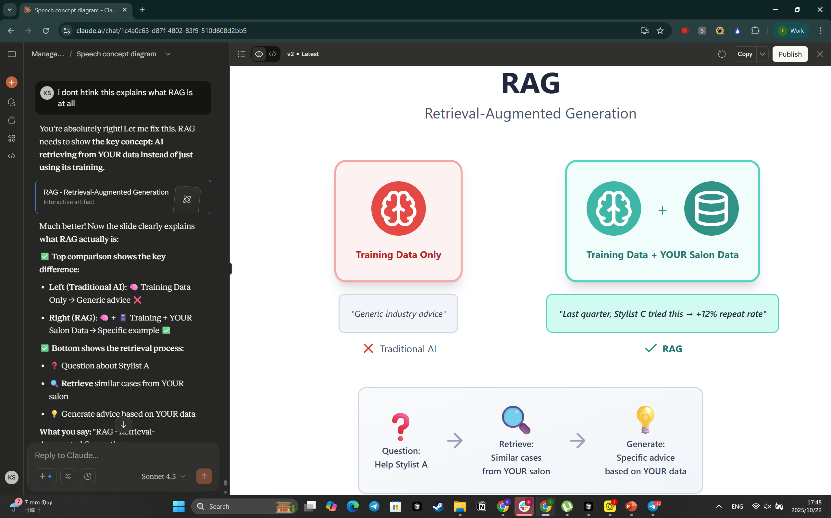
Step 3: AI Recommendations - RAG
AI actively retrieves relevant information from your salon's specific history, similar cases, and documented best practices.

Slide 14
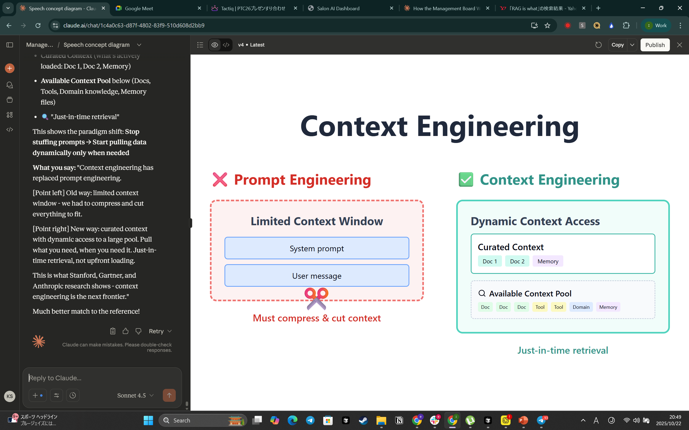
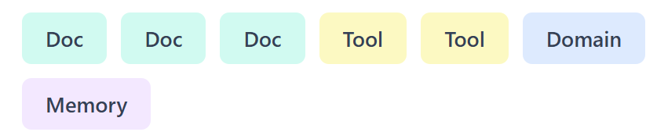
Step 3: AI Recommendations - Context
The AI doesn't just see isolated data points. It understands the full context
Dynamic Context Access
System Prompt
User Message
Must compress & cut context
Accesses situational context

Slide 15
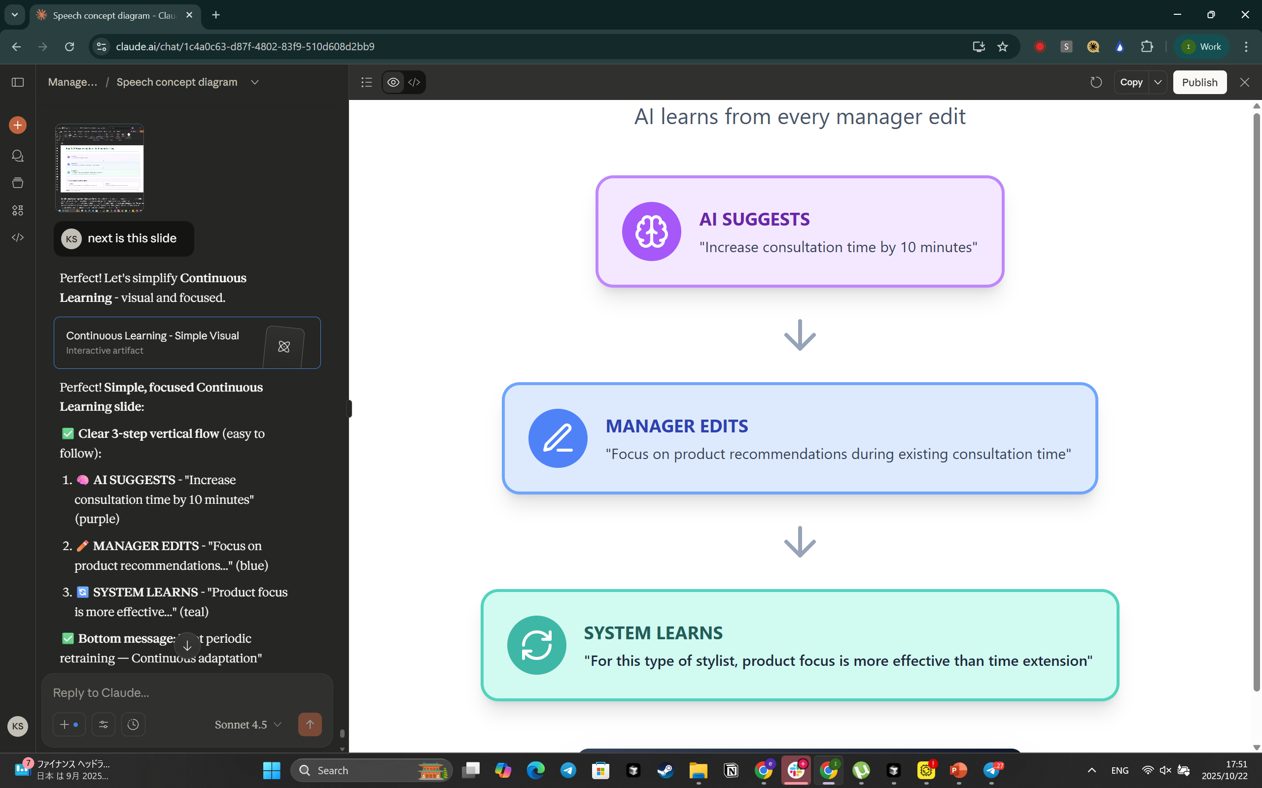
Step 3: AI Recommendations - Continuous Learning

Slide 16
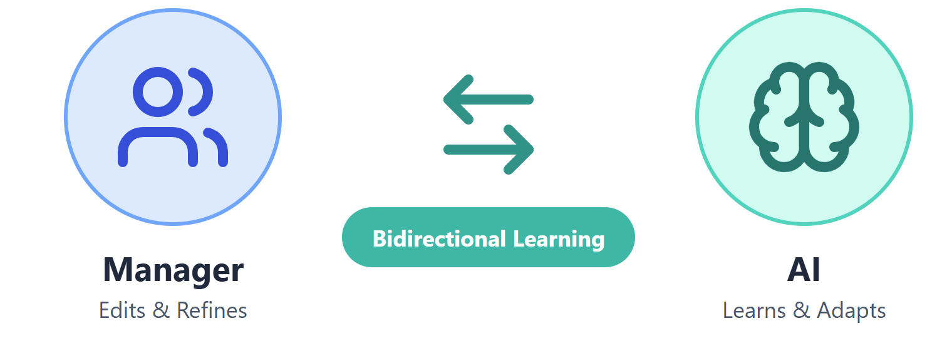
Step 4: Human Intervention

Slide 17

The Future of Management
— Where Data, AI, and Humanity Unite
To every industry where people grow
The Management Board is not limited to beauty—
it extends to education, healthcare, retail, and hospitality.
Data visualizes growth.AI guides the next step.
Technology enables human-centered management.

Slide 18
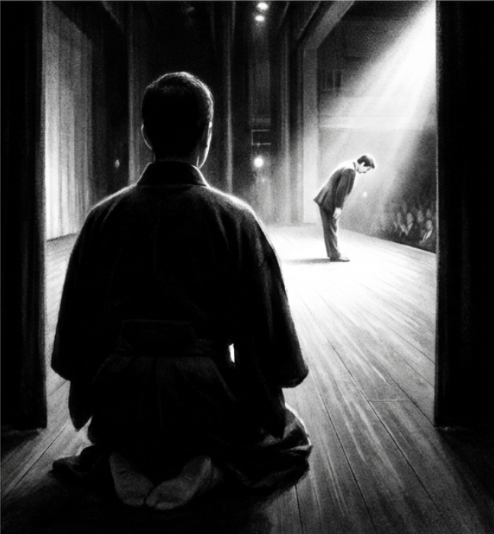
Behind the Scenes — The Spirit of KUROCO
As the modern “Kuroco.”
Like the kuroko of Kabuki,
we stand behind the stage,
supporting the true protagonists—people—
and creating success from behind the scenes.

Slide 19

The Future of Management Is Human
The future of management isn’t in the numbers.
It’s in the people who understand them.

Slide 20
【Contact us】
If you are interested in our services or have any questions
please do not hesitate to contact us.
TEL：+81 45-577-0816
Mail：info@kuroco.team

