Slide 1
Universal Fibre for Coherent Data Centre Interconnects
18-21 January 2026
Fabio A. Barbosa
Optical Network Group, University College London (UCL), UK

Slide 2





Acknowledgements
I would like to express gratitude to all my collaborators:
Dr Ming-Jun Li, Corning Inc, USA
Mareli Rodigheri, University of Campinas, Brazil
Samuel Lennard, University College London, UK
Dr Filipe Marques Ferreira, University College London, UK

Slide 3
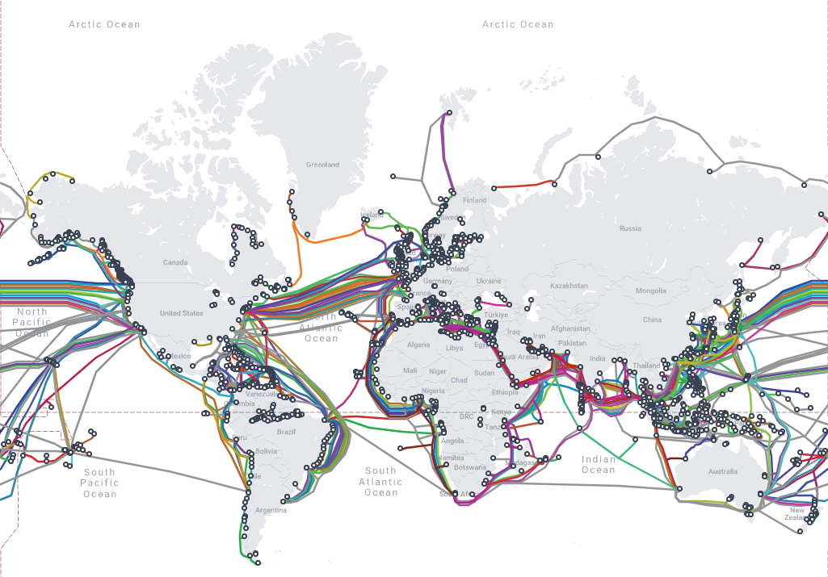

Optical communication systems
The backbone of our connected world:
Enabler of innovations:
Cloud computing
Video streaming
Artificial intelligence (large language models)
Map of undersea optical fibre cables
Data Centres

Slide 4
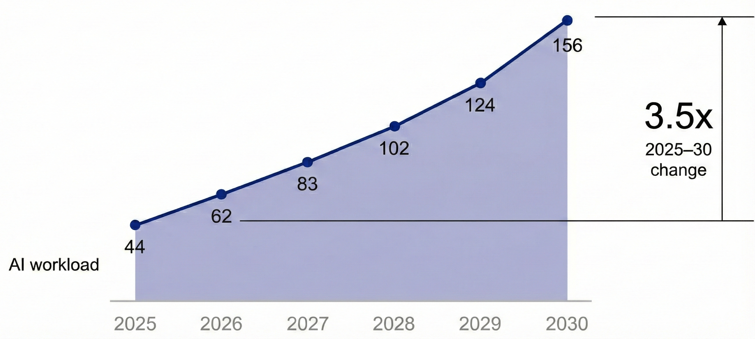
Data Centre Capacity Expands, So Do the Challenges
Estimate of Global Demand for Data Centre Capacity^{[1]} (gigawatts)
Data centre capacity:
Global demand could more than triple by 2030^{[1]}
Computing centres distributed over multiple locations:
Requiring high-capacity optical communication systems
Optical fibres are replacing copper for short-reach links
AI data centres:
Require 10x more optical fibre than traditional ones^{[2]}
This trend calls for a scalable, yet cost-effective optical fibre cable infrastructure
[1] Adapted from: McKinsey & Company: The cost of compute: A $7 trillion race to scale data centers. Apr. 2025
[2] Corning: Optimizing AI Data Centers with Structured Cabling Strategies. Jan. 2025.

Slide 5
Different types of optical fibres: single versus multimode fibres
Single-mode fibre (SMF)
Multimode fibre (MMF)
Cladding
Core
Longer transmission reach (>500m, 10-50km)
Associated with the largest transmission capacity
Short-reach (~100 metres)
Compatible with transmitters based on vertical-cavity surface emitting lasers (VCSELs):
  Cheap and energy efficient
  Good solution for short-reach links
Generally, these fibres are not compatible with each other, requiring distinct transmission technologies

Slide 6
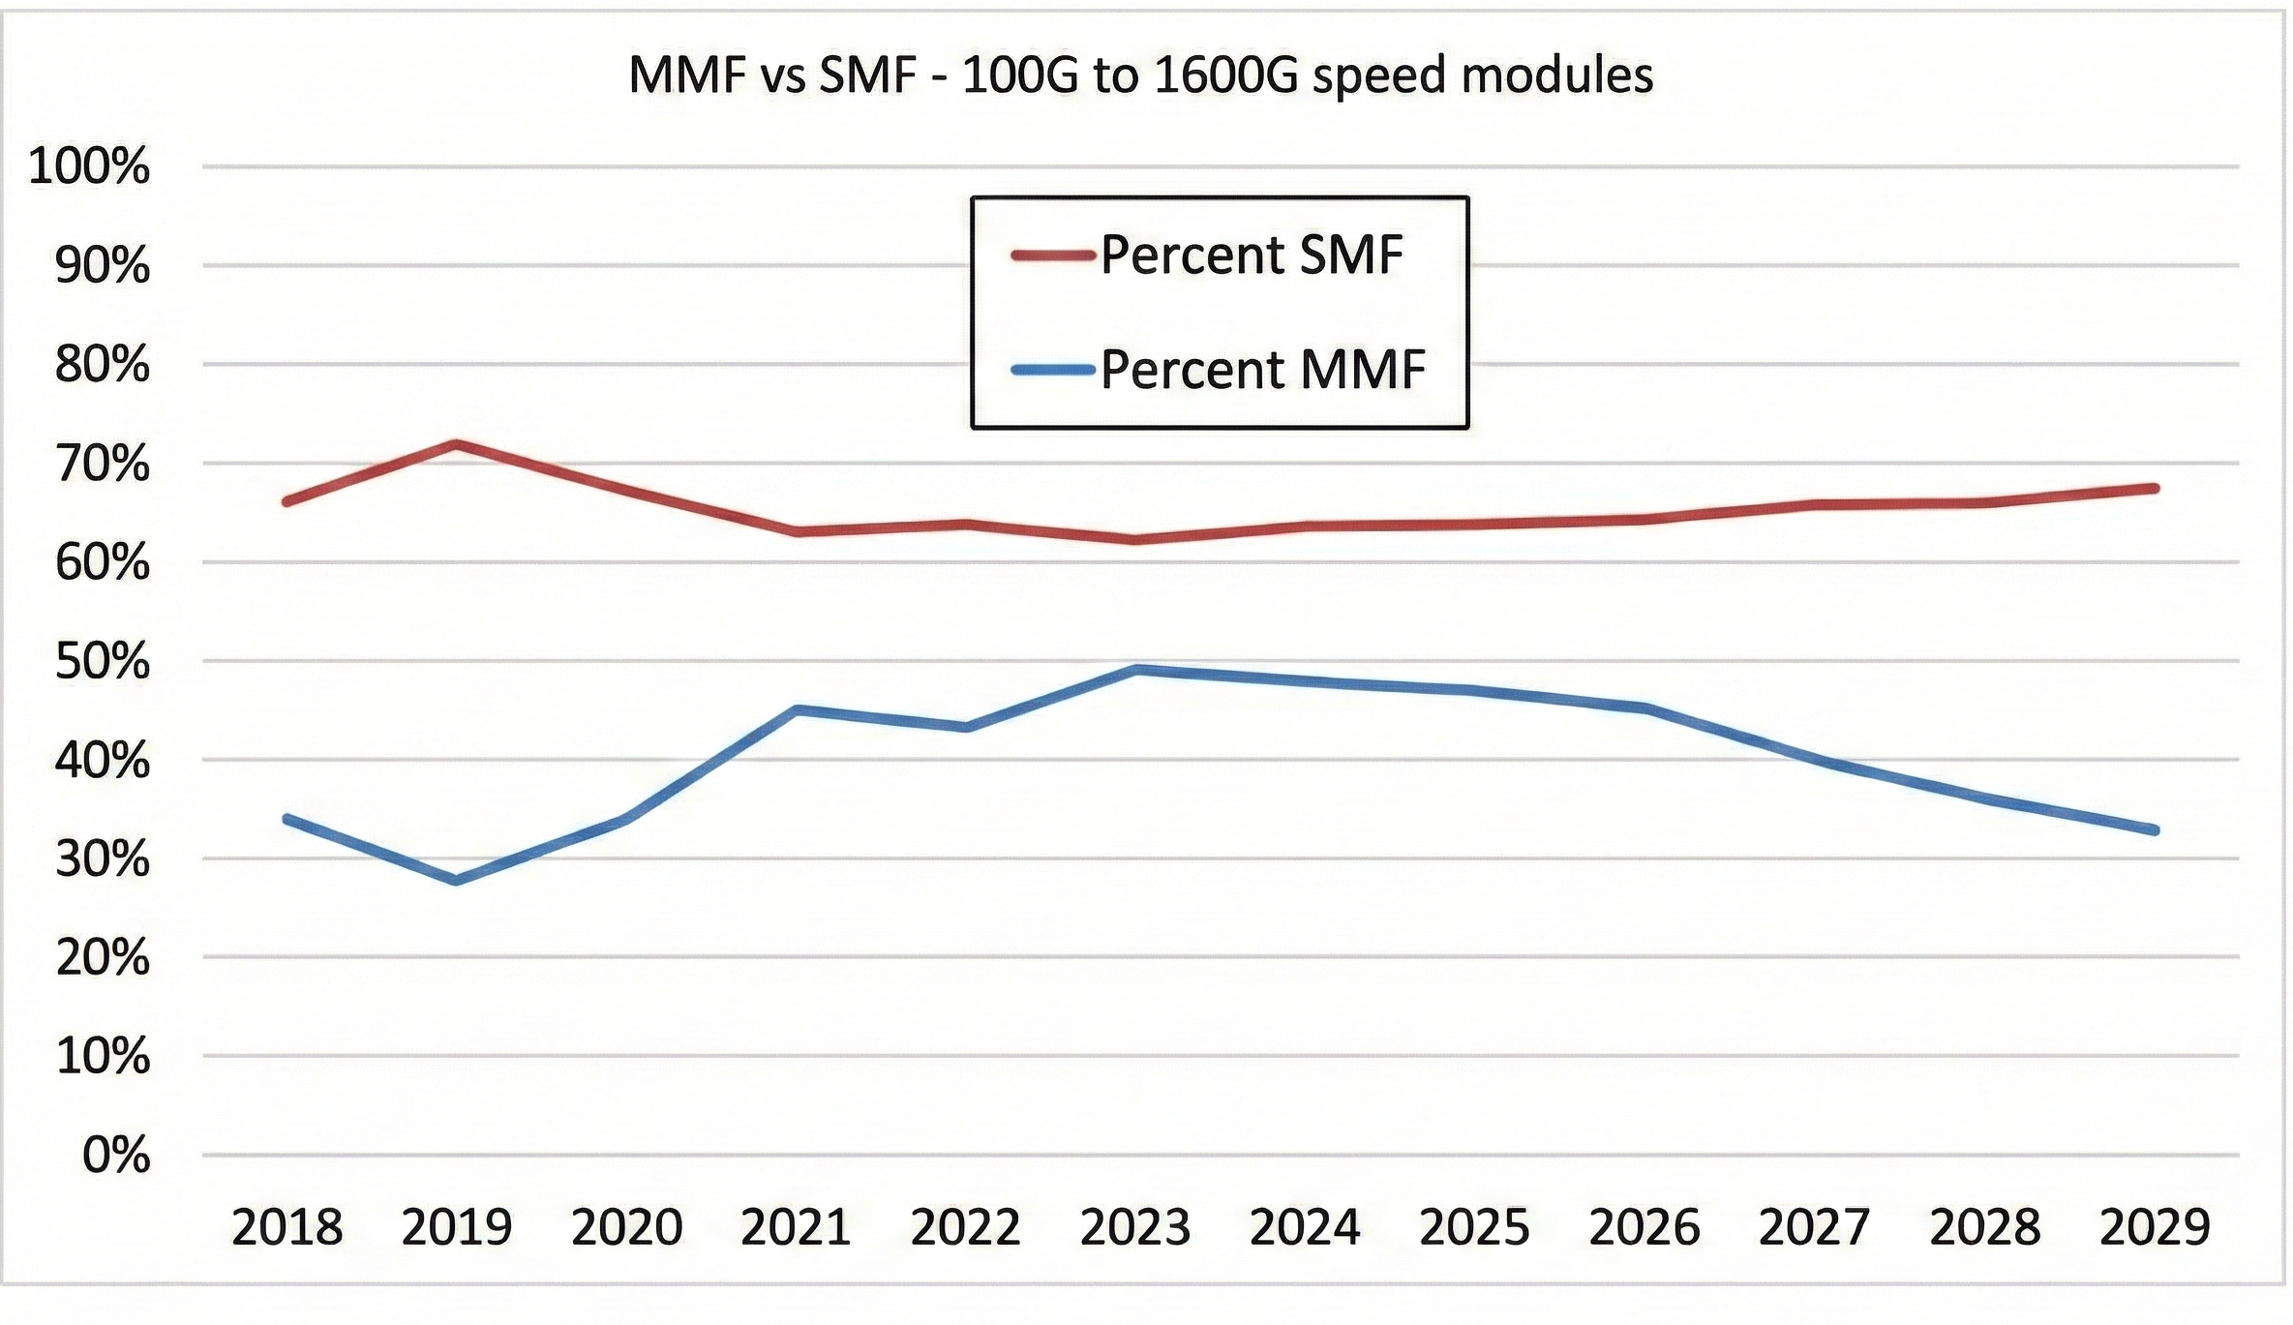
Optical Fibre in Data Centres: single versus multimode fibres
Multimode fibre (MMFs)
Proportions of fibres deployed in data centres^{[1]}
Single-mode fibre (SMF)
Cladding
Core
[1] Adapted from: V. Bhatt, “On continued significance of multimode links in data centers,” J. Lightw. Technol., vol. 43, no. 4, pp. 1700–1707, Feb. 2025.

Slide 7
Data Centre Capacity Expands, So Do the Challenges
Optical fibre infrastructure:
Pre-deployed during construction of the buildings
Rewiring data centres is disruptive, not interesting
Needs to be chosen wisely
Optical transceivers (transmitter/receiver):
Need to be upgraded over several generations
Need to keep up with service demand
Initial step towards scalability:
Optical circuit switches (OCS)

Slide 8
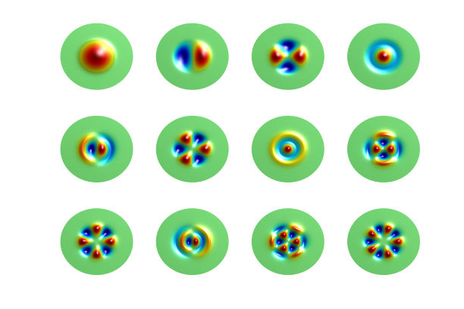
Different types of optical fibres: single versus multimode fibres
Multimode fibre (MMFs)
Proportions of fibres deployed in data centres^{[1]}
Degrees of freedom
“Space” (Modes)
Amplitude, phase,
frequency and polarisation
x
x
x
x
y
z
y
z
y
z
y
z
The spatial diversity of MMFs is not currently explored
  Technological and economical challenges
  What about the future?
    Significant advancements in space-division multiplexing (SDM) have been achieved

Slide 9
Future-Proof Data Centre Infrastructure
Optical circuit switching (OCS):
Offers scalability
Transceiver upgrades are easier
Single-mode fibre (SMFs) vs Multimode fibres (MMFs)
Support different needs
Both fibres are largely deployed in data centres
Require different transmission technologies
What if there were a versatile fibre that supported both single-mode and multimode transmission technologies?
Unified cable infrastructure
Transceiver upgrades, potentially exploring the spatial diversity in the future

Slide 10
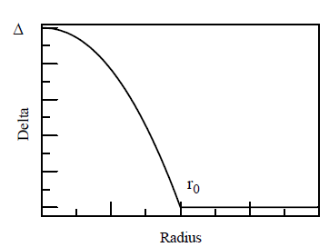
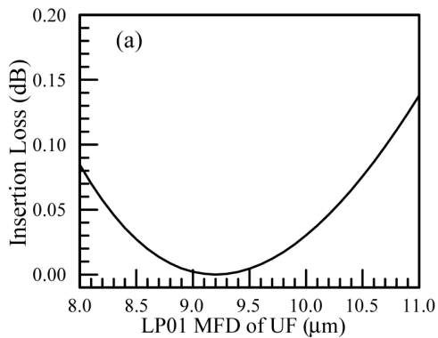
Universal Fibre: Multimode and Single-Mode Transmission
Characteristics of the Universal Fibre (UF):
Smaller core diameter (~30 μm) and larger refractive index contrast than that of 50 μm OM fibres
Bandwidth optimized for short wavelengths (850 nm)
LP₀₁ mode field diameter matches that of single-mode fibres (SMFs) at 1310 and 1550 nm
This fibre supports both multimode and single-mode transmission efficiently
Previous investigations:
Significant performance for direct detection VCSEL^{[1,4]}
  Vertical-cavity surface-emitting lasers (VCSELs) are cheap and power-efficient, a positive characteristic
Refractive index profile
Analysis of mode field diameter (MFD)^{[2]}
[1] X. Chen et al., OFC, Th4E.4 (2016); | [3] A. A. Juarez et al., IEEE Photon. Technol. Lett, vol. 30, n. 14, pp. 1341-1344 (2018);
[2] X. Chen et al., Opt. Express, vol. 24, n.16, pp. 18492-18500 (2016); | [4] X. Chen et al., J. Lightw. Technol., vol. 37, n. 2, pp. 389-395 (2019);

Slide 11
Coherent Transmission over the Universal Fiber
The aims of this work are to:
Assess the universal fibre for (single-mode) coherent transmission over C-band
Compare its performance against that of standard single-mode fibres (SMFs)
This work considers:
Data centre interconnect (DCI) applications using single-mode transmission technology
Key point:
To verify if the universal fibre can meet DCI needs with (coherent) single-mode transmission technology, while offering spatial diversity for future upgrades

Slide 12
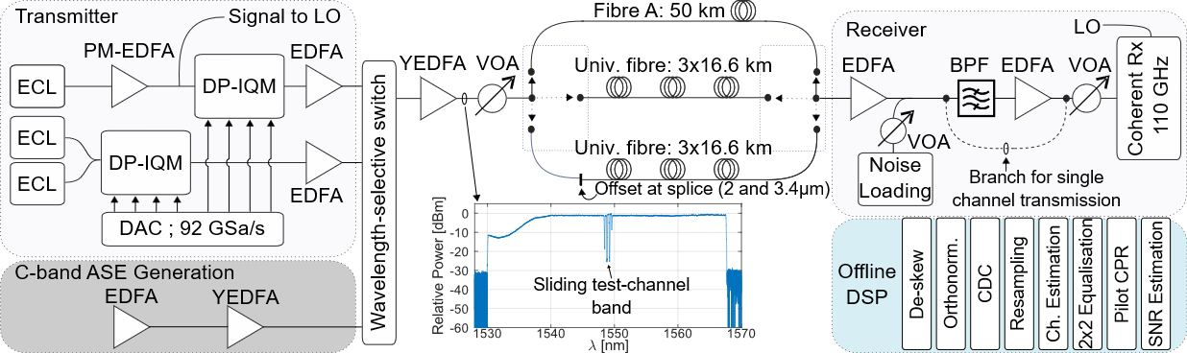
Experimental Setup
High-speed single-mode transmitter
High-speed single-mode receiver
Transmission link of ~50 km:
Fibre A: Single-mode fibre (SMF) - Regular effective area (~80 μm²)
Universal fibre (UF): 3x16.66 km (and 1-m SMF pigtails at both ends)

Slide 13
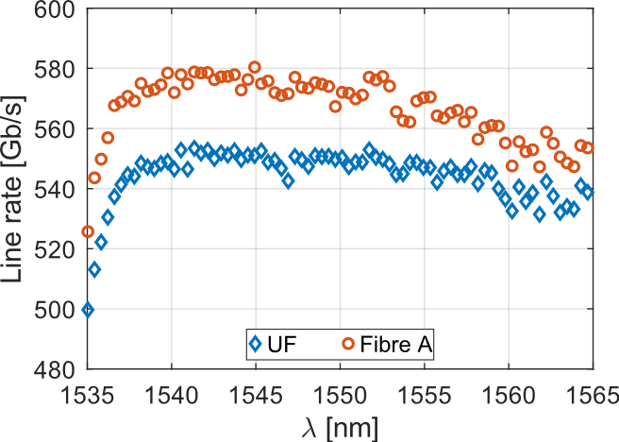
Universal Fiber: C-Band Single-Mode Coherent Transmission
256-QAM
Universal fibre (UF):
UF approached Fibre A* (SMF) within a 4% gap
Combined line rate of 75 channels:
Fibre A: 42.5 Tb/s
Universal fibre: 40.8 Tb/s
Universal fibre (UF) supports current data centre needs
In addition, it offers the spatial diversity for future upgrades
Note: The line rates were estimated using the generalized mutual information (GMI)
Modulation format: 256-QAM
UF: Universal fibre
Fibre A*: State-of-the-art single-mode fibre

Slide 14
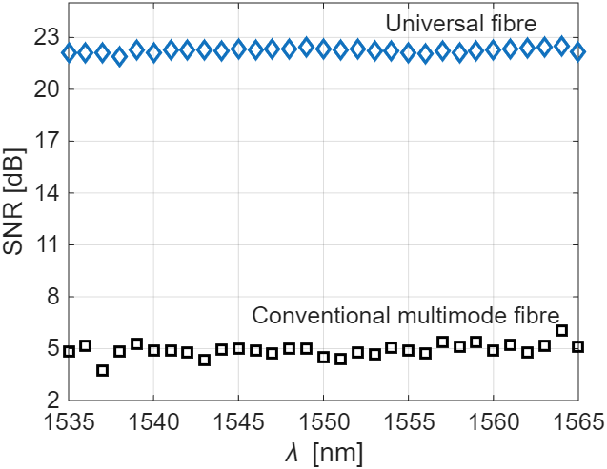
Universal Fiber: C-Band Single-Mode Coherent Transmission
Universal fibre versus conventional multimode fibre
Comparison using single mode transmission technology
Universal fibre (UF):
Performs significantly better than a conventional multimode fibre
>15 dB gain
Note: Signal-to-noise ratio (SNR)
Modulation format: 16-QAM

Slide 15
Summary
This work investigated a novel fibre type, universal fibre, for data centre interconnects
Universal fibre is a versatile multimode fibre specially designed to support single-mode transmission
Using single-mode transmission technology, a combined line rate of 40.8 Tb/s for 75 channels was achieved over 50-km universal fibre
Conventional single-mode DSP can be applied to the universal fibre
Universal fibre supports DCI applications using single-mode transmission to meet current needs, while being compatible with VCSEL-based transmission and a scalable path for future SDM upgrades

Slide 16
Thank you for your attention!
Thanks to UKRI EPSRC for support under:
Beyond Exabit Optical Communications: MR/T041218/1
Strategic Equipment: EP/V007734/1
EPSRC TRANSNET: EP/R035342/1
Thanks also to:
Corning Incorporated
São Paulo Research Foundation: 2023/03732-4

Slide 18


Data Centre Architectures
Optical switches replace electrical ones
Traditional Architectures
Optical Circuit Switching (OCS)
Fixed Connections
Fixed topology, changing it requires rewiring
Limited scalability
Transceiver upgrades are more challenging
  Generally, they need to operate at similar rates
Arbitrary topologies
Scalability
Technology refresh made easier
  Topology modifications can be done to allow transceivers to operate at different rates
SP – spline switch | OCS – Optical circuit switching | AB – Aggregation block | TOR – Top-of-rack switches

Slide 19
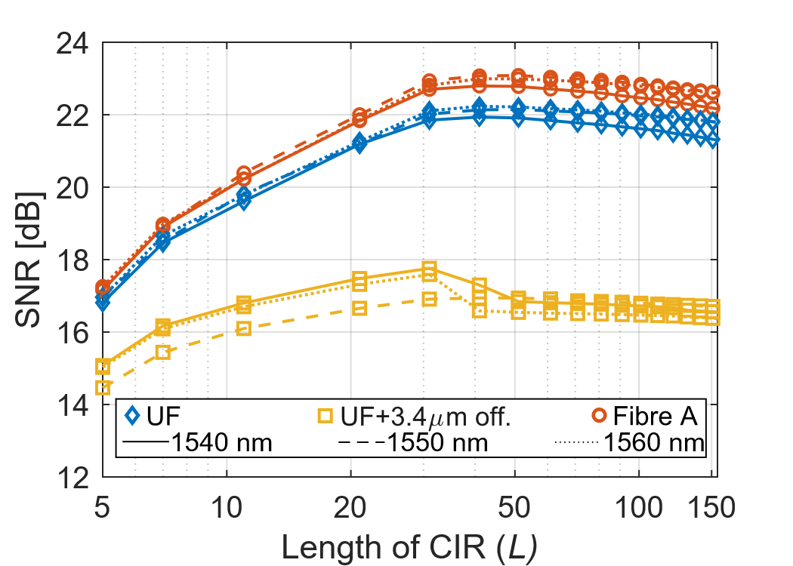
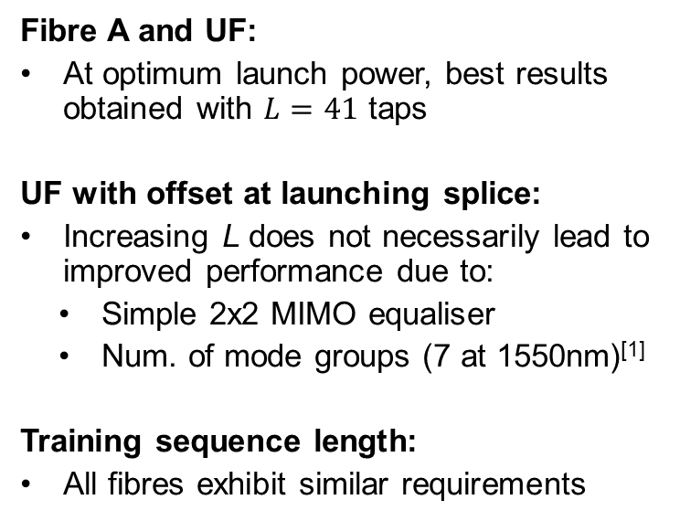
Channel Estimation and Equalisation
16-QAM
Fibre A and UF:
At optimum launch power, best results obtained with $L=41$ taps
UF with offset at launching splice:
Increasing L does not necessarily lead to improved performance due to:
  Simple 2x2 MIMO equaliser
  Num. of mode groups (7 at 1550nm)^{[1]}
Training sequence length:
All fibres exhibit similar requirements
Not improving with L
Note: The fibres are distinguished by different markers, while wavelengths by different lines
[1] X. Chen et al., J. Lightw. Technol., vol. 37, n. 2, pp. 389-395 (2019);

Slide 20
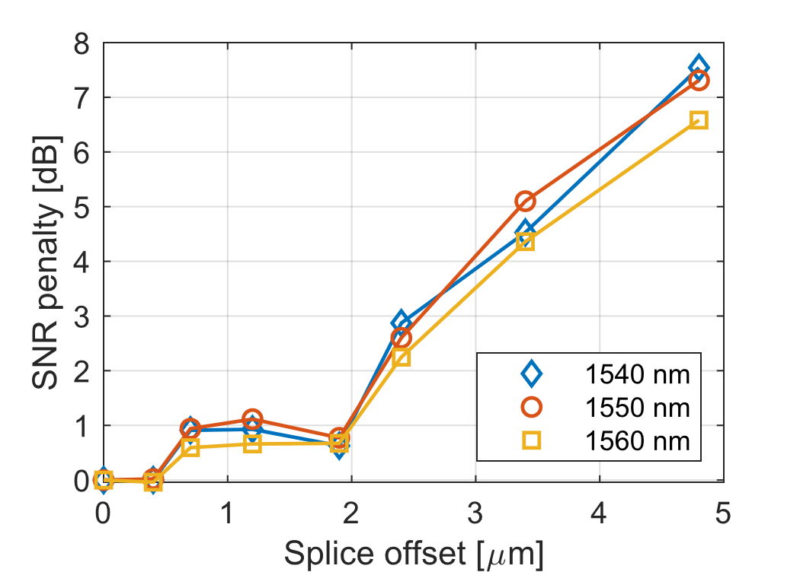
On the Effects of Offset at Launching Splice
256-QAM
DWDM Transmission
Offset at launching splice increases:
Excitation of high-order modes
Multipath interference (MPI) levels
Typical alignment precision:
Connectors^{[1]}: < 1μm
Fibre splicers: < 0.1 μm
Standard core-to-core alignment
Note: The results were obtained at optimal CIR length, and for a DWDM transmission scenario
[1] X. Chen et al., Opt. Fibre Technol., vol. 69, pp. 102848 (2022);

Slide 21

Digital Signal Processing Stages
Parameters:
Two consecutive CAZAC training sequences
Pilot symbols at rate 1/32 for phase recovery
Digital pre-emphasis
Channel estimation:
Time-domain least-square (LS) approach
Estimation is truncated to $L$ taps
Channel equalization:
Frequency-domain zero forcing equalization
Overlap-save with 4096-point FFT and overlap of 128 samples
Performance metric:
SNR of received constellations
CDC

