Slide 1
Unpacking Submarine Cable Supply Contract Models:
10 Minutes Below the Surface
18-21 January 2026
Denise Wood
Greenberg Traurig, LLP

Slide 2



Market Conditions are Stress-Testing Traditional Contracting Models
  Demand continues to accelerate, but supply chains are constrained
    >$13B in new submarine cable systems (2025–2027)
    Increased hyperscaler participation and private system ownership
    Longer lead times and limited supplier capacity
  Geopolitics and regulation are reshaping contract models to manage risk
    Increased regulatory scrutiny across multiple jurisdictions
    Permitting considerations
    Supplier selection is constrained by geopolitical/national security considerations

Slide 3
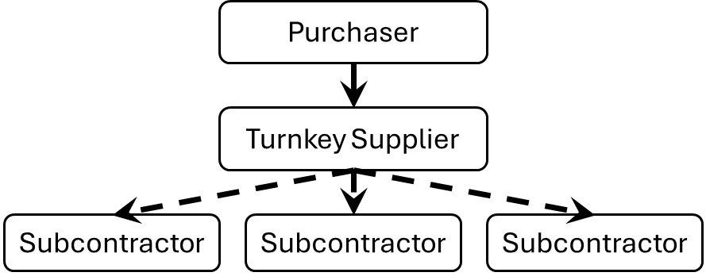
Turnkey Contracting Model
Key Features
Single supplier responsible for design, manufacture, installation, and delivery
Predictable pricing and schedule certainty
Reduced interface management for purchaser
Key Challenges
Reduced flexibility once contract is signed
Risk priced at a premium
Limited transparency into sub-supplier performance
Heightened exposure to supplier bottlenecks and geopolitical risk

Slide 4
Disaggregated Contracting Model
Key Features
Separation of supply, installation, and design responsibilities
Increased flexibility and supplier choice
Potential cost efficiencies
Ability to mitigate supplier concentration risk
Key Challenges
Purchaser assumes interface and integration risk
Increased coordination and administrative burden
Complex liability and warranty alignment
Greater exposure to regulatory sequencing issues
Purchaser
Design
Supplier
Permitting
Supplier
Marine Installation Supplier
Cable
Supplier
Repeater
Supplier
Subcontractor
Subcontractor
Subcontractor

Slide 5





Key Contractual Considerations
Contract Architecture
Interface definitions and responsibility matrices
Cross-defaults and step-in right
Back-to-back performance standards and warranties
Risk & Supply Chain
Supplier concentration and substitution rights
Export controls and geopolitical exposure
Allocation of delay and force majeure risk
Regulatory & Permitting
Landing rights and licensing sequencing
Alignment of commercial milestones with regulatory approvals
National security and foreign ownership reviews

Slide 6
Market Direction
Current Trends
Hybrid models (e.g., turnkey marine installation + disaggregated supply)
Increased carve-outs from traditional turnkey scope
Earlier regulatory diligence influencing supplier selection
Greater use of conditional milestones tied to permit issuance
More robust termination and re-procurement rights
Looking Ahead
No single “right” contracting model
Risk allocation must reflect:
    Project maturity
    Regulatory landscape
    Owner’s execution capability

Slide 7
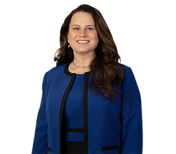

Thank You!
Denise Wood represents technology and communications companies on a broad range of commercial and regulatory matters, with a particular focus on submarine cable systems and digital infrastructure. She advises clients on the negotiation and structuring of domestic and cross-border digital infrastructure agreements, including submarine cable joint build, consortium, and supply arrangements, as well as related commercial agreements. Denise also assists clients in navigating the regulatory approvals required to land, deploy, and operate submarine cable systems and associated digital infrastructure across multiple jurisdictions.
Denise Wood
Shareholder | Greenberg Traurig, LLP
Denise.Wood@gtlaw.com

