Slide 1

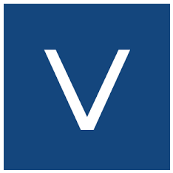
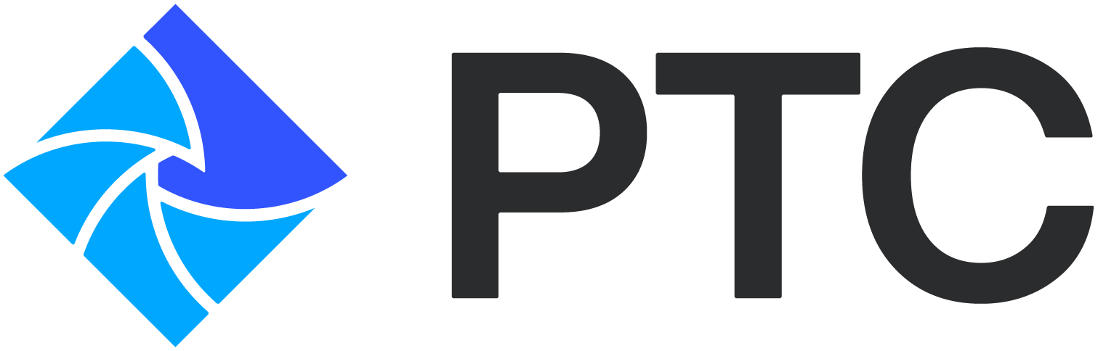
Vitralogy SmartFM
Mitigating DC Operations Risks Proactively in the AI age
Notes:
Welcome, thank you for joining and speaking some time with us.Thank you Bob for helping us start this journeyThank you Jason or helping us move this forward and continue the steps to make this a broad adoptionThank you Scott for taking the time and efforts in help take this over the finish line!

Slide 2
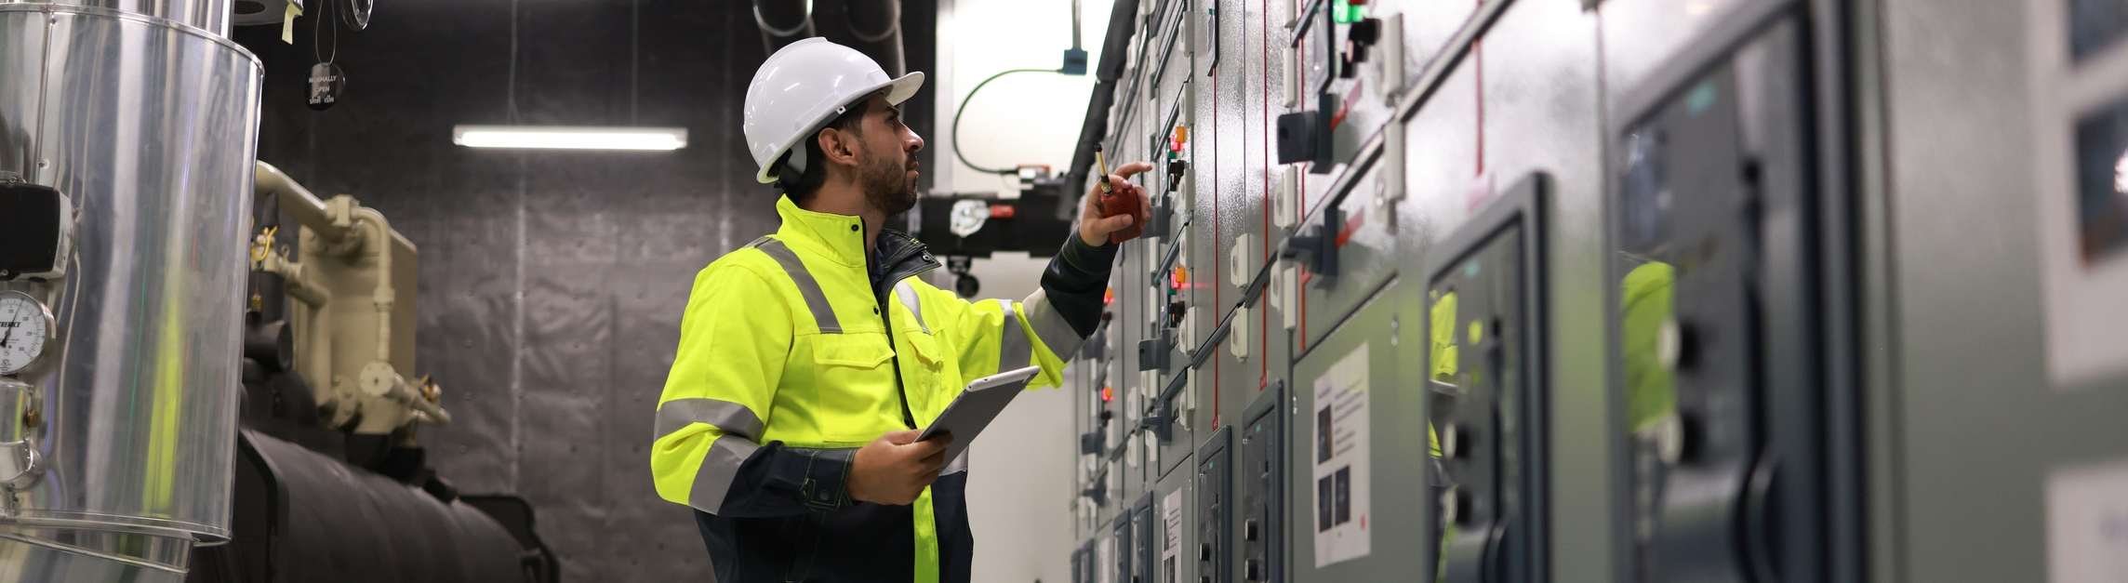
The AI Era Has Created a New Data Center Risk Profile
The Uptime Institute has reported that four out of five major outages are still caused by preventable human or procedural errors
Notes:
This is our co· Introduction – Good Morning. Thank you for coming out. Introduce yourself and role.
· AI workloads have fundamentally changed what data centers look like operationally—higher rack densities, more dynamic thermal conditions, and more frequent configuration changes. But while the infrastructure has advanced quickly, the human processes surrounding it—rounds, MOPs, EOPs, shift handoffs—have not evolved at the same pace. The margin for operational error is shrinking, but the number of touchpoints, contractors, and procedures is expanding.
· The Uptime Institute has reported that four out of five major outages are still caused by preventable human or procedural errors. In an AI world where loads are less predictable and uptime expectations are higher, that gap becomes even more dangerous.
· This is what we call the Operational Risk Gap: the growing space between what modern infrastructure demands and what human processes are able to reliably execute.
· Vitralogy helps close that gap.re mission - to transform how a facility does work and manages their compliance requirements (regulatory, managerial, or insurance)

Slide 3
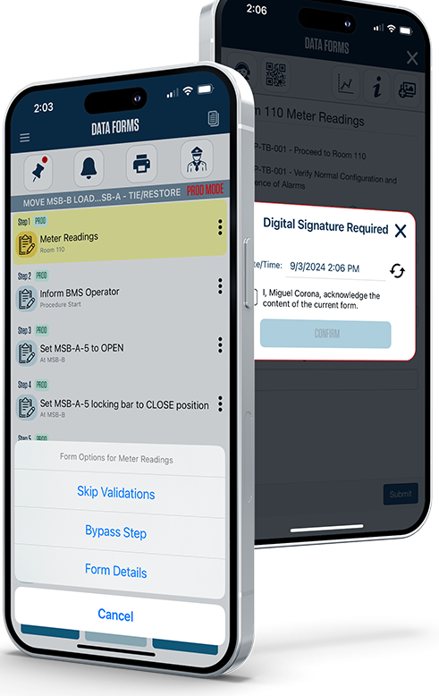



Vitralogy SmartFM
Engineering Rounds, MOPs, EOPs
AI Document Analysis
Smart Binder
CMMS Integration
Notes:
· Vitralogy is purpose-built for critical facility operations. Our customers include CBRE, Fortune 100 telecom companies, hospitals, and high-stakes science and research environments—places where uptime, precision, and compliance cannot fail.
· Vitralogy provides Operational precision at scale
· We are an enterprise platform built for critical environments with:
o SOC 2 certification
o Microsoft 365 / Entra SSO integration
o ServiceNow, Quantum, Tririga, Shield integrations
Our SmartFM platform includes:
Engineering
Rounds & Readings
standardizing
digital rounds
Methods of
Procedures (MOPs)
ensures zero
skipped steps
Emergency
Operating Procedures (EOPs)
ensures zero
skipped steps
AI-powered
SmartBinder™
Digital binder that keeps
documents organized and up-to-date.
Compliance
oversight, alerts, analytics, and audit trails
Compliance-ready audit logs
Seamless operational workflows
API Integration to all cloud based CMMS and work order systems
Zero disruption to your existing
ecosystem
These tools make operations standardized, visible, logged, and compliant, without disrupting the way your teams already work.

Slide 4
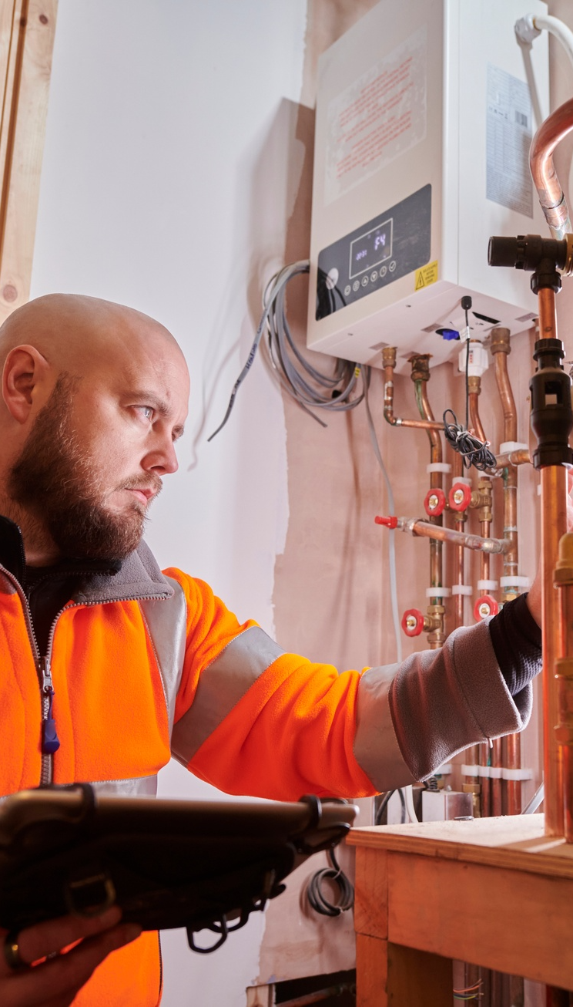



Vitralogy Smart Rounds
Industry Leader in Critical Facility Rounds
Leader in Critical facilities
CMMS Integration
Reporting for DataCenters
Fully Integrates with modern CMMS and Workorder Systems.
VItralogy is the leader for Rounds and Inspections in Telecom, Healthcare, Life Sciences and Class A Commercial
Reports specific for DataCenters, such as energy consumption
Notes:
Rounds and daily readings are the heartbeat of a data center. But in most facilities, they’re still captured on paper, spreadsheets, or inconsistent checklists.
SmartRounds™ modernizes this with:
Automatically displayed forms based on equipment and area
Timestamped entries that enforce accountability
Shift-aware logging so teams know what’s been checked and when
Out-of-range alerts that notify leadership immediately
Combined with SmartBinder A searchable digital binder where all readings, comments, and photos are stored 24/7 providing easy access to historical logs
This eliminates drift, accelerates issue detection, and enables consistent operations across all shifts and contractors and eliminating manual data errors, all while increasing confidence in better SLA compliance.

Slide 5

Vitralogy SmartMOP
Method of Procedure
Avoid Mistakes
  Step based procedures are correctly followed end-to-end as required.
Standardize MOPs
  Enterprise platform to standardize and approve MOPs
Management Visibility
  Immediate awareness of missed steps or changes in process. Clarity on engineer productivity and time to complete
Change Control
  Effective management of change control within MOP processes
Notes:
SmartMOP: Enforcing MOP/EOP Compliance with Zero DriftIf rounds are the heartbeat, then MOPs and EOPs are the nervous system. One skipped step in a MOP can take a rack offline. One incorrect EOP action during a cooling failure can escalate instantly. These procedures are often executed differently by each technician, depending on training, memory, or habit.SmartMOP eliminates that variability.It provides:
Skipped-step detection and
manager alerts
QR code validation to ensure the
right equipment is touched
Digital signatures and co-pilot
signoffs
Time-based requirements and
step-level instructions
Standardized procedure templates
Integration with CMMS systems
like ServiceNow and Quantum
This ensures that every high-risk procedure—every breaker racking, UPS switchover, or cooling reset—is executed exactly the same way, every time, with full traceability.This system guarantees:
The right person performed the
right step
At the right time
On the right piece of equipment
With full audit trails
This is how we turn procedures into controls, not suggestions.

Slide 6



Next Steps
Kevin Hohman
630-865-8047
khohman@vitralogy.com

